Slide 1


Lesson 11:
Work with equivalent fractions, decimals and percentages Level 1
Objectives
Convert between a decimal and fraction and percentage where the denominator is a factor of 10 or 100
Understand and use equivalences between common fractions, decimals and percentages (FDP)
Order FDP amounts by understanding place value

Slide 2
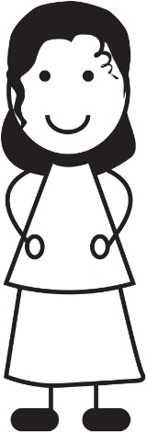




Is Yaima correct?
$$\frac{1}{2}$$
On this card, the fractions, decimal and percentage all have the same value.
$$50\%$$
$$0.05$$
$$\frac{5}{10}$$
Yaima
Yaima is not correct. Why?
How do you know this?
Notes:
Discuss with the learners. Guide them to see that 0.05 is not equal to the other three quantities on the card. Ask learners to suggest what number should be on the card instead of 0.05 so that all the quantities have the same value. (0.5)
Make the link between $\frac{5}{10}$ and 0.5 in terms of place value.

Slide 3
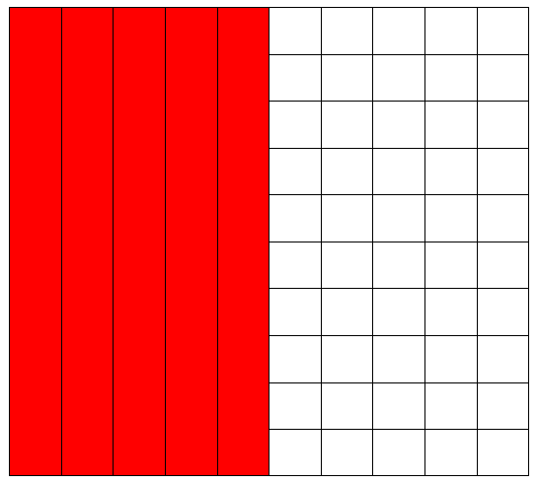
Matching fractions, decimals and percentages
DISCUSS
What fraction does the coloured part represent?
Notes:
Ask learners to suggest what fraction the coloured part of the picture shows. Accept all variations, including $\frac{50}{100}$ and $\frac{5}{10}$ .
Ask learners what percentage of the picture is coloured.
Ask: If 50% is 0.5 then what is 10% as a decimal/fraction? What is 30% etc.

Slide 4
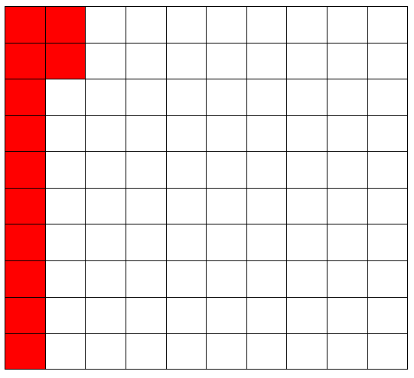
DISCUSS
Matching Fractions, Decimals and Percentages
What fraction does the coloured part represent?
What are some equivalent fractions for your answer?
Notes:
Ask learners what the coloured part of the diagram represents. Encourage all variations ($\frac{12}{100}$ , $\frac{3}{25}$ , $\frac{6}{50}$ etc.)
Ask learners what percentage of the picture is coloured. How do they write this percentage as a decimal?

Slide 5
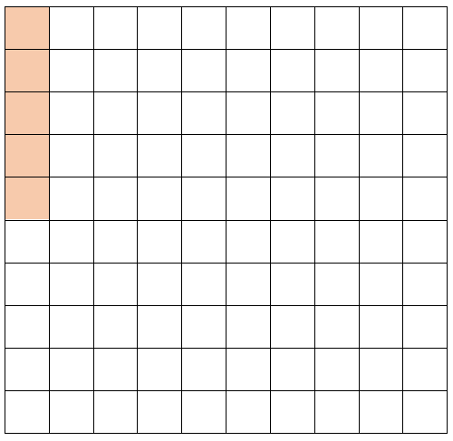
Matching fractions, decimals and percentages
DISCUSS
What fraction is this?
Notes:
Tutor may ask learners what this is as a fraction. 5/100
What is percent out of? 100
So what is this as a percent? 5%
Tutor asks whole class: if 50% is 0.5 then what is 5% as a decimal?

Slide 6
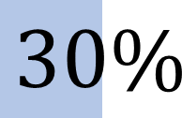





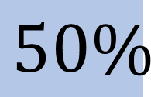

Which of these are true?
DISCUSS
$$\frac{1}{2}$$
$$\frac{1}{3}$$
=
$$50\%$$
=
$$30\%$$
$$\frac{1}{10}$$
$$\frac{1}{5}$$
$$0.01$$
=
$$20\%$$
=
Which of these are true?
Explain why, using diagrams or otherwise.
Notes:
Encourage learners to discuss in pairs. Ask learners to write their explanations on mini whiteboards.

Slide 7
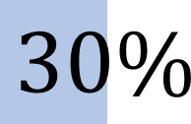





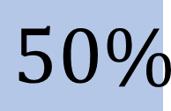

Answers: Which of these are true?
DISCUSS
$$\frac{1}{2}$$
$$\frac{1}{3}$$
=
$$50\%$$
=
$$30\%$$
$$\frac{1}{10}$$
$$\frac{1}{5}$$
$$0.01$$
=
$$20\%$$
=
Notes:
Ask some pairs to share their explanations. Refer back to the 100-grid to help explain, if necessary, especially for the 1/3, as this is a very common misconception.

Slide 8
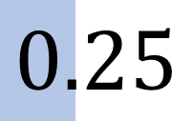


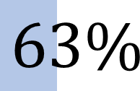
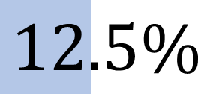
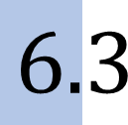

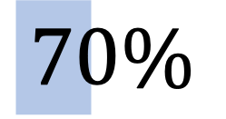
DISCUSS
Which of these are true? (2)
$$\frac{1}{4}$$
=
$$63\%$$
=
$$6.3$$
$$0.25$$
$$\frac{1}{8}$$
$$\frac{7}{10}$$
=
=
$$12.5\%$$
$$70\%$$
Which of these are true?
Explain why, using diagrams or otherwise.
Notes:
Encourage learners to discuss in pairs. Ask learners to write their explanations on mini whiteboards.

Slide 9
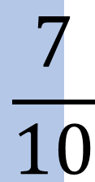
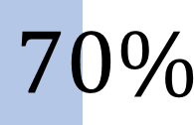
DISCUSS
Answers: Which of these are true? (2)
$$\frac{1}{4}$$
=
$$63\%$$
=
$$6.3$$
$$0.25$$
$$\frac{1}{8}$$
$$\frac{7}{10}$$
=
=
$$12.5\%$$
$$70\%$$
Notes:
Ask some pairs to share their explanations. Again, use the 100 grid to help explain that 63% is 63/100, which is 0.63 as a decimal.

Slide 10
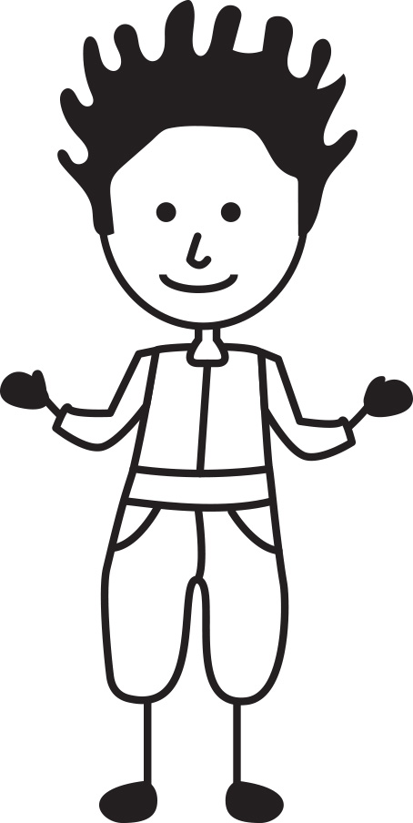
EXPLORE
What is place value?
0.63
What does she mean?
Sixty-three tenths?
Sixty-three hundredths?
My number is zero point
sixty-three.
What is misleading about saying ‘zero point sixty-three’?
10
Notes:
Introducing place value of tenths, hundredths, etc.

Slide 11
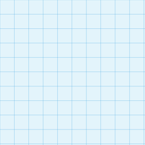
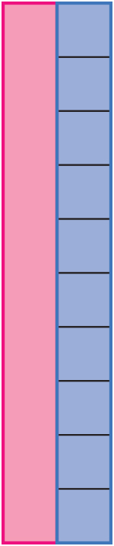


DISCUSS
What is this? (1)
This is whole, so it is…
$$\frac{?}{100}$$
$$\frac{?}{100}$$
One tenth =
11
Notes:
Ask learners to identify the first grid 100/100, so that is a whole equivalent to 100% or 1. Try to encourage the learners to discuss and share this information.
Follow through the similar questioning with 1/10 is 10/100 so how many tenths in a hundred grid? What are the small units? (hundredths)
Refer back to earlier slides, so what would 30% look like? 3/10, 30/100 etc.
How does that transform to a decimal?

Slide 12
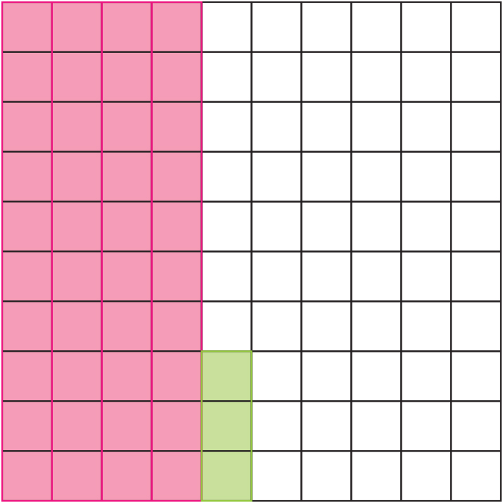
DISCUSS
What is this? (2)
Ones | Tenths | Hundredths
2 | 4 | 3
12
Notes:
Ask learners what number this would be as a decimal? 2 whole , 4/10, 3/100 so 2.43.
Introduce the table so learners can see the place value of each number.

Slide 13
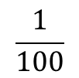


DISCUSS
Place value
What comes next…?
Can you see a pattern?
$$\frac{1}{10}$$
$$\frac{1}{100}$$
$$\frac{1}{1000}$$
Hundreds | Tens | Ones | Tenths | Hundredths
13
Notes:
Discuss the patterns in terms of ones, tens, hundreds, thousands, etc.
Show that the pattern also works in reverse tenths, hundredths, thousandths, etc.
Why is ones on there and not oneths?
Help learners understand that after the decimal it is part of one.

Slide 14

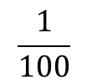

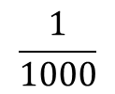
ACTIVITY 1
Place value in a table
Handout
available
Put these values into the table.
Can you write these decimals as fractions?
1.18
0.08
0.008
0.18
0.182
0.8
$$\frac{1}{10}$$
$$\frac{1}{100}$$
$$\frac{1}{1000}$$
Tens | Ones | Tenths | Hundredths
14
Notes:
Use the handout to support the activity.
Learners first put the values in the table and then write each as a fraction. Can they order the numbers? Class discussion about the order.

Slide 15
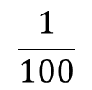
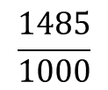

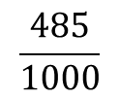
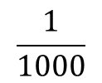
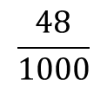
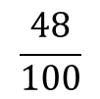

ACTIVITY 2
Place value – Ordering
Handout
available
Write these fractions as decimals and put them into the table.
Now put them into ascending order.
$$\frac{4}{10}$$
$$\frac{1485}{1000}$$
$$\frac{485}{1000}$$
$$\frac{48}{100}$$
$$\frac{48}{1000}$$
$$\frac{1}{10}$$
$$\frac{1}{100}$$
$$\frac{1}{1000}$$
Tens | Ones | Tenths | Hundredths
15
Notes:
Use the handout to support the activity.
Discuss what ‘ascending’ means if necessary.
What is the opposite?

Slide 16
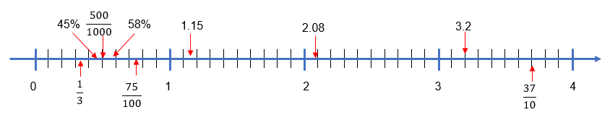
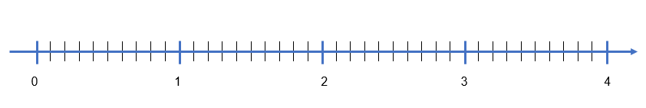




ACTIVITY 3
Place value on a number line
Handout
available
Position these numbers on the number line.
1.15
$$\frac{37}{10}$$
$$\frac{500}{1000}$$
Do you need to estimate any of the numbers? Why?
Label on the number line the smallest value and the biggest value.
$$\frac{75}{100}$$
3.2
58%
$$\frac{1}{3}$$
45%
2.08
16
Notes:
Use this slide to bring together the lesson to this point.
If learners struggle, encourage them to convert into a decimal, percentage or a fraction.

Slide 17
ACTIVITY 3
Place value – Comparing numbers
Yaima is stuck on a question.
She needs to know which is the larger number:
0.078 0.14
Is Yaima correct? Explain.
78 is bigger than 14, so 0.078 must be bigger than 0.14.
17
Notes:
Slide to reinforce learning and highlight common misconception. Encourage learners to use the 100 grid.

Slide 18



EXPLORE
Card sort – matching fractions, decimals
and percentages
Handout
available
Put four triangles to make a square card.
Each group of four triangles should contain equivalent fractions, decimals and percentages
$$50\%$$
$$\frac{10}{20}$$
$$\frac{50}{100}$$
0.5
18
Notes:
Handout - Tarsia to include FDP equivalents,
If learners are struggling, encourage them to apply to grids or bars to prove they match.
Extension also provided with more challenging FDP amounts, within the set.

Slide 19
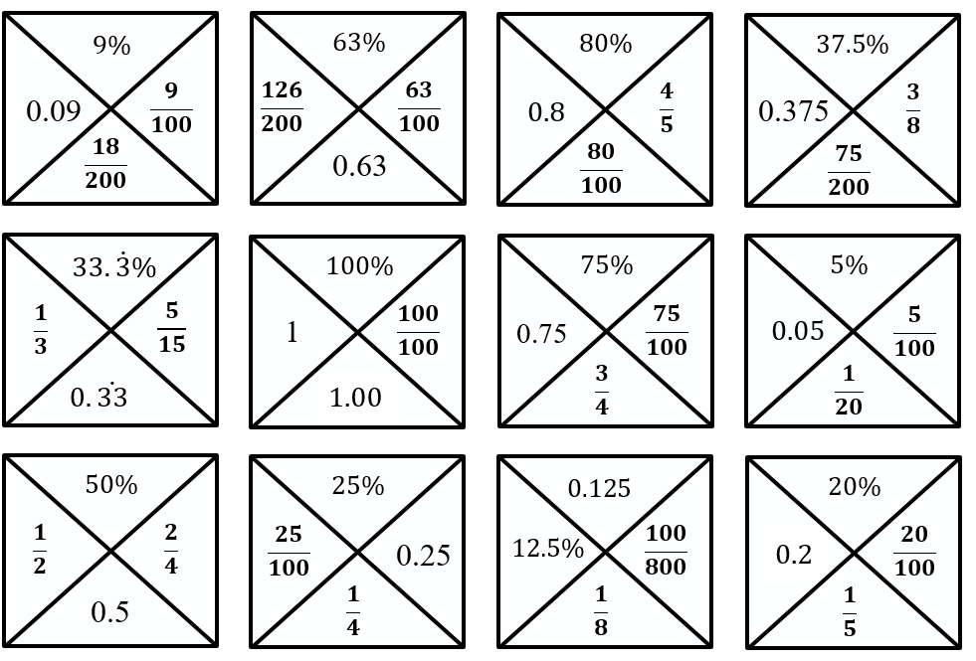
DISCUSS
Card sort – answers
19

Slide 20





EXPLORE
Add to make 1
$$\frac{1}{5}$$
12.5%
$$\frac{3}{4}$$
0.01
20%
$$\frac{1}{2}$$
10%
One quarter
$$\frac{1}{20}$$
0.5
25%
0.15
$$\frac{1}{3}$$
5%
75%
One tenth
You may use each fraction, decimal and percentage more than once, and add in new ones.
Find different combinations of fractions, decimals and percentages that add up to one.
Present the combinations using a bar model.
Notes:
Tutor to ensure that:
Learners can use all of the quantities multiple times to make 100% or 1 and add in more to make the bar total.
Learners should be challenged to find as many different solutions as possible using all FDP.
Learners then represent their answers in bar models.
Before learners start the task, show next slide as an example.

Slide 21


How many ways to make 1? – An example
EXPLORE
40%
0.5
Make 1
$$\frac{1}{10}$$
Notes:
Bars for $\frac{1}{10}$ and tenths are shown to model an answer.
Encourage learners to apply variation when developing their own ideas.
Stretch and challenge
Suggest learners use at least one of each fraction/decimal/percentage and can create their own combinations with new fraction/decimal/percentage amounts.
Misconceptions
Learners do not understand place value and think that 0.9 is $\frac{9}{100}$ or that 0.15 is greater than 0.2.
Learners order fractions using only the numerator and do not grasp equivalence and think $\frac{2}{3}$ , $\frac{3}{5}$ , $\frac{4}{9}$ , $\frac{5}{8}$ are in order of smallest first.
Learners are unable to work out thirds and think one third is equivalent to 0.3.
Learners are only able to use double and double again and do not know that 0.2 is $\frac{1}{5}$.
This activity allows for exploration of different outcomes, while helping to highlight common misconceptions with fractions/decimals/percentages.

Slide 22
REVIEW
How many ways to make 1?
Add to 1
Notes:
Some examples may be provided by each group to the tutor. This slide can be used as a template on which their ideas are noted.
Identify complex combinations or combinations that draw out misconceptions.

Slide 23
PRACTICE QUESTION
REVIEW
Practice question (1)
Worksheet
available
Write the following numbers in order of size.
Start with the smallest number.
0.102 0.04 0.2
0.04, 0.102, 0.2

Slide 24

PRACTICE QUESTION
REVIEW
Practice question (2)
Worksheet
available
Write 60% as a fraction in its simplest form.
$$\frac{3}{5}$$

Slide 25




PRACTICE QUESTION
REVIEW
Practice question (3)
Worksheet
available
Daniel has these test results:
Public Services 46% Maths English Art and Design
His tutor wants to compare these results.
List the subjects in order from his best result to his worst result.
Show why you think this.
$$\frac{14}{25}$$
$$\frac{13}{20}$$
$$\frac{6}{10}$$
Maths = $\frac{14}{25}$ = $\frac{56}{100}$= 56%
English = $\frac{13}{20}$ = $\frac{65}{100}$ = 65%
Art and Design = $\frac{6}{10}$= $\frac{60}{100}$= 60%
Best to worst: English, Art and Design, Maths, Pub Services.

Slide 26
Lesson review:
Work with equivalent fractions, decimals and percentages Level 1
Objectives
Convert between a decimal and fraction and percentage where the denominator is a factor of 10 or 100
Understand and use equivalences between common fractions, decimals and percentages (FDP)
Order FDP amounts by understanding place value
Suggested further steps/areas to work on
Fraction, decimal and percentage equivalence in shapes

Slide 27
Lesson 11:
Credits
Text acknowledgements
Pearson Edexcel Functional Skills, Past Paper 3 - Mathematics Level 1 (Calculator) PMAT1/C03 Question 7a, Pearson Edexcel Functional Skills, Past Paper 3 - Mathematics Level 1 (Calculator) PMAT1/C03 Question 3a, Pearson Edexcel Functional Skills, Practice Paper 1 - Mathematics Level 1 (Calculator) PRACL1/C01 Question 7

