Slide 1


Lesson 28:
Algebra notation and collecting like terms
Objectives
Recognise the difference between simplified and non-simplified expressions.
Introduce the use of algebra tiles to represent terms in expressions.
Add and subtract variables, including those with indices.
Simplify expressions by collecting like terms.
Notes:
Go over lesson objectives with the class or leave this until the end of the lesson, if the objectives are thought to disengage those learners who have an algebra barrier.

Slide 2

Say what you see
DISCUSS
How could you write this in a simpler way?
+
+
3b
Notes:
The aim of slides 2–4 is to promote a discussion on how to write an expression for the total number of items of fruit.
For each slide, ask learners to say what they see, then question how it could be written in a simpler way (i.e., algebraically).
Some learners may say:
b + b + b
3 × b
Encourage learners to write it in the simplest way, which is 3b. Remind learners that the multiply sign (×) isn’t used in algebra.

Slide 3

Say what you see
DISCUSS
+
+
+
+
4b + a
How could you express all the fruit we have now?

Slide 4

Say what you see
DISCUSS
+
+
−
b + a + o − o
How could you express all the fruit we have now?
b + a
Notes:
At this point, you may talk about zero pairs. The concept of zero pairs has been introduced in Lesson 27: Directed Numbers.

Slide 5



Say what you see
YOUR
TURN
b + b + b = 3b
1
+
+
2
b + 2f + 2f = b + 4f
+
+
3
+
f + b + d
+
4
−
2f − 2d
Notes:
Introduce each question one at a time and ask learners to write down their answers on mini whiteboards. Check that all learners have the idea before moving on.
Responses could include the letters:
‘b’ for burger
‘f’ for fries
‘d’ for drinks
which means:
b + b + b = 3b
b + 2f + 2f = b + 4f
f + b + d (cannot be simplified)
2f – 2d (and cannot be simplified – ask why it cannot be simplified).
Learners may ask how two drinks can be removed. Suggest it may be due to their being bought in error and a refund being given.

Slide 6




What do you see in this image?
YOUR
TURN
Sort this cutlery into the correct drawer space in the cutlery drawer. Items must not be mixed.
Write an expression for the number of knives, forks, dessert spoons, and teaspoons.
Notes:
Ask learners to complete this on mini whiteboards.
“When you have done the dishes or unstacked the dishwasher, you need to sort your cutlery into the correct drawer space in the cutlery drawer. The items of cutlery must not be mixed.”
Check all learners’ responses and discuss any incorrect responses.

Slide 7

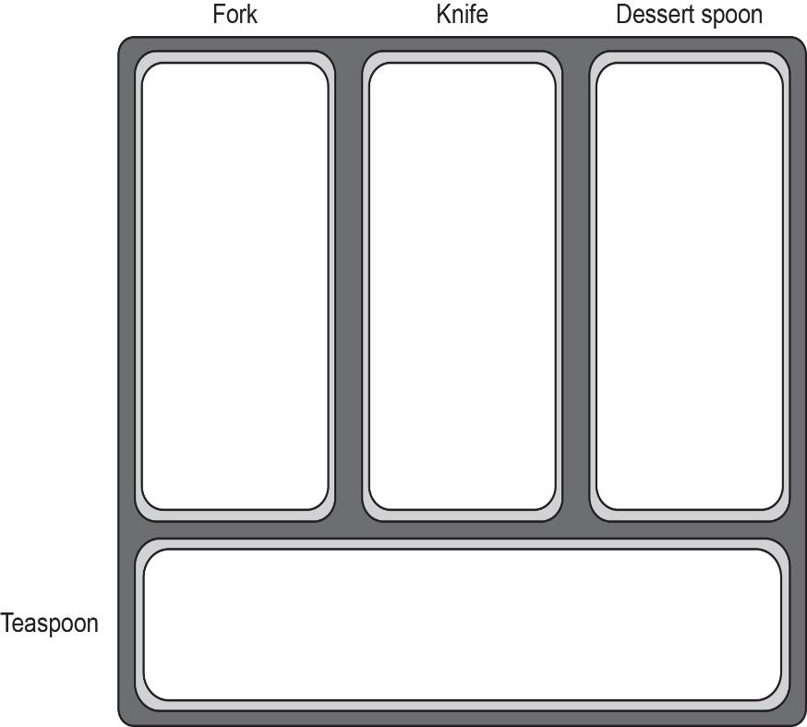



Sort the Cutlery
YOUR
TURN
7
Notes:
Play the animation to show the cutlery being sorted into the tray.

Slide 8



Sort the Cutlery
DISCUSS
Is Dev correct?
Explain your answer.
Dev says…
2f + 3k = 5fk
8
8
Notes:
Allow learners to consider this question and discuss it in pairs, then take responses.
Highlight that forks cannot be mixed with knives in the cutlery tray!
When we add 2 forks to 3 knives, the result is 2 forks and 3 knives. Not 5 forkknives!
This is a common misconception.

Slide 9


Sort the Cutlery
DISCUSS
No, that’s wrong.
Think of it this way, Dev. You have different types of cutlery — forks and knives — and you cannot mix them.
Therefore, this will be
2f + 3k
Dev says…
2f + 3k = 5fk
9
9
Notes:
Reinforce the previous slide’s discussion.

Slide 10

Sort the Cutlery
DISCUSS
Oh, I get it.
So we just collect up the forks, knives, spoons, etc.
So 2f is a shorthand way of writing
‘2 forks’, and 3k is a shorthand way of writing ‘3 knives’.
Dev says…
10
10
Notes:
Use this slide to reinforce that you cannot combine the variables when adding or subtracting.

Slide 11
How to Write Expressions
DISCUSS
fork
knife
dessert spoon
teaspoon
3f
+
3k
+
4d
+
5t
Notes:
Work through the animations step by step, asking the class for their suggestions.
Ask if this expression can be simplified at all (and ascertain why not).

Slide 12

Simplifying expressions
KEY IDEA
Letters are used as shorthand to represent items (or variables).
Only letters (or items) that are the same can be added or subtracted.
Notes:
This slide can be used to recap knowledge from previous slides.

Slide 13
What are Algebra Tiles?
EXPLORE
= 1
= −1
= x
= −x
= x²
= −x²
Notes:
Hand out sets of algebra tiles to each group of 2–3 learners and introduce the value of each tile.
Remind learners of the concept of zero pairs, using the +1 and −1 tiles to start with.
This concept was introduced in the Directed Numbers lesson. If learners have not done this lesson, then this concept may need a bit of practice.
An online virtual alternative is available on Maths Bot: https://mathsbot.com/manipulatives/tiles

Slide 14
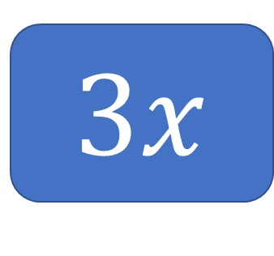




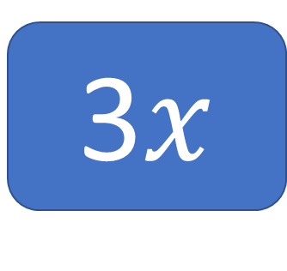

Show me using the algebra tiles
YOUR
TURN
3$x$
3$x$
$$+x$$
$$+x$$
$$+x$$
$$+x$$
$$+x$$
Notes:
Ask the learners to work in groups and use algebra tiles to model the expression being shown on the slides.
After all learners have modelled their answers, show the answer using the animation. Address any queries or incorrect representations.

Slide 15
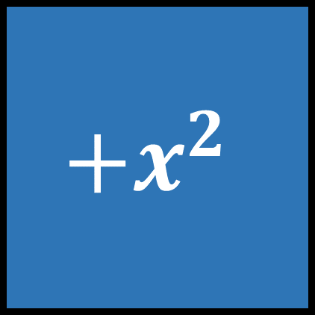
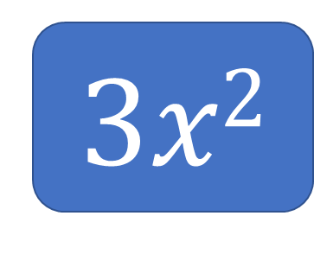


Show me using the algebra tiles
YOUR
TURN
3$x2$
$${+x}^{2}$$
$${+x}^{2}$$
$${+x}^{2}$$
Notes:
Learners continue to use algebra tiles to represent the expression on each of slides 15–22. Check responses and answer queries as you go through.

Slide 16

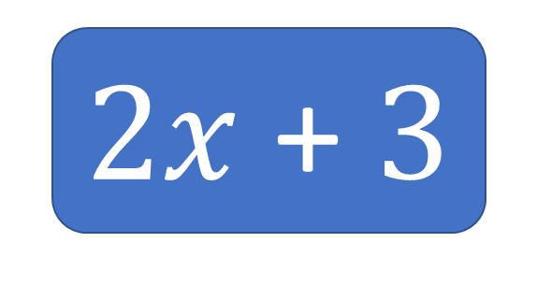




Show me using the algebra tiles
YOUR
TURN
2$x$ + 3
$$+x$$
$$+x$$
$$+1$$
$$+1$$
$$+1$$
Notes:
Learners continue to use algebra tiles to represent the expression on each of slides 15–22. Check responses and answer queries as you go through.

Slide 17



Show me using the algebra tiles
YOUR
TURN
$$x2+x$$
$${+x}^{2}$$
$$+x$$

Slide 18

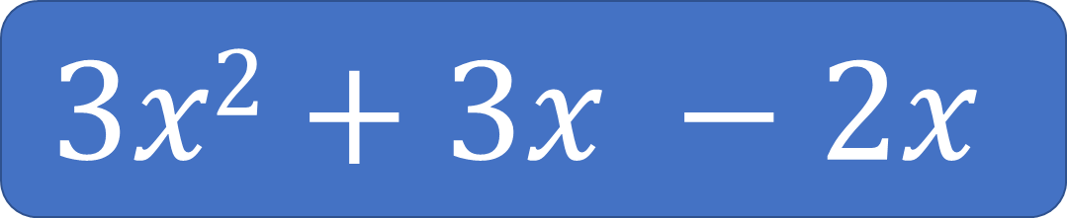







Show me using the algebra tiles
YOUR
TURN
$$3x2+3x −2x$$
$${+x}^{2}$$
$${+x}^{2}$$
$$+x$$
$$+x$$
$$+x$$
$$−x$$
$$−x$$
$${+x}^{2}$$
Notes:
Ask learners to keep this example on their desks, as it will be used in slide 20 to demonstrate zero pairs.

Slide 19






Zero pairs
DISCUSS
$${ +x}^{2}$$
$${ −x}^{2}$$
This is known as zero pairs.
$$+x$$
$$−x$$
$$+1$$
$$−1$$
19
Notes:
Model and discuss the idea of zero pairs. Relate this to the Directed Numbers lesson, if applicable.

Slide 20
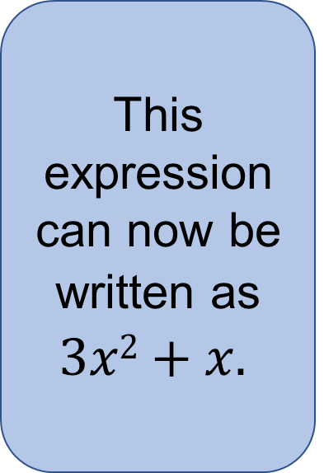




Example 1
DISCUSS
$$3x2+3x −2x$$
This expression can now be written as $3x2+x.$
$${+x}^{2}$$
$${+x}^{2}$$
$$+x$$
$$−x$$
$$+x$$
$$−x$$
$$+x$$
$${+x}^{2}$$
Notes:
Ask learners to use the idea of zero pairs for slides 20–22.

Slide 21















Example 2
DISCUSS
$$5x+5 −3$$
$$+x$$
$$+x$$
$$+x$$
$$+x$$
$$+x$$
$$+1$$
$$+1$$
$$+1$$
$$+1$$
$$+1$$
$$−1$$
$$−1$$
$$−1$$
$$5x+2$$
Notes:
The tutor should ask learners to use tiles to model this question, emphasising that they should look for zero pairs. The tutor will then show animations.

Slide 22







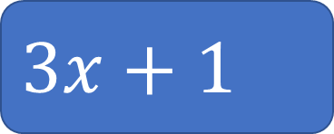




Example 3
DISCUSS
$$2x+4x+1−3x$$
$$+x$$
$$+x$$
$$+x$$
$$−x$$
$$−x$$
$$+1$$
$$+x$$
$$+x$$
$$+x$$
$$−x$$
$$3x+1$$
Notes:
The tutor should ask learners to use tiles to model this question, emphasising that they look for zero pairs. The tutor will then show animations.

Slide 23


Who is correct?
REVIEW
2x + 4x + 1 – 3x
is 9x + 1
Who is correct?
No, it’s not.
It’s 3x + 1
What do you think Dev did wrong?
Notes:
Ask learners to discuss in pairs who is correct and who is wrong.
Animations then show that Dev is wrong. Class discussion follows about why he is.
A common misconception is that learners ignore the sign in front of the number or variable.

Slide 24

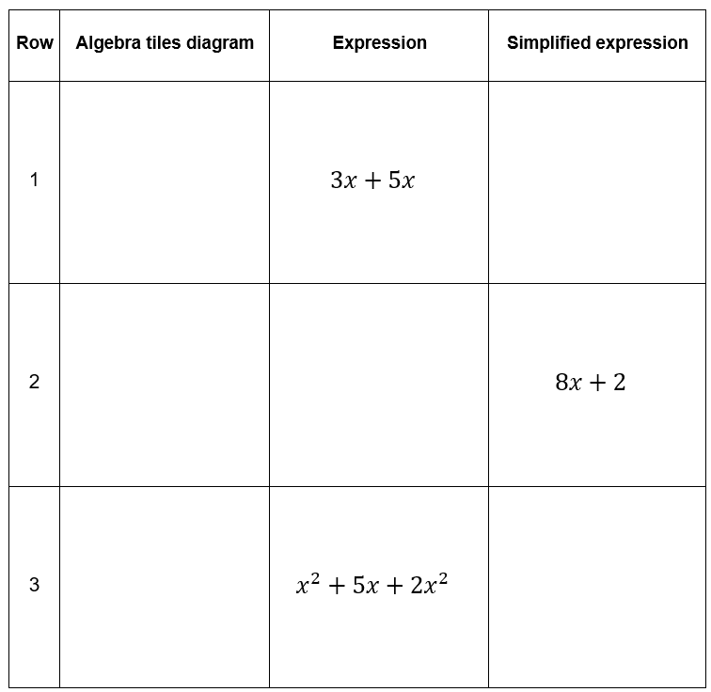
Explore
YOUR
TURN
Handout
available
Work in pairs.
Place the cards to complete the missing information on the sheets.
Use your algebra tiles to help you simplify the expressions.
You need to draw your own algebra tile model for one of the rows.
Notes:
Ensure that you have printed enough sheets for all pairs of learners and have sets of cards cut up for each pair.
Ask learners to work in pairs to fill in the missing cells with a picture or missing information; encourage collaboration and taking turns.
Learners might like to use the algebra tiles as a scaffold.
While learners complete the task, the tutor should circulate, listen to the learners' discussions, and observe their responses.
When learners have finished the task, ask for feedback on any questions that they found particularly difficult, as well as on what helped them.
Share the answer sheet for the task with learners so they can check their work and address any issues.
Time allocated: 30 minutes

Slide 25

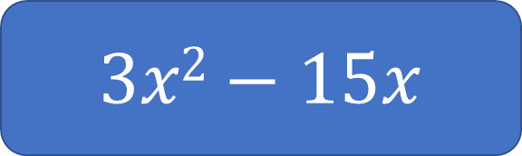
Review the Task (1)
REVIEW
Handout
available
$x2+7x−2$ $− 6x−x2−4$
Row 8
Row 9
$$3x2−15x$$
Notes:
Focus the discussion on rows 8 and 9 and any difficulties encountered.
For row 9, the intention is not to teach factorising in this session but to recognise that there are common factors between the two terms. Some learners may have correctly matched this card in row 9 by multiplying out the bracket on the card. This should be commended, but not expected.

Slide 26
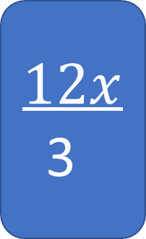
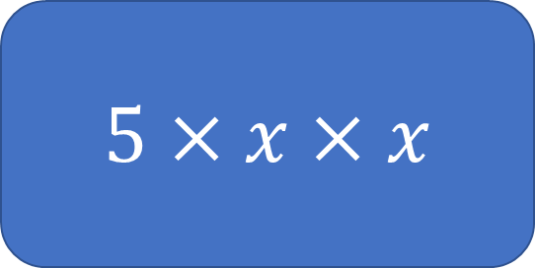
Review the Task (2)
REVIEW
Handout
available
$$12x$$
3
Row 10
$$5×x×x$$
Row 11
Notes:
These extension questions from rows 10 and 11 can be left out if learners are struggling with adding and subtracting like terms.

Slide 27
Practice question (1)
PRACTICE QUESTION
Handout
available
Simplify 8x − 3 + 6x
Circle your answer.
2x − 3 11x 5 + 6x 14x − 3
Notes:
Learners must now use the skills they have developed to answer some exam questions.

Slide 28
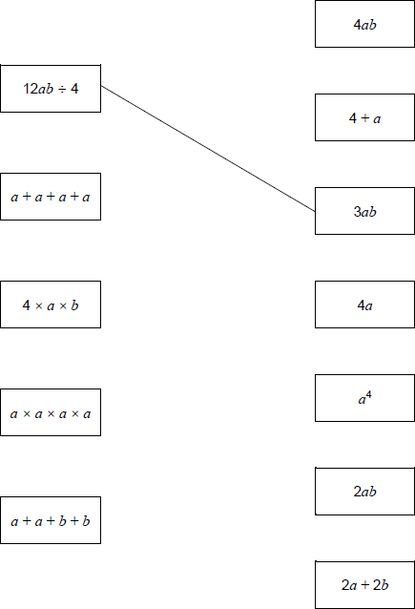
Practice question (2)
PRACTICE QUESTION
Handout
available
Match each expression on the left with one on the right.
One has been done for you.

Slide 29
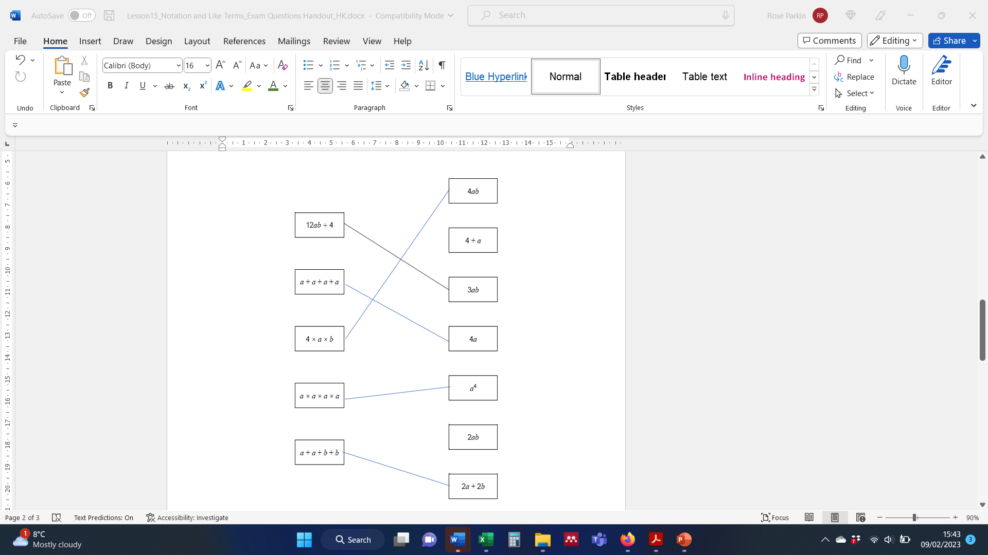
Practice question (2) – answer
PRACTICE QUESTION

Slide 30
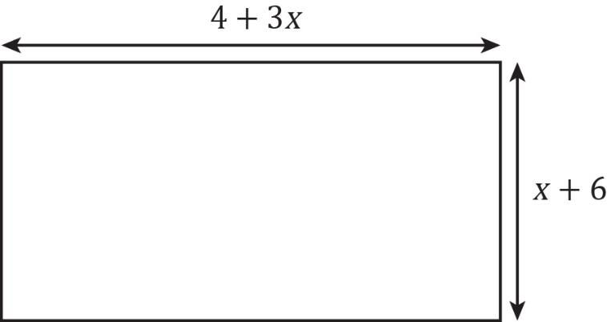
Practice question (3)
PRACTICE QUESTION
Handout
available
The diagram shows a garden in the shape of a rectangle.
Diagram NOT accurately drawn
All measurements are in metres.
The perimeter of the garden is 32 metres.
Work out the value of

Slide 31
Practice question (3) – answer
PRACTICE QUESTION
4 + 3x + x + 6 + 4 + 3x + x + 6 = 32
8x + 20 = 32
8x = 12
x = 1.5 metres
Notes:
An alternative way of solving Practice question 3 using semi-perimeter:
4 + 3x + x + 6
4 + 3x + x + 6 = 16
4x = 6
x = $\frac{6}{4}$
x = $\frac{3}{2} (or 1.5)$

Slide 32
Lesson review:
Algebra notation and collecting like terms
Objectives
Recognise the difference between simplified and non-simplified expressions.
Introduce the use of algebra tiles to represent terms in expressions.
Add and subtract variables, including those with indices.
Simplify expressions by collecting like terms.
Notes:
The tutor should recap key learning points while reviewing lesson objectives.

Slide 33
Lesson 28:
Credits
Text acknowledgements
AQA: GCSE Maths 8300/2F November 2020, Question 12 (Slide 27), GCSE Maths 8300/2F June 2020, Question 12 (Slide 28 & 29)
Pearson Education Ltd: Edexcel Level 1/Level 2 GCSE (9-1) June 2013 1MA1/1F Mathematics Paper 1 (Non-Calculator) Foundation Tier Question 28 (Slide 30)
Photo acknowledgements
Shutterstock.com: Vectorfair.com

