Slide 1
Education for sustainable development: ESOL resources
Session 1 – local area

Slide 2
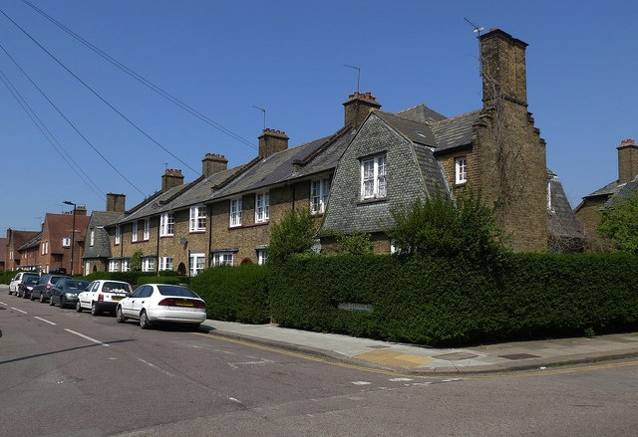
First word?
Notes:
Starter – 2 minutes per slide (1 minute thinking time, 1 to talk), four slides. Elicit the first word learners recall when they see this image. Make a note or scribe. Adapt locally with images of local areas - these four are all in the London area.
"Terraced houses, Tower Gardens Estate" by Julian Osley is licensed under CC BY-SA 2.0

Slide 3
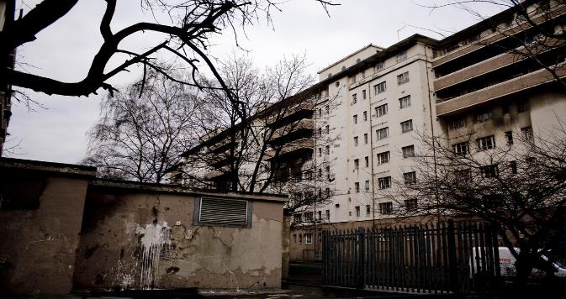
First word?
Notes:
"Woodberry Down Estate" by Nicobobinus is licensed under CC BY-NC 2.0

Slide 4
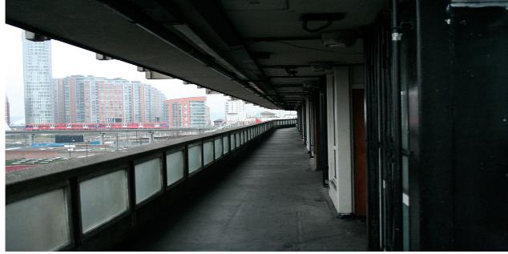
First word?
Notes:
"Robin Hood Gardens" by Christian 胡萝卜男 is licensed under CC BY-NC-SA 2.0

Slide 5
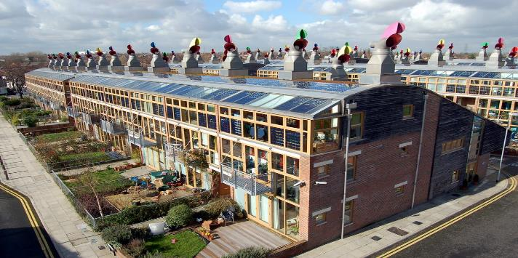
First word?
Notes:
"BedZED" by telex4 is licensed under CC BY 2.0

Slide 6
Address or area?
What area do you live in? Check the name / spelling / pronunciation with your teacher.
13 Mary Street, West Hampstead, NW3 6PX | Kilburn | Church Street
Queens Park | Flat 5, Compton House | 219 Lisson Grove London NW8 8LW
Room 6, Church Army House | King’s Cross | Edgware Road
Notes:
10 minutes – recap /reinforce knowledge of difference between area and address. Elicit example of complete and incomplete addresses (need for town/city name, postcode). Highlight UK-based order – house/flat number then street name, postcode after town/city. Local adaptation – edit this slide with local examples. Sensitivity to learner’s housing situation is needed – avoid clearly identifiable private addresses of learners and encourage learners to talk about the area they live, rather than give their full address. Literacy focus – check for spelling of familiar local vocabulary – street name, neighbourhood. Pronunciation focus – practice relevant local area names

Slide 7
My local area
Work with a partner. Ask and answer these questions:
Do you live near the college?
What neighbourhood / area do you live in?
What is your local area like?
Make a note of your partner’s answers. Tell the class about their answers.
Notes:
30 minutes Concept check before start – Who are you working with? How many questions? What are they about? Do you need to make notes? Why? In large class, learners feed back to a group. E1 / E2 focus on 3rd person –s for reporting “He lives in…” E3+ reported speech “He says that…”, “She told me that…” Edit instruction according to level.

Slide 8
Issues or problems in your local area
What issues or problems are there in your local area?
Think about things which affect many or all the people where you live, not just you or a few people.
Notes:
Discussion task. Check for understanding and pronunciation of “issues” – discussion can be whole group, small group, pairwork. Recap / summary with whole group – scribe issues – check for spelling

Slide 9
Issues or problems in your local area
Notes:
Optional scribing page

Slide 10
What kind of issue is it?
Is it about:
Air pollution | Housing and living conditions
Personal safety | Equality and inclusion
Education | Green / open spaces
Jobs and work | Something else?
Notes:
These issues are addressed by seven of the United Nations Sustainable Development goals. Explain / give examples / link to issues already raised. Refer back to starter photos 2 and 3 (Woodberry Down Estate and Robin Hood Gardens) – what issues are there in this area?

Slide 11
Next time
We are going to talk about the issues you
have in your local area. You will learn how to
describe a problem and what you want to do
about the problem.
Homework: take a photo of your local area. Bring the photo to class / share the photo with your teacher. Take the photograph safely!

Slide 12
Last word?
One word from today’s class.
Notes:
Recap / recall exercise. Learners take one word from the class today and identify why they think it is useful, what they have learned about the word, how they would like to use it.

Slide 14
ESD ESOL Pilot
Session 2 – Local Issues

Slide 15
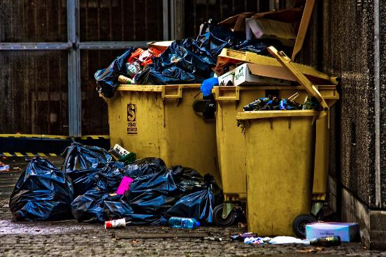
Local issues
Notes:
"Rubbish" by garryknight is licensed under CC BY 2.0 You may prefer to upload your own photo or one taken by one of the learners.

Slide 16
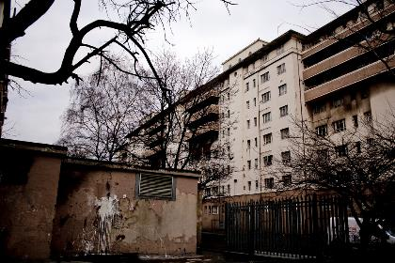
Last time, we talked about…
area
neighbourhood
issues
Notes:
Starter – ask learners to talk in pairs / small groups about the last session – what do they remember? Photo shows first as a reminder, list of key words comes afterwards.

Slide 17
This time, we are going to…
speak and write about problems
use these words: issue, problem, concern
use adjectives “worried” “concerned” – “I’m worried about…” “I’m concerned about…”
role play – tell someone about your concerns
talk about solutions to problems

Slide 18
Can you see any problems here?
Notes:
"Robin Hood Gardens" by Christian 胡萝卜男 is licensed under CC BY-NC-SA 2.0 – small groups – ask learners to identify what problems they can see. Tell them after this they will be practising the language we use to describe problems. Problems could include: dark, not safe, no open space, no green space, noise, old housing, dangerous for children (balcony), nowhere to play, noisy trains

Slide 19
The problem is…
“The problem is, it’s so dark.”
“The big issue is safety.”
“I’m worried about the children playing outside.”
“Noise from the train line is a concern!”
“We’re concerned about air pollution.”
Notes:
Examples which the learners may have identified. Adapt if needed to add their own suggestions.

Slide 20
Did you bring any photos?
Tell us about a problem in your local area.
The problem is…
The big issue is…
I’m worried about…
…. is a concern.
I’m concerned about…
Notes:
Phrases from previous slide. Encourage learners to describe issues in their local area using these phrases. If learners have previously shared photos with you (with their permission, and if subject matter is appropriate), display or print before class to share

Slide 21
“I’m really concerned about…”
Work in pairs, A and B.
A – you are a local resident. You are worried about a problem that is affecting the local community. Talk to B.
B – you work in an advice centre. You listen to people who have problems. Listen to A.
Notes:
Concept check – how many people are there? Who is A / B? What is B’s job? Why is A worried? What is A going to do?

Slide 22
Before you start, think about…
Is it about:
Air pollution | Housing and living conditions
Personal safety | Equality and inclusion
Education | Green / open spaces
Jobs and work | Something else?
Notes:
These issues were listed in Session 1 – they refer to the UN Sustainable Development Goals

Slide 23
What did you talk about?
B – What was A’s problem?
Notes:
Scribe topics on whiteboard – encourage use of phrases eg “She’s got a problem with…” “He’s worried about…”. In the next activity the learners will start talking about what they want to do about the problem.

Slide 24
What solutions are there?
Let’s talk about one of the problems. Can you think of any solutions?
For example – the problem is “there is nowhere safe for my children to play”. The solution – “We need a new playground” / “We would like the car park turned into a play space.” / “Why can’t the council plan for better public play spaces?”
Notes:
Choose one of the problems – ideally linked to one of the UN Sustainable Development goals. After the learners have read and practised the examples on this slide, encourage them to discuss the problem in small groups. Phrases are repeated on next slide.

Slide 25
What solutions are there?
We need…
We would like…
Why can’t…?
Notes:
Note: these phrases work best when discussing problems that have a community solution – we need to contact the council about it.

Slide 26
Next time
We are going to look at local council websites. We will read to get information about local issues.
Homework: write a summary of a problem in your local area – what’s the issue? what are you concerned about? what do you need? what would you like to happen?

Slide 27
Last word?
One sentence from today’s class.
Notes:
Recap / recall exercise. Learners take one sentence from the class today. Focus on the structures they have practised.

Slide 29
ESD ESOL Pilot
Session 3 – Local Information

Slide 30
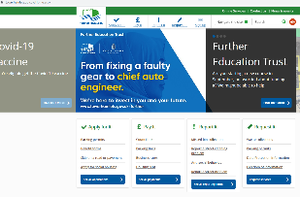
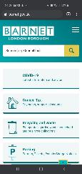
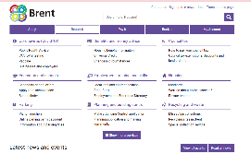
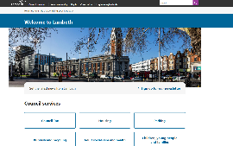
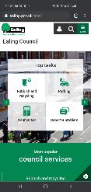
Local information
Notes:
Edit with screenshots of one or more local council websites relevant to your learners. For this session, learners will need online access. The objective is to embed digital skills (using a search engine, identifying a URL, navigating a website, highlighting, sharing a URL) and to focus on accurate spelling for effective searching and noting a URL) Learners can use their own devices to search, or can use a shared device (eg teacher’s pc / laptop / ipad). If learners have no access to smartphones, tutor can model search facility with own device. If this is not appropriate for your learners, you can adapt this session as a discussion of local council names / areas / services, including “report a problem” facilities.

Slide 31
Last time, we talked about…
issues
concerns
solutions
Notes:
Starter – ask learners to talk in pairs / small groups about the last session – what do they remember? Ask them to share their homework with each other (read it out / show it).

Slide 32
This time, we are going to…
search for a website
visit a local council website
find information about an issue
talk about how we can share our concerns (email, webchat, social media message, online reporting app)

Slide 33
Ask and answer
What is the name of your local council / local authority?
Have you ever visited the local council website?
Notes:
These issues were listed in Session 1 – they refer to the UN Sustainable Development Goals

Slide 34

Internet search!

Slide 35
Find your local council website
What words will you search for?
What is the website URL (address)?

Slide 36
Now search for information
Think about your problem from Session 2
Where can you find information about this problem?
Have a look around your local council website. Can you find a way to report a problem?

Slide 37
What did you find?
Tell other learners about the information you found on your local council website.
Notes:
Small group sharing or whole class. If whole class, use smartboard (if available) to display council website.

Slide 38
Next time
We will write online messages about problems – maybe you can report a problem on your local council website?
Homework: write about the area where you live. What’s the name of the area? What council is it in? What is the council website address? What is your opinion of the website?
Notes:
Homework task - encourage learners to write this in a notebook they will be able to access easily.

Slide 39
Today I learned…
Did you learn a new skill today?
Did you get some new information today?
Notes:
Recap / recall exercise. Focus on skill acquisition – digital skills – and knowledge acquisition – local council details.

Slide 41
ESD ESOL Pilot
Session 4 – Report a problem

Slide 42
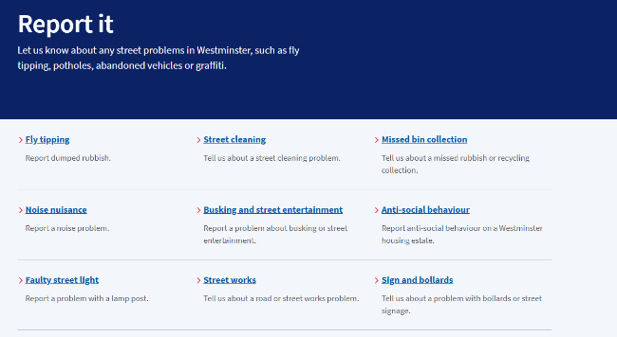
Report a problem
Notes:
Edit with local council website equivalent pages.

Slide 43
Last time, we…
searched for…
visited…
found…
talked about…
Notes:
Starter – ask learners, in pairs, to recall the activities from the last session (these prompts follow the order of slide 3 from last week and demonstrate the past tenses of the verbs)

Slide 44
This time, we are going to…
write sentences about problems
talk about relevant information – what to include, what not to include
write an online message
write an online message to report a problem and ask for action

Slide 45
How can you report a problem?
in person
by phone
on an app
online
by email
by letter
Notes:
Recall the methods explored in the last session and reinforce – use a local council website to demonstrate “report a problem”

Slide 46
Reporting a problem online
Write a short text about the problem.
Which words from session 2 will you need?
Notes:
In session 2, learners used these phrases The problem is… / The big issue is… / I’m worried about… / …. is a concern. / I’m concerned about… to describe problems and We need… / We would like… / Why can’t…? To express possible solutions. Target – learners will write sentences demonstrating their knowledge and skill in describing a problem and a possible solution.

Slide 47
Reporting a problem online
How do you start?
What relevant information do you include?
What personal details do you share?
Who will read your message?
What will be a good outcome?
Notes:
Adapt according to task – discuss how an online message is more direct and less formal than a letter or an email. Discuss relevant information and unnecessary details. Discuss what personal information is relevant and what is unnecessary.

Slide 48
Write your online message!
Now, it’s time to write your online message to report a local issue and to ask for action.
Notes:
Adapt as a homework task, a collaborative task, an in-class task with later feedback. Concept checking –what are you going to write? Why? Who is going to read it? What do you want them to do after they read your message? What will be a good outcome?

Slide 49
Next time
We will review all the sessions – what have we talked about, what have you done, what have you learned, what would you like to do next?
Notes:
Homework task - encourage learners to write this in a notebook they will be able to access easily.

Slide 50
New words today
Choose three words from today’s class. Share them with the class. What words do you want to use again?
Notes:
Learners recall vocabulary, eg online / relevant / include / details / share / issue / concern / worried / action / message / outcome

Slide 52
ESD ESOL Pilot
Session 5 – Local priorities

Slide 53
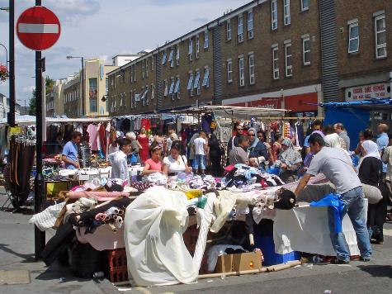
Local priorities
Notes:
Use photos shared by learners in Session 2 to illustrate this session, or locally sourced images of the area. "Church Street Market" by diamond geezer is licensed under CC BY-NC-ND 2.0

Slide 54
Last time, you…
talked about problems and solutions
wrote sentences about problems
wrote a message to report a problem online

Slide 55
Review!
What have we talked about?
What have you looked at?
What have you learned?
What would you like to do next?

Slide 56
What do you remember?
Work in pairs / small groups. Use your notes from class. Talk about what you remember from:
Session 1 – your local area
Session 2 – local issues
Session 3 – local information
Session 4 – report a problem
Notes:
Encourage learners to review their own notes and to recall verbally. Assessment opportunity – record the learners discussing the sessions – one pair / small group for each session.

Slide 57
In “Local issues”, I have…
Write sentences about what you have done on this short course. For example, “I have talked about the area where I live.”
Write sentences about what you would like to do next, after this course.
Notes:
Use of present perfect – differentiate for lower levels with “I have…” prompts followed by verbs “I have talked about…” “I have looked at…” “I have learned…”. Assessment opportunity – learners write sentences / two paragraphs / a review text about the activity

Slide 58
What are your priorities?
What else would you like to change in your local area? Work in a group of three and agree your top three priorities for change. Give reasons for your list. For example, “Our top priority is housing. This is most important because…”
Present your priorities to the class.
Notes:
Small group discussion and presentation activity. Assessment opportunity – record the presentations. Groups of three can divide presentations into one priority each.

Slide 59
Last word
One word you want to remember from this course.
One activity you would like to do again.

