Slide 1
T LEVEL IN MANAGEMENT AND ADMINISTRATION
Supporting holistic delivery of Core Content and Occupational Specialism content

Slide 2
Lesson 1
Understanding business growth

Slide 3
Lesson 1 aim
To explore the concept of business growth.

Slide 4

Blooket quiz
https://dashboard.blooket.com/set/692d66b9738f998c8dd28dde

Slide 5
Misunderstandings/misconceptions
Share with your peers any misunderstandings or misconceptions which arose from the quiz.
Support peers with their misunderstandings or misconceptions.

Slide 6
Organic growth
Organic (or internal) growth involves expansion from within a business, for example, by expanding the product range, or the number of business units and locations.
Organic growth builds on the business’s own capabilities and resources. For most businesses, this is the only expansion method used.
(Tutor2U. (2023). Organic (Internal) Growth. [Online]. Tutor2U. Available at: https://www.tutor2u.net/business/reference/organic-internal-growth?srsltid=AfmBOoo1_wgAYWrAvNqsMlN32 [Accessed 8 December 2025].)

Slide 7
Inorganic growth
External growth (inorganic growth) usually involves a merger or takeover. A merger occurs when two businesses join to form a new (but larger) business. A takeover occurs when an existing business expands by buying more than half the shares of another business.
(BBC Bitesize. (2025). Business growth - AQA. [Online]. Bitesize. Available at: https://www.bbc.co.uk/bitesize/guides/zd83vk7/revision/3 [Accessed 8 December 2025].

Slide 8
Task-Organic and inorganic examples
Read through the Organic and inorganic examples.
Determine whether the organisation experienced organic or inorganic growth and tick the appropriate box.
Check answers against the teacher’s answers.

Slide 9
Inorganic growth strategies
Mergers.
Acquisitions.
Strategic alliances.
Joint ventures.
Franchising.

Slide 10
Mergers
Description: Two companies combine to form one entity.
How it supports growth: Increases market share, reduces competition, and creates a larger resource base.

Slide 11
Advantages and disadvantages of mergers
Advantages:
  Greater economies of scale (cost savings).
  Access to new markets and customers.
Disadvantages:
  Cultural clashes between organisations.
  Complex integration process and redundancies.

Slide 12
Acquisitions
Description: One company purchases another.
How it supports growth: Provides immediate access to new products, markets, and technologies.

Slide 13
Advantages and disadvantages of acquisitions
Advantages:
Rapid expansion into new sectors.
Instant increase in customer base and revenue streams.
Disadvantages:
High financial cost and risk.
Possible resistance from the acquired company’s employees.

Slide 14
Strategic alliances
Description: Two companies collaborate without merging.
How it supports growth: Enables resource sharing and joint innovation without full ownership.

Slide 15
Advantages and disadvantages of strategic alliances
Advantages:
Shared risk and investment.
Access to complementary skills and technologies.
Disadvantages:
Limited control over partner’s actions.
Conflicts in objectives or priorities.

Slide 16
Joint ventures
Description: Two or more businesses create a new entity for a specific project.
How it supports growth: Combines expertise and resources to enter new markets or develop new products.

Slide 17
Advantages and disadvantages of joint ventures
Advantages:
  Shared costs and risks for large projects.
  Combines the strengths of multiple companies.
Disadvantages:
  Profit-sharing reduces individual returns.
  Disagreements can disrupt operations.

Slide 18
Franchising
Description: A business allows others to operate under
It’s brand for fees or royalties.
How it supports growth: Expands brand presence quickly with minimal capital investment.

Slide 19
Advantages and disadvantages of franchising
Advantages:
  Rapid expansion with lower financial risk.
  Franchisees bear operational costs.
Disadvantages:
  Less control over franchisee operations.
  Brand reputation can suffer if franchisees underperform.

Slide 20
Organic and inorganic case study
Read through the provided organic and inorganic case study.
As a group, discuss which strategy or strategies from the presentation would be most effective.
Make notes of reasons for choice(s).
Produce a poster giving your choice and reasons.

Slide 21
Peer review organic and inorganic case study
Pass your poster to the allocated group.
Annotate the poster you have received with feedback.
Pass along to the next group.
Annotate the new poster with feedback.
Return the poster to the original group.

Slide 22
Reflection
Reflect on the feedback you have received.
Improve the reasoning on the poster.
Hand the completed poster to the teacher.

Slide 23
Organic growth strategies
Market penetration.
Product development.
Market development.
Diversification.
Increasing operational efficiency.

Slide 24
Market penetration
Description: Increasing sales of existing products in current markets through promotions, pricing strategies, or improved customer service.
How it supports growth: Boosts revenue without major structural changes.

Slide 25
Advantages and disadvantages of market penetration
Advantages:
  Low risk as it focuses on familiar markets.
  Cost-effective compared to entering new markets.
Disadvantages:
  Limited growth potential if the market is saturated.
  Competitors may respond aggressively with price cuts.

Slide 26
Product development
Description: Creating new products or improving existing ones to meet customer needs.
How it supports growth: Attracts new customers and retains existing ones.

Slide 27
Advantages and disadvantages of product development
Advantages:
  Increases customer loyalty and satisfaction.
  Opens opportunities for upselling and cross-selling.
Disadvantages:
  High research and development costs and time investment.
  Risk of product failure if demand is misjudged.

Slide 28
Market development
Description: Entering new geographical areas or targeting new customer segments with existing products.
How it supports growth: Expands customer base and revenue streams.

Slide 29
Advantages and disadvantages of market development
Advantages:
  Access to untapped markets.
  Diversifies customer portfolio, reducing risk.
Disadvantages:
  Requires significant marketing and distribution investment.
  Cultural and regulatory challenges in new regions.

Slide 30
Diversification
Description: Introducing new products into new markets, often unrelated to current offerings.
How it supports growth: Reduces dependency on a single product or market.

Slide 31
Advantages and disadvantages of diversification
Advantages:
  Spreads risk across different markets.
  Potential for high returns if successful.
Disadvantages:
  Very high risk and complexity.
  Requires substantial resources and expertise.

Slide 32
Increasing operational efficiency
Description: Improving processes, reducing waste, and enhancing productivity to support higher output.
How it supports growth: Frees up resources for reinvestment and increases profitability.

Slide 33
Advantages and disadvantages of increasing operational efficiency
Advantages:
  Cost savings improve margins.
  Enhances competitiveness in pricing and delivery.
Disadvantages:
  May require investment in technology and training.
  Resistance to change from employees.

Slide 34
Organic and inorganic examples task
Refer back to the Organic and inorganic examples provided earlier.
Suggest organic growth strategies that could be used for each of the examples given.
Make note of your reasons why.

Slide 35
Netflix
As I go through the provided Netflix case study, annotate your copy with key points of analysis.
In pairs, discuss the answers to the questions related to the Netflix case study.
Suggest one new strategy that Netflix could use to support growth.
Check your answers.

Slide 36
Reflection lesson 1
Complete the Reflection template provided and return it to the teacher.

Slide 37
Homework lesson 1
Read through your previous notes.
Perform a SWOT on your Industry Placement organisation.

Slide 38
Lesson 2
Internal analysis - SWOT

Slide 39
Reviewing business growth
Let’s look back at your completed Reflection templates and posters.

Slide 40
Lesson 2 aim
Understand the relationship between SWOT analysis and growth strategies.

Slide 41
Starter task-lesson 2
Individually read the different SWOT statements.
Classify each by writing either Strength, Weakness, Opportunity, Threat next to it.

Slide 42
Check your answers
Strengths Strong brand recognition Financial stability Diverse product portfolio Advanced technology infrastructure Skilled workforce | Weaknesses Complex organisation structure High operational costs Dependence on key markets Limited agility Legacy systems
Opportunities Emerging markets Digital transformation Sustainability initiatives Strategic partnerships Diversification | Threats Intense competition Economic instability Regulatory changes Cybersecurity risks Changing consumer preferences
Learners to check their answers against those provided.

Slide 43
SWOT analysis Industry Placement
Pass homework to a peer.
Review the homework given to you. Indicate if any of the statements in the SWOT analysis are in the wrong classification.
Return SWOT back to the original learner.

Slide 44
Middlesbrough FC Case study
Read through the Middlesbrough Football Club case study provided.
Ask for clarification of any terminology you are unsure of.

Slide 45
SWOT analysis indication
Individually indicate whether the statements in the case study are:
Strengths
Weakness
Opportunities
Threats
Irrelevant.

Slide 46
Strengths and weaknesses
Strengths | Weaknesses
Strong regional identity Modern multi-purpose stadium Increased revenues (up 12.8%) Growth in matchday and commercial revenue Strong fan and sponsor engagement Investment in player recruitment and youth development Active community engagement New leadership Digital cashless payment systems | After‑tax financial loss of £9.6 million. Very high wage bill (£31.4 million) Heavy spending on player recruitment (£18.8 million) Wi‑Fi connectivity issues during large events Dependence on performance on the pitch to stabilise finances

Slide 47
Opportunities and threats
Opportunities | Threats
Potential promotion to the Premier League Growing matchday and commercial income trends Expansion of community projects Increased use of the stadium for non‑football events Enhancing fan engagement Sustainability initiatives Increased demand for community health, education, and inclusion initiatives Regeneration of the local area | Failure to achieve promotion Financial Fair Play regulations Rising operational costs in professional football Regulatory compliance requirements (health & safety, safeguarding, employment law) Planning approval challenges Economic uncertainty

Slide 48
Create a case study
Create a case study of an organisation, this can be a real business or a fictitious one.
The case study should include statements that are:
Strengths
Weaknesses
Opportunities
Threats
Irrelevant.

Slide 49
Swap your case study
Swap your case study with another group, as identified by the teacher.
In your groups indicate whether the statements in the case study are:
Strengths.
Weakness.
Opportunity.
Threat.
Irrelevant.

Slide 50
Create a SWOT matrix
Individually create a SWOT matrix.
This can be completed either on A4 paper or electronically.

Slide 51
Peer review the SWOT
Pass the case study and SWOT back to the original group.
Peer review the matrix against the intended content.
Annotate the matrix with feedback if there are any errors.

Slide 52
Feedback
Give one key issue identified when completing the tasks.

Slide 53
Different types of growth
Inorganic
Mergers, acquisitions, strategic alliances, joint ventures, franchising.
Organic
Market penetration, product development, market development, diversification, and increasing operational efficiency.
.

Slide 54
Suggest growth strategies
Refer to the Case study – Middlesbrough Football Club.
Identify the types(s) of growth that are appropriate to the organisation.
Suggest inorganic and/or organic growth strategies that could be applied based on the SWOT analysis completed.

Slide 55
Synthesis
Synthesis is the act of combining different ideas or things to make a whole that is new and different from the items considered separately.
(Cambridge Dictionary. (2025). Synthesis. [Online]. Cambridge Dictionary. Last Updated: 2025. Available at: https://dictionary.cambridge.org/dictionary/english/synthesis [Accessed 8 December 2025])

Slide 56
Plenary-lesson 2
Individually, write an answer to the following question:
How does SWOT analysis support growth planning?
Develop your answer by working with others.

Slide 57
Homework-lesson 2
Focus on the specific part of PESTLE you have been given.
Research specific examples of factors a business needs to consider for your particular part of PESTLE.

Slide 58
Lesson 3
External analysis - PESTLE

Slide 59
Lesson 3 aim
To analyse external factors affecting business growth using the PESTLE framework.

Slide 60
PESTLE homework
Work in groups.
Share the results of your homework research.
Complete the PESTLE template.
Pass to another group. Using a different coloured pen, add to the PESTLE template you have been passed.
Pass to another group and repeat the process.

Slide 61
Read the case studies
You have two case studies: Fresh Fields Supermarket and Global Bite Foods Ltd.
Read through each. Anything not clear?
Select the one you want to work on.

Slide 62
Identify the PESTLE factors
Work in groups.
Analyse the case study – refer back to how a case study was analysed and annotated in a previous lesson.
Carry out a PESTLE analysis on the organisation in the case study, identifying the PESTLE factors. You can complete a PESTLE template to record your conclusions.

Slide 63
What are the PESTLE factors?
Work in groups.
Analyse the case study – refer back to how a case study was analysed and annotated in a previous lesson.
Carry out a PESTLE analysis on the organisation in the case study, identifying the PESTLE factors. You can complete a PESTLE template to record your conclusions.

Slide 64
Adding a voiceover to a presentation
Watch the demonstration of how to add a voiceover to a presentation.
Take notes. Ask questions if anything isn’t clear.

Slide 65
Create a presentation
Produce a slide to show your PESTLE analysis.
Prepare a script for a three-minute oral presentation of the key points in the content.
Record your script as a voiceover on your slide.
Use headphones if it is distracting when other people are talking.

Slide 66
Presentation review
Individually download your allocated slide show for peer review.
Listen to the slide show and complete the Voiceover checklist.
The checklist will ask you to comment on:
The content – was it accurate?
The presentation – was it clear, logical, easy to follow?

Slide 67
Reflection on voiceover feedback
In your groups, review the completed Voiceover checklists.
Note any comments that appear in multiple checklists.
Note any comments that are more unique and only appear in one or two checklists.
Discuss and agree on any comments that should be actioned for improvement.

Slide 68
Synthesising content
Remember how you developed your answer to a question by synthesising answers that others had given, and used this to further develop your answer.
Use that approach to answer the following question:
How does a PESTLE analysis support growth planning?

Slide 69
Improving your answer
Work with a partner.
Discuss your individual answers. Look at how you can synthesise to create a new, improved answer.
Access the Collaborative wall.
Add your improved answer there.

Slide 70
Homework-lesson 3
Choose a local company to research.
Select three areas for improvement that the company may need to work on in the future.

Slide 71
Lesson 4
Setting SMART growth objectives

Slide 72
Lesson 4 aim
Be able to produce SMART objectives for a business.

Slide 73
Business goals and objectives
Business goals:
Describe what a business wants to achieve overall.
Are long-term and give the organisation direction
Are often broad and strategic.
Business objectives:
Specify how the goals will be achieved.
Are short to medium term.
Are specific and measurable.
Guide day-to-day decision-making.

Slide 74
Implications of poor objective setting
Poorly written objectives can:
Create confusion.
Waste resources.
Prevent a business from measuring success.
If an objective is unclear, the business may work hard to achieve very little.

Slide 75
Example of a poorly written objective
Improve customer satisfaction this year.
Why would this be considered a poorly written objective?

Slide 76
SMART objectives
Specific – clear and focused.
Measurable – quantifiable.
Achievable – realistic.
Relevant – linked to business growth.
Time-bound – deadline set.

Slide 77
SMART objective example
Increase average customer satisfaction survey scores from 78% to 88% by 31 March 2027 by improving staff customer service training and responding to all customer feedback within 48 hours.

Slide 78
Draft SMART objectives
Work in pairs.
Complete the SMART objectives worksheet.
Pass the completed worksheet to another pair for review.

Slide 79
Draft SMART objectives again
Work in groups.
Read the Pulse Performance Fitness Ltd. case Study.
Write three SMART objectives aligned to business growth for the organisation.
Pass to another group for review.

Slide 80
Review of SMART objectives
In your groups, make changes to your SMART objectives if needed.
Select one of your SMART objectives. Write it on flip chart paper and put it on the wall.
In your groups, review three of the SMART objectives. Use a different coloured marker pen to annotate with feedback.

Slide 81
Finalise your SMART objective
Read through all the feedback on your SMART objective.
Make changes to the SMART objective if needed.

Slide 82
Review of homework
Individually refer to your completed homework.
For each of the three ideas for improvement, write a SMART objective.
Pass to another learner for peer review.
Review your feedback. Make changes to one of your SMART objectives if needed. Hand it in to the teacher.

Slide 83
How easy is it to write SMART objectives?
Access the Poll application.
Select one aspect of SMART that you found the most difficult to include when writing SMART objectives.

Slide 84
Lesson 5
Planning tools – Gantt charts

Slide 85
Lesson 5 aims
Understand the importance of structured planning to meet growth objectives.
Be able to create a Gantt chart using spreadsheet software to visually plan a business growth project.

Slide 86
Sunrise Café
Sunrise Café has decided to extend its opening hours from 3.00 pm to 6.00 pm to attract more customers.
Work in pairs.
You will be given a series of cards which set out actions the café needs to take.
Organise these into chronological order – the order that they need to happen.

Slide 87
Sunrise Café actions
Inform existing staff about changes to shifts and responsibilities.
Hire two part-time staff to cover the extra hours.
Update the staff rota once new employees are hired.
Train the new staff before the extended hours launch.
Order additional ingredients and supplies to meet increased demand.
Update the café’s website and social media with new hours.
Launch the new hours on the first Monday of next month.

Slide 88
Need for a structured growth plan
When a business wants to grow, whether it is launching a new product, expanding opening hours or adopting new technology, it cannot rely on guesswork.
It requires a growth plan. This helps to ensure that:
Resources are available.
Tasks are completed in the correct order.
Deadlines are realistic.
The business can monitor progress and respond to delays.

Slide 89
Six phases of a growth plan
A small business wants to launch an online booking system to make customer reservations easier.
Research – identify needs, compare options, gather customer feedback.
Choose a supplier – decide on the platform or developer.
Develop system – build or customise the booking tool.
Test system – check for errors, test usability, fix issues.
Train staff – ensure employees can use the system.
Launch – go live, promote to customers, monitor performance.

Slide 90
What is a dependency?
When planning growth over time, tasks are often dependent on one another.
A dependency explains how and when one task can start or finish in relation to another.

Slide 91
Types of dependencies
Lead and Lag Time: Dependencies can include offsets. Lag is a delay added between tasks, while Lead is an overlap, allowing the successor to start earlier.
Logical Dependency: Natural, unavoidable sequence of tasks (e.g., buying ingredients before cooking).
External Dependency: Dependence on third-party deliverables (e.g., waiting on regulatory approval).

Slide 92
Dependencies can also be….
Finish to start.
Start to start.
Finish to finish.

Slide 93
Finish to start
One task must finish before the next task can start.
For example:
Staff must be recruited before they can be trained.
Why does this matter?
Prevents tasks from being started too early, causing delays or wasted time.

Slide 94
Start to start
One task must start before another task can start, but they can run at the same time.
For example:
Menu planning must start before marketing content for the new menu can begin, even though both continue together.
Why does it matter?
Allows tasks to overlap and save time in a growth plan.

Slide 95
Finish to finish
One task must finish at the same time as, or after another task finishes.
For example:
Staff training must finish at the same time as final rota confirmation.
Why does it matter?
Ensures related activities are completed together before launch.

Slide 96
Start to finish
One task must start before another task can finish.
For example:
The new booking system must start opening before the old system can be fully shut down.
Why does it matter?
Helps manage change without disrupting business operations.

Slide 97
Why dependencies matter
You cannot test something until it has been built.
Tasks need people, tools, and materials to be available.
Some tasks need permission before they can start.
Tasks must happen in a certain order. Often, one task must be completed before the next one can start.

Slide 98
Introducing Gantt charts
A Gantt chart is a project planning tool that helps businesses to:
Visualise the project timeline.
See when each task starts and finishes.
Understand dependencies.
Identify overlapping tasks.
Track milestones.
Businesses of all sizes use Gantt charts because they make planning clearer and more efficient.

Slide 99
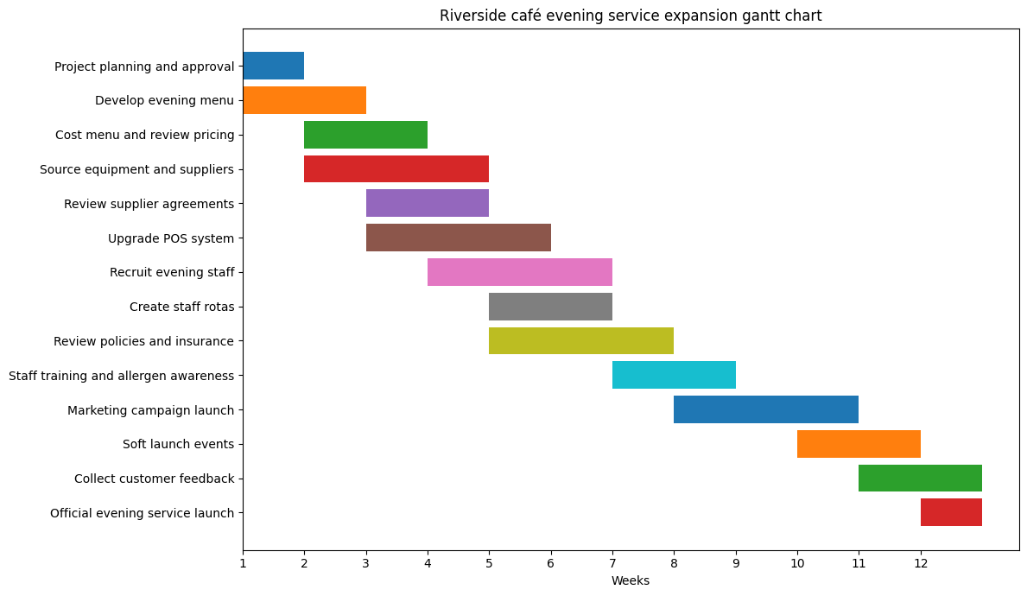
Example Gantt chart

Slide 100
Key features of a Gantt chart
Bars – showing duration. Longer bars indicate a longer task, and shorter bars indicate a shorter task.
Milestones – these mark important progress points or achievements in the project.
Dependencies – indicate the order tasks must follow. They show that one task relies on another being finished.

Slide 101

How to make a Gantt chart
Ask for a transcript, headphones or the weblink if you prefer.

Slide 102
Riverside Café
Work individually.
Read The Riverside Café – expanding into evenings case study.
Create a Gantt chart to enable the café to meet its growth objectives.
Upload your Gantt chart. Ensure your name is in the file name.

Slide 103
Compare Gantt charts
Move into groups of four.
Each person in the group open your Gantt chart and the Gantt charts of your three group members. Split the screen so that you can see all four Gantt charts at the same time.
Discuss the Gantt charts and any similarities and differences.

Slide 104
Reasons why changes are needed
Resource issues: Timeline shifts happen when staff or resources are unavailable or take longer than expected.
Unforeseen problems: Unexpected issues like system faults or equipment failures can disrupt the schedule.
Changes in scope: The timeline extends when extra tasks or new requirements are added during the project.
Dependencies and knock-on effects: A delay in one task causes delays in all dependent tasks that follow.

Slide 105
Task – timeline shift
Supplier or cost changes: A 15% increase in supplier prices could delay menu finalisation while new costings are reviewed.
Poor initial planning: Underestimating how long it takes to update policies, and compliance checks could push later tasks back.
Equipment delays: Late delivery of equipment, such as a pizza oven or outdoor heaters, could prevent the café from being fully ready.
Marketing timing issues: If marketing starts too late, the café may delay launch to build enough customer awareness.

Slide 106
Group discussion
What is the impact of timeline shifts?
Which issue is most likely to cause the biggest impact?
Could any delays be mitigated with contingency planning?
How do real businesses manage shifting timelines?

Slide 107
Exam-style question
Evaluate how effective planning tools, such as Gantt charts, can help businesses manage timeline shifts during projects like the Riverside Café expansion.

Slide 108
Lesson 6
Planning tools – use of artificial intelligence (AI)

Slide 109
Lesson 6 aim
Use AI tools to support project planning.

Slide 110
Planning a focus group meeting
An event is being organised. The Human Resources manager will hold a focus group with staff to discuss their views on what is required to further improve the staff management relationships.
Work in pairs.
Create a Gantt chart for the event.

Slide 111
Timeline shift discussion
Work in pairs.
Discuss the impact of timeline shifts on the project's final deadline.

Slide 112
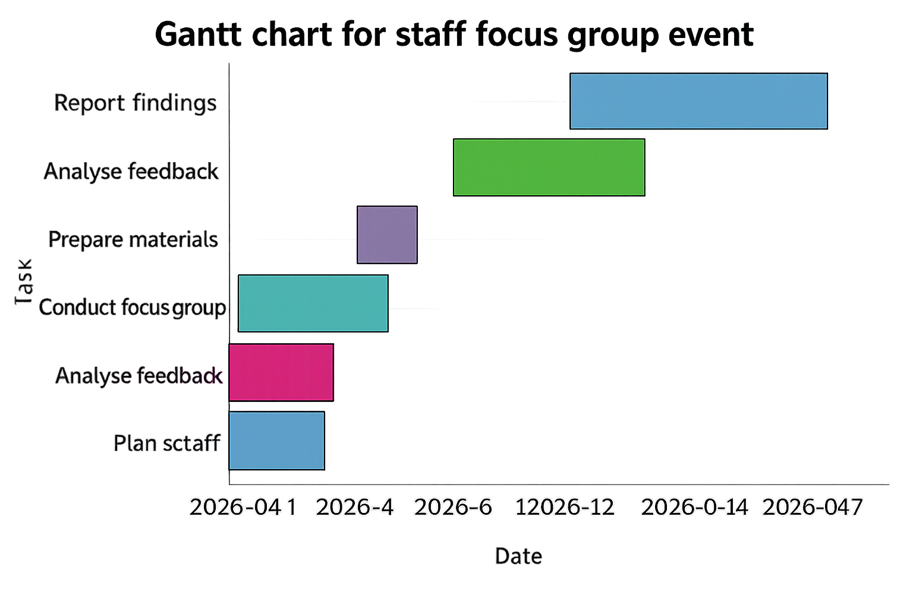
Completed Gantt chart

Slide 113
AI
ChatGPT is an AI chatbot which can understand questions and give helpful, human-like answers. It can be used to help in a business setting by breaking a project into tasks and deciding on the order in which tasks should be completed.
Copilot is an AI assistant built into Microsoft apps, which is built into Word, Teams and Excel. It can be used in a business setting to help create a Gantt chart using a task list and summarising progress for managers.

Slide 114
AI search prompts
AI tools need clear and well-structured prompts.
Start by clearly explaining what you want help with. Include some context, such as the business task or scenario you are working on.
Be specific about the output you need, e.g., an email.
Short, clear instructions work best but remember that AI is only a support tool.

Slide 115
AI prompts – Gantt charts
Prompts which could be used in relation to planning tools could include:
Create a simple Gantt chart for a small project to organise a fundraising event with tasks, durations, and dependencies.
Help me identify the tasks needed for a social media campaign and arrange them into a Gantt chart structure.

Slide 116
AI prompts – SWOT
Prompts which could be used in relation to planning tools include:
Create a SWOT analysis for a new smoothie bar opening in a city centre.
Give me example strengths, weaknesses, opportunities, and threats for a business offering online tutoring.

Slide 117
AI prompts – PESTLE
Prompts which could be used in relation to planning tools could include:
Produce a PESTLE analysis for a retailer launching an eco‑friendly product range.
Give an example of how social trends can create opportunities or threats.

Slide 118
Project plan for Riverside Café project
Work in groups.
Agree on which AI software you will be using (ChatGPT or Copilot).
Use the AI software to produce a project plan for the Riverside Café launch.

Slide 119
Share your prompts and AI plan
Form a new group with people from other groups.
Share your AI project plan and the prompts you used to achieve it.
Are there any similarities and differences in outcomes and approaches?
Add these to the Collaborative wall.

Slide 120
Key points for project planning
What are the activities?
Is there a critical path?
Prioritise and sequence activities.
Allocate resources (including time).
Set monitoring points.

Slide 121
Project methodologies
What do we remember about these project management methodologies?
Six sigma.
PRINCE.
Agile.
Which planning tools work best with these methodologies? Allocate a mark out of five for each. A mark of five is because it is the best, and one for the least effective.

Slide 122
Lesson 7
Time management – prioritisation techniques

Slide 123
Lesson 7 aim
Be able to manage time effectively by using tools to prioritise workplace tasks based on deadlines and levels of importance.

Slide 124
How good is your time management?
Think about one of your Industry Placement days.
List everything you do from waking up to getting home.
Categorise them into productive and unproductive tasks.

Slide 125
Understanding units of time
60 seconds = 1 minute.
60 minutes = 1 hour.
Method to calculate elapsed time (duration):
Subtract the start time from the end time.
Example with minutes: 10.15 to 11.10. First, count to the next hour (11.00 = 45 mins), then add the remaining minutes (10 mins) for a total of 55 minutes.

Slide 126
Calculating ratio
A ratio compares two numbers to show how they relate.
Identify the two (or more) quantities. Decide what values you are comparing. Example: 8 apples and 4 oranges.
Write the ratio using a colon (:). Put the values in order. 8:4.
Simplify the ratio (if needed). Divide both parts by the highest common factor (HCF). 8:4 → divide by 4 → 2 : 1.
State the ratio clearly. Write your final answer. 2:1.

Slide 127
What ratio were you productive?
Calculate the ratio of your productive : unproductive tasks.
Enter the ratio in the Collaborative wall.

Slide 128
Common reasons for time wasting
Procrastination.
Poor prioritisation.
Distractions (social media, mobile phones).
Lack of planning.
Overcommitting.

Slide 129

Pomodoro technique (Ask for a transcript, headphones or the weblink if you prefer)

Slide 130
Pomodoro workplace task
Review the tasks to be completed as shown on the Pomodoro workplace task sheet.
Using the Pomodoro technique, categorise and schedule the workplace tasks provided.

Slide 131
Outlook calendar scheduling
Open an Outlook calendar.
Follow how to schedule and categorise tasks, inputting data as shown.
Ask questions if you are not following this.

Slide 132
Schedule your Pomodoro tasks
Individually open an Outlook calendar for a day.
Transfer the information from the Pomodoro workplace task sheet onto your Outlook calendar.
Include additional information that would be helpful.
Review your calendar against the Pomodoro calendar example.

Slide 133

Eisenhower matrix (Ask for a transcript, headphones or the weblink if you prefer)

Slide 134
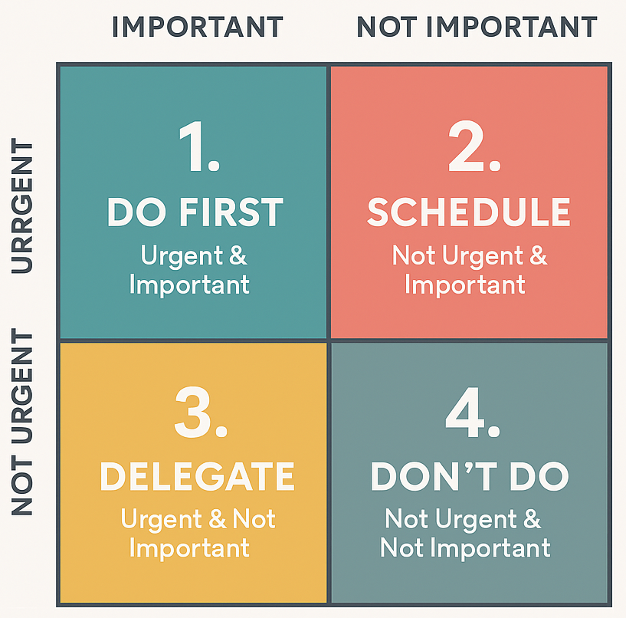
Eisenhower matrix example

Slide 135
Eisenhower prioritisation task
In pairs, complete the Eisenhower workplace task sheet.

Slide 136
Creating a table in PowerPoint
Open PowerPoint.
Start a new presentation.
Follow the demonstration and create a table of your own.

Slide 137
Creating an Eisenhower matrix in PowerPoint
Open PowerPoint and start a new presentation.
Create a slide with a colour-coded matrix. Add the content of the completed Eisenhower workplace task sheet.
Add a voiceover to the slide (you learned how to do this in an earlier lesson).

Slide 138
Eisenhower peer review
Watch and listen to the presentation.
Complete a peer review and complete the Eisenhower peer review sheet.
Pass the completed Eisenhower peer review sheet to the original pair.

Slide 139
Review the Eisenhower matrix feedback
What was one thing you did well?
What was one thing you could improve?

Slide 140
Can you use these techniques?
Remember when you realised you had unproductive time on your Industry Placement.
How can you use Pomodoro and Eisenhower techniques to be more productive?

Slide 141
Homework-lesson 7
Put into practice the new techniques when on Industry Placement or when working.
Keep a record of how the techniques have been applied.

Slide 142
Lesson 8
Collaborative decision making

Slide 143
Lesson 8 aim
Be able to collaborate in a team to carry out tasks.

Slide 144
Were you more productive?
How did you get on putting your new techniques into practice?
Give one example of how you used a technique to improve your own productivity.
Give examples of any difficulties encountered with the use of the techniques.
Input these into the Collaborative wall.

Slide 145
Recap prior learning
Organic.
Inorganic.
SWOT.
PESTLE.
SMART.

Slide 146
Using evidence to justify decision
When justifying, make sure you show or prove that something is reasonable, right, or necessary
You do this by providing good reasons or evidence to support an action, decision, or belief.

Slide 147
Ideas for the strategic direction
Individually review the Clothing Company SWOT and PESTLE analyses provided.
Produce ideas for the strategic direction of the company.
Set at least one SMART objective related to those ideas.
Justify the idea, drawing on evidence from the SWOT and PESTLE.

Slide 148
Critique the idea
Write your one idea and an evidence justification using one SMART objective.
Pass to another learner.
Critique the idea, focusing on the quality of the justification. Can you see any problems or issues to be considered?
Now pass to the next learner.

Slide 149
Collaboration
Collaboration is when individuals or teams work together to achieve a shared goal by combining skills, knowledge, and resources.

Slide 150
Key ideas in collaboration theory
Shared goals - everyone works towards a common outcome.
Communication - clear and open exchange of ideas is essential.
Collective problem-solving - groups generate better solutions together.

Slide 151
Benefits of collaboration
Improves creativity and innovation.
Increases efficiency and productivity.
Supports learning from others’ perspectives.

Slide 152
Race across 100 miles task
One person in your group will be the Observer.
Work out the logistics of travelling 100 miles between two points (you will be told which two points).
The Observer notes when they see explicit examples of collaboration.
The group will total the cost and time spent.

Slide 153
How did you do?
How much money did you spend?
How long did it take to travel between the two points?

Slide 154
Observer feedback
Feedback examples of collaboration observed.

Slide 155
Apply your collaborative skills
Now work in groups.
Go back to the Clothing Company SWOT and PESTLE analyses.
Discuss the ideas you produced individually. Collaboratively agree on three ideas to take forward. Set at least one SMART objective for each idea.
Justify with evidence.

Slide 156
Clothing Company peer review
Pass your completed outputs to a peer group.
Review what you have been given and complete the Peer review sheet.

Slide 157
Did collaboration improve ideas?
Did you find it better to work collaboratively, or were your individual ideas better?

Slide 158
Answer the question
A business introduces a new project management system to improve team efficiency. Teams are expected to work collaboratively when planning tasks, sharing information, and making decisions about priorities.
Question
Evaluate the effect of collaboration on decision-making within teams.

Slide 159
Lesson 9
Planning for growth

Slide 160
Lesson 9 aims
Understand how a SWOT and PESTLE analysis can be used to develop growth strategies.
Demonstrate how to produce SMART objectives, a Gantt chart and an Outlook calendar of activities.

Slide 161
BrewCo Coffee Ltd. case study
Individually read the case study.
Is there anything in there that is not clear?

Slide 162
BrewCo Coffee Ltd. growth strategies
Work in groups.
Discuss the key points highlighted in the case study, and which growth strategies would be appropriate for BrewCo Ltd
Choose three growth strategies and write a SMART objective for each.
Complete the BrewCo Coffee Ltd growth strategies activity.

Slide 163
Peer review of growth strategies
Pass your BrewCo Coffee Ltd. growth strategies to a peer group.
In your groups, discuss the completed materials.
Complete the BrewCo Coffee Ltd. peer review sheet.
Give the completed peer review to the original group.

Slide 164
Review the feedback
In your groups, read through the feedback on the BrewCo Coffee Ltd. peer review sheet.
Discuss if any changes need to be made to;
The growth strategies.
The rationales.
The SMART objectives.
Hand everything in.

Slide 165
Plan to achieve an objective
Continue in your groups.
Select one of your SMART objectives.
Discuss how BrewCo Ltd can achieve the objective.
Decide the actions needed, the sequence to follow and any dependencies that will arise.

Slide 166
Create a Gantt chart for the objective
Work individually.
Open a new workbook in Excel.
Create a Gantt chart using information from the discussion you had in your group.
Upload the completed spreadsheet for teacher comments.

Slide 167
BrewCo Coffee Ltd administration task
Work in groups.
Read the BrewCo Coffee Ltd. administration task.
Discuss the actions needed to complete the task as set out in the case study. Sequence the tasks and determine any dependencies.
Use the information in the case study to help.

Slide 168
Create an Outlook calendar for the administrative task
Work individually.
Open Outlook and set up a new workday.
Input into your calendar the plans for the working day discussed with your group.
Upload for the teacher to review.

Slide 169
Next steps
In the next lesson, you will get a new case study and will propose growth strategies, write SMART objectives and produce a Gantt chart. You will do this individually.
Before then, you will get feedback on what you have done today.
Review your feedback. Ask if there is anything you do not understand, then ask. Prepare your notes so that you can use them to help you if needed.

Slide 170
Lesson 10
Consolidation

Slide 171
Lesson 10 overview
In this lesson, you will analyse a case study.
You will carry out a SWOT and PESTLE analysis and use this to develop ideas for growth strategies, writing them as SMART objectives.
You will then create a Gantt chart to show how to achieve one of these objectives.
You will peer review the work of others.

Slide 172
Case study introduction
You have been given a case study – North East Link Logistics Ltd.
Read the case study carefully.
As you read:
Identify any terms you do not understand.
Highlight key points.
Ask for clarification where needed.

Slide 173
Initial task
Individually carry out a SWOT and PESTLE analysis for the organisation.
Use the information in the case study, although you may have to do some research.
Based on your analysis, propose growth strategies for the business. Give reasons for your proposals.
Select three strategies and produce a SMART objective for each.

Slide 174
Turning objectives into a plan
Review your SMART objectives and select one that you can turn into a plan.
Decide what actions are needed and the sequence to follow. Identify any dependencies in your plan.
Produce a Gantt chart to visually represent the plan.

Slide 175
Peer assessment activity
Upload the Gantt chart for peer review. Pass your SMART objectives, proposed growth strategies and rationale to a peer for review.
Review the submitted outputs. Complete the North East Link Logistics Ltd. peer review sheet.

Slide 176
Self-assessment
Read the peer feedback carefully.
Complete the Self-assessment section of the peer review form.
Make one change to your outputs.

Slide 177
Submission
Submit the following to the teacher:
The case study document with the growth strategies and SMART objectives.
Your Gantt chart.
The completed peer assessment checklist and your self-assessment.

Slide 178


Acknowledgements
PRODUCED BY
FUNDED BY
Stockton Riverside College has produced this resource on behalf of the Education and Training Foundation
This programme is funded by the Department for Education
ET-FOUNDATION.CO.UK

