Slide 1


Lesson 6:
Speed
Objectives
Convert between units of time (seconds, minutes and hours)
Understand meaning of average speed and the factors that can affect average speed in real-life contexts
Solve problems that involve distance, time and speed

Slide 2


Introduction
Alicia says 1 hour and 6 min is 1.6 hours.
Alicia is not correct.
Can you explain why?
÷2
÷5
Min
Hour
1 h and 6 min
= 1 h + 0.1 h
= 1.1 h
60
30
6
66
÷60
1
0.5
0.1
1.1
÷2
÷5
Notes:
Tutor guidance:
Ask learners to share their methods. In how many ways can they get 6 from 60? Can they do it in one step? If they keep halving, will they get 6?
Discuss the importance of multiples and factors here. If there are no common factors to jump to, what would you do?
Guide learners to express 5 min and 1 min in hours, and then work out the hours taken for 6 min. Discuss additive links.
3. Ask learners what they notice about the relationship between numbers, between columns and between rows. Discuss both vertical (between min and h) and horizontal (min to min or h to h) relationships in ratio table. Emphasise that ratio between minutes and hours remains the same for each column.
4. Learners do not need to draw arrows and write the multiplication and division operations between columns but encourage them to do so at the start to avoid making mistakes.

Slide 3

Speed as a rate
KEY IDEA
Speed can be thought of as the distance travelled per unit of time. It is the ratio of distance to unit time.

Slide 4
DISCUSS
Speed as a rate
For example, if we say that a car travels at a speed of 100 miles per hour, then it means it covers 100 miles in one hour.
Miles and hours are different units.
Distance (miles)
Time (h)
100
1
Notes:
Tutor guidance:
Ask learners how many hours it will take to travel 200 miles, 150 miles, 25 miles and 125 miles at 100 mph.
Vary by redrawing the ratio table with time in min.
Discuss when to use min instead of hours in ratio table.

Slide 5
DISCUSS
Speed as a rate (2)
Example 1
A car travels 10 miles in 2 hours.
Calculate the average speed of the car in miles per hour.
÷2
Distance (miles)
Time (h)
10
5
5 miles in 1 hour
2
1
= 5 mph
÷2
Notes:
Remind learners that speed is distance travelled per unit of time. ‘Miles per hour’ means the number of miles travelled in one hour.

Slide 6
DISCUSS
Speed as a rate (3)
Example 2
A car travels 10 miles in 12 minutes.
Calculate the average speed of the car in miles per hour.
÷2
×10
Distance (miles)
Time (min)
10
5
50
12
6
60
50 mph
÷2
×10
Notes:
Point out that time is in min in the ratio table and not in hours. Remind learners that since they need to give the answer in mph, they should convert minutes to hours and work out the distance travelled for 60 min.

Slide 7
DISCUSS
Speed as a rate (4)
Example 3
A car travels 65 miles in 13 minutes.
Calculate the average speed of the car.
÷13
×60
Distance (miles)
Time (min)
65
5
300
13
1
60
300 mph
÷13
×60
Notes:
Point out that there are no common factors of 13 and 60.
Introduce the unitary method (dividing the smaller number by itself to get 1).

Slide 8
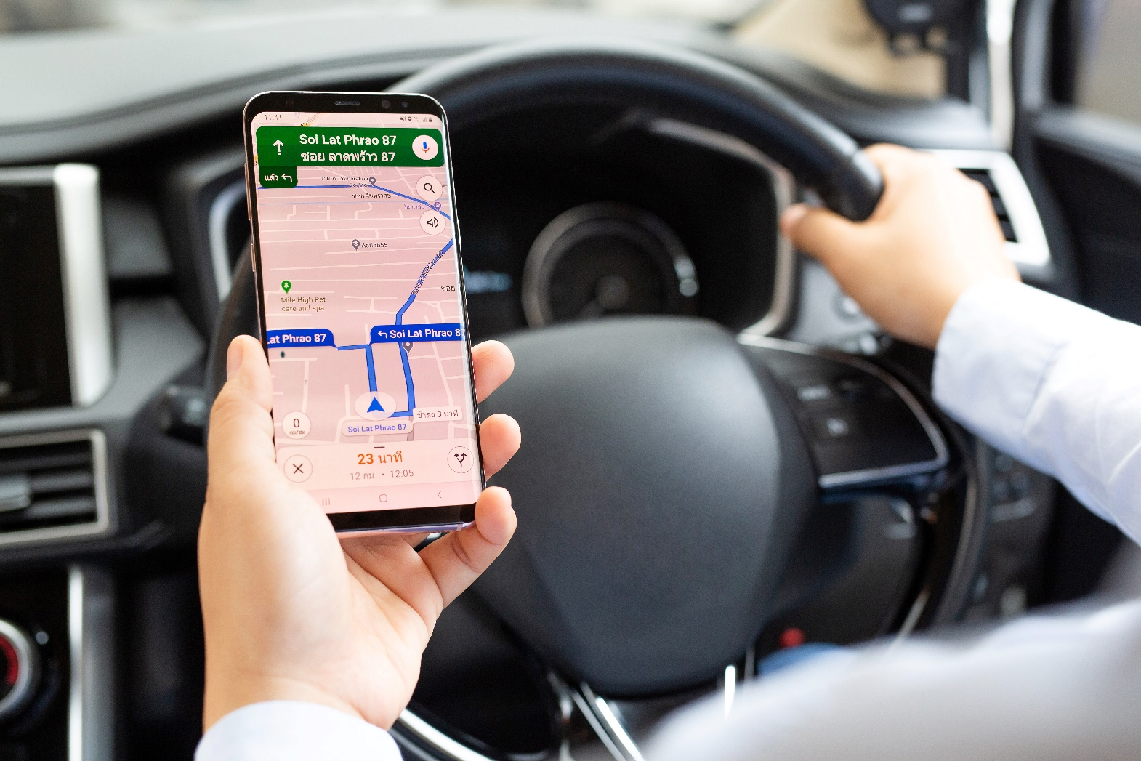
Finding average speed
EXPLORE
Let’s compare average walking, driving and cycling speeds using data from a map.

Slide 9




Online maps – no internet
YOUR
TURN
Handout
available
Use the information from the maps in the handout.
Calculate the average speeds for driving, walking and cycling for the journey.
Notes:
Use this slide if learners do not have access to Wi-Fi and/or mobile devices. Provide learners with the ‘Online maps (no internet)’ handout. Ask them to work in pairs to find the average speeds and answer the questions.

Slide 10
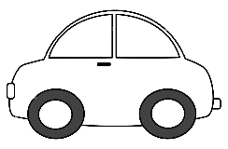


Online maps
YOUR
TURN
Handout
available
Use a map application to find the distance from this centre to [a local landmark].
Find the distance and time needed for the journey by driving, by walking and by cycling.
Calculate the average speeds for driving, walking and cycling for the journey.
Notes:
Use this slide if learners have access to Wi-Fi and their mobile devices. Provide learners with the ‘Online maps’ handout.
Tutors should try to select a local landmark which gives an integer distance and time which is a factor of 60 (for example, 3 miles in 12 mins). Edit the slide to replace the text ‘[a local landmark]’ with the name of the chosen landmark. Provide learners with the ‘Online maps’ handout. Ask them to work in pairs to find the average speeds and answer the questions.

Slide 11
Answers: Online maps – no internet (1)
a)
Distance (miles) | 1.3 | 2.6 | 5.2 | 7.8 | 15.6
Time (min) | 5 | 10 | 20 | 30 | 60
15.6 mph
b)
Distance (miles) | 30 | 10 | 5 | 1 | 1.3
Time (min) | 60 | 20 | 10 | 2 | 2.6
2.6 min
Notes:
Ask learners to share how they calculated the average speeds.
Some may have used a multiplicative method; others may have used addition with multiplicative methods e.g. find 5 and then 10 and add both answers to find 15. Look out for incorrect additive strategies e.g. if 1 is 4 then 8 is 11 and not 32 (4 + 7 and not 4 × 8). Tutors can model using the ratio table with learners’ methods. An important discussion will be around which methods they found the most efficient, even if it was not the one they initially used.
Use questions (d), (e), (g) and (h) for discussion before showing learners the suggested answers.

Slide 12
Answers: Online maps – no internet (2)
c)
Distance (miles) | 1.2 | 0.6 | 0.3 | 3
Time (min) | 24 | 12 | 6 | 60
3 mph
d) Why is the distance for walking different from the
distance for driving?
The walking route is different from the driving route.
e) A person’s average walking speed is thought to be 3–4 mph.
Compare this to the average speed found in c).
The average speed found in c) is in the lower end of this range.

Slide 13
Answers: Online maps – no internet (3)
f)
Distance (miles) | 1.5 | 0.5 | 5 | 10
Time (min) | 9 | 3 | 30 | 60
10 mph
g) Does a car, a bicycle or a person walking usually travel at the
same speed for an entire journey?
Why?
No. For example, a car or bicycle might slow down and stop in traffic. A person might slow down while walking.
h) What does ‘average speed’ mean?
The distance you travel in a unit of time.

Slide 14



Pizza time
YOUR
TURN
Handout
available
Use the information on the three cards to find out which pizza shop delivers on time.
Use ratio tables to show your work.
Pizza on
the Go!
Pizza HQ
Pizza Perfect
Notes:
Provide learners with the ‘Pizza time’ handout and ask them to answer the questions. This task will not be scaffolded as the previous one and learners will be required to extract the necessary information to create ratio tables in order to answer the questions.
Use the ‘Pizza time scaffolded’ handout if learners require scaffolding.

Slide 15
Pizza time answers (1)
Pizza on the Go!
Pizza HQ
Distance (miles) | 25 | 2.5
Time (min) | 60 | 6
Distance (miles) | 0.375 | 1.5
Length (in.) | 1 | 4
The distance is 1.5 miles.
6 minutes after 18:51 is 18:57.
The driver arrives at 18:57.
Distance (miles) | 18 | 3 | 1.5
Time (min) | 60 | 10 | 5
5 minutes after 18:47 is 18:52.
The rider arrives at 18:52.

Slide 16
Pizza time answers (2)
Pizza Perfect
Distance (miles) | 12 | 1 | 0.8
Time (min) | 60 | 5 | 4
4 min + 10 min = 14 min
14 min after 18:40 is 18:54.
The cyclist arrives at 18:54.
Pizza on the Go! will deliver the pizza closest to 19:00.

Slide 17
Pizza time challenge answers
Handout
available
Pizza on the Go!
Pizza Perfect
Temperature drop (°C) | 1 | 3
Time (min) | 2 | 6
Temperature drop (°C) | 1 | 7
Time (min) | 2 | 14
90°C – 3°C = 87°C
90°C – 7°C = 83°C
Pizza HQ
Temperature drop (°C) | 1 | 0.5 | 2.5
Time (min) | 2 | 1 | 5
90°C – 2.5°C = 87.5°C

Slide 18
DISCUSS
Pizza time
What must food delivery companies consider when completing deliveries to their customers?
Notes:
Example answers:
Profit – it may not be worth it for a company to deliver too far away from their shop, as it takes too much time and costs too much (in terms of paying workers or fuel).
The food may get too cold if the delivery location is too far away.

Slide 19
Practice question (1)
PRACTICE QUESTION
Worksheet
available
Emily drives 186 miles in 3 hours.
What is her average speed?
…………………… mph
÷3
Distance (miles)
Time (h)
186
62
62
3
1
÷3

Slide 20
Practice question (1)
PRACTICE QUESTION
Worksheet
available
Sarah drives at an average speed of 58 mph for 4 hours.
How many miles does Sarah drive?
…………………… miles
×4
232
Distance (miles)
Time (h)
58
232
1
4
×4

Slide 21

Practice question (2)
PRACTICE QUESTION
Worksheet
available
Nimer was driving to a hotel.
He looked at his Sat Nav at 13:30.
Nimer arrived at the hotel at 14:48.
Work out the average speed of the car from 13:30 to 14:48.
You must show all your working.
…………………… mph
Time taken = 78 min
÷78
x60
Time | 13:30
Distance to destination | 65 miles
Distance (miles)
Time (min)
65
$$\frac{5}{6}$$
50
78
1
60
÷78
x60
50
Notes:
Ask learners whether they have used a different approach to that used prior to the lesson when solving proportion problems. How has their thinking changed? What have they learned about multiplicative structure?

Slide 22
Practice question (3)
PRACTICE QUESTION
Worksheet
available
Lara is a skier.
She completed a ski race in 1 minute 54 seconds.
The race was 475 m in length.
Lara assumes that her average speed is
the same for each race.
(a) Using this assumption, work out how long Lara
should take to complete a 700 m race.
Give your answer in minutes and seconds.
………… minutes ………… seconds
÷ 475
×700
Distance (metres)
Time (seconds)
475
1
700
114
0.24
168
÷ 475
×700
2
48

Slide 23
Practice questions
PRACTICE QUESTION
Worksheet
available
Lara’s average speed actually increases the further she goes.
(b) How does this affect your answer to part (a)?
…………………………………………………………………………
…………………………………………………………………………
Lara should take less time to complete the race.

Slide 24
Lesson review:
Speed
Objectives
Convert between units of time (seconds, minutes and hours)
Understand meaning of average speed and the factors that can affect average speed in real-life contexts
Solve problems that involve distance, time and speed
Suggested further steps/areas to work on
Interpret and use distance−time graphs

Slide 25
Lesson 6:
Credits
Photo acknowledgements
Shutterstock.com: Vectorfair.com, Kamonwan Wankaew
Text acknowledgements
Pearson Education Ltd: Pearson Edexcel GCSE (9-1) In Mathematics (1MA1) Foundation (Calculator) Paper 2F, Q9 June 2018
Pearson Education Ltd: Pearson Edexcel GCSE (9-1) In Mathematics (1MA1) Foundation (Calculator) Paper 3F, Q27 November 2019
Pearson Education Ltd: Pearson Edexcel GCSE (9-1) In Mathematics (1MA1) Foundation (Calculator) Paper 3F, Q24 November 2018

