Slide 1


Lesson 19:
‘Benchmark’ percentages and equivalent fractions and decimals
Objectives
Work with equivalent fractions, decimals and percentages using multiple representations
Use benchmark percentages and bar models to solve non calculator percentage problems
This is a non calculator lesson

Slide 2





Is Yaima correct?
$$\frac{1}{2}$$
On this card, the fractions, decimal and percentage all have the same value.
$$50\%$$
$$0.05$$
$$\frac{5}{10}$$
Yaima
Yaima is not correct. Why?
How do you know this?
Notes:
Discuss with the learners. Guide them to see that 0.05 is not equal to the other three quantities on the card. Ask learners to suggest what number should be on the card instead of 0.05 so that all the quantities have the same value. (0.5)
Make the link between $\frac{5}{10}$ and 0.5 in terms of place value.

Slide 3
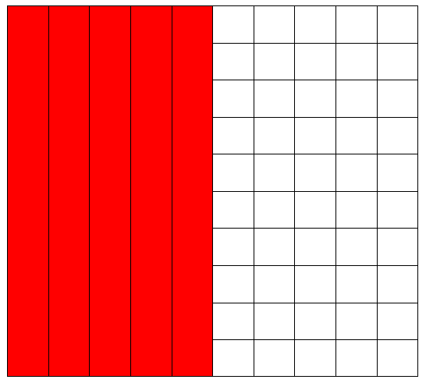
Matching fractions, decimals and percentages
DISCUSS
What fraction does the coloured part represent?
Notes:
Ask learners to suggest what fraction the coloured part of the picture shows. Accept all variations, including $\frac{50}{100}$ and $\frac{5}{10}$ .
Ask learners what percentage of the picture is coloured.
Ask: If 50% is 0.5 then what is 10 % as a decimal/fraction? What is 30% etc.

Slide 4
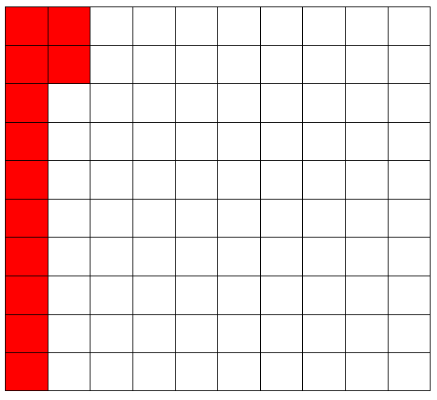
DISCUSS
Matching Fractions, Decimals and Percentages
What fraction does the coloured part represent?
What are some equivalent fractions for your answer?
Notes:
Ask learners what the coloured part of the diagram represents. Encourage all variations ($\frac{12}{100}$ , $\frac{3}{20}$ , $\frac{6}{50}$ etc.)
Ask learners what percentage of the picture is coloured. How do they write this percentage a decimal?

Slide 5
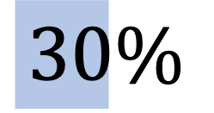





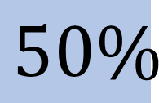

Which of these are true?
DISCUSS
$$\frac{1}{2}$$
$$\frac{1}{3}$$
=
$$50\%$$
=
$$30\%$$
$$\frac{1}{10}$$
$$\frac{1}{5}$$
$$0.01$$
=
$$20\%$$
=
Which of these are true?
Explain why, using diagrams or otherwise.
Notes:
Encourage learners to discuss in pairs. Ask learners to write their explanations on mini whiteboards.

Slide 6
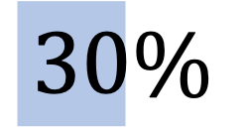





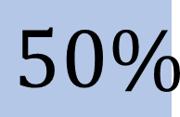

Answers: Which of these are true?
DISCUSS
$$\frac{1}{2}$$
$$\frac{1}{3}$$
=
$$50\%$$
=
$$30\%$$
$$\frac{1}{10}$$
$$\frac{1}{5}$$
$$0.01$$
=
$$20\%$$
=
Notes:
Ask some pairs to share their explanations.

Slide 7


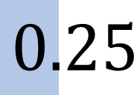

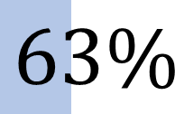
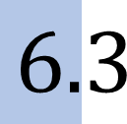
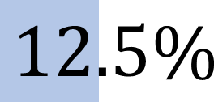
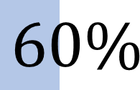
DISCUSS
Which of these are true? (2)
$$\frac{1}{4}$$
=
$$63\%$$
=
$$6.3$$
$$0.25$$
$$\frac{1}{8}$$
$$\frac{3}{5}$$
=
=
$$12.5\%$$
$$60\%$$
Which of these are true?
Explain why, using diagrams or otherwise.
Notes:
Encourage learners to discuss in pairs. Ask learners to write their explanations on mini whiteboards.

Slide 8
DISCUSS
Answers: Which of these are true? (2)
$$\frac{1}{4}$$
=
$$63\%$$
=
$$6.3$$
$$0.25$$
$$\frac{1}{8}$$
$$\frac{3}{5}$$
=
=
$$12.5\%$$
$$60\%$$
Notes:
Ask some pairs to share their explanations.

Slide 9




EXPLORE
Card sort – matching fractions, decimals
and percentages
Handout
available
Put four triangles to make a square card.
Each group of four triangles should contain equivalent fractions, decimals and percentages
$$50\%$$
$$\frac{10}{20}$$
$$\frac{50}{100}$$
0.5
9
Notes:
If learners are struggling, encourage them to use to grids or bar models to help them compare the values.

Slide 10
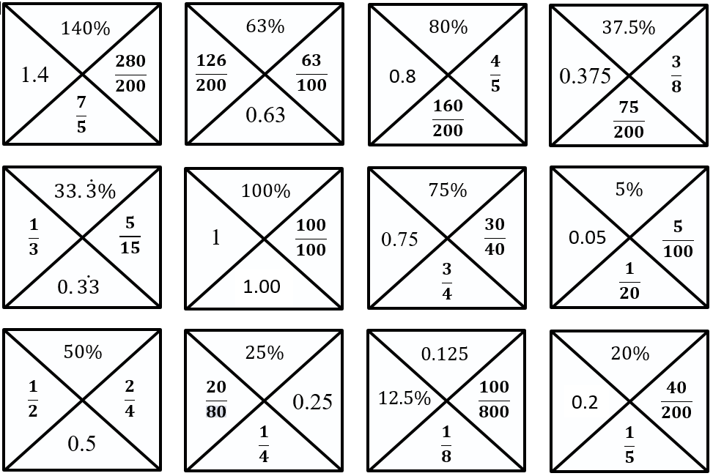
DISCUSS
Card sort – answers
10

Slide 11





EXPLORE
Add to make 1
$$\frac{1}{5}$$
12.5%
0.01
$$\frac{3}{4}$$
20%
$$\frac{1}{2}$$
10%
One quarter
$$\frac{1}{20}$$
0.5
25%
0.15
$$\frac{1}{3}$$
5%
75%
One tenth
You may use each fraction, decimal and percentage more than once, and add in new ones.
Find different combinations of fractions, decimals and percentages that add up to one.
Represent the combinations using a bar model.
Notes:
Ask learners to work on the activity in pairs. Provide each pair with flip chart paper and marker pens.
Model some examples from the class. Identify any challenging combinations or any that allow you to explore misconceptions.
Learners can use all of the quantities multiple times to make 100% and add in more to make the total of 1.
Learners should be challenged to find as many different solutions as possible using all fractions, decimals and percentages.
Learners then represent their answers using bar models.

Slide 12
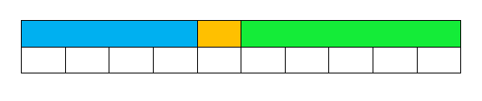
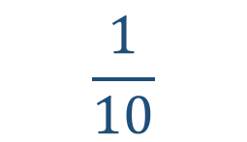
How many ways to make 1?
EXPLORE
40%
0.5
Make 1
$$\frac{1}{10}$$
Notes:
Bars for $\frac{1}{10}$ and tenths are shown to model an answer.
Encourage learners to apply variation when developing their own ideas.
Stretch and challenge
Ask learners could use at least one of each fraction/decimal/percentage and can create their own combinations with new fraction/decimal/percentage amounts.
Misconceptions
Learners do not understand place value and think that 0.9 is $\frac{9}{100}$ or that 0.15 is greater than 0.2.
Learners order fractions using only the numerator and do not grasp equivalence and think $\frac{2}{3}$ , $\frac{3}{5}$ , $\frac{4}{9}$ , $\frac{5}{8}$ are in order of smallest first.
Learners are unable to work out thirds and think one third is equivalent to 0.3
Learners are only able to use double and double again and do not know that 0.2 is $\frac{1}{5}$.
This activity allows for exploration of different outcomes, while helping to highlight common misconceptions with fractions/decimals/percentages .

Slide 13
DISCUSS
How many ways to make 1? (2)
40%
0.5
Make 1
$$\frac{1}{10}$$
Notes:
Ask groups to share some of the combinations they have come up with.
Identify complex combinations or combinations that draw out misconceptions.

Slide 14
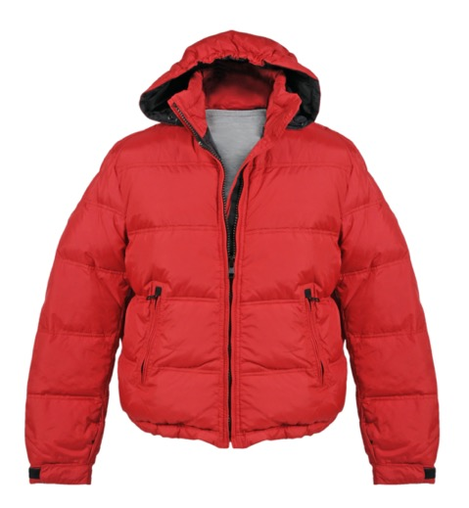
c
Percentages without a calculator
DISCUSS
A jacket is on sale with 20% off. The original price is £80.
What was the sale price for the jacket?
?
20%
8
8
8
8
8
8
8
8
8
8
£80
Answer = £80 -16= £64
Notes:
Tutors may model the question on the whiteboard.
Before showing the animations, ask learners how they can represent the question in a bar model.
What information does the question tell them? How would they show this on the bar model?
What is it that they are trying to find? How would they show this on the bar model?
How could the bar be divided up? Would they divide the bar into sections 10% or 20%? How many 20%s are there in 100%? How many 10%s?
What would be the money value of each section?
So what would be the discount? … and what would be the sale price of the jacket?

Slide 15
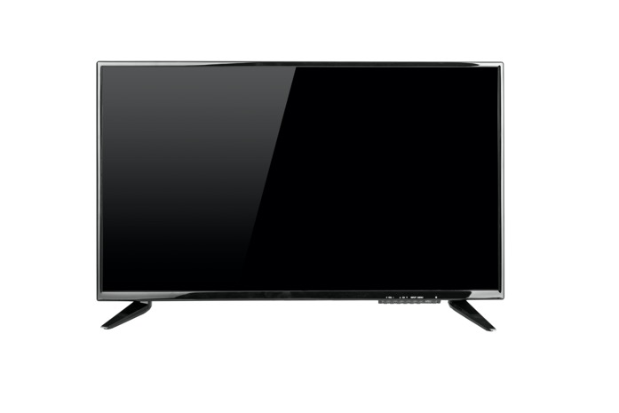
c
Percentages without a calculator
DISCUSS
A TV is on sale with 20% off. The sale price is £300.
What was the original cost of the TV?
Draw a bar model to show what you already know, and what you need to find out?
?
75
75
75
75
75
£300
20%
80%
Answer = £300 + £75= £375
Notes:
Tutors may model the question on the whiteboard.
It is important to show connections. Guide learners to see 20% is the same as $\frac{1}{5}$ .
Ask learners to label the bar.
What information does the question tell them? How would they show this on the bar model?
What is it that they are trying to find? How would they show this on the bar model?
How could it be divided up? What value does the whole bar represent?
The whole bar represents 100%. How many 20% are in 100? So, 20% is the same as $\frac{1}{5}$ .
How much is $\frac{1}{5}$ worth?
So how much has the TV been discounted by?
What is the original cost of the TV set?

Slide 16

c
Percentages without a calculator
DISCUSS
A TV is on sale with off. The sale price is £300.
What was the original cost of the TV?
Draw a bar model to show what you already know, and what you need to find out?
?
75
75
75
75
75
£300
$$\frac{4}{5}$$
Answer = £300 + £75= £375
Notes:
This slide shows the same question, except the 20% discount is now shown as 1/5 discount.
Ask learners to label the bar and work through the question.
How would it be divided up? What value does the whole bar represent? How much does it part represent.
Ask learners which section represents what they need to find.
The whole bar represents £300. How many 20% are in 100? So, 20% is the same as $\frac{1}{5}$ .
How much is $\frac{1}{5}$ worth?
What is the original cost of the TV set?

Slide 17
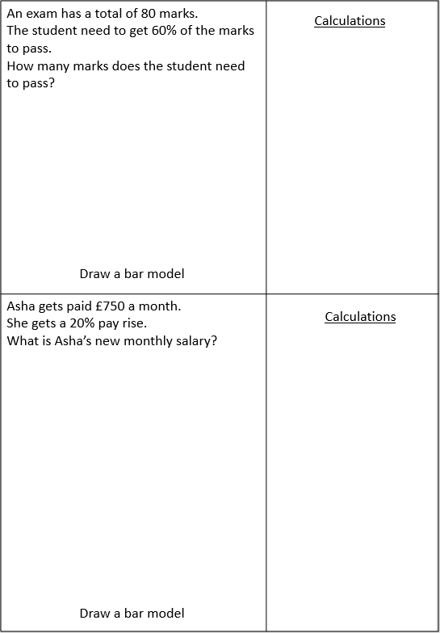
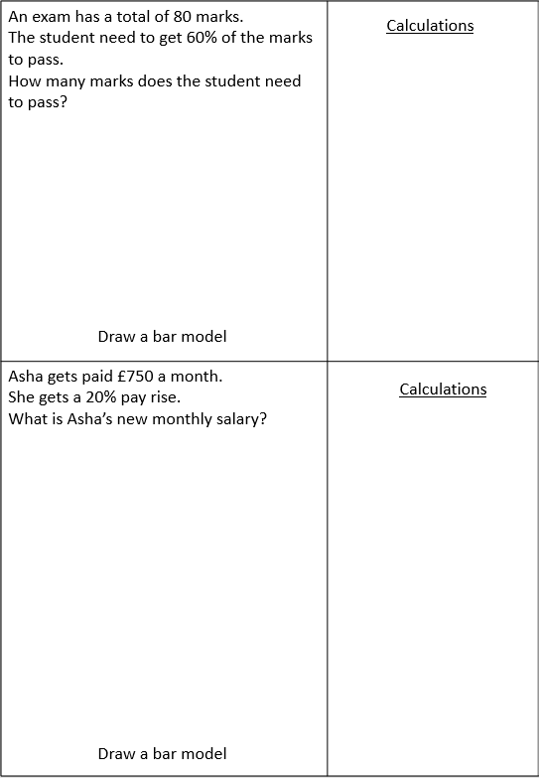
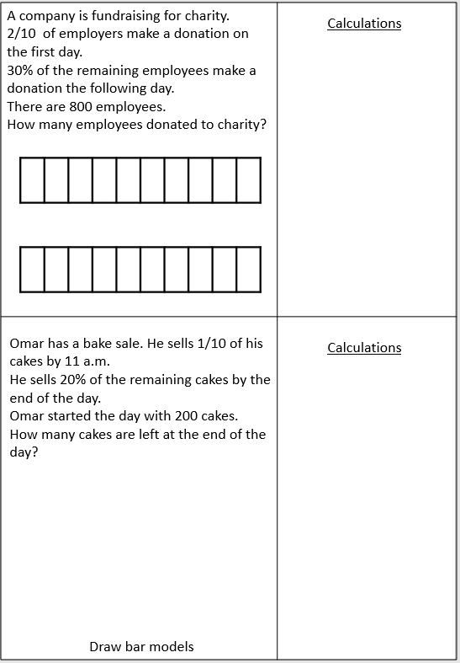
Problem-solving with bar models
YOUR TURN
Handout
available
Notes:
Provide each learner with a copy of the ‘Problem-solving with bar models’ handout. Learners can work individually or in pairs for peer support.
Encourage learners to think for themselves. Use probing questions, rather than showing them how to do it.

Slide 18

REVIEW
Problem-solving with bar models (a)
Jack saves 20% of his monthly wage.
Jack is paid £900 per month.
How much does Jack save each month?
80%
20%
£180
£180
£180
£180
£180
£900
Answer: £180
Notes:
Slides 18 to 24 show suggested bar models and solutions for the ‘Problem-solving with bar models’ handout.

Slide 19
REVIEW
Problem-solving with bar models (b)
At a school, 15% of the students were late to class at least once during the week.
There are 2500 students in the school.
How many students were late at least on once in that week?
85%
15%
£250
250
125
250
250
250
250
250
250
250
125
250
2500
Answer: 375 students
Notes:
Modelled answer for each question from handout 2

Slide 20
REVIEW
Problem-solving with bar models (c)
640 fans attended a local rugby match.
35% of the fans were women.
How many women attended the match?
65%
35%
32
£250
64
64
64
64
64
64
32
64
64
64
640
Answer: 224 women

Slide 21
REVIEW
Problem-solving with bar models (d)
The total marks for an exam was 80 marks.
A student needs to get 60% of the marks to pass.
How many marks does the student need to pass?
60%
40%
£250
8
8
8
8
8
8
8
8
8
8
80
Answer: 48 marks

Slide 22
REVIEW
Problem-solving with bar models (e)
Asha’s salary was £750 a month at first.
She gets a 20% increase in her salary.
What is Asha’s new monthly salary?
100% = £750
20%
£150
£150
£150
£150
£150
£150
120% = £900
Answer: £900

Slide 23
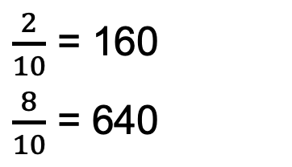
REVIEW
Problem-solving with bar models (f)
A company is collecting donations for charity.
of employees donate on the first day.
30% of the remaining employees donate the following day.
There are 800 employees in the company. How many employees donated to charity?
$\frac{2}{10}$ = 160
$\frac{8}{10}$ = 640
80
80
80
80
80
80
80
80
80
£250
80
30% = 192
70% = 448
£250
64
64
64
64
64
64
64
64
64
64
160 + 192 = 352
30%
70%
Answer: 352 employees

Slide 24

REVIEW
Problem-solving with bar models (g)
Omar has a bake sale. He sells of his cakes by 10 a.m.
He sells 20% of the remaining cakes by noon.
Omar started the day with 200 cakes.
How many cakes are left at noon?
$\frac{1}{10}$ = 20
$\frac{9}{10}$ = 180
20% = 36
80% = 144
20
20
20
20
20
20
20
20
20
20
18
18
18
18
18
18
18
18
18
18
20 + 36 = 56
200 – 56 =144
20%
80%
Answer: 144 cakes

Slide 25


PRACTICE QUESTION
REVIEW
Practice question (1)
Worksheet
available
Write $\frac{1}{4}$ as a percentage.
25%
Write 0.23 as a percentage.
23%
Write 0.4 as a percentage.
40%
Notes:
Learners can work through the questions on this slide independently, using the accompanying worksheet.
Alternatively, teachers can do this as a whole class activity, with learners writing answers on mini-whiteboards.

Slide 26
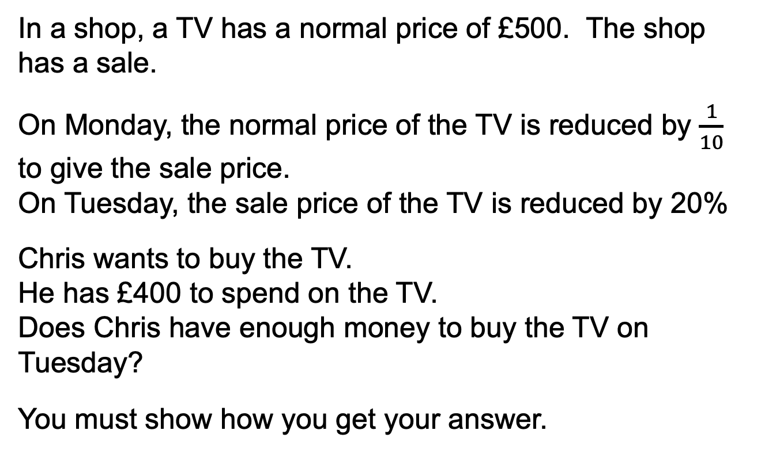
PRACTICE QUESTION
REVIEW
Practice question (2)
Worksheet
available
In a shop, a TV has a normal price of £500. The shop has a sale.
On Monday, the normal price of the TV is reduced by $\frac{1}{10}$ to give the sale price.
On Tuesday, the sale price of the TV is reduced by 20%
Chris wants to buy the TV.
He has £400 to spend on the TV.
Does Chris have enough money to buy the TV on Tuesday?
You must show how you get your answer.
Monday price = £450
Tuesday price = £360
Yes, Chris has enough money
Notes:
Use this question as an extension, if time allows.
When taking feedback, make sure learners explain their methods before revealing the answer.

Slide 27
Lesson review:
Fractions, decimals and percentages
Objectives
Work with equivalent fractions, decimals and percentages using multiple representations
Use benchmark percentages and bar models to solve non calculator percentage problems
Suggested further steps/areas to work on
Fraction, decimal and percentage equivalence in shapes

Slide 28

Lesson 19:
Credits
Text acknowledgements
Pearson Edexcel 1MA1/2F Level 1/Level 2 GCSE (9−1) Mathematics Paper 2 (Calculator) Foundation Tier November 2020, Pearson Edexcel 1MA1/2F Level 1/Level 2 GCSE (9 – 1) Mathematics Paper 2 (Calculator) Foundation Tier November 2019, Pearson Edexcel 1MA1/1F Level 1/Level 2 GCSE (9−1) Mathematics Paper 1 (Non Calculator) Foundation Tier November 2020
Photos
Shutterstock.com: Karkas, Sergey Slonitskyi,

