Slide 1


Route Exchange Network – Agric, Environmental & Animal
ETF – 4.3.26

Slide 2
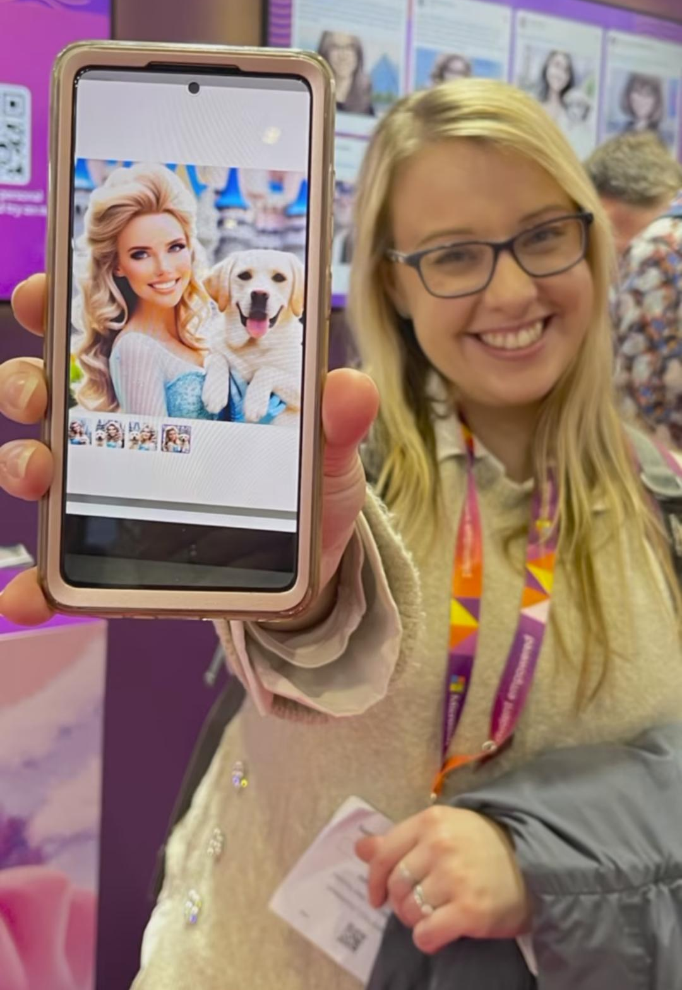
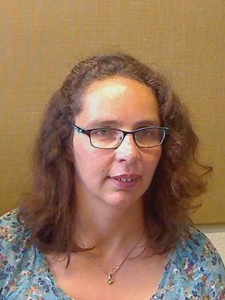
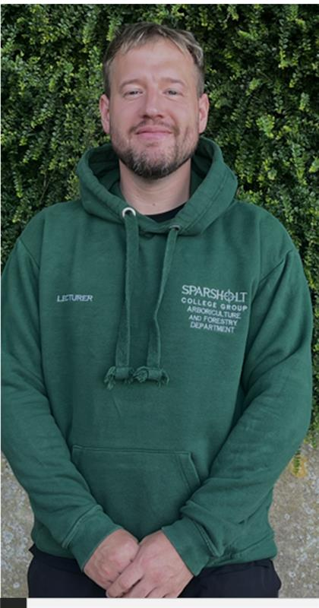
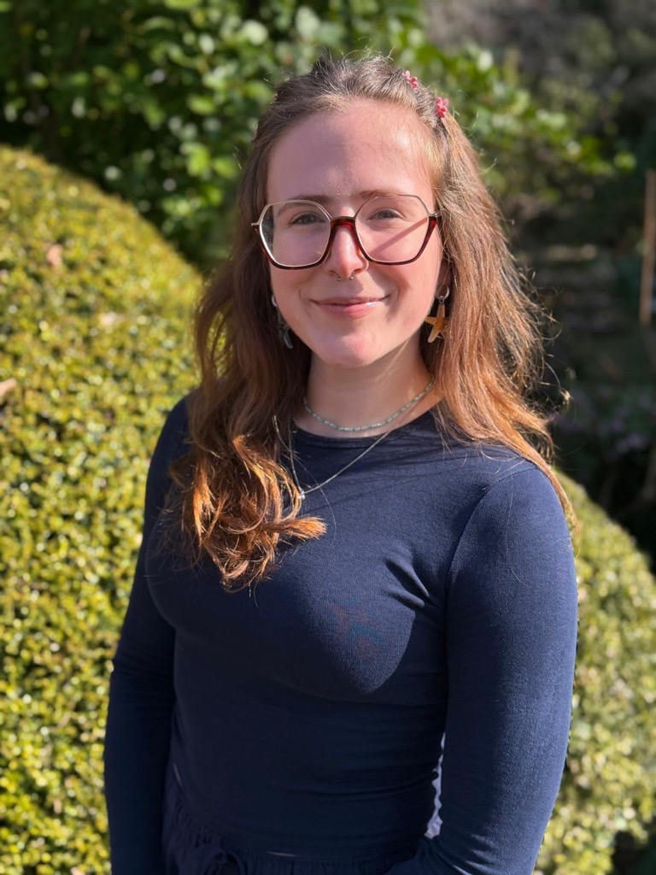
About Us
Kat Luck – Digital and Innovation Manager
Anna Massey – DigiEd Technologist
Nick Smith - Course coordinator for Level 3 Forester and Arboriculture (T-Level YR 1&2)
Ella Harder - Animal T-Level Year 1 Curriculum Lead

Slide 3
T Level Course Offers
Sparsholt Campus
Tree & Woodland
Livestock Production
Crop Production
Land Based Engineering
Ornamental Horticulture
Animal Care and management
Animal Care and Science
Andover Campus
Automotive: Maintenance Installation and Repair for Light and Electric Vehicles
Management and Administration
Onsite Construction (Bricklaying)
Onsite Construction (Carpentry)
Digital Production, Design and Development
TV Media Broadcast and Production
Education
Design and Development for Engineering and Manufacturing
Health (Adult Nursing)

Slide 4

Environmental
Ornamental Horticulture and Landscaping.
Trees and Woodland Management – Arboriculture and Forestry.
  2 years; common core and core 1st year – all theory.
  Occupational specialism & ESP in the 2nd year.

Slide 5
What has worked well
Teaching core and common core to Trees & Woodland and Horticulture learners. They have benefited from being combined. Utilising staff from both departments to teach Common core and core.
Ensure learners use the required file names for C&G when saving their ESP tasks and written Occupational Specialism tasks saves so much time.
Ensuring time is given for learners to check the completion of their ESP and Occ Sp theory tasks before uploading in terms of page numbers, correct file names, and header document completion.
Making the most of the assessment window and beginning assessments at the very start of the window to allow a buffer of a few weeks before the upload date in May to ensure everything has been triple checked.

Slide 6
What has worked well cont.
Preparation and introduction of ESP in Year 1 is vital if ESP assessments are not until Year 2. Utilising the library for workshops on referencing, information searches and sources of information have helped learners. Building in tasks using citations and report writing skills in Year 1 also.
Completing and uploading work as we go for ESP and Occ Sp to ensure it is not all end loaded saves a huge amount of time.
Building in mock exam questions and the end of unit tests to reinforce learning and support with revision has been effective.
Resources provided at spot on, working through methodically and sequency through the units.
Using the C and G worksheet and resources, useful for revision and mock test for practicing.

Slide 7
What we would like to develop
Building more of the occupational specialism requirements into the Year 1 so that when it comes to Year 2 more time can be spent refreshing rather than learning from scratch.
Provide employers with an opportunity to support their learners with some elements of the occupational specialism during Year 1 and Year 2.
Moderator recommendation – staggered starts but we were going from C and G ratio for the task.

Slide 8
Agric
Overview
2-year technical qualification
Combines theory, practical skills & industry placement
Prepares students for employment, apprenticeships or HE
Year 1 – Core (Theory-Based)
Classroom-based learning
Scientific principles (animal & plant biology, soils)
Year 2 – Occupational Specialism
ESP (Employer Set Project)-Assessed in Autumn term
Livestock OS Assessments- Practical and written assessments- Delivered January – May
Crop OS Assessments
2 seasonal blocks:
September- November
January-May
Additional Key Elements
Minimum 315-hour industry placement
Practical competency development
Assessment – 2 External exams in June

Slide 9
What has worked well
Industry Placement (315+ hours)
Real workplace experience
Improved employability skills
Strong employer feedback
Applying Skills in Occupational Specialism (OS)
Learners applying theory to practical tasks
Clear link between classroom learning and farm practice
Stronger understanding through real scenarios
Growing Confidence & Competence
Increased independence in practical tasks
Improved decision-making skills
Trips & Industry Engagement
Farm visits and specialist units
Guest speakers from industry
Exposure to current industry practices & technology

Slide 10
What we would like to develop
Earlier Integration of Theory & OS
Strengthen links between Year 1 theory and Year 2 specialism
Industry Placement Expansion
Broaden range of placement providers
Increase exposure to specialist enterprises (e.g. dairy tech, precision farming)
Develop stronger employer mentoring
Assessment Preparation
Earlier familiarisation with OS assessment criteria
Mock practical assessments
Seasonal Crop Planning
Enhance planning for seasonal OS crop blocks
Increase crop variety exposure where possible

Slide 11
Animal
2 year course
1st year.
Common core and core pathway exams, and the summer ESP series.
We link OS for 5 hours with our behaviour learners with practical sessions and behaviour lessons.
5 hours with our science students for a mix of animal practical's and lab practical's'.
2nd year.
OS Research project, synoptics and knowledge test (science pathway only)
OS teaching up until 12th of January

Slide 12
What worked well
Holistic teaching
Industry involvement/engagement
Students confidence has grown
OS has improved theory and practice link
Lab practicals' for science students
Sitting ESP in the first year

Slide 13
What we would like to develop
More OS teaching in the first year
Improve OS assessment timetable logistics – large cohort can make it complicated
Behaviour pathway lessons after OS assessments

Slide 14
Practical assessments
Cameras easy to use!
Be aware of surrounding sounds. Do not schedule practical's in surrounding rooms/use microphone muffler
Be aware of time it takes to upload and rename files
Notes:
Sound: Cameras pick up more than you think. Make others aware you are doing an assessment that is recorded.
Timing: Give assessors extra admin time! Uploading and renaming videos and pictures takes longer than you think! Have extra SD cards so if the camera is needed for both upload and recording this can be done at the same time.

Slide 15
Recordings
Curriculum
Easy to use
Durable, ideally water resistant
Straight forward downloading
Long battery life
DigiEd/I.T
No split files
Multiuse
Compatibility
File size

Slide 16
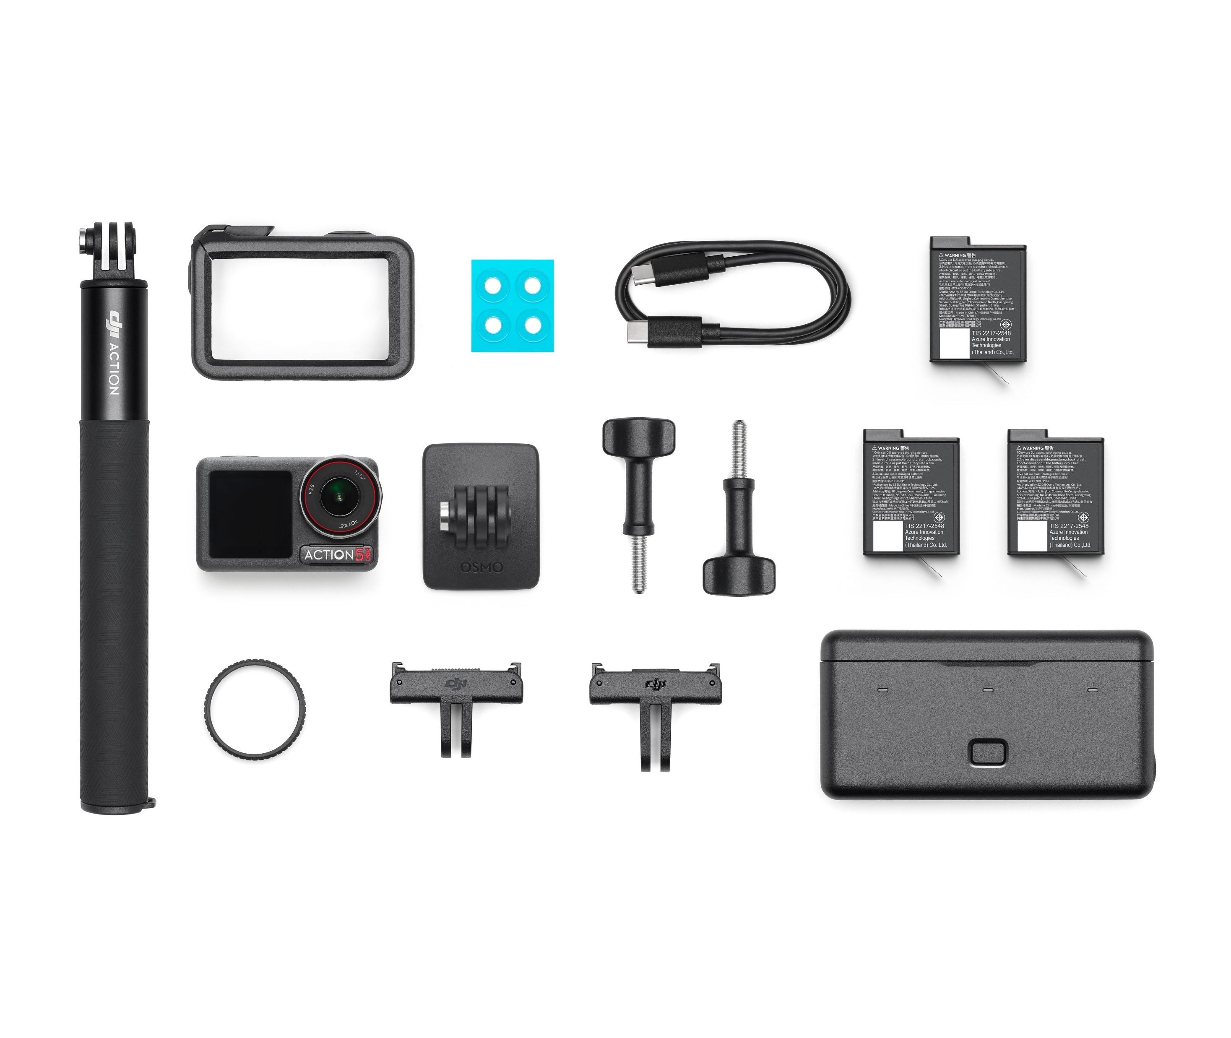
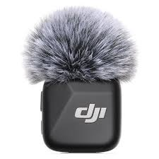
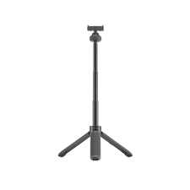
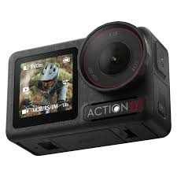
What we got
DJI Osmo Action 5 Pro Adventure combo
DJI Osmo Action Mini Extension Rod
DJI Mic Mini Transmitter
256 MicroSD Extreme Pro Card
UCB C Charging Plug

Slide 17
Implementation
DigiEd/I.T testing
Curriculum training
On the day support
Follow up support
Cameras kept in DigiEd

Slide 18

File Compression
File size for upload – max 2.5GB
Smaller the file the faster upload
Adobe Express
Create a media encoder
Can line up files to be compressed and leave it
Ideally computer disk space

Slide 19
Camera/recording feedback
Pros
Battery life
Waterproof
Durable
Multiple uses
Multiple accessories
Picture and sound quality
Ease of download
Timer
Easy to use
Quick to set up
Cons
Cost
Minium film quality 1080HD
Compression (if required)
Microphone – noise cancelling

Slide 20
Top Tips
Prepopulate your templates
Make separate folders for each student beforehand
Online signature
Download and compress as you go
Powerful computer to handle the compressing

Slide 21

Any Questions

Slide 22
Break out rooms – 10 minutes
What T Level courses do you deliver and what year are you one?
What have gone well?
What would you like to develop?

