Slide 1


Lesson 17:
Perimeter of rectangles and compound shapes
Level 1
Objectives
Find the missing side lengths in rectilinear and compound rectilinear shapes
Explore the concept of perimeter and calculate the perimeter of compound rectilinear shapes
Understand the concept of perimeter and use it in a range of problem-solving situations

Slide 2
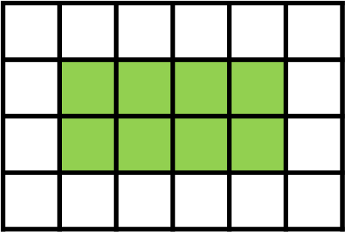
DISCUSS
Finding perimeter by counting
1 cm
Dev thinks the perimeter of the green shaded shape is 16 cm.
1 cm
1
2
3
4
12
5
11
6
Ruby thinks the perimeter of the green shaded shape is 12 cm.

10
9
8
7
Perimeter = 12 cm
Carlos thinks the perimeter of the green shaded shape is 8 cm.
Who is correct?
What do you think the others did wrong?
Notes:
Ask learners to consider the statements and decide who is correct and what the others did wrong.
Ask learners to explain their reasoning and state the misconceptions that Dev and Carlos held.
Dev has made the common mistake of counting the squares around the rectangle (including those 4 extra corner squares).
Carlos has worked out the area instead of the perimeter.

Slide 3
Perimeter, area and volume
Perimeter, area and volume are measures that are used in many everyday situations.
Can you define them and give a real-life example of each?
Perimeter measures the total distance around an object or shape.
Area measures the entire inside surface of a 2D object or shape.
Volume measures the entire space inside a 3D object or shape.
Notes:
Although this lesson focuses on perimeter, learners often get the concepts perimeter, area and volume mixed up. Additionally, FS Level 1 questions mostly do not specify whether the concept of area or perimeter should be used and learners need to use the contextual information given to determine which measure to use.
Use whole class discussion to elicit the definitions for each of the measures, what the difference between the measures is, and a few everyday life examples of each.
The animation can be used to reinforce the definitions given by the learners.
If it has not already been made explicit, emphasise that area is a concept that measures the inside surface of a 2D shape whereas volume measures the space inside a 3D shape.

Slide 4


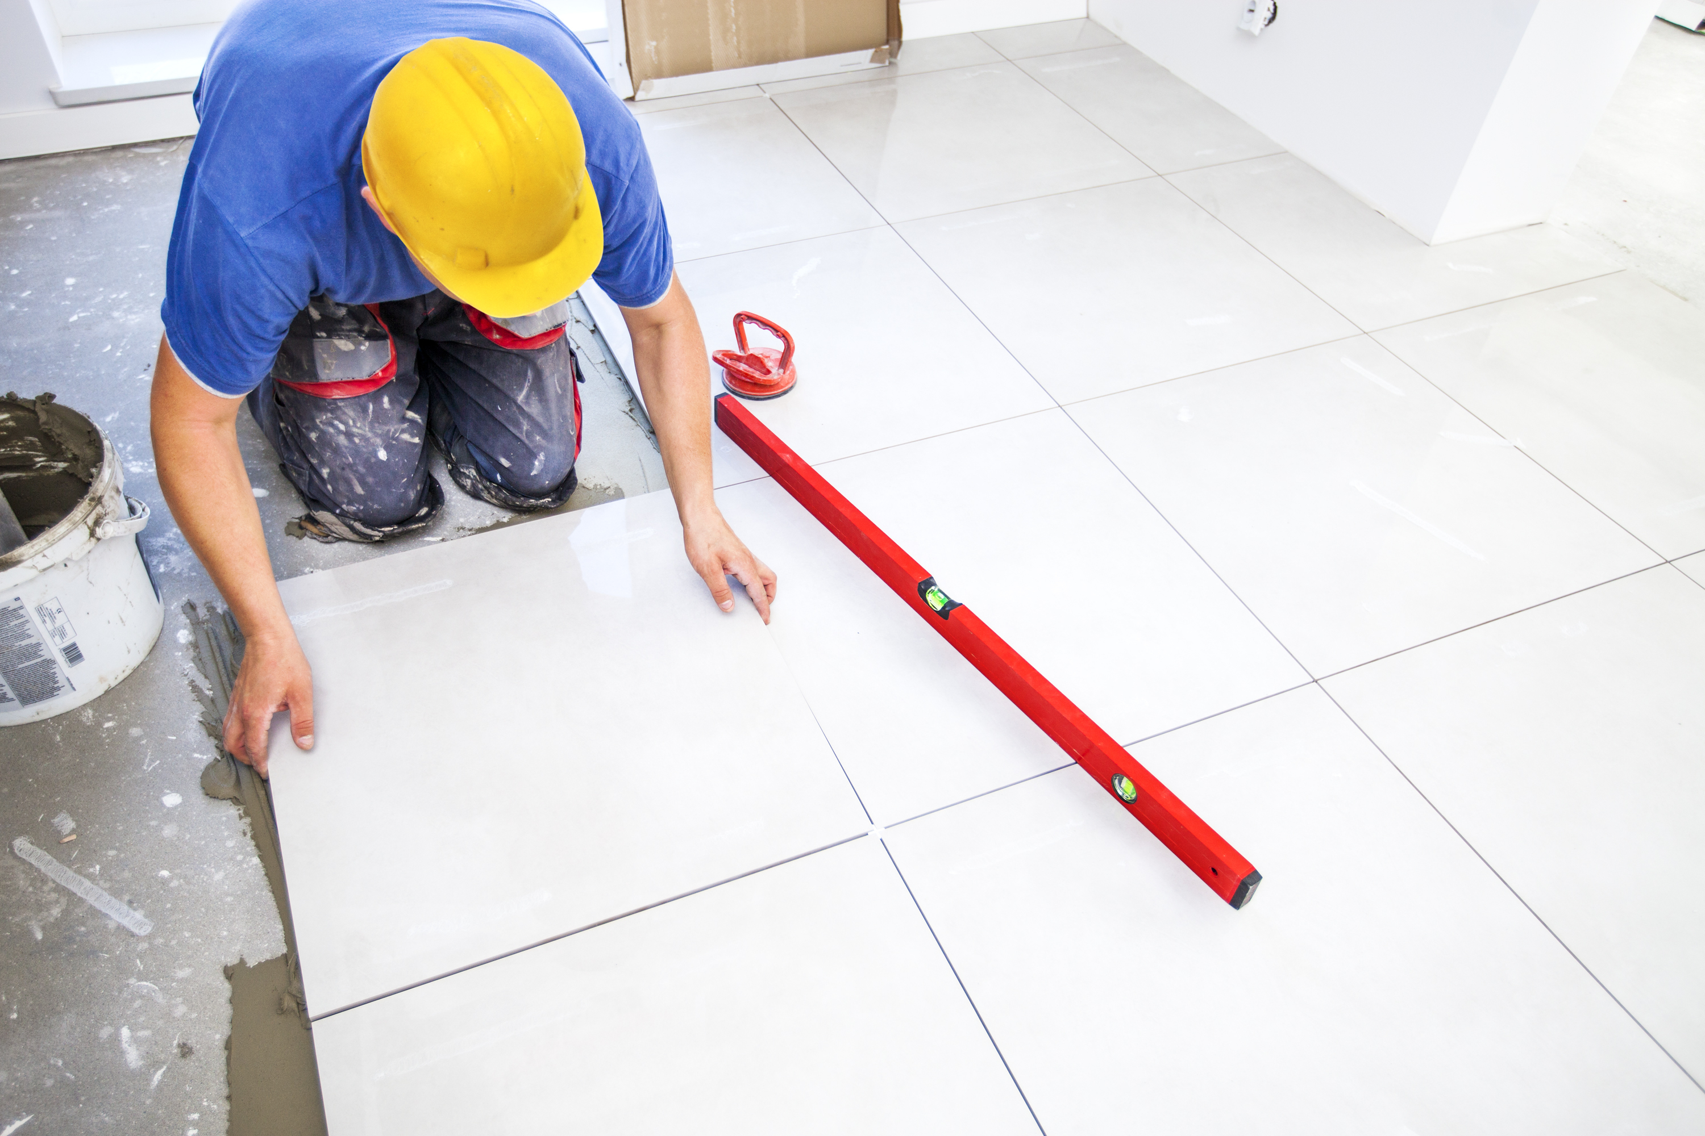
Perimeter and area
KEY IDEA
Perimeter measures the total distance around this photo frame.
Area measures the entire inside surface of this floor.
Notes:
Tutor to use these examples to highlight the difference between area and perimeter using real-life examples.

Slide 5
Perimeter or area?
DISCUSS
AREA
Tiling a floor
Painting a wall
AREA
AREA
Paving a garden
Fencing a garden
PERIMETER
PERIMETER
Laps around a field
Sowing grass seed
AREA
PERIMETER
Skirting boards
Ribbon around a cake
PERIMETER
Notes:
This mini quiz is designed to introduce learners to some of the key contexts and terminology that relate to area and perimeter questions.
Highlight that the term ‘perimeter’ or ‘area’ might not be in the question and that learners may come across real-life examples which include words they are not familiar with (e.g. paving slabs and skirting boards). This would be particularly relevant to learners whose primary language is not English.
Learners to use mini whiteboards to categorise the phrases as relating to either area or perimeter. Learners should keep track of how many they got correct. The activity can be adapted to a standard written quiz or an online quiz using software such as Kahoot if that is preferable for a particular group.
Ask learners to record their scores out of 8.

Slide 6
Perimeter… strategies
70 cm
30cm
30 cm
30 cm
40 cm
40 cm
30 cm
Discuss:
How do you calculate the perimeter of a rectangle?
What about a square?
70 cm
Notes:
Tutor to allow the class a few minutes to discuss their strategy with their pair.
Learners to feedback.
Discussion about more room for error if just adding the numbers up. Do some double opposite sides and then add? Do some double the height and length and then add?
For a square do they know two times one length by 4?

Slide 7
Perimeter definition and terms
KEY IDEA
Perimeter is the length of each side of a 2D shape added together.
Perimeter measures distance, so the common units are mm, cm, m and km.
Key perimeter words are ‘border’, ‘around’, ‘edges’, ‘fence’ and ‘enclose’.
Notes:
Tutor to highlight the definition of perimeter, remind learners it is something they will need to remember.
Tutor to highlight key words which could be used to indicate perimeter.

Slide 8
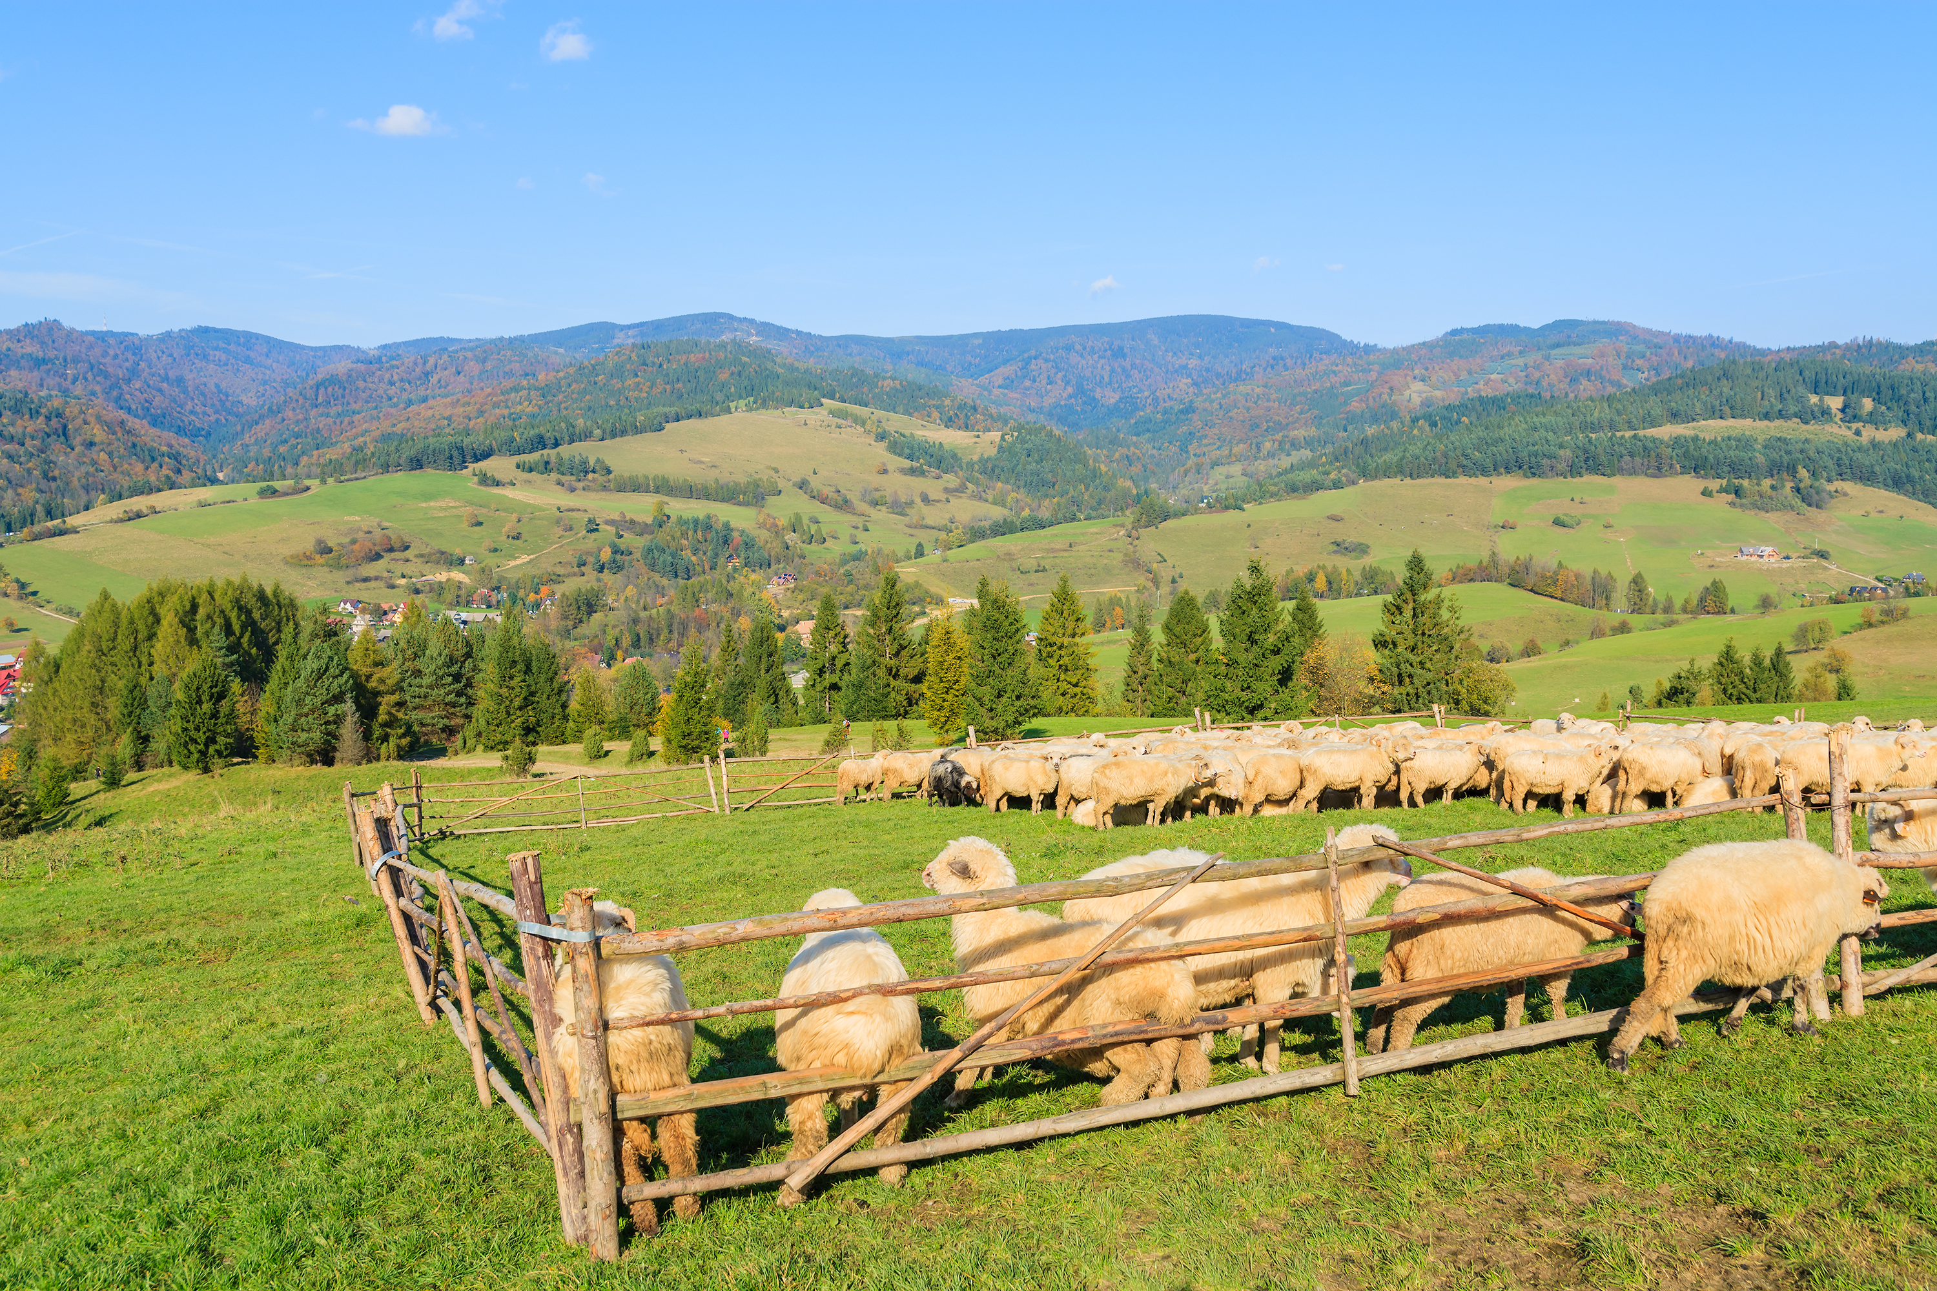

Perimeter of compound shapes (1)
DISCUSS
A farmer is going to make fenced enclosures for his sheep.
10 m
4 m
2 m
9 m
5 m
Can you find the perimeter of this enclosure?
What do you notice about the opposite sides of this rectilinear shape?
1 m
12 m
1 m
Enclosure 1
Perimeter = 10 m + 9 m + 12 m + 5 m + 2 m + 4 m
= 42 m
Notes:
Learners to work individually to find the perimeter of the enclosure.
Use whole class feedback to elicit and highlight:
1) the importance of including ALL sides when calculating the perimeter. Encourage learners to write down each side length in their calculation so they can check if they have counted all the sides.
2) The fact that opposite sides of a rectangular shape are equal in length, even if they are ‘split’ (i.e. the base line is 12 m and the opposite sides add to 12 m. The right side is 9 m and the left sides add to 9 m.
3) The importance of including the correct unit in the final answer.

Slide 9

Perimeter of compound shapes
2 m
10 m
4 m
4 m
4 cm + 5 cm = 9 cm
9 m
2 cm + 10 cm = 12 cm
5 m
2 m
12 m
Check your answer by looking at opposite sides. OPPOSITE SIDES ARE EQUAL:
2 m + 10 m = 12 m
5 m + 4 m = 9 m
Add and double: 21 m x 2 = 42 m
Notes:
Tutor to talk through animation that shows that the opposite parallel sides of a rectilinear shape equal each other.

Slide 10

Perimeter of compound shapes (2 and 3)
Can you use the lengths given to find the lengths of the missing sides?
How much fencing will the farmer need for these enclosures?
9 m
4 m
10 m
8 m
10 m
?
35 m
?
16 m
12 m
30 m
Enclosure 2
Enclosure 3
Notes:
Tutor to highlight that sometimes not all the side length measurements will be given and learners will need to work them out from the information which is given.
This activity gives learners the opportunity to practise the skill of finding missing side lengths. Enclosure 2 has the missing side lengths indicated to provide scaffolding if needed.
Learners work individually using mini whiteboards/the handout to work out the perimeter of the shapes.
Ask learners to discuss their answers with a partner and see if they got the same answer. If they did not, they should try to figure out who made an error and what they did wrong.

Slide 11
Perimeter of compound shapes (2)
Can you use the lengths given to find the lengths of the missing sides?
How much fencing will the farmer need for these enclosures?
9 m
Perimeter = 10 + 9 + 4 + 3 + 6 + 12
= 44 m
4 m
12 – 9 = 3 m
10 m
?
Check your answer by looking at opposite sides:
4 m + 6 m = 10 m
9 m + 3 m = 12 m
Add and double: 22 x 2 = 44 m
?
10 – 4 = 6 m
12 m
Enclosure 2
Notes:
Optional answer slide to show missing side lengths and perimeter calculations, step by step.

Slide 12
DISCUSS
Perimeter of compound shapes (3)
Can you use the lengths given to find the lengths of the missing sides?
How much fencing will the farmer need for these enclosures?
12 m
19 m
19 m
Perimeter = 16 m + 10 m + 19 m + 12 m
+ 19 m + 8 m + 16 m + 30 m
= 130 m
10 m
8 m
35 m
16 m
16 m
30 m
Enclosure 3
Notes:
Optional answer slide to show missing side lengths and perimeter calculations, step by step.

Slide 13


Perimeter – Rachel’s room
Rachel is planning to hang fairy lights around the edge of her room.
Each string of lights is 2 m in length.
Each string costs £2.50 and she has a budget of £30.
She won’t hang lights in the doorway.
Use the diagram to calculate if she has enough money.
Notes:
Introduce this activity to learners. Remind them that they will need to read all the information given and reinforce the importance of identifying this as a perimeter question – Lights will go AROUND the room (key perimeter terminology).
Highlight that this is a multi-mark question and that learners should show all their working.
Some learners may be overwhelmed by the amount of text. Elicit strategies for dealing with this, e.g. covering the text and revealing the information line by line/circling or highlighting key information, etc.
Learners should work individually and then compare methods and answers with a partner.
The diagram is on the next slide and in the handout.

Slide 14
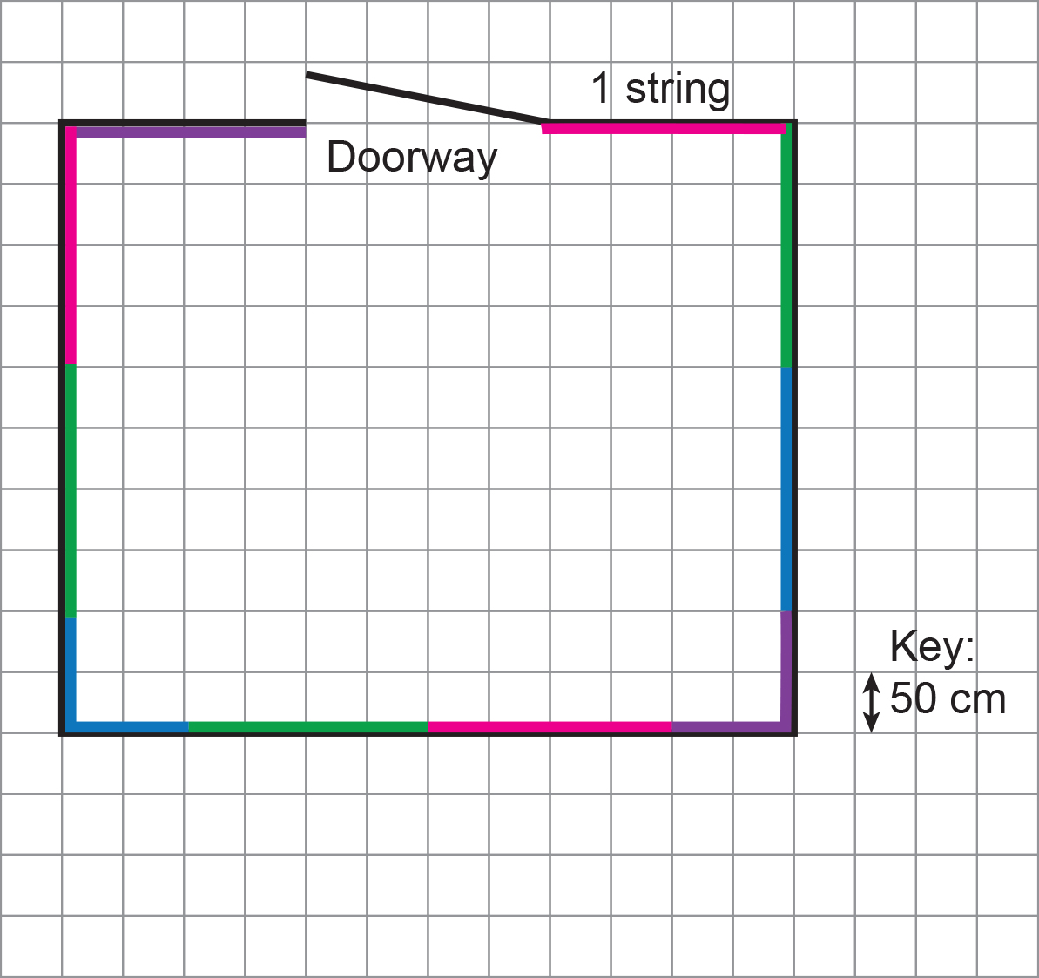
Perimeter – Rachel’s room
EXPLORE
Method 1:
Total number of strings needed = 10
Total cost of strings = 10 × £2.50 = £25
Rachel has enough money.
Notes:
This slide shows one method of answering the question.
The number of strings of lights needed is calculated by marking off 4 blocks at a time (4 × 50 cm = 200 cm = 2 m).
Highlight that the key is in cm and the length of the light is in metres and emphasise the importance of making sure the units are converted to be the same unit.
Highlight that Rachel can hang lights across a corner of her room and that they should exclude the door frame as Rachel was not going to hang lights across the door.

Slide 15
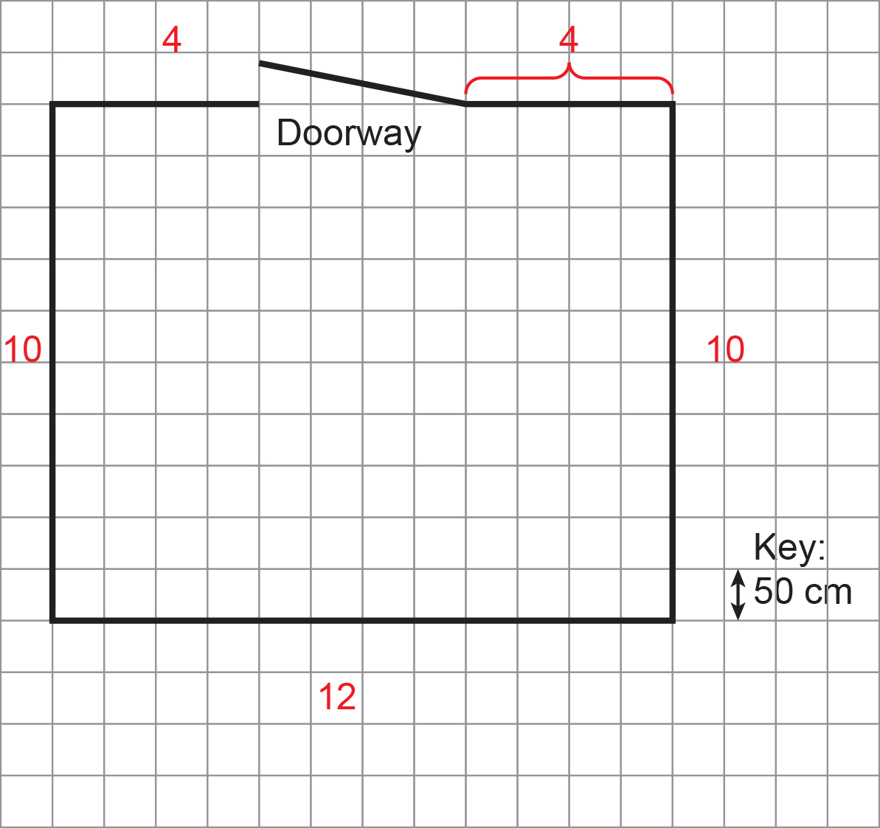

Perimeter – Rachel’s room
EXPLORE
Method 2:
Number of blocks = 40
Perimeter = 40 × 50 cm = 2000 cm = 20 m
Number of strings needed is: 20 $÷$ 2 = 10
Cost of strings needed is: 10 × £2.50 = £25
Rachel does have enough money.
Notes:
This slide shows a different method to answer the question.
The number of strings of lights needed is calculated by finding the total perimeter of the room and then dividing by the length of each string.
Highlight that Rachel can hang lights across a corner of her room ant that they should exclude the door frame as Rachel was not going to hang lights across the door.

Slide 16
Perimeter – Radhika’s room
EXPLORE
Radhika is also planning to decorate her room with fairy lights.
She buys light strings which are 145 cm in length.
She hangs lights around the whole room except for above her wardrobe.
How many strings of lights does she need to buy?
Wardrobe
80 cm
160 cm
2.5 m
4.5 m
Notes:
In this activity learners need to calculate how many strings of lights are needed without using the grid to count each string.
Learners should work individually and then compare methods and answers with a partner.
Learners will need to calculate the perimeter and then divide to find the number of strings as they cannot use the counting square length method.

Slide 17
Perimeter – Radhika’s room
EXPLORE
Radhika is also planning to decorate her room with fairy lights.
She buys light strings which are 145 cm in length.
She hangs lights around the whole room except for above her wardrobe.
How many strings of lights does she need to buy?
Wardrobe
80 cm
160 cm
2.5 m
4.5 m
Perimeter = 450 cm + 250 cm + 450 cm + 250 cm – 160 cm – 80 cm
= 1160 cm
Strings needed = 1160 cm $÷$ 145 cm = 8 strings
Notes:
Optional worked answers slide.
Highlight that learners could change all measurements to either cm or to m.
Potential errors learners might make are not changing measurements to the same units and not subtracting the wardrobe measurements correctly.

Slide 18
Perimeter
KEY IDEA
To answer multi-step problem solving questions involving the perimeter of a rectilinear shape:
Calculate missing side lengths if necessary
Convert units if necessary
Calculate the perimeter of the shape by adding up all the side lengths
Subtract any excluded lengths
Calculate the amount of material needed and, if necessary, the cost of the material
Notes:
General steps to solve most perimeter problem-solving questions.

Slide 19

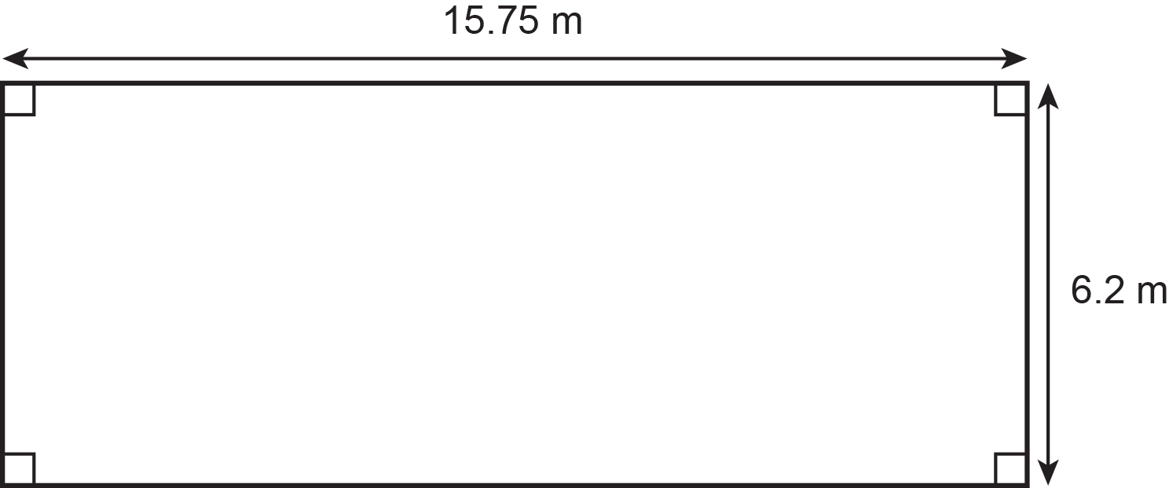
Practice question 1
PRACTICE QUESTION
Worksheet
available
Jasmine has an allotment.
The allotment is in the shape of a rectangle.
Work out the length of fencing Jasmine needs to buy.
Jasmine wants to put a fence around the edge of the allotment.
There needs to be a gap in the fencing of 1.5 m for a gate.
Fencing is sold in whole metres.
Notes:
Tutor to give learners the choice of 2 questions to answer from the 4 (or all 4 if time allows). The questions are of varying difficulty.
Tutor to reinforce to the class that this question is a 3-mark question so there are various opportunities to get marks.
Encourage learners to highlight key words and information in the question so they understand exactly what is being asked.
Learners to think about all possible ways to get marks: to draw/annotate sketches, to find missing lengths, etc.
Tutor to explain about follow through marks. FTM enable the learners to get marks for working done later in the question, even if their first answer is incorrect.

Slide 20
Practice question (1) – answers
PRACTICE QUESTION
Worksheet
available
Jasmine has an allotment.
The allotment is in the shape of a rectangle.
Total perimeter:
15.75 m + 15.75 m + 6.2 m + 6.2 m
= 43.9 m
Fencing needed:
43.9 m – 1.5 m = 42.4 m
Jasmine wants to put a fence around the edge of the allotment.
There needs to be a gap in the fencing of 1.5 m for a gate.
Fencing is sold in whole metres.
Jasmine needs to buy 43 m of fencing.
Work out the length of fencing Jasmine needs to buy.
Notes:
Draw learners’ attention to the fact that this is a perimeter question although the question does not use the word perimeter. ‘Fence around’ is the key term.
Remind learners that this is a calculator question so they shouldn’t spend time working out the perimeter without using their calculator.
Draw learners’ attention to the fact that the whole perimeter won’t be fenced – the gate length needs to be subtracted.

Slide 21
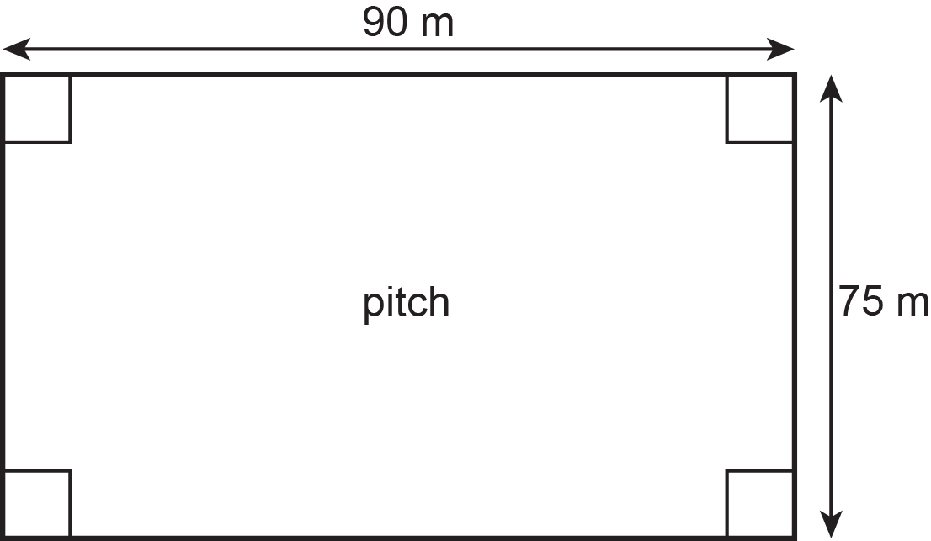
Practice question (2)
PRACTICE QUESTION
Worksheet
available
Ali is preparing for a race.
He runs laps around a football pitch to prepare for the race.
The length of each lap is the total distance along the four edges of the pitch.
Ali needs to run at least 10 km.
What is the minimum number of complete laps Ali should run?
Notes:
Tutor to give learners the choice of 2 questions to answer from the 4 (or all 4 if time allows). The questions are of varying difficulty.
Tutor to reinforce to the class that this question is a 4-mark question so there are various opportunities to get marks.
Encourage learners to highlight key words and information in the question so they understand exactly what is being asked.
Learners to think about all possible ways to get marks and to draw/annotate sketches to find missing lengths.
Tutor to explain about follow through marks. FTM enable the learners to get marks for working done later in the question, even if their first answer is incorrect.

Slide 22

Practice question (2) – answers
PRACTICE QUESTION
Worksheet
available
Ali is preparing for a race.
He runs laps around a football pitch to prepare for the race.
The length of each lap is the total distance along the four edges of the pitch.
Perimeter (one lap)
= 90 m + 75 m + 90 m + 75 m
= 330 m
10 km = 10 × 1000 = 10 000 m
10 000 $÷$ 330 = 30.3 laps
Ali needs to run at least 10km.
Ali needs to run at least 31 laps.
What is the minimum number of complete laps Ali should run?
Notes:
Tutor to highlight that even if learners don’t know how to answer the question fully, they could identify this is a perimeter question (laps AROUND) and perimeter is adding all the side lengths. This is an easier and more accessible mark and learners should be encouraged not to leave the question blank if they are stuck.
Highlight that the field dimensions are in m but his goal is in km and students need to convert to the same unit (either unit).
Highlight that he needs to do at least 10 km so they would need to round 30.3 up to 31 as he would need to run a bit more than 10 km to run a whole number of laps.

Slide 23
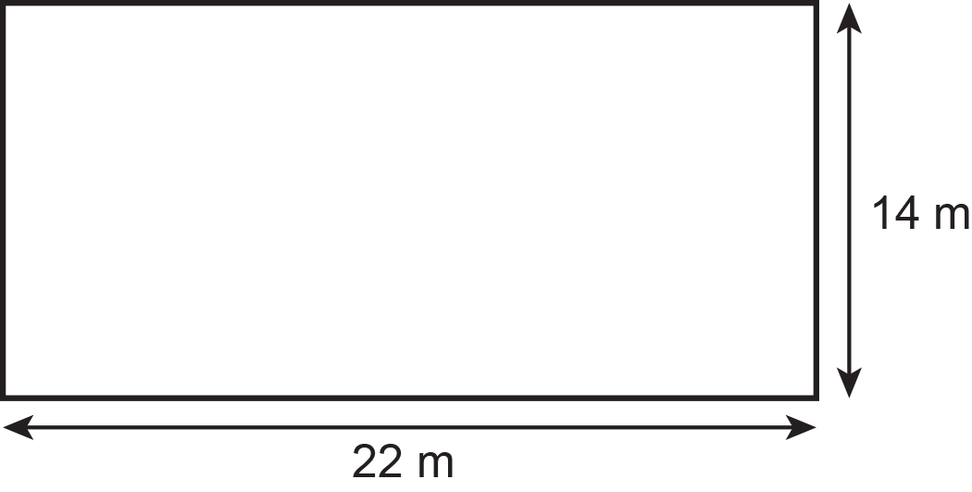
Practice question (3)
PRACTICE QUESTION
Worksheet
available
Zeenat wants to buy edging to put along the edges of her lawn.
She has this sketch of the lawn.
The lawn is in the shape of a rectangle.
Each metre of edging costs £5.
Zeenat thinks the total cost of the edging will be £360.
Is Zeenat correct?
Show why you think this.
Use a reverse calculation to show a check of your answer.
Notes:
Tutor to give learners the choice of 2 questions to answer from the 4 (or all 4 if time allows). The questions are of varying difficulty.
Tutor to reinforce to the class that this question is a 4-mark question so there are various opportunities to get marks.
Encourage learners to highlight key words and information in the question so they understand exactly what is being asked.
Learners to think about all possible ways to get marks: draw/annotate sketches, find missing lengths, etc.
Tutor to explain about follow through marks. FTM enable the learners to get marks for working done later in the question, even if their first answer is incorrect.

Slide 24
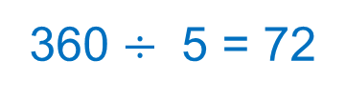
Practice question (3) – answers
PRACTICE QUESTION
Worksheet
available
Zeenat wants to buy edging to put along the edges of her lawn.
She has this sketch of the lawn.
The lawn is in the shape of a rectangle.
Perimeter
= 22 m + 14 m + 22 m + 14 m
= 72 m
Cost = 72 × 5 = £360
Zeenat is correct.
Each metre of edging costs £5.
Zeenat thinks the total cost of the edging will be £360.
Is Zeenat correct?
Show why you think this.
Use a reverse calculation to show a check of your answer.
360 $÷$ 5 = 72
Notes:
Draw learners’ attention to the fact that this is a perimeter question although the question does not use the word perimeter. ‘Along the edges’ is the key term.
This is a non-calculator question so learners will need to work carefully to find the perimeter and the cost of the edging.
Remind learners that the final question is whether Zeenat is correct, so they need to make it clear whether they think she is or is not.

Slide 25
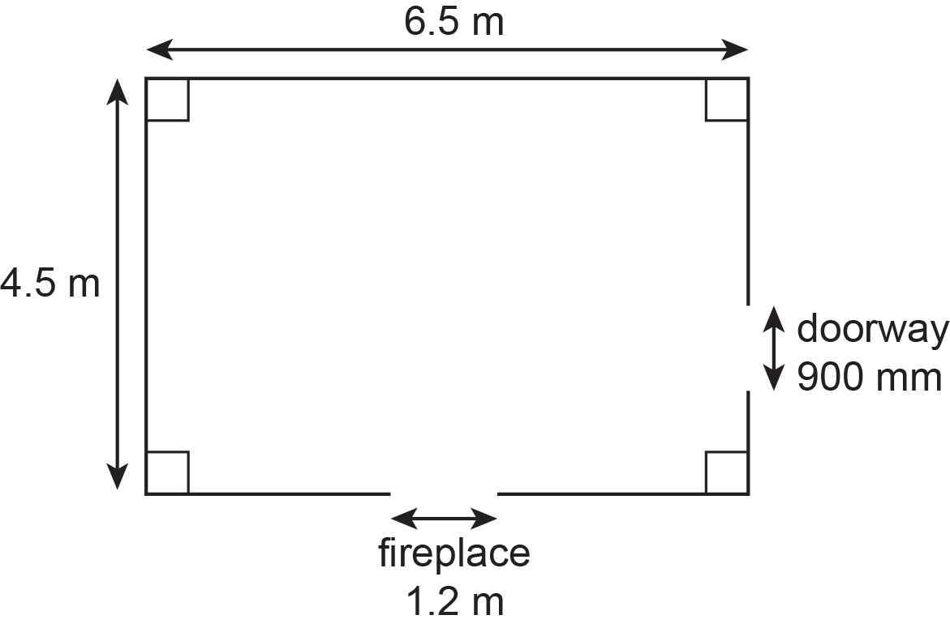
Practice question (4)
PRACTICE QUESTION
Worksheet
available
Amy wants new skirting boards in her living room.
The skirting boards will
  go along the bottom of each wall
  not go across the doorway
  not go across the fireplace.
  Amy has this sketch of her living room.
Skirting boards come in lengths of 2.4 m.
The lengths of skirting board can be cut and joined.
How many lengths of skirting board does Amy need?
You must show your working.
Notes:
Tutor to give learners the choice of 2 questions to answer from the 4 (or all 4 if time allows). The questions are of varying difficulty.
Tutor to reinforce to the class that this question is a 4-mark question so there are various opportunities to get marks.
Encourage learners to highlight key words and information in the question so they understand exactly what is being asked.
Learners to think about all possible ways to get marks: draw/annotate sketches, find missing lengths, etc.
Tutor to explain about follow through marks. FTM enable the learners to get marks for working done later in the question, even if their first answer is incorrect.

Slide 26
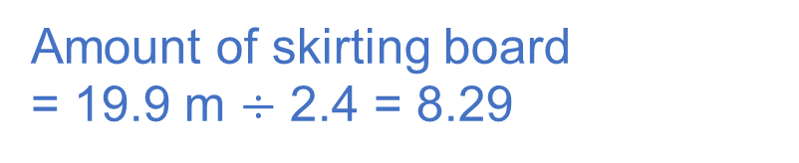
Practice question (4) – answers
PRACTICE QUESTION
Worksheet
available
Amy wants new skirting boards in her living room.
The skirting boards will
  go along the bottom of each wall
  not go across the doorway
  not go across the fireplace.
  Amy has this sketch of her living room.
Perimeter
= 6.5 + 6.5 + 4.5 + 4.5
= 22 m
Needing skirting board
= 22 m – 0.9 m – 1.2 m
= 19.9 m
Amount of skirting board
= 19.9 m $÷$ 2.4 = 8.29
Skirting boards come in lengths of 2.4 m.
The lengths of skirting board can be cut and joined.
How many lengths of skirting board does Amy need?
You must show your working.
Amy should by 9 lengths of board.
Notes:
Draw attention to different units and the need to convert to either all m or all mm (m would be easier as only 1 to convert).
Draw attention to sections which won’t need skirting board.
Draw attention to the fact that although only 8.29 lengths are needed Amy will need to buy 9 lengths and cut the board. Discuss why the answer was rounded up and not down (as would be correct if rounding without a context).

Slide 27
Lesson review:
Perimeter of rectangles and compound shapes
Level 1
Objectives
To find the missing side lengths in rectilinear and compound rectilinear shapes
To explore the concept of perimeter and calculate the perimeter of compound rectilinear shapes
Understand the concept of perimeter and use it in a range of problem-solving situations
Suggested further steps/areas to work on
Area and volume

Slide 28
Lesson 17:
Credits
Photo acknowledgements:
123RF.com: Pawel Kazmierczak; Shutterstock.com: Dagmara_K , Ekler, Naddya, Studio DMM Photography, Designs & Art
Text acknowledgements:
Pearson Edexcel Functional Skills, Past Paper 4 – Mathematics Level 1 (Calculator) PMAT1/C04 Question 7, Pearson Edexcel Functional Skills, Practice paper (Sept 2019) – Mathematics Level 1 Section B (Calculator) PRACL1/01 Question 11, Pearson Edexcel Functional Skills, Past Paper 2 – Mathematics Level 1 (Non-Calculator) PMAT1/NO2 Q3 Question 3, Pearson Edexcel Functional Skills, Practice Set 2 – Mathematics Level 1 (Calculator) PRACL2/C02 Question 8

