Slide 1


Lesson 6:
Scales, maps and units
Level 1
Objectives
To be able to convert metric units of measurement
To be able to use a scale to find lengths
To be able to represent a proportional situation in a ratio table

Slide 2

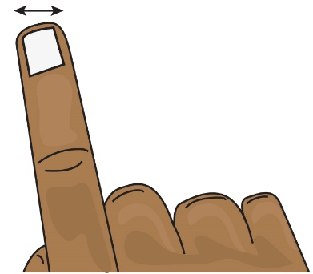
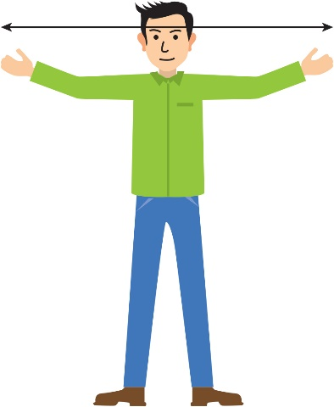
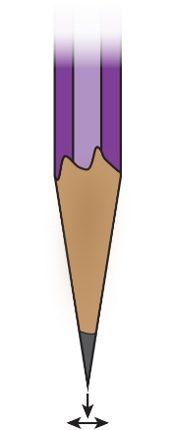
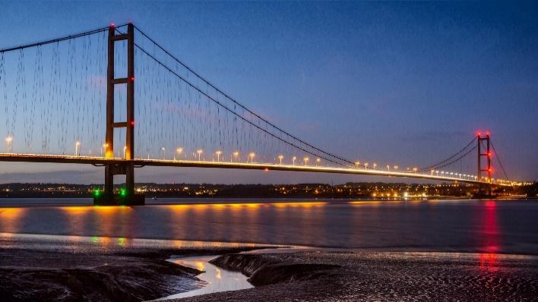
INTRODUCTION
Find the measurements
1 cm
10 mm
1 m
1 mm
1000 m
100 cm
1 km
Notes:
Learners to work in pairs to match the measurements and pictures.
Do they have a sense of how long each unit is?
When they complete the task, they should have all the metric conversions for length they will need in this lesson.
Answers:
Width of a finger: 1 cm
Arm span: 1 m
Pencil tip: 1 mm
Distance between two bridge pylons: 1 km

Slide 3
INTRODUCTION
Find the measurements
1 cm
10 mm
1 m
1 mm
1000 m
100 cm
1 km
Notes:
Tutor to ask for feedback from the class.
The learners may measure their finger using cm but some may have said mm. Talk about the conversion and that 10 mm is the same as 1 cm – tell them to look at their rulers.
They would probably measure arm width using metres – but could have used cm. Similarly, ask how many cm are in 1 m.
The bridge would be measured in km – but how many metres are in a km?
mm is the odd one out – we don’t normally measure in smaller units than mm.

Slide 4
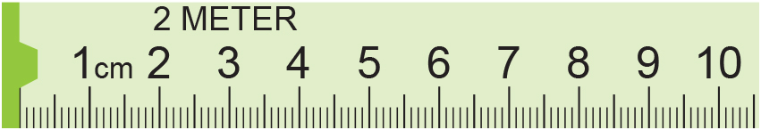
MODEL
Reading scales and converting metric units
3.9 cm
or 39 mm or 0.039 m
Convert this measurement to millimetres and to metres
Centimetres | 1
Millimetres | 10
0.039
Metres | 1
Centimetres | 100
×10
×10
3.9
÷100
÷100
39.0
3.9
Notes:
Ask what reading is shown by the arrow.
Animation then shows it as 3.9 cm and students are asked to convert this to mm and m. Allow a few minutes and then ask students for their methods.
Tutor to explain that ratio tables are an effective method.

Slide 5
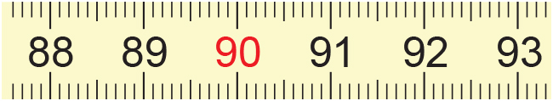
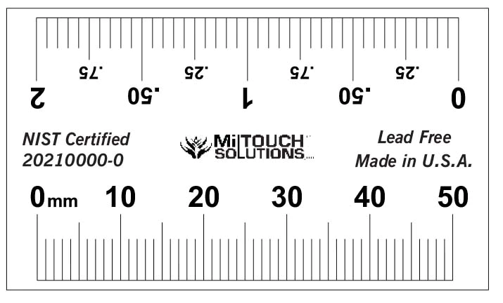
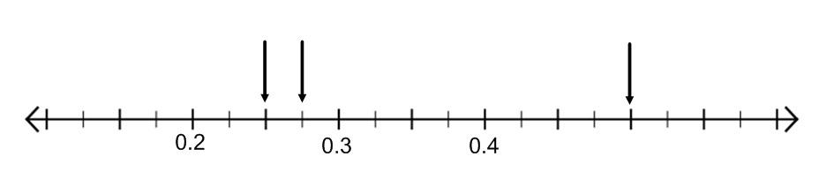
EXPLORE 1
Reading scales and converting metric units
1) Write these in cm, mm and m.
(a)
(b)
2) Write these in mm and cm.
(a)
(b)
(c)
(b)
(c)
(a)
3) Write these in m and cm.
m
Notes:
The worksheet has ratio tables pre-drawn to help learners organise their thinking.
The scale in Q3 is harder to read. How can learners help themselves to work this out?

Slide 6
REVIEW
Reading scales and converting metric units: answers
(a)
1) Write these in cm, mm and m.
89.3 cm, 893 mm, 0.893 m
91.0 cm, 910 mm, 0.91 m
(b)
2) Write these in mm and cm.
12 mm, 1.2 cm
24 mm, 2.4 cm
48 mm, 4.8 cm
(a)
(b)
(c)
3) Write these in m and cm.
(b)
(c)
(a)
0.5 m, 50 cm
0.25 m, 25 cm
0.275 m, 27.5 cm
m

Slide 7
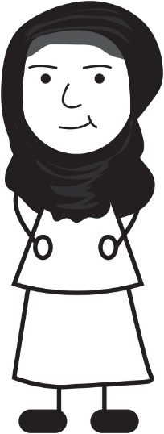
EXPLORE 1
Rahima’s mistake
Rahima is doing a metric conversion.
Rahima is not correct?
Can you explain why with a ratio table?
0.3 m is the same as 0.003 cm because
you divide by 100 to change from m to cm.
Notes:
Learners may give the answer that Rahima needs to multiply by 100 but can they explain why this is correct?
Diagrams such as ratio tables make this explanation very clear.

Slide 8
REVIEW
Rahima’s mistake: using ratio tables
cm
metres
100
10
30
1
0.1
0.3
So, 0.3 m is 30 cm.
Notes:
Using a ratio table to illustrate the conversion will allow learners to work well without a calculator and will underpin their understanding of converting between metric units.
Ask questions such as:
Would you use all of these steps?
What could you do differently?
This allows learners to really think about the relationship of the numbers with a simpler example before moving on to the more difficult tasks coming up.
A ratio table is used to illustrate approaches. It is important to reiterate that this can be used for illustration of a range of approaches. Although the ratio table is provided, it is only intended to be used to capture learners’ thinking, not as a ‘method’. The ratio table does, however, suggest multiplicative approaches and is encouraged to be used, along with their own diagrams, if appropriate, to capture your learners’ thinking. What is important is that the learners understand what they, and their peers, have done.

Slide 9
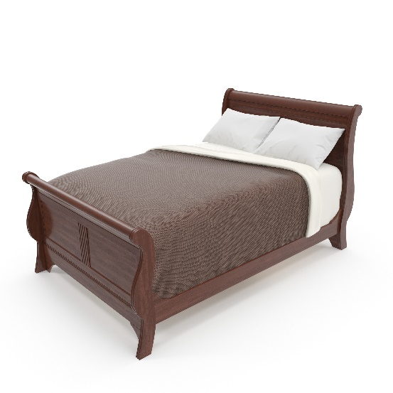
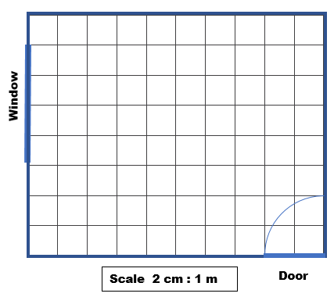
EXPLORE
Bedroom design
Ali has bought a new bed and is planning where to put it in his room. He has made a scale drawing of his room.
The scale is 2 cm : 1 m.
Here is how he worked out the scale size of the bed:
2 m
1.4 m
drawing (cm) | 2
real bed (m) | 1
×2
×2
4
×2
2.8
2
1.4
So now he draws a rectangle size 4 cm by 2.8 cm
on centimetre squared paper.
Scale 2 cm : 1 m
Bed
Where do you think he should put the bed in his room?
Notes:
Tutor to allow learners time to think about the scale and the size of the bed and work out how many squares length and width the bed would be. Animations then show how using the ratio table is an effective way of working out the dimensions. Tutor to point out that the bed will be 2.8 cm on the grid so learners need to approximate 2.8 by making it slightly smaller than 3 boxes wide.

Slide 10
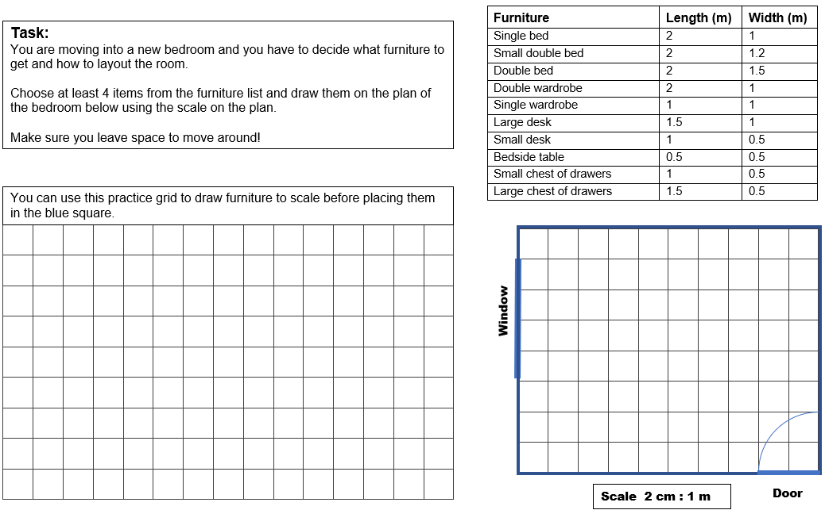
EXPLORE
Bedroom design
Notes:
Tutor to give out the worksheet and allow the learners to work through the task.
In pairs learners decide which items of furniture they want to have in their room and use the scale to work out the dimensions of the scaled down items. Encourage learners to use ratio tables to organise their thinking and working.
Learners should then draw their furniture on the grid and label each piece. They can then either redraw it on the bedroom plan in the place they want it or cut out the furniture and stick it on the plan to allow them to move things around before making a final design.

Slide 11
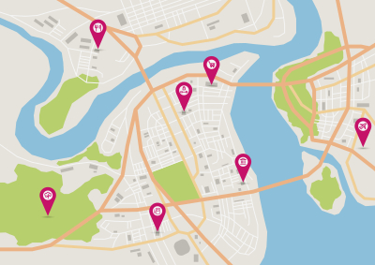
REVIEW
Maps and technology
Access an interactive map.
Can you see the scale?
What happens to the scale when you zoom in or out?
Pick two places on the map and use the scale to estimate the distance between them.
Notes:
Learners can access an interactive map on their phones or the tutor can demonstrate on the board.

Slide 12
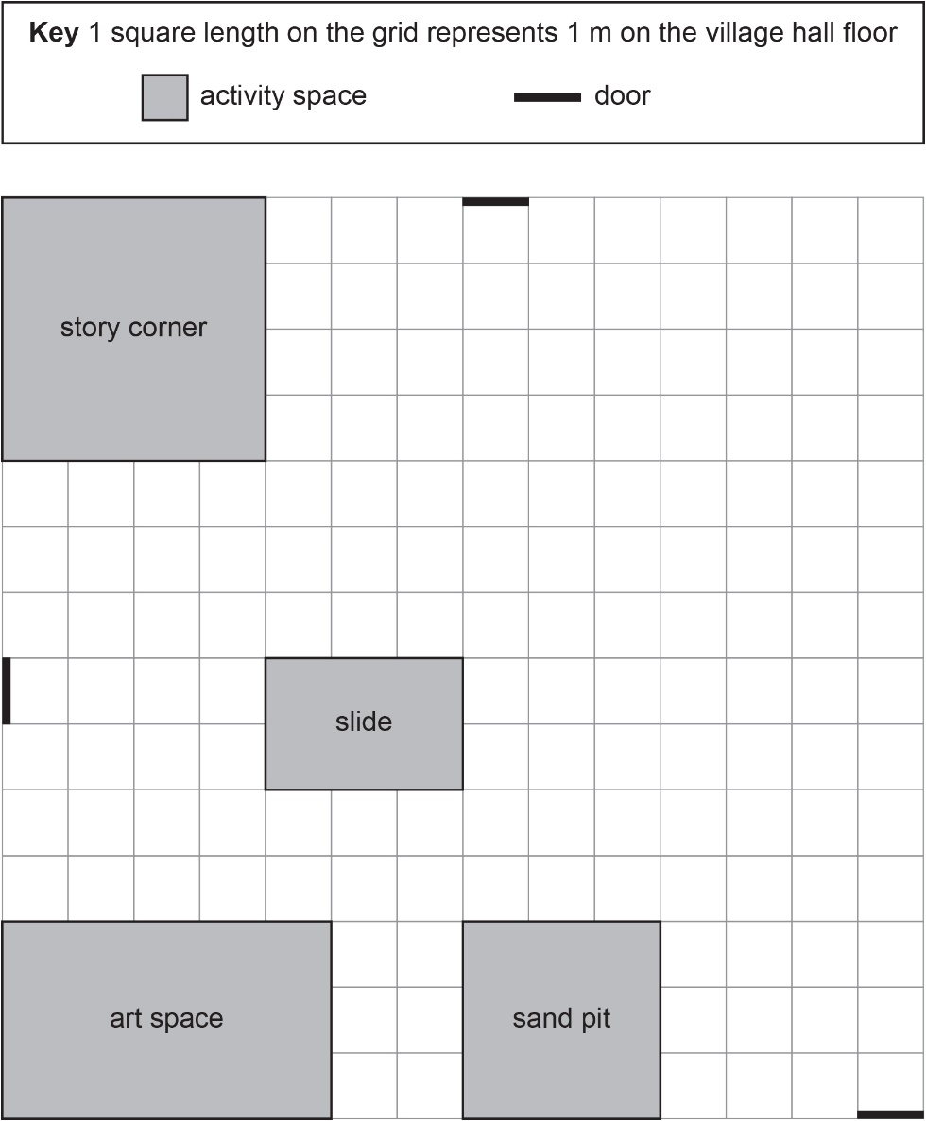
REVIEW
Exam question 1
Sam wants to create a space for water play in the village hall.
He has this diagram of the floor in the village hall.
The space for water play must be
  in the shape of a rectangle 3.5 m by 4 m
  at least 2 m away from other activity spaces
  at least 3 m away from any door.
Draw a space for water play on the grid.
Notes:
Again, encourage learners to draw ratio tables to convince themselves they have got the answer correct

Slide 13
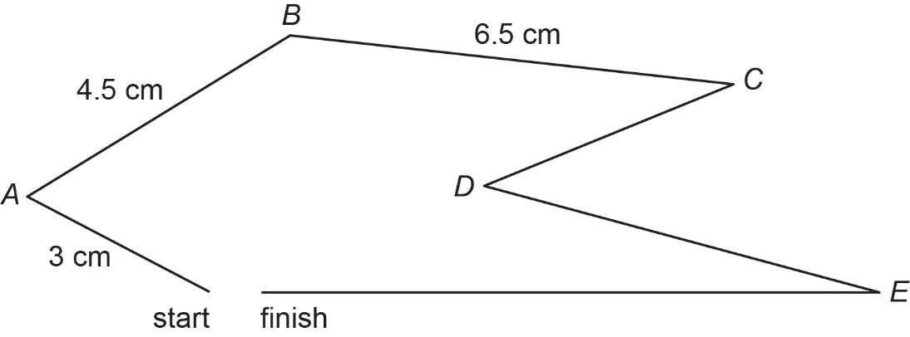
Exam question 2
REVIEW
John is organising a charity sailing race on the sea.
He starts to draw this accurate scale map of the course.
Key: 1 cm on the map is km on the sea.
Sailors begin the race at the start and follow the course to the finish.
John says
‘The course has a total distance of more than 18 km.’
Is John correct? You must show your working.

Slide 14

REVIEW
Exam question 1: answers
Sam wants to create a space for water play in the village hall.
He has this diagram of the floor in the village hall.
The space for water play must be
  in the shape of a rectangle 3.5 m by 4 m
  at least 2 m away from other activity spaces
  at least 3 m away from any door.
Draw a space for water play on the grid.
Water Play
drawing (square) | 1
water play (m) | 1
×1
×1
3.5
×1
4
3.5
4

Slide 15

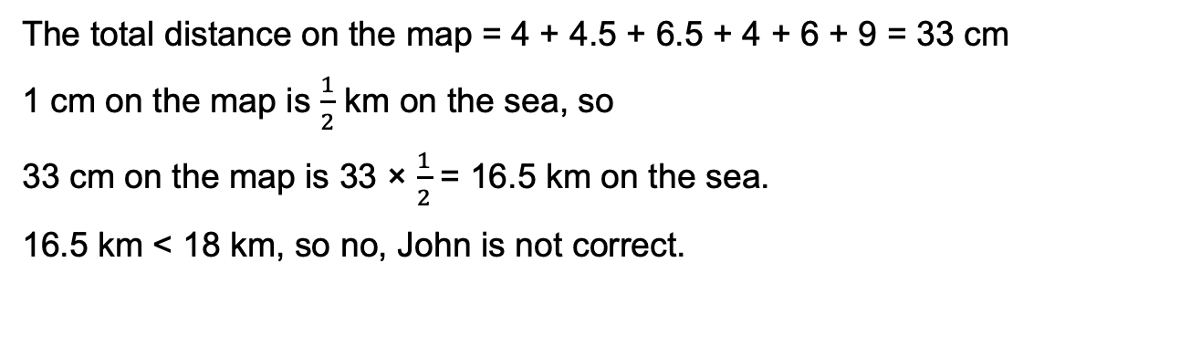
Exam question 2: answers
REVIEW
4 cm
6 cm
9 cm
Key: 1 cm on the map is km on the sea.
The total distance on the map = 4 + 4.5 + 6.5 + 4 + 6 + 9 = 33 cm
1 cm on the map is $\frac{1}{2}$ km on the sea, so
33 cm on the map is 33 × $\frac{1}{2}$ = 16.5 km on the sea.
16.5 km < 18 km, so no, John is not correct.
Notes:
Again encourage learners to draw ratio tables to convince themselves that they have got the answer correctly.

Slide 16
Lesson review:
Scales, maps and units
Level 1
Objectives
To be able to convert metric units of measurement
To be able to use a scale to find lengths
To be able to represent a proportional situation in a ratio table
Suggested further steps/areas to work on
Converting between imperial units and metric units

Slide 17

Lesson 6:
Credits
Photo Acknowledgements
Shutterstock.com: 3DMI, Luke Broughton, Maria Kazanova
Text Acknowledgements
Pearson Edexcel Functional Skills, Practice Paper 3 - Mathematics Level 1 (Calculator) PRACL2/C03 Question 4, Pearson Edexcel Functional Skills, Practice Paper 3 - Mathematics Level 1 (Calculator) PRACL2/C03 Question 11

