Slide 1


Lesson 1:
Attitudes to maths and getting unstuck
Objectives
To motivate, engage and develop resilience in FE maths resit learners
To get to know maths learners and recognise their previous experiences
To equip learners with strategies to progress in their maths
To promote a safe, positive learning environment in
the classroom

Slide 2
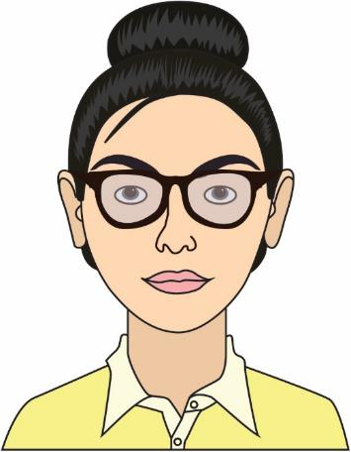
Introduce the team!
Natacha Shakil
Maths Tutor
Likes – food, walking and family time
Notes:
Introduce yourself and the course (share some interesting, non-maths facts about yourself with the class to personalise).
Introduce the team: Use a slide of pictures of team members with interesting facts about each other – to help ‘normalise’ the maths team and promote the fact that the team are approachable.
You can use avatars, bit emojis or photos. Discuss with your team what you want to use.

Slide 3

Two truths and a lie!
Notes:
Aim
This is a non-maths activity to engage learners and build relationships.
Instructions
This activity can be done as a whole group or groups at tables depending on your class. Tutor should circulate so they can get to know learners.
Learners should be given 2 to 3 minutes to think about their answers.
Each person shares two things that are true about themselves and one thing that is a lie.
The group has to try to guess which ones are true and which one is a lie.
Each learners should be encouraged to feed back an interesting truth to the class – this is good for the tutor to note down to refer to at a later date – making it personal.
Evidence from action research
Relationship building is KEY – non-maths activities can be great in helping to build trust with your learners. Maths anxiety can present itself in a number of different ways (withdrawal, avoidance, aggression, etc.) and can often be the result of learners having had a negative experience with a previous maths tutor. For example, their being put on the spot in front of their peers when they did not know an answer and being made to feel embarrassed in front of their class. If this situation is not dealt with at the time, learners can end up trying to protect themselves from this happening again in future, either by avoiding the situation or by acting out (both allowing them to avoid the risk of getting something wrong again).

Slide 4
The good, the bad and the ugly!
YOUR
TURN
Something you like about maths or a positive experience.
Something challenging about maths or an experience you did not like.
Notes:
What do you like about maths? What do you not like about maths?
Aim
The purpose of this activity is to allow learners to discuss their feelings about maths and to understand that they are not alone. Later on in the lesson learners will develop coping strategies for this.
Instructions
Each learner is to have a packet of sticky notes on the table.
The activity is for each learner. Individually. to write a minimum of one good thing on a sticky note and a minimum of one not so good thing on a separate sticky note. More is fine (but there should be one thing per sticky note). Normally they have multiple negative things to say, but they will struggle and need some coaching to find one good thing. So ask if there was a particular topic they enjoyed or something that helped them; it can be small as long as it is a positive.
It is okay for learners to discuss this with each other, as long as they each provide at least two sticky notes.
The tutor should also share some good and some not so good experiences about their maths journey.
Once learners have done this, ask them to stick the notes up on the board or a wall, where there is plenty of space to move them round.
Keep positive and negative notes separate, initially.
Once everyone has contributed, the tutor starts to review them with the whole class. The tutor can categorise the sticky notes as they go through the responses with the group.
Review the negative ones first – important – Take time to discuss the negative experiences; let learners explore these feelings and try to understand them. This shows learners that they are not alone in their feelings. You can expect the following responses.
Tutor good or bad or no tutor/cover.
Topic related
Feeling anxious or stressed (but why? It is important they understand why)
Not passing
Picked on to answer questions.
These are the main points, but not exclusive.
Now review the positive sticky notes. Normally you can offset the negative with the positive. For example, ‘tutor’ will appear in the good section and in the bad section, so you can demonstrate that not all tutors are bad and explain that you intend to support them, etc. Fractions and algebra are normally in the bad section, but you can explain that you are going to approach these topics differently to the way they were done in school (or offset this with one of the positive comments).
The value of this exercise is to allow learners to ‘get it off their chest’ at the beginning, then you can start to build a relationship with them.
Evidence from action research
Encourage conversation about previous maths experiences (negative experiences of maths at school, exams, low grades) and validate the learners’ feelings. This will allow them the space to process their thoughts and feelings in a supportive environment, which will help them feel heard and acknowledged. Learners often feel that their worries/concerns are sometimes not taken seriously by staff and this can cause them to feel isolated (which in turn can increase anxiety).
Do not be afraid to be vulnerable – e.g. by sharing a previous situation/topic at school that has made you feel anxious. This can make learners feel less alone and trust that you understand their feelings to a certain degree.

Slide 5

How did this make you feel?
REVIEW
Notes:
It is important to point out that learners are not alone. Other people also struggle or feel anxious, and this is okay.
Their feelings need to be validated.
Understand that there will be a range of feelings.

Slide 6
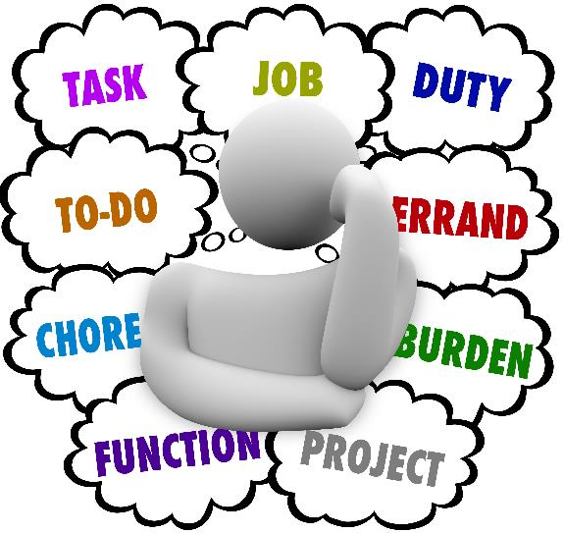
What do you do when you feel stressed or anxious?
YOUR
TURN
Think of something that makes you feel nervous or anxious.
What do you do to help overcome these feelings?
Create a spider diagram or a revision card to present your information.
Notes:
Aim
This is how we move forward, when we feel anxious.
Instructions
Ask learners to think about something that made them feel anxious, e.g.
driving test
sports trial
job interview
new beginnings, school, college, house, etc.
Then they need to think about what they did to overcome that anxiety, e.g.
practice/revision
research
preparation, a good night’s sleep, a healthy lifestyle (consider Maslow's hierarchy of needs)
talking to someone/asking questions.
Ask learners to create a spider diagram or revision card (or collect the information digitally) so that they have something to refer to. It is important that learners understand how to move themselves to a better place to succeed, while also being okay with challenge.

Slide 7
Strategies to help you move forward
REVIEW
Notes:
This slide is for the tutor to collect feedback from the group.
What did learners come up with?

Slide 8
Anxiety strategies
REVIEW
Share your worries/stresses with someone you trust.
Use breathing techniques, e.g. box breathing.
Start with questions that you feel comfortable with.
Remember, a little bit of stress helps you to concentrate and to learn new things!
Understand rather than memorise.
Know what to do when you get stuck.
Notes:
This slide is hidden and can be unhidden.
This slide contains tips that were identified through action research and can be shared by the tutor to support learners.
These are additional tips:
Share your worries/stresses with someone you trust – maths tutor, learning support, a peer – the likelihood is that someone else in the room is feeling the same!
Breathing techniques, e.g., box breathing – taking a couple of minutes will calm your nervous system which will help reduce your anxiety in moments of stress/being overwhelmed.
Start with questions you feel comfortable with – this will help boost your confidence before tackling a new topic/more advanced question.
Remember, a little bit of stress helps you to concentrate and learn new things! If you are feeling completely comfortable with a task, this means that it is unlikely you will be learning anything new. Being able to recognise when it gets a bit too much and to understand what helps you best in those moments is a skill which will help make your experience of maths less stressful and more enjoyable.
Encourage understanding over memorisation. Anxiety can sometimes come from the pressure to remember information. Letting them know that you just want them to understand a mathematical concept, as opposed to remembering it, can help take off the pressure. What is ironic is that research shows, when this happens, learners are actually then more likely to remember the information!
Know what to do when you get stuck – do you feel more comfortable asking a friend for help or your tutor? Can any of your previous notes help you tackle the task?
Final point leads onto the next activity – Stuck poster.

Slide 9

What do you do when you are stuck?
YOUR
TURN
How do you get unstuck?
Create a spider diagram or a revision card to present your information.
Notes:
Aim
Link this to the anxiety activity. Learners have discussed previously what to do when they are stressed or anxious. Let them now consider what to do when they are stuck.
Instructions
Ask learners to think about why they are stuck. Is it about maths or about motivation?
Encourage learners to focus on the maths.
Spend a few minutes as a class thinking about what you do when you get stuck to promote some discussion.
You may want to use some probing questions:
What do you do when you get lost? Ask someone
What resources do you have? Mobile/internet/handouts/books
Could you present the problem differently (CPA approach: Concrete, Pictorial, Abstract)? Could you draw a picture?
What do you know already? What can you answer?
Ask learners to work in pairs or small groups to discuss this, but each learner should create a ‘stuck poster’ so they can refer back to it when they need to support themselves.

Slide 10
Strategies to help you get unstuck
REVIEW
Notes:
This slide is for the tutor to collect feedback from the group.
What did learners come up with?

Slide 11
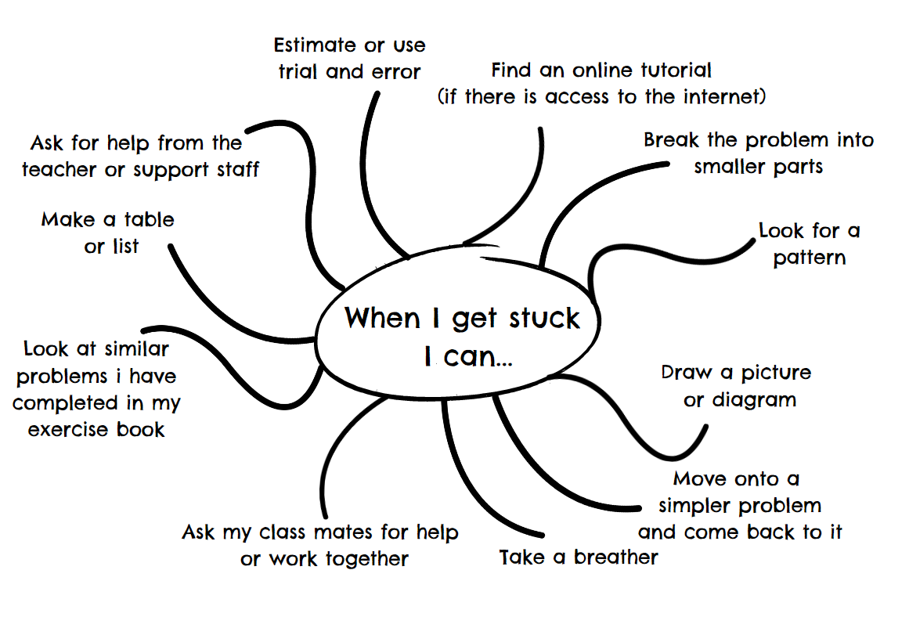
Example 1
REVIEW
Notes:
This slide is hidden and can be unhidden.
This slide contains a poster created through action research and offers some suggestions for the tutor.

Slide 12
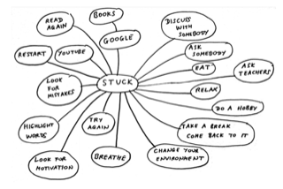
Example 2
REVIEW
Notes:
This slide is hidden and can be unhidden.
This slide contains a poster created through action research and offers some suggestions for the tutor.

Slide 13
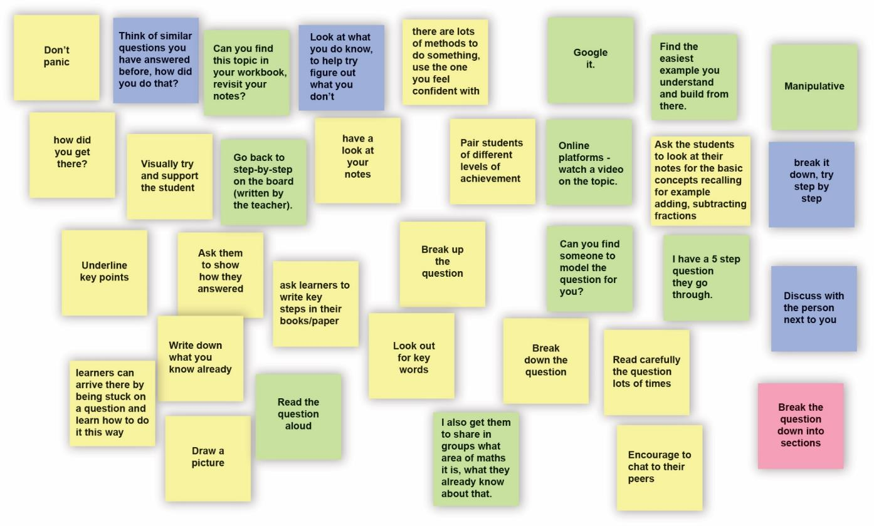
Example 3
REVIEW
Notes:
This slide is hidden and can be unhidden.
This slide contains a jam board created by FE tutors and offers some suggestions for the tutor.

Slide 14
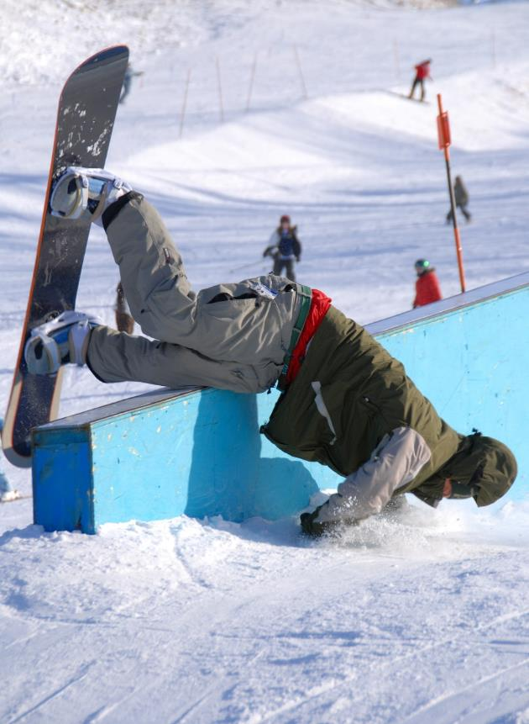
Mistakes
Means
I
Start
To
Acquire
Knowledge
Expertise
Skills
Notes:
Aim
Celebrate mistakes: they are a learning process.
Link back to the previous activities (sticky note activity) and the vulnerabilities raised. Explain to learners that it is okay to make mistakes because that is where the learning happens.
You can model this by making mistakes on the board or saying ‘I often tell learners that I make mistakes, so don’t be afraid to correct me’.
Use mistakes to explore misconceptions.
Link to being stuck – learners now have strategies to become unstuck but they will make mistakes and that is okay.
Create a safe learning environment, where learners can explore, without fear of repercussions.

Slide 15
Maths activity
How many combinations can you make?
YOUR
TURN
10
1
1
1
1
10
10
10
(10×10) + (1×10) + (1×10) + (1)
=121
Notes:
Aim
Low stakes activity to explore number sense and concrete–pictorial–abstract.
Instructions
Learners can work together in pairs for this activity.
You can introduce this by using algebra tiles or multilink cubes, if available. Eventually learners will naturally convert to the pictorial and abstract as they run out of tiles.
If you do not have concrete manipulatives, you can still do the activity by drawing the images.
Ask learners to think of different combinations to create 121 using 100s, 10s and 1s.
Encourage learners to draw answers initially, not use the numbers, e.g.
100 10 10 1 (as shown on the slide)
(12 × 10) + 1
(10 × 10 ) + (21 × 1)
(11 × 10) + (11 × 1) and so on.
For more information for the tutor about number sense, search for the video ‘Jo Boaler Number Sense’ on a video hosting site such as YouTube, which shows number sense for different numbers.
An alternative activity can be put in here, such as a problem-solving task.

Slide 16
How many combinations did you make?
YOUR
TURN
Notes:
Collect feedback from your group and share some on the board.

Slide 17

What have we talked about today?
REVIEW
KEY IDEA
Strategies to overcome anxiety
Strategies for getting unstuck
It is good to make mistakes
Number sense
Notes:
Tutor to summarise key learning points.
Refer to this as a toolkit that learners can refer back to throughout the year for support.
It is important that the tutors make reference to the content throughout their teaching, as appropriate.

Slide 18
Lesson review:
Attitudes to maths and getting unstuck
Objectives
To motivate, engage and develop resilience in FE maths resit learners
To get to know maths learners and recognise their previous experiences
To equip learners with strategies to progress in maths
To promote a safe, positive learning environment

Slide 19
Lesson 1:
Credits
Photo acknowledgements
Shutterstock.com: karnoff, Gunnar Pippel, Howard Sandler
Images on slides 11–13 courtesy of CfEM.

