Slide 1


Lesson 11:
Adding and subtracting fractions
Level 2
Objectives
Add and subtract fractions with common denominators
Add and subtract fractions with different denominators using array representations
Recognise equivalent fractions using array representations
Simplify fractions

Slide 2
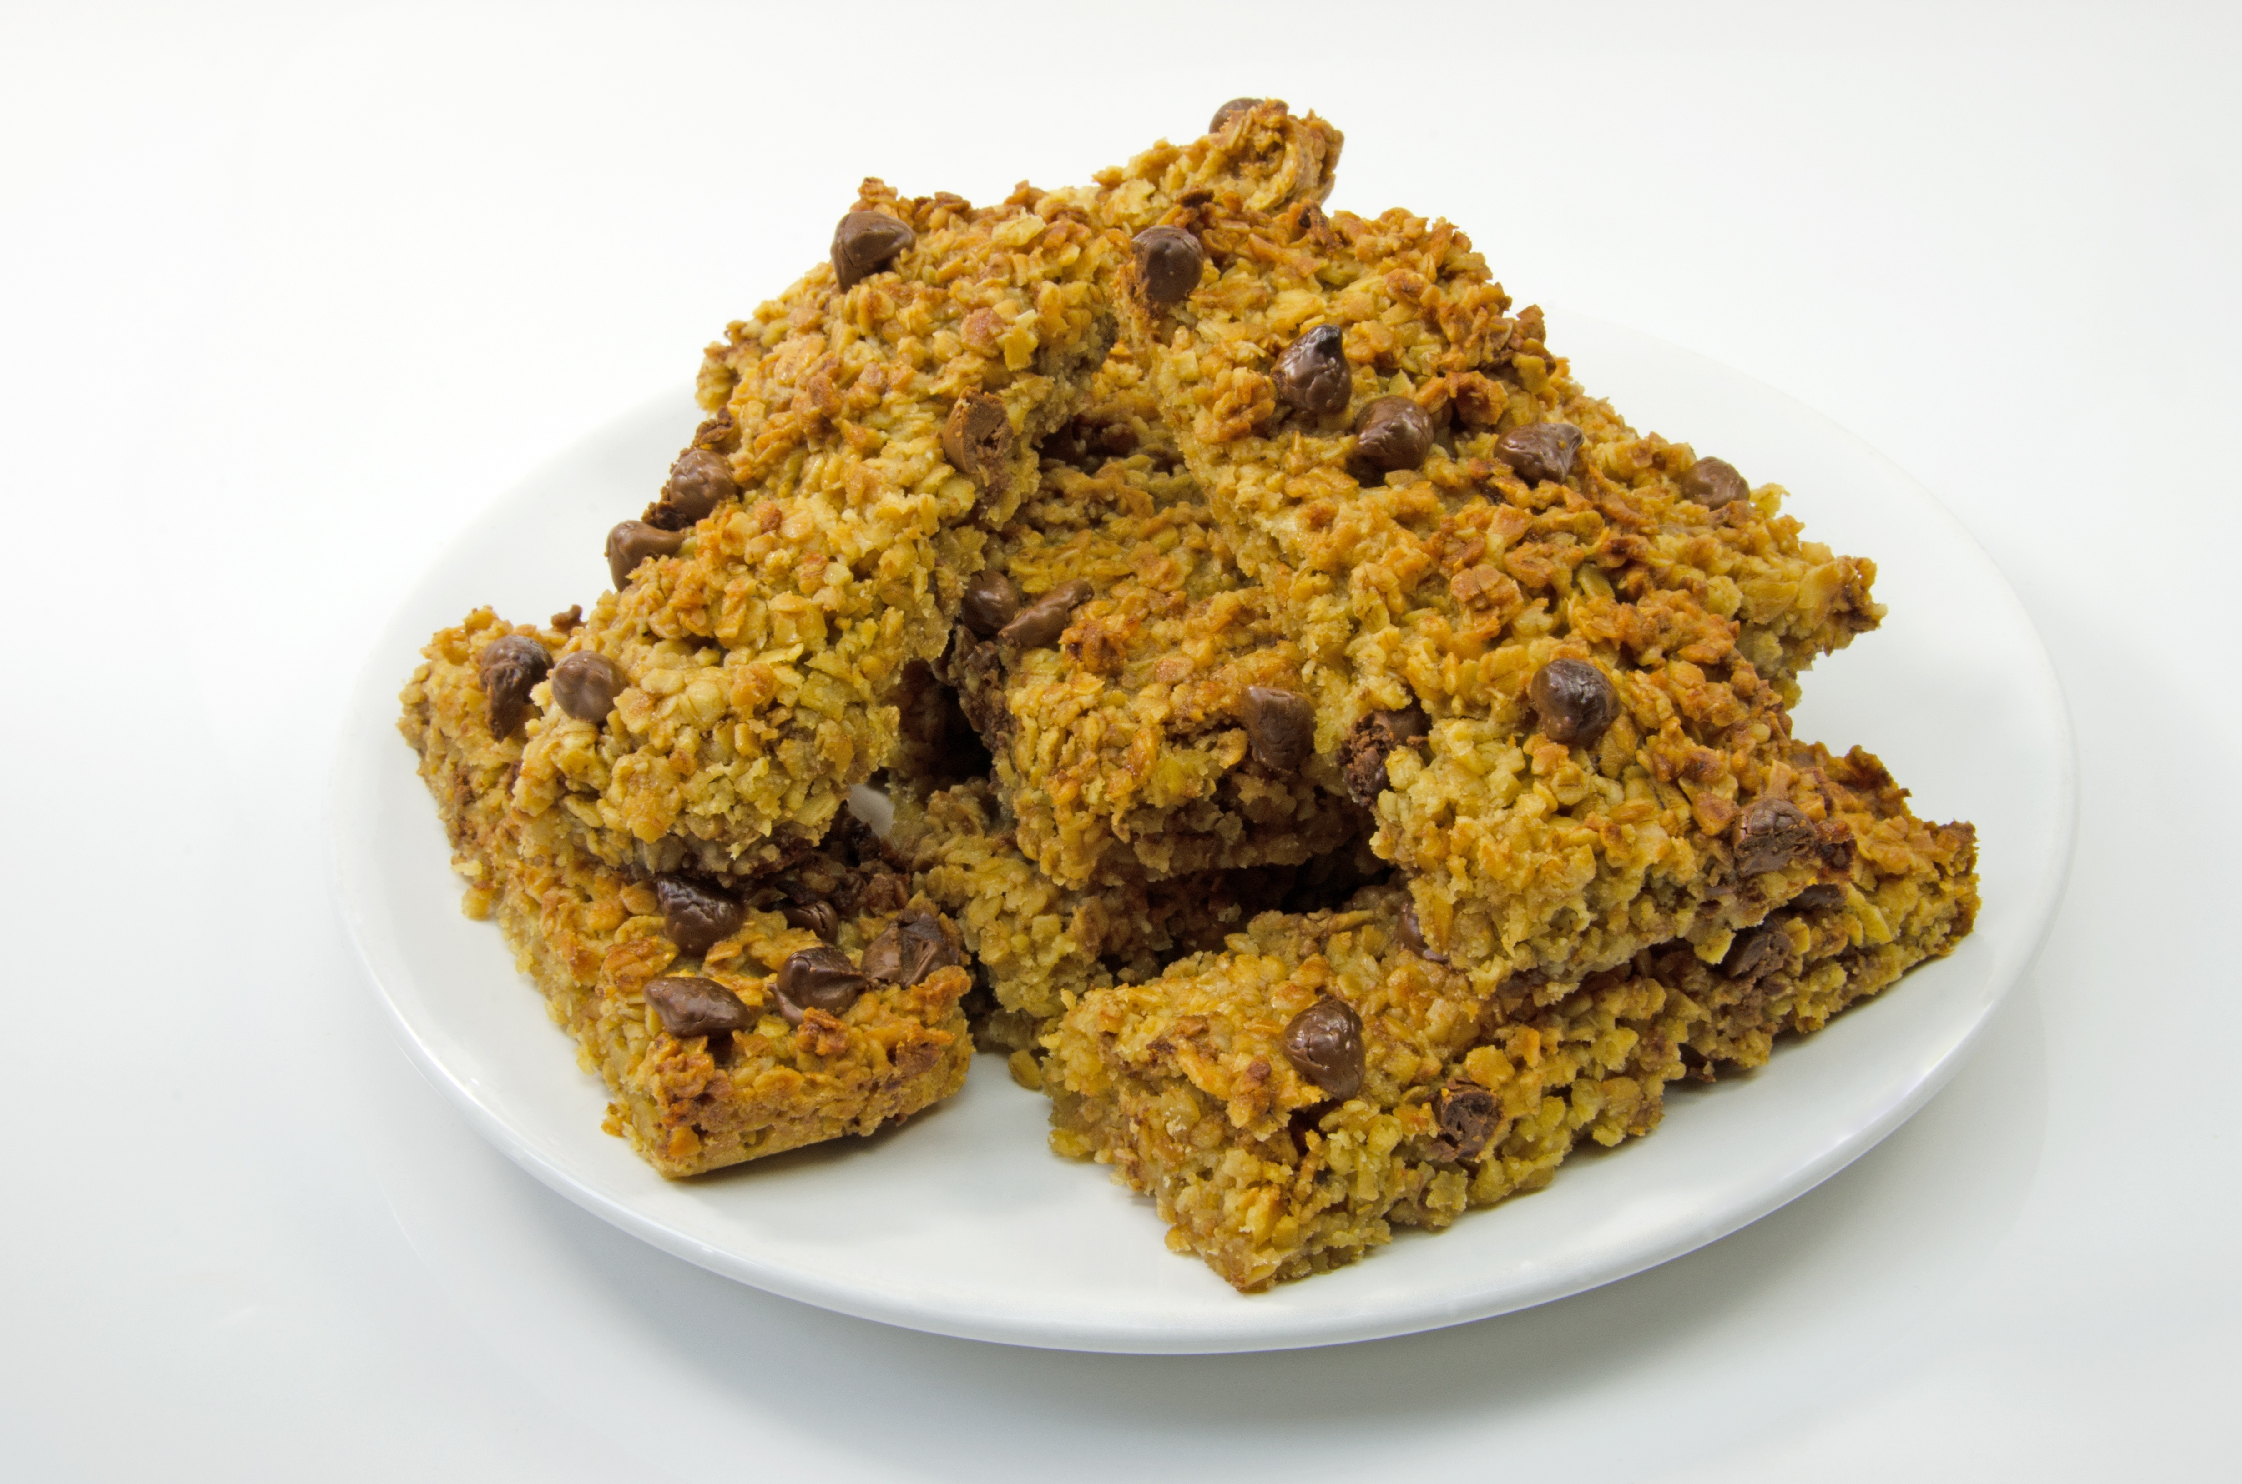
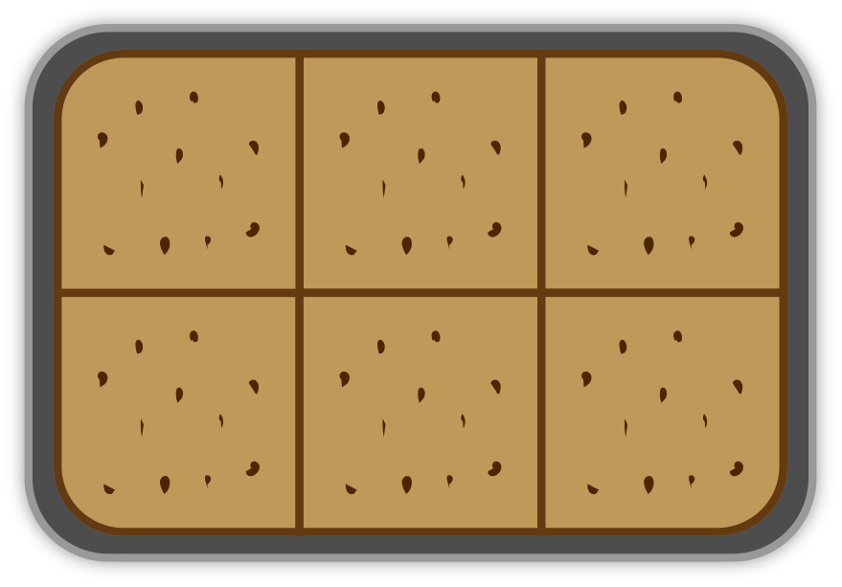
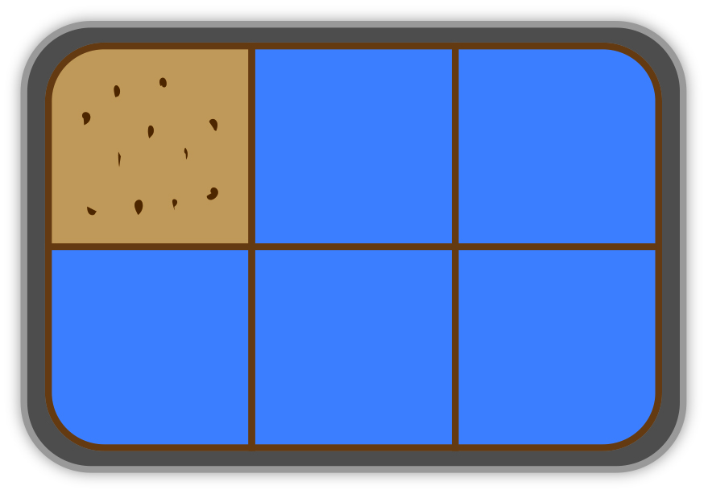
Introduction activity – Flapjack in a tray
Matthew works in a café behind the counter selling food and drink.
The café sells slices of flapjack. There are 2 trays of flapjack on display. Both trays of flapjack are cut into 6 equal pieces. Each piece of flapjack is for sale.
Notes:
Tutor guidance is given for the lesson introduction
Learners draw representations of both trays. Encourage discussion. If five pieces are sold from one tray, what fraction of flapjack is left in the tray? Show animation of five pieces being sold and one piece left i.e., 1/6.
Establish that learners understand the mathematical language that will be helpful to them in the following activities
Key words: Numerator, denominator, factors, multiples, sum, horizontal and vertical.
If appropriate, draw attention to other areas of maths where this language is also used – make connections. Notice how learners engage with the language of fractions and how easily they relate to fractions.
The objectives of this slide are:
to set the context
to establish prior learning
to encourage discussion
to initiate the understanding of arrays and their relationship with the fraction denominator and numerator

Slide 3
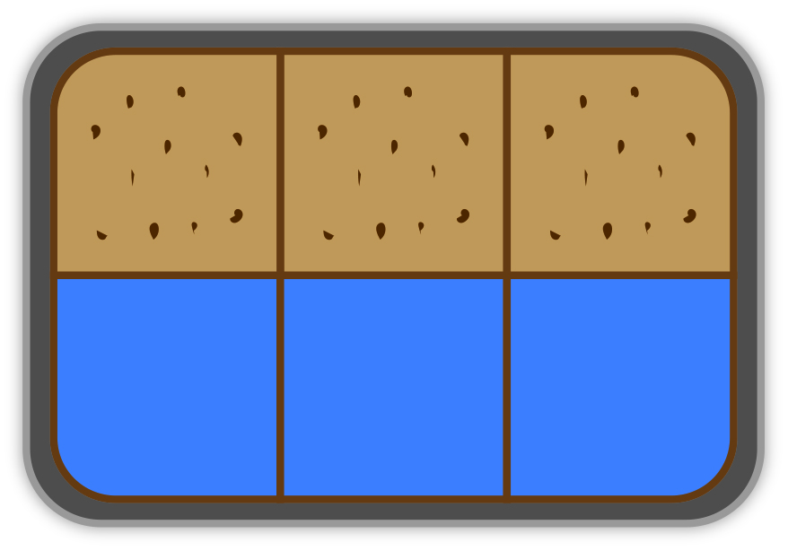
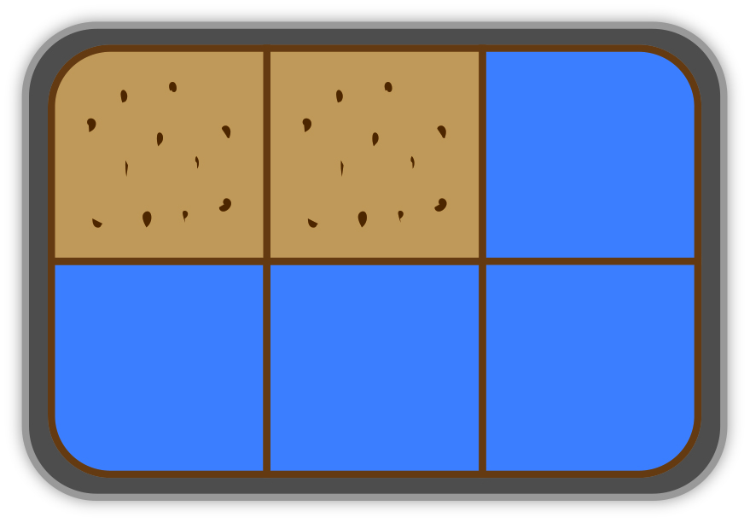
Introduction activity – Flapjack in a tray
At the end of Matthew’s shift working at the café, there were 3 pieces of flapjack left in one tray and 2 pieces of flapjack left in the other tray
If Matthew added all of the pieces of flapjack together, how many pieces would he have?
Matthew placed all the pieces of flapjack into one of the trays.
What fraction of this tray would be filled with flapjack?
Notes:
Learners’ can present their answers on mini white boards and then record their work in their workbooks
Ask learners’ to draw representations of both trays i.e. one with 3/6 and one with 2/6 and their final answers
Learners can present their representations and answers.
After learners have displayed their representations, use animation to reveal the trays.
Sharing of ideas enables learners;
To gain insight and allows different entry points to the task.
Recognise their misconceptions
Encourages an environment where everyone can succeed.

Slide 4
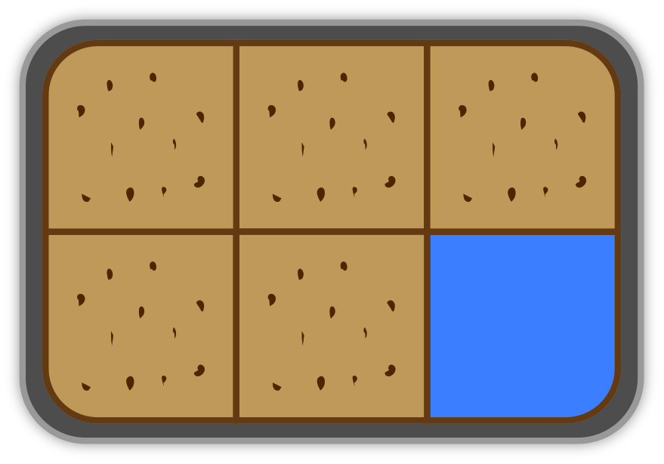



Discuss 1: Learners’ representations and answers
REVIEW
+
=
+
=
$$\frac{5}{6}$$
$$\frac{3}{6}$$
$$\frac{2}{6}$$
Notes:
Finally, tutor can show the PowerPoint array representations.
Learners record their work in their workbooks.
Questions
What is the total number of pieces of flapjack a tray will contain? – the denominator
How many pieces of flapjack do we have in the tray? – the numerator
When the pieces from the two trays are added to one tray, what fraction of that tray contains flapjack?
If 2/6 has been left in one tray, how much has been eaten from that tray? Learners can work backwards and assemble a whole tray.
6/6 pieces in one tray is a whole tray.
How many sixths have been eaten in total?

Slide 5

Adding and subtracting fractions
KEY IDEA
The total number of pieces that make up one whole is known as the denominator. This number is written at the bottom of the fraction.
The number of pieces that we have of the whole is know as the numerator. This number is written at the top of the fraction
When we add or subtract fractions, we always add or subtract equal pieces. The denominators must be the same.
Notes:
Clarify understanding of these key ideas.
Learners record these key ideas in their workbooks.

Slide 6

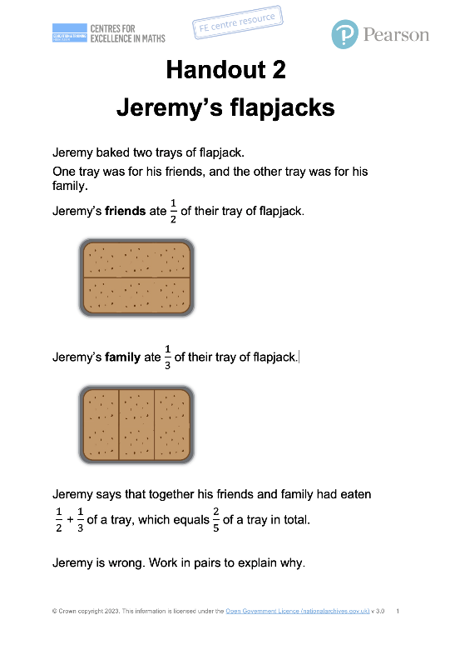
Jeremy’s flapjacks
EXPLORE 2
Handout
available
Jeremy has baked two trays of flapjacks for his friends and family.
Read through the handout and consider why Jeremy is wrong about the total amount eaten.
Discuss your thoughts with your partner, using the diagrams of the flapjacks to help you.
Come to an agreement and present your thinking on your mini-whiteboard.
Notes:
In this activity we:
are working with fractions that have different denominators
are using arrays to represent these two different fractions and their respective denominators
are introducing these fraction representations with either vertical or horizontal lines.
aim to expose a common misconception – leaners adding the numerators together and denominators together
introduce a method of finding a new denominator that is the same for both fractions
Ask learners to work in pairs and give each pair a copy of Handout 2: Jeremy’s flapjacks. If learners jump to the abstract to find the LCM, ask them to explain why this works using the array representation.
Make sure that learners explain their approach to their partner, working together to agree on a solution and each developing their own understanding. If you notice that one learner is answering all the questions, or they are not working collaboratively, ask a learner to explain a question that has been answered by their partner.
Observe learners as they complete this task but do not intervene unless necessary. As learners work on the task, notice how they illustrate their strategy. As you observe them, identify those with different approaches.
After learners have had time to attempt the activity, ask learners to hold up their mini-whiteboards showing their reasoning. Select one or two pairs with different approaches to explain their thinking to the whole class and check if other learners agree or disagree with the explanation. Discuss and resolve any errors or misconceptions that arise.

Slide 7
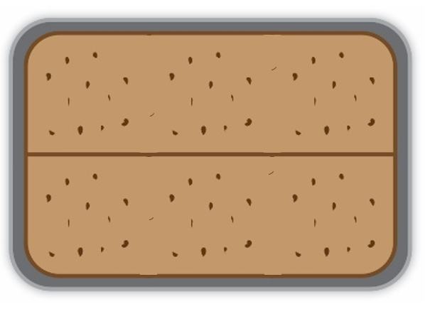
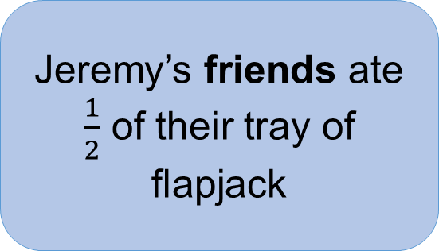
DISCUSS
Jeremy’s friends
Jeremy’s friends ate $\frac{1}{2}$ of their tray of flapjack
Notes:
Use slides 7-9, as required, to consolidate learner explanations and understanding.
First of all reveal one tray cut into halves (i.e. two pieces).
Check understanding that Jeremy’s friends have eaten one of these two pieces.

Slide 8
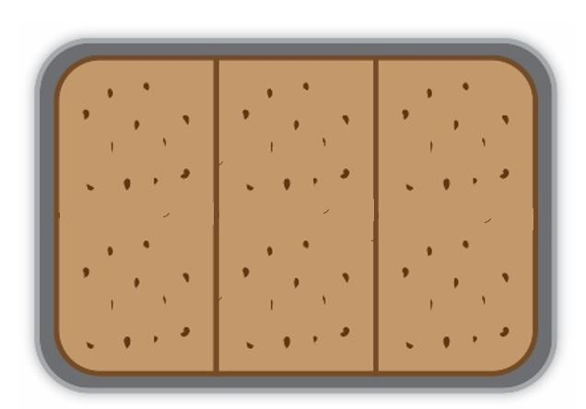
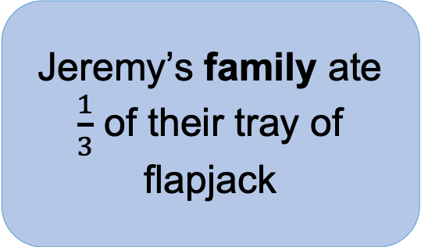
DISCUSS
Jeremy’s family
Jeremy’s family ate $\frac{1}{3}$ of their tray of flapjack
Notes:
Reveal the other tray cut into thirds (i.e. three pieces).
Check understanding that Jeremy’s family have eaten one of these three pieces.

Slide 9
DISCUSS
Common Denominator
Now let’s combine the two cuts.
How many pieces are there now?
What fraction is each piece?
This means that the common denominator of 2 and 3 is 6.
Notes:
Reveal a tray with both the horizontal cut (halves) and vertical cut (thirds).
Ask how many pieces there are now & what fraction of the whole tray each piece represents (i.e. 1/6)
Remind learners that 6 is the denominator of the fraction, so this means the common denominator of 2 and 3 is 6.
Check that learners understand what has been said, and ask:
Can you see the half eaten by Jeremy friends? Where?
Can you see the third eaten by Jeremy’s family? Where?
So how many pieces have they eaten between them?
What is this as a fraction of the whole tray?

Slide 10



Adding fractions
DISCUSS
+
=
$$\frac{1}{2}$$
+
=
$$\frac{5}{6}$$
$$\frac{1}{3}$$
Notes:
Use this slide to summarise what was demonstrated in the previous slides.
Establish through discussion and questioning that:
the new denominator is 2 × 3, a multiple of the denominators 2 and 3
equivalent fractions have been used
the new numerators have been multiplied by the same multiplier as their respective denominator.
Question learners:
What do you notice about the new denominator?
What do you notice about the new numerator?
Can this fraction be simplified?
Did learners notice the third denominator is a multiple of each of the first two?
Use of words: horizontal, vertical, factors and multiples, prime numbers.

Slide 11
Adding and subtracting fractions
KEY IDEA
When adding or subtracting two fractions with different denominators, you must make the fractions equivalent, and both fractions must have the same denominator.
You can use a common multiple or lowest common multiple to make the fractions equivalent.
If you can, simplify your answer.
Notes:
Clarify understanding of these key ideas.
Learners record these key ideas in their workbooks
If appropriate, tutors should draw attention to the LCM e.g., the LCM of 2 and 3 is 6.

Slide 12
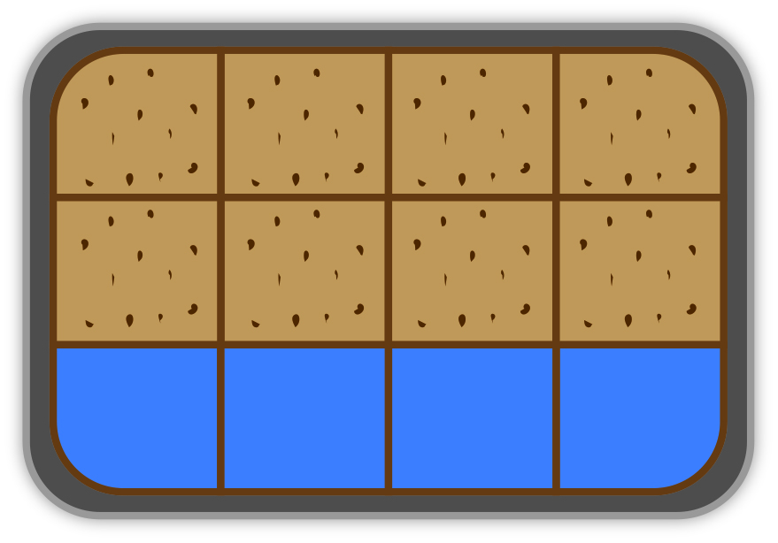
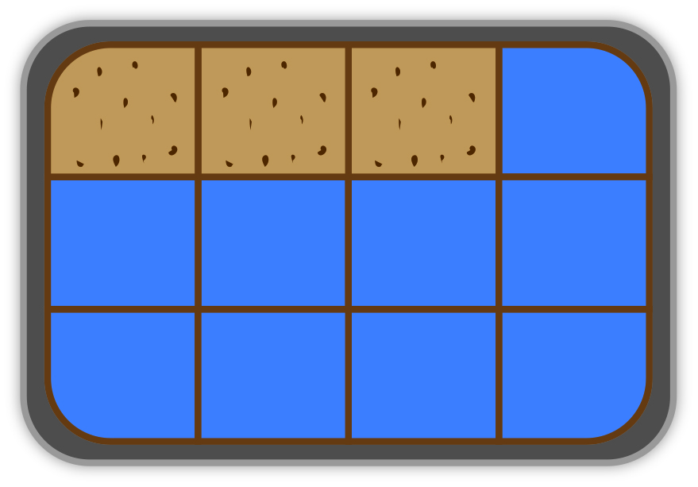
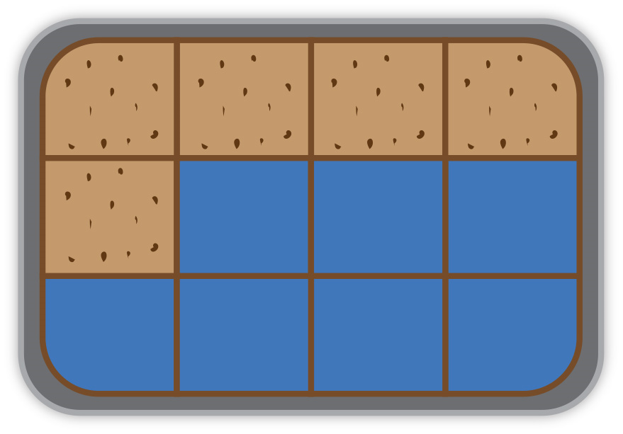
Tutor demonstration – subtracting fractions
−
=
8/12
3/12
=
5/12
−
Notes:
Tutor models a subtraction using two 3 × 4 arrays to solve 2/3 – 1/4.

Slide 13
Review of tutor demonstration
–
=
2/3 – 1/4
8/12 – 3/12 = 5/12
Explain why these are equivalent fractions.
Can this answer be simplified?
If not, why not?
Notes:
Draw out the term equivalent. Why is 8/12 equivalent to 2/3? Why is 3/12 equivalent to 1/4?
Reiterate the key ideas.
Question learners :
Why are these equivalent fractions?
Can the answer be simplified?
If not, why not? – prime number
Encourage learners to draw array representations of these fractions.
Words: ratio, multiplier, divide

Slide 14

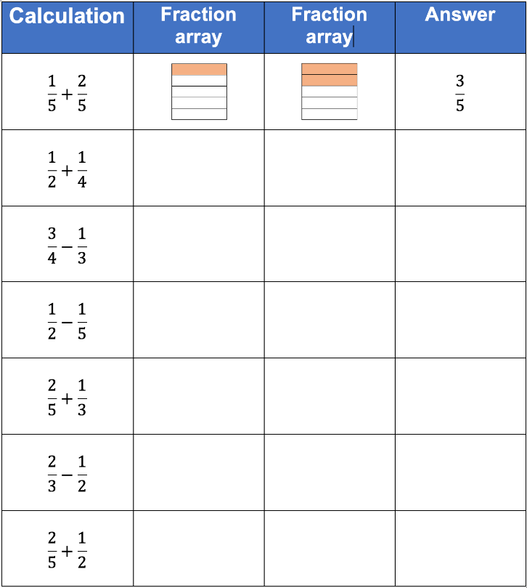
Card matching activity
EXPLORE 3
Work in pairs and share your ideas.
First, match the fraction array cards with the fraction calculations.
Next, match the fraction answer cards to the fraction arrays.
Finally, match percentage cards to the fraction answers.
Notes:
Learners to work in pairs.
Learners to be given the incomplete fractions grid. This can be on A3 and laminated.
The purpose of this activity is to:
provide an opportunity for procedural variation
expose misconceptions
show connections with percentages
encourage discussion and understanding
use array representation to provide insight into the new denominators and numerators
Common misconceptions:
Adding or subtracting fractions as they are.
Changing the denominators and not the numerators.
Using a multiplication to calculate a new denominator, but an additive approach to the numerator.
1. First, learners match the fraction answers (fraction cards provided).
Correct answers provided, as well as possible misconceptions.
Allow for any misconceptions.
2. Second, leaners match the fraction array representations to the calculations.
3. Third, learners can lay the percentage cards alongside their respective common fraction answers.
Make sure that learners explain their approach to their partner, working together to agree on a solution and develop their own understanding. If you notice that one learner is answering all the questions, or they are not working collaboratively, ask a learner to explain a question that has been answered by their partner.
Observe learners as they complete this task but do not intervene unless necessary. As learners work on the task, notice how they illustrate their strategy. As you observe them, identify those with different approaches. You can call them on to explain their thinking in the next part of the lesson.

Slide 15


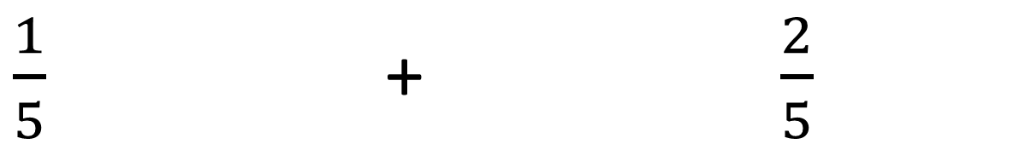
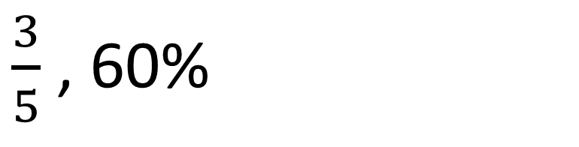
REVIEW
$\frac{1}{5}$ + $\frac{2}{5}$
$\frac{3}{5}$ , 60%
Notes:
Use slides 15-21 to discuss learners’ responses to the card match activity. Animation will reveal the answer and percentage equivalent.
What did learners notice – equivalent/simplified fractions.
Did learners complete calculations without the arrays?
How easily did the learners match the percentage cards?

Slide 16
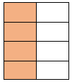

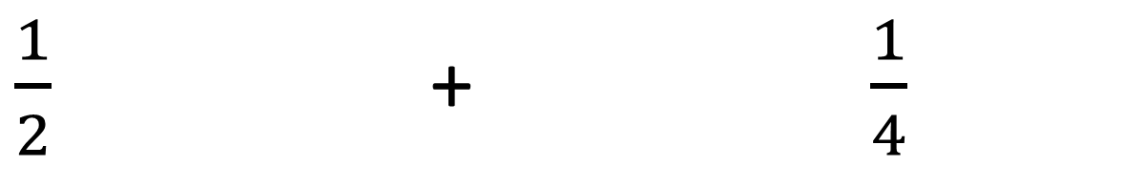
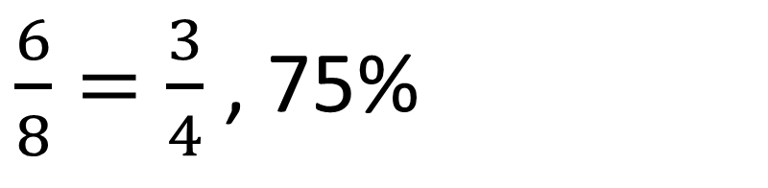
REVIEW
$\frac{1}{2}$ + $\frac{1}{4}$
$\frac{6}{8}=\frac{3}{4}$ , 75%

Slide 17


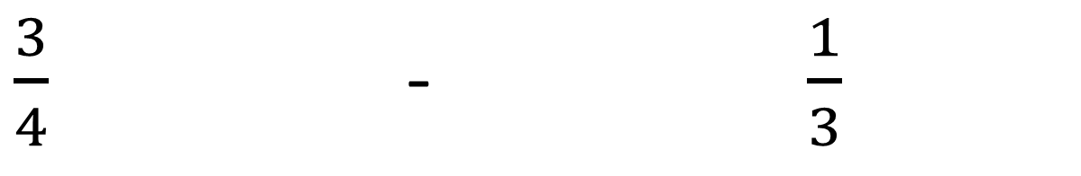

REVIEW
$\frac{3}{4}$ - $\frac{1}{3}$
$$\frac{5}{12}$$

Slide 18


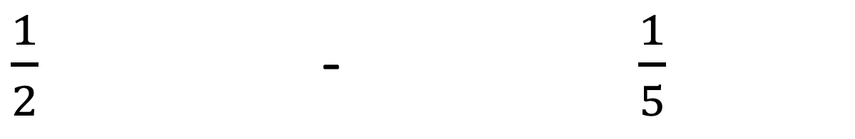
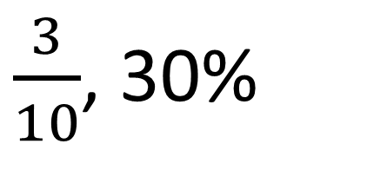
REVIEW
$\frac{1}{2}$ - $\frac{1}{5}$
$\frac{3}{10}$, 30%

Slide 19


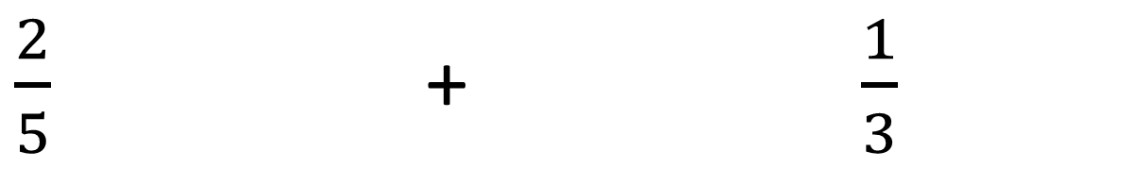

REVIEW
$\frac{2}{5}$ + $\frac{1}{3}$
$$\frac{11}{15}$$

Slide 20


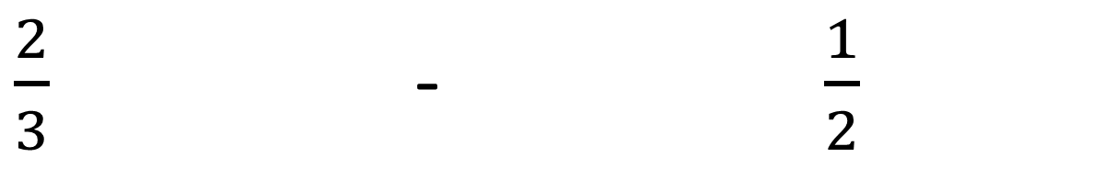

REVIEW
$\frac{2}{3}$ - $\frac{1}{2}$
$$\frac{1}{6}$$

Slide 21


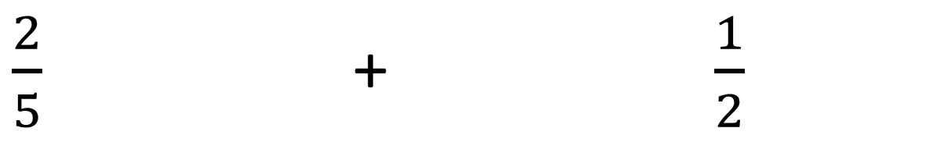

REVIEW
$\frac{2}{5}$ + $\frac{1}{2}$
$$\frac{9}{10}, 90\%$$

Slide 22

Practice question 1
REVIEW
Work out
$$\frac{17}{40}$$
Notes:
Distribute copies of the exam question handout and ask learners to attempt these independently.
Use slides 22 and 23 to discuss answers and methods.

Slide 23

Practice question 2
REVIEW
Gareth sells hot drinks.
He sells cups of tea, cups of coffee and cups of hot chocolate.
Of all the hot drinks he sold last week:
were cups of tea
were cups of coffee.
What fraction of all cups of hot drinks sold were cups of hot chocolate?
$$\frac{4}{15}$$
Notes:
Distribute copies of the exam question handout and ask learners to attempt these independently.
Use slides 22 and 23 to discuss answers and methods.

Slide 24
Lesson review:
Adding and subtracting fractions
Level 2
Objectives
Add and subtract fractions with common denominators
Add and subtract fractions with different denominators using array representations
Recognise equivalent fractions using array representations
Simplify fractions
Suggested further steps/areas to work on
Adding and subtracting mixed numbers
Notes:
Ask learners whether they have used a different approach to that used prior to the lesson when adding or subtracting fractions. How has their thinking changed? What have they learned about adding and subtracting fractions?

Slide 25
Lesson 11:
Credits
Photo acknowledgements:
123RF.com: Andy Fletch
Text acknowledgements:
Pearson Edexcel Functional Skills, Practice Set 3 - Mathematics Level 2 (Non-Calculator) PRACL2/N03 Question 3c, Pearson Edexcel Functional Skills, Past Paper 5 - Mathematics Level 2 (Non-Calculator) PMAT2/N05 Question 1

