Slide 1


Lesson 3:
Graphs and charts
Level 1
Objectives
Gather, record and present data
Interpret different charts
Construct pie charts

Slide 2
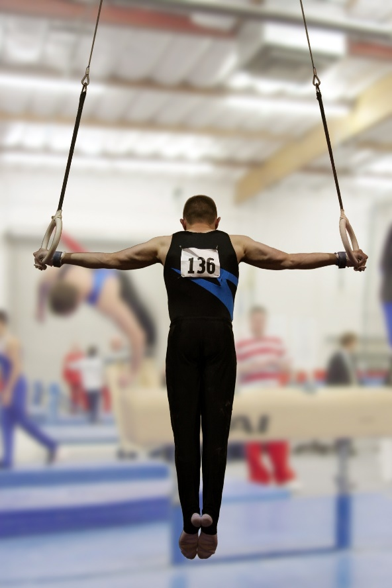
Say what you see (1)
Total medals won by four countries in the 2016 Rio Olympic Games
Country | Tally
Brazil | IIII IIII IIII IIII
Kenya | IIII IIII III
Jamaica | IIII IIII I
South Africa | IIII IIII
How could you display this tally on a graph or chart?
Notes:
Start by asking the class what they can see on the slide – leaving the question entirely open.
After taking a range of open responses, probe as required to identify:
The type of chart. Probe further for what a tally chart shows, how it is compiled and what its purpose is. Make sure that learners are familiar with the five-bar gate format.
What the chart is showing – a list of countries, medals won by the countries, etc.
Move on to more specific questions – how many medals were won by Brazil? Which country won the fewest medals? etc.
Highlight that a tally chart is a way of collecting data, but is not a final representation of the data.
Use the animation to reveal the question: How could you display this tally on a graph or chart?
Ask learners to discuss this question in pairs, then write their answers on mini whiteboards. When all have written their answers, ask them to hold the answers up.
Write down the different suggestions on the board and discuss why each may or may not be a good representation. (NB The only one that isn’t appropriate is a line graph, as this should only be used for numeric data in sequence.)

Slide 3
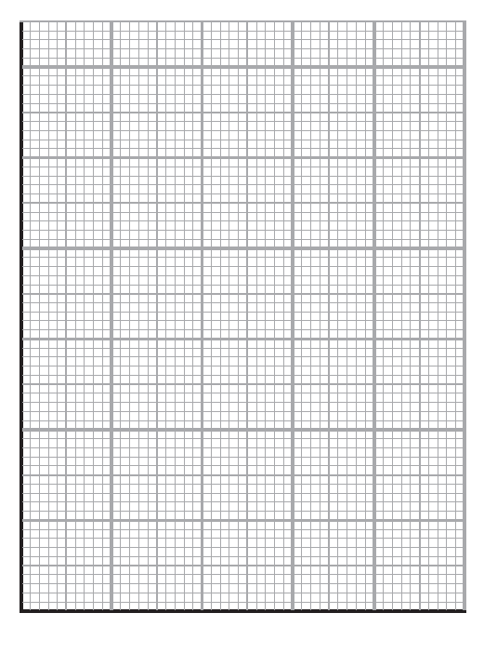
What’s the same and what’s different?
DISCUSS
20
15
Number of medals won
10
5
Brazil
Kenya
Jamaica
S Africa
Country
Notes:
Start by drawing attention to the four charts shown (including the tally chart on Slide 3), and check that everyone is aware of what they are called. Inform that all the charts are displaying the same data on medals won at the 2016 Rio Olympics.
Ask learners to work in pairs and compare the four representations, and to note down:
What is the same & what is different about each representation?
What are the advantages & disadvantages of the different types of chart?
Allow 5 min for discussion, then take feedback.
Probe for similarities & differences first, e.g.:
Tally chart & bar chart both show ‘bars’ – though one is vertical and the other horizontal (does this matter?).
The pie chart shows percentages (how would you work out percentages from the other two charts?)
Extend the discussion to take in the advantages & disadvantages of different representations, e.g.:
The bar chart is easier to see the number of medals won by each country.
The pie chart is easier to see the percentage (or proportion) of medals won by each country.
A tally chart is often the raw data and this is then presented as a bar or pie chart.
Is a line graph appropriate? When might you use a line graph?
Finish by asking which representation of the data would they choose if they were trying to communicate this information? (and does it depend on the purpose?)

Slide 4
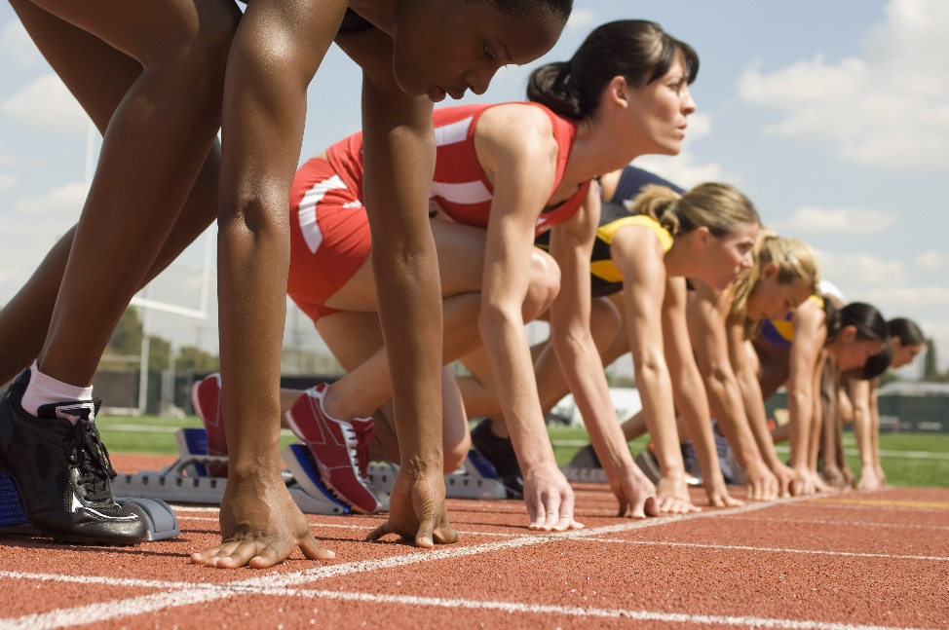
Say what you see (2)
Ages of athletes in the 100 m race at the 2012
London Olympic Games
26, 25, 19, 17, 23, 17, 23, 27, 29, 20,
21, 21, 24, 19, 23, 19, 17, 25, 30, 18,
36, 23, 24, 24, 17, 15, 17, 20, 26, 29,
28, 19, 16, 23, 19, 27, 19, 19, 25, 21,
20, 25, 24, 20, 25
    How could you display this as a tally?
    How could you display this on a graph or chart?
Notes:
Discuss this set of data, and discuss the ways that it is different to the data about medals won (e.g. it is numeric data, data isn’t organised into categories).
Discuss initial impressions of the data – what sorts of ages are the athletes? What is the youngest age? What is the oldest age? Is this what they’d expect?
Q1: Use animation to reveal the first question. Ask learners to discuss this in pairs or small groups. While they do so, circulate to listen to their discussions and offer prompts if required.
When learners have understood the need to group the data, ask them to do so and produce a grouped frequency table on their mini whiteboards and compare their answers with another pair.
Ask learners to hold up their mini whiteboards and check for mistakes & misconceptions. Note the bands that have been used – what age groups have they chosen? Are they equal? Are they overlapping? Discuss points that arise to ensure everyone has understood.
Finally, ask if the tally chart has helped them make more sense of the data. What is it showing?
Q2: Reveal the 2nd question, and ask learners to discuss in pairs what type of graph/chart they would use to display the data. Discuss answers – line graphs and bar charts would be the best representations. However, pie charts would not be so good, as this would only show the percentages, but not the trend in the data.

Slide 5
Grouped frequency tables
A grouped frequency table is a way of organising a large set of data into more manageable groups.
Ages of athletes in the 100 m race at the 2012 London Olympic Games
26, 25, 19, 17, 23, 17, 23, 27, 29, 20, 21, 21, 24, 19, 23, 19, 17, 25, 30, 18, 36, 23, 24, 24, 17, 15, 17, 20, 26, 29, 28, 19, 16, 23, 19, 27, 19, 19, 25, 21, 20, 25, 24, 20, 25
Depending on how the group is chosen, there is more than one way to present the table. Here are two examples.
Age group | Frequency
15−17 | 7
18−20 | 12
21−23 | 8
24−26 | 11
27−29 | 5
30−32 | 1
33−35 | 0
36 or older | 1
Age group | Frequency
15−20 | 19
21−25 | 17
26−30 | 8
31−35 | 0
36 or older | 1
Notes:
Two examples of grouped frequency tables.

Slide 6

Representing data
KEY IDEA
Different types of graph and chart are suitable for different purposes.
Line graphs are good to track trends in numeric data, particularly over time.
Pie charts are good for showing percentages or proportions of the whole, but do not show trends.
Bar charts are suitable for either purpose.
Notes:
Highlight the suitability of different representations for different data and purposes. Give examples to illustrate.

Slide 7


Task 1 – Data collection (1)
PRACTICE
Handout
available
Working in groups of 2 or 3, you need to collect data from the other learners in the class and record this data in a tally chart.
What data could you collect?
how they get to college?
favourite type of music?
favourite brand of sportswear?
best takeaway food?
Limit the number of answers to 4 categories.
Notes:
Data collection activity. Handout 1
Tutor to discuss why data collection may be done? Why would companies carry out market research? And how, once data is collected, it would be presented visually in charts so that good decisions are made.
For the task, ask learners to work in pairs or 3s. Learners are to decide on a question and collect data from each other. Animation on the slide provides suggestions on the data they could collect. Allow the learners a few minutes to think about this in pairs or groups and then feed back.
Next ask learners to circulate the room collecting the required data from each other and recording it on a tally chart (note that if the data is numeric, they may want to use a grouped tally chart).

Slide 8

Task 2 – Data collection (2)
PRACTICE
Now that you have collected your data, present the data in two different types of graphs or charts.
What types of graphs or charts could you use?
  Pictogram, bar chart, line graph, pie chart…
Is there anything missing in your graphs or charts?
Prepare to share your graphs or charts with another group.
Notes:
Data presenting activity. Handout 1
Next, ask the learners to present the data in two different formats of graph or chart – bar chart, line graph, pie chart. Some may use a pictogram which is fine – although not assessed in FS. They can use Handout 1 to present their data.
When completed, each pair should share their graphs/charts with the class and comment on what it is showing. Ask them to say which of their representations shows the data most clearly, and see if others agree.
Class discussion about what is needed on charts and what they have missed off (keys/evenly spaced scales/axis labels/titles). The learners could mark their own charts. Did they miss anything off? Explain how in FS exams they will not get all the marks if they do not remember all the criteria needed: title, labels, even scale, etc.

Slide 9
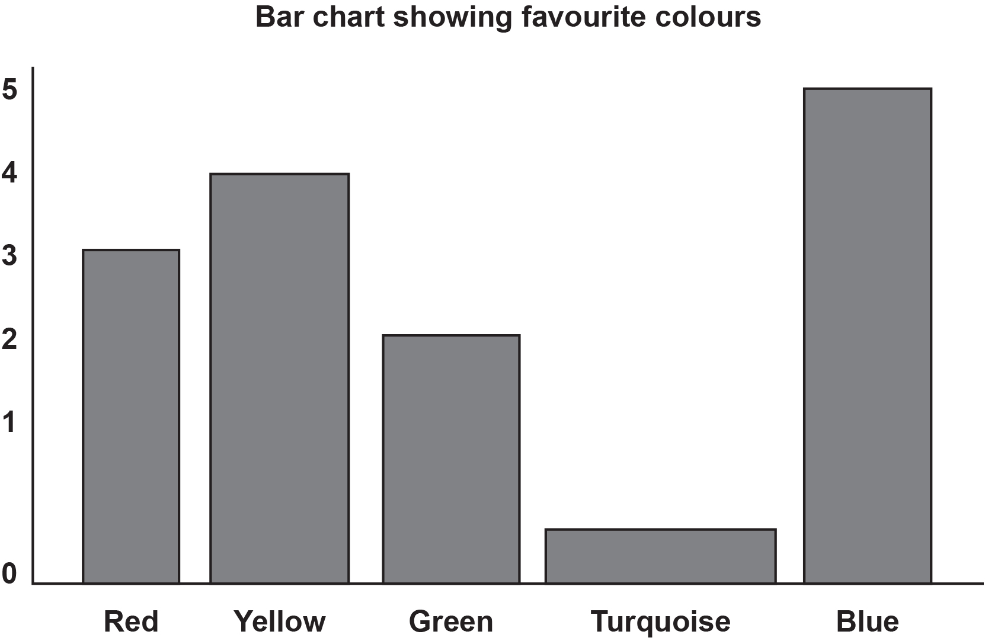
What’s wrong?
EXPLORE
Notes:
This bar chart has been drawn incorrectly. Ask learners to examine the chart for a minute or so and identify things that are wrong with it.
Ask different learners for their feedback and discuss it.
If not mentioned, highlight the following:
The y-axis is missing
Neither axis is labelled
The width of the bars are unequal
The title is incomplete (whose favourite colours?)

Slide 10
Representing data
KEY IDEA
Graphs & charts need to be labelled and plotted accurately to be understood by the reader. Labels may include:
Title (say what the chart is showing)
Axis titles
Evenly spaced divisions & labels on axes
Key
Gaps between bars (if discrete data)
Notes:
Emphasise that the purpose of graphs and charts is to communicate complex information clearly to the reader. In order to do this, they need to be labelled and plotted accurately.
Highlight that all graphs and charts should have a title, but that other labels depend on the type of chart. (Axes titles & labels are required on a bar chart, whereas a key is required on a pictogram, and often a pie chart.)

Slide 11
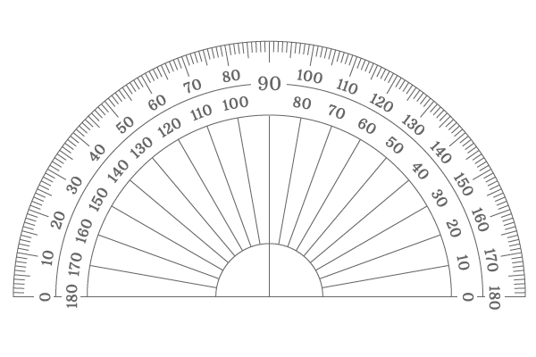
Pie charts: favourite takeaways
Handout
available
In a survey, students were asked what was their favourite takeaway. The results are shown below.
Plot this data as a pie chart.
Chinese
Takeaway choice | Frequency | Angle
Chinese | 50 | 150º
Pizza | 30 | 90º
Curry | 40 | 120º
Total | 120 | 360º
Notes:
Give out Handout 2 so that learners can work through the example with you.
Use Slides 10–11 to model the plotting of the pie chart using a protractor.

Slide 12
Favourite takeaways
Takeaway choice | Frequency | Angle
Chinese | 50 | 150º
Pizza | 30 | 90º
Curry | 40 | 120º
Total | 120 | 360º
Curry
Chinese
Pizza
Notes:
Use slides 10–11 as required, to model the plotting of the pie chart using a protractor.

Slide 13
DISCUSS
Pie charts: favourite drinks
Students were asked what their favourite drink was.
What’s missing from the table?
How can you find the missing angles so you can plot the pie chart?
Favourite drink | Frequency | Angle
Cola | 50 | 150º
Lemonade | 30
Fruit juice | 40
Total | 120 | 360º
× 3
× 3
90º
× 3
120º
× 3
Notes:
In this question, not all the angles are provided.
Ask learners what is missing, then reveal the 2nd question.
Discuss how the missing angles can be found.
Use the animation as appropriate to highlight the ×3 multiplier for cola & the total, & discuss how the missing value can be found before revealing with the animation.

Slide 14
DISCUSS
Pie charts: favourite sports
In another survey, 1400 students were asked what their favourite sport was.
Results are shown in the pie chart.
How many said football was their favourite sport?
How many said boxing was their favourite sport?
Notes:
This question relates to a different survey.
Reveal Q1 and ask learners to display answers on mini whiteboards. Check for any errors or misconceptions and discuss how learners arrived at the answer.
Repeat for Q2.

Slide 15
Using a ratio table to solve Q1 and Q2
How many said football was their favourite sport?
How many said boxing was their favourite sport?
football = 180º
boxing = 90º
 | Total | Football | Boxing
Degrees | 360
No. of people | 1400
÷ 2
÷ 2
180
90
700
350
÷ 2
÷ 2
Notes:
This slide can be used to show how a ratio table can be used to solve the question.

Slide 16
Constructing and interpreting pie charts
KEY IDEA
Constructing and interpreting pie charts involves direct proportion.
It requires conversions between frequencies and degrees (and vice versa) by scaling up or down.
Ratio tables may help with this.
Notes:
Emphasise the proportional relationship between frequency (no. of items) and degrees, and the connections with work that they did earlier in the year on proportion – including the use of ratio tables.

Slide 17
Practice question 1
PRACTICE
Handout
available
Here is information about the distances travelled in miles by some people yesterday.
distance (miles)
5 | 4 | 12 | 8
1 | 2 | 8 | 7
18 | 7 | 9 | 11
11 | 22 | 7 | 6
2 | 3 | 3 | 1
Sandro starts to show this information in a grouped frequency table.
Complete the grouped frequency table.
Use five equal groups.
distance (miles) | tally | frequency
1 to 5 | |||| ||| | 8
6 to 10
17
Notes:
Provide Handout 3 containing exam questions and ask learners to work through them.
Answers are provided on the next slide after each question.

Slide 18
Practice question 1 – answers
PRACTICE
Handout
available
Here is information about the distances travelled in miles by some people yesterday.
distance (miles)
5 | 4 | 12 | 8
1 | 2 | 8 | 7
18 | 7 | 9 | 11
11 | 22 | 7 | 6
2 | 3 | 3 | 1
Sandro starts to show this information in a grouped frequency table.
Complete the grouped frequency table.
Use five equal groups.
distance (miles) | tally | frequency
1 to 5 | |||| ||| | 8
6 to 10 | |||| || | 7
11 to 15 | ||| | 3
16 to 20 | | | 1
21 to 25 | | | 1
18
Notes:
Use this slide to discuss how the answer is arrived at.

Slide 19
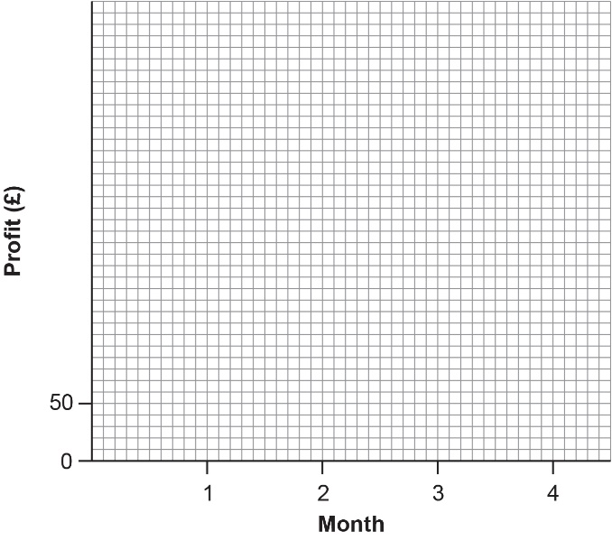
Practice question 2
PRACTICE
Handout
available
Layla starts a business making and selling scarves.
The table shows information about the profit she makes in the first four months.
month | 1 | 2 | 3 | 4
profit (£) | 200 | 180 | 220 | 275
Draw a graph for this information on the grid below.
19

Slide 20
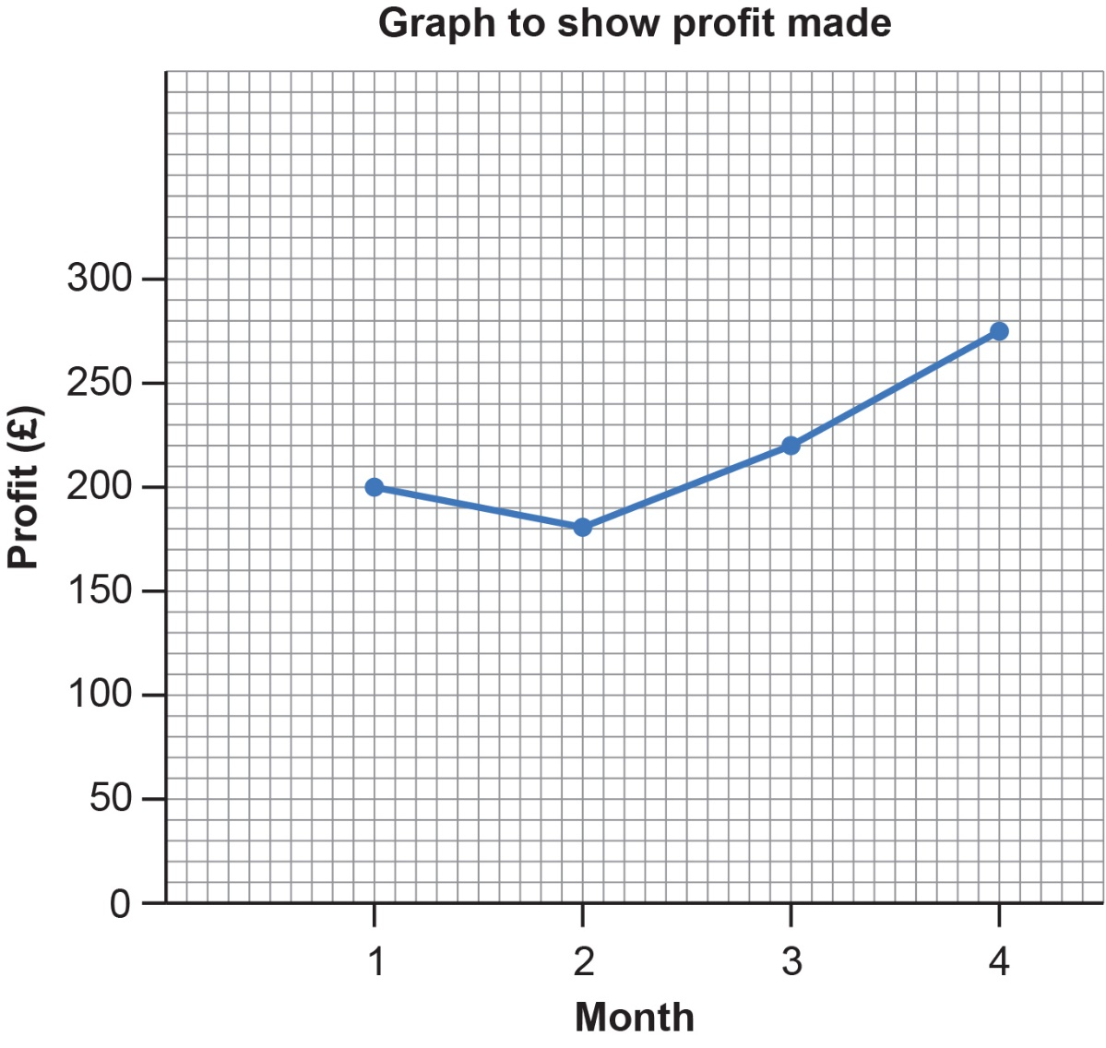
Practice question 2 – answers
PRACTICE
Handout
available
Layla starts a business making and selling scarves.
The table shows information about the profit she makes in the first four months.
month | 1 | 2 | 3 | 4
profit (£) | 200 | 180 | 220 | 275
Draw a graph for this information on the grid.
20
Notes:
Use this slide to discuss how the answer is arrived at.

Slide 21
Practice question 3
PRACTICE
Handout
available
Martyn clears all the rubbish left at the sports club.
He counts all the plastic drink bottles left each day for 60 days.
The table shows the results.
number of plastic bottles | frequency
0 – 9 | 2
10 – 19 | 12
20 – 29 | 15
30 – 39 | 23
40 – 49 | 8
Martyn wants to display this information in a chart.
Draw a chart to show this information.
21

Slide 22
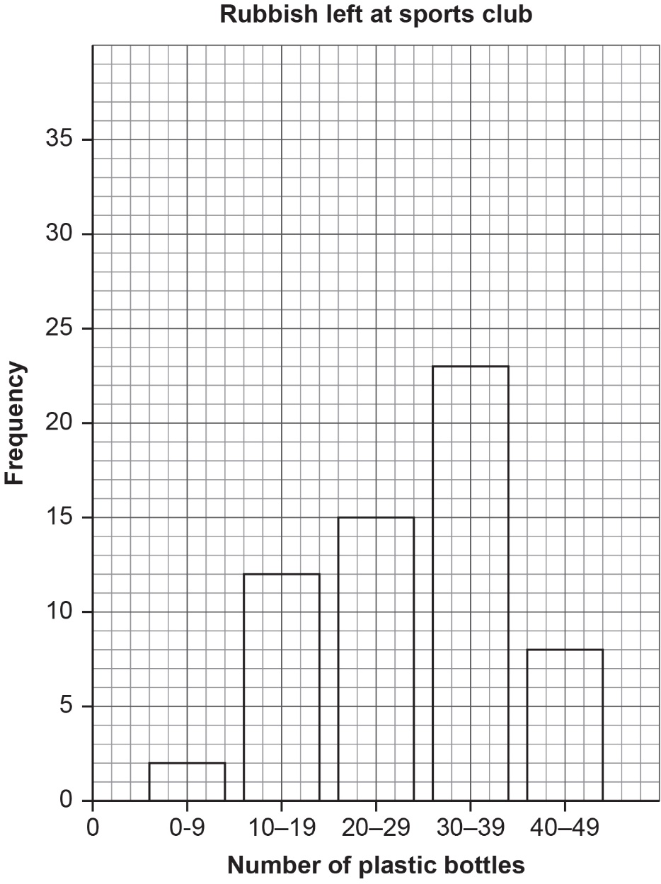
Practice question 3 – answers
PRACTICE
Handout
available
Martyn clears all the rubbish left at the sports club.
He counts all the plastic drink bottles left each day for 60 days.
The table shows the results.
number of plastic bottles | frequency
0 – 9 | 2
10 – 19 | 12
20 – 29 | 15
30 – 39 | 23
40 – 49 | 8
Martyn wants to display this information in a chart.
Draw a chart to show this information.
22
Notes:
Use this slide to discuss how the answer is arrived at.

Slide 23
Practice question 4
PRACTICE
Handout
available
John is a milkman.
The table shows information about the type of milk John delivers each day.
type of milk | number | angle
skimmed | 20 | 60°
semi skimmed | 55 | 165°
whole | 45 | 135°
Draw a pie chart to show this information.
Remember to label the chart.
23

Slide 24
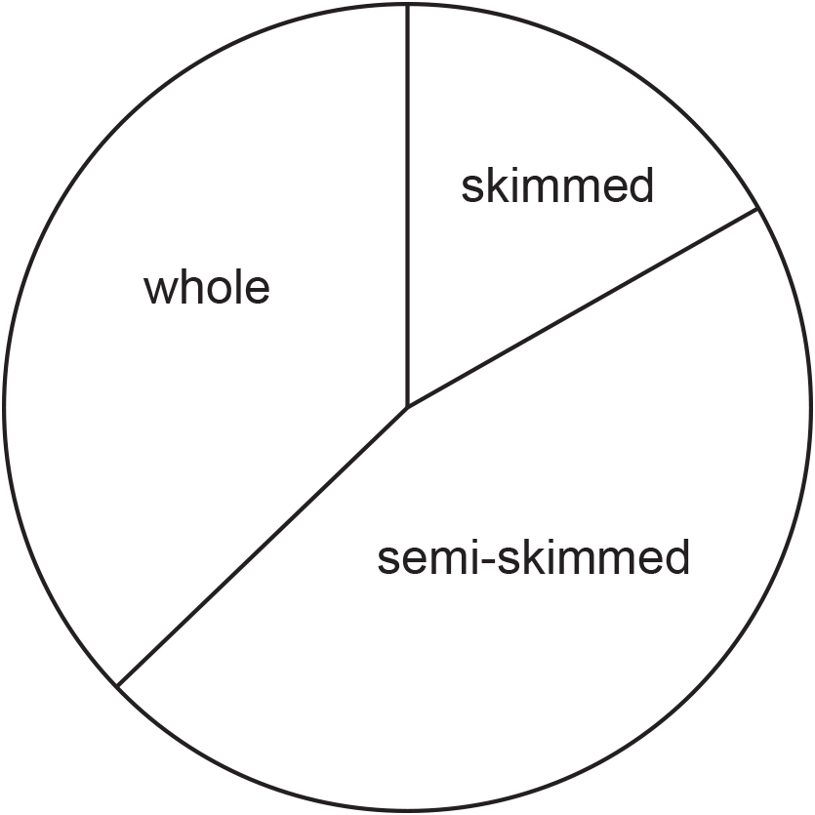
Practice question 4 – answers
PRACTICE
Handout
available
John is a milkman.
The table shows information about the type of milk John delivers each day.
The type of milk John delivers each day
type of milk | number | angle
skimmed | 20 | 60°
semi skimmed | 55 | 165°
whole | 45 | 135°
Draw a pie chart to show this information.
Remember to label the chart.
24
Notes:
Use this slide to discuss how the answer is arrived at.

Slide 25
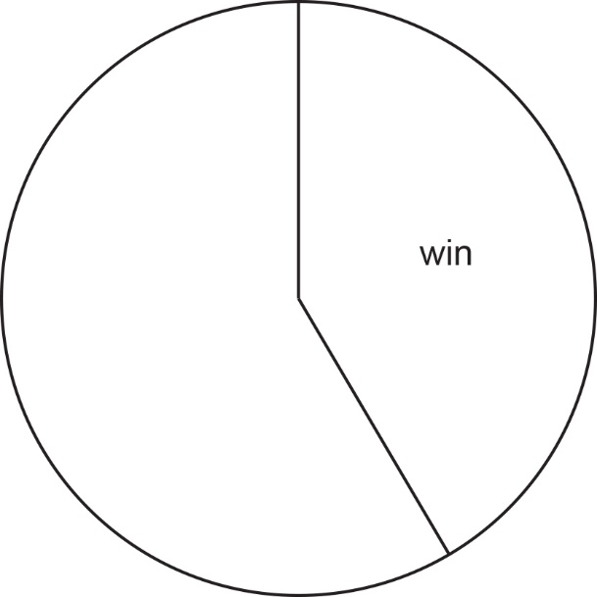
Practice question 5
PRACTICE
Handout
available
Michael is organising a meeting at his rugby club.
He wants to display the results of the games the rugby team played last year.
Michael has this information.
result | number of games | angle size
win | 25 | 150
lose | 15
draw | 20
Michael starts to display this information in a pie chart.
Complete the pie chart for Michael.
25
Notes:
This is a more challenging question, which can be used as an extension.

Slide 26
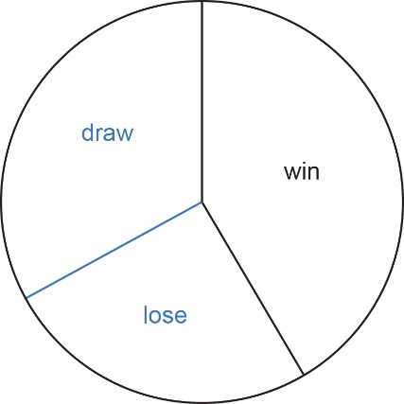
Practice question 5 – answers
PRACTICE
Handout
available
result | number of games | angle size
win | 25 | 150
lose | 15 | 90
draw | 20 | 120
26
Notes:
This is a more challenging question, which can be used as an extension.

Slide 27
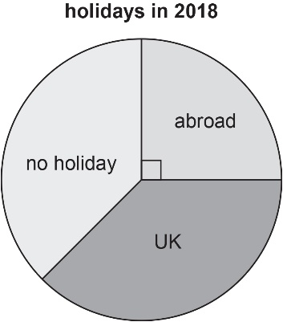
Practice question 6
PRACTICE
Handout
available
Place the correct number in the space to complete the sentence.
Angles around a point add up to ……………… degrees.
Shelley reads an article about holidays in 2018.
She sees this pie chart.
The pie chart shows where 1800 people went on holiday in 2018.
Shelley thinks that 540 of these people went abroad on holiday.
(b) Is Shelley correct?
Show why you think this.
27

Slide 28
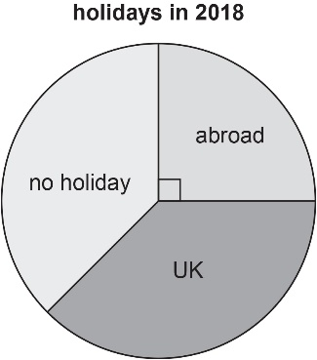
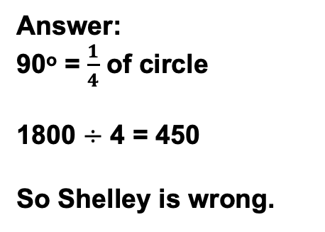
Practice question 6 – answers
PRACTICE
Handout
available
Place the correct number in the space to complete the sentence.
Angles around a point add up to ……………… degrees.
Shelley reads an article about holidays in 2018.
She sees this pie chart.
360
The pie chart shows where 1800 people went on holiday in 2018.
Shelley thinks that 540 of these people went abroad on holiday.
Is Shelley correct?
Show why you think this.
Answer:
90º = $\frac{1}{4}$ of circle
1800 $÷$ 4 = 450
So Shelley is wrong.
28
Notes:
Use this slide to discuss how the answer is arrived at.

Slide 29
Lesson review:
Graphs and charts
Level 1
Objectives
Gather, record and present data
Interpret different charts
Construct pie charts

Slide 30
Lesson 3:
Credits
Photo acknowledgements
Shutterstock.com: Bildagentur Zoonar GmbH, Galina Barskaya, sirtravelalot; 123RF.com: attaphong
Text acknowledgements
Pearson Edexcel Functional Skills, Practice Paper 3 - Mathematics Level 1 (Calculator) PRACL1/C03 Question 5, Pearson Edexcel Functional Skills, Past Paper 4 - Mathematics Level 1 (Calculator) PMAT1/C04 Question 3a, Pearson Edexcel Functional Skills, Practice Paper 2 Mathematics Level 1 (Calculator) PRACL1/C02 Question 5, Pearson Edexcel Functional Skills, Practice Paper 2 Mathematics Level 1 (Calculator) PRACL1/C02 Question 4 Pearson Edexcel Functional Skills, Past Paper 5 - Mathematics Level 1 (Calculator) PMAT1/C05 Question 5, Pearson Edexcel Functional Skills, Past Paper 3 - Mathematics Level 1 (Non-Calculator) PMAT1/N03 Question 4

