Slide 1


Lesson 18:
Area of squares, rectangles and rectilinear compound shapes
Level 1
Objectives
Explore the area of squares, rectangles and compound rectilinear shapes
Understand the concepts of area and use them in a range of problem-solving situations

Slide 2
DISCUSS
Area by counting
1 cm
Dev thinks the area of the green shaded shape is 8 cm.
1 cm
1
2
3
4
5
6
7
8
Ruby thinks the area of the green shaded shape is 12 cm².
Area = 8 cm²
Carlos thinks the area of the green shaded shape is 8 cm².

Who is correct?
What do you think the others did wrong?
Notes:
Learners consider the statements and decide who is correct and what the others did wrong.
Tutor asks learners to explain their reasoning and elicits the misconceptions that Dev and Ruby held.
Dev has worked out the area but has written the units as cm instead of cm².
Ruby has made the common mistake of confusing the perimeter and area of the rectangle.

Slide 3

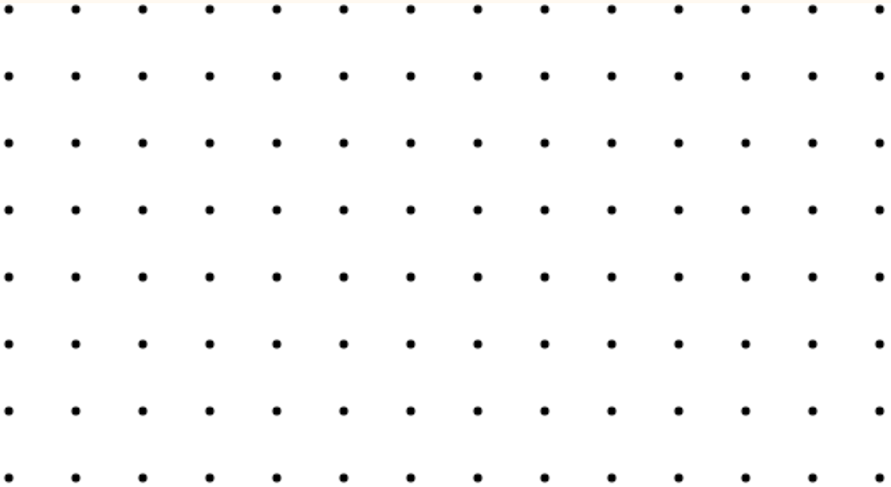

Area and factors
DISCUSS
Handout
available
Use dot paper to draw as many different rectangles as you can with an area of 24 units.
What is the length and width of each rectangle?
The factors of 24 are 1, 2, 3, 4, 6, 8, 12 and 24.
The side lengths are factor pairs of 24.
24 × 1
12 × 2
6 × 4
8 × 3
Dev
Notes:
Ask learners to work individually to draw as many rectangles as they can with an area of 24 units.
Get learners to share how many rectangles they could draw and what they noticed about the rectangles and their dimensions.
Prompt the learners to think about the dimensions of the rectangles.
Use the slide to show some factor pairs that give an area of 24 units.
It is important to use the term ‘factors’ and make the link between factor pairs and dimensions clear.
Note that some learners may have drawn their rectangles in the vertical orientation. Emphasise that these give the same area and have the same dimensions.
Mention perimeter again and highlight the difference between the perimeter and area of a rectangle.
The purpose of this activity is for the learners to understand that a rectangle with a constant area can be made using rectangles with different dimensions (pairs of factors).

Slide 4

Area
KEY IDEA
Area of a rectangle = base × height
height (h)
base (b)
Notes:
Highlight the formula for the area of a rectangle. Remind learners it is something they will need to memorise. Some tutors or learners may use the terms ‘length’ and ‘width’. Make it clear that ‘base’ and ‘width’ refer to the same thing and the terminology is not what is important. Base and height were used so they correlated with the terminology in the formula for the area of a triangle.

Slide 5
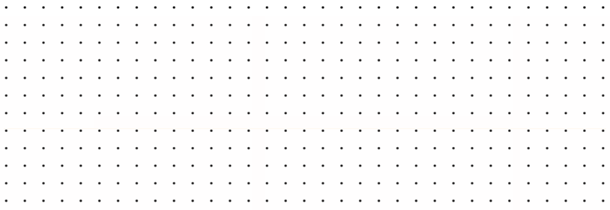
Area of rectilinear shapes
Handout
available
A rectilinear shape is drawn on 1 cm by 1 cm dot grid paper.
What is the area of the shape?
Is there more than one way to find the area?
1 cm
1 cm
Notes:
Highlight that a rectilinear shape is a shape made up 1 or more of rectangles.
Learners work in pairs using dot paper to find out the area of the shape. Some may not know how to calculate the area but encourage them to have a go at counting the squares, focusing on what they can do. Provide prompts – could they split the shape?
Tutors to tell learners that they want to discuss methods so make sure they have worked together and have shown their working.
Ask learner pairs to come to the board (Smartboard using the PPT or draw the diagram on a whiteboard or using their mini whiteboards) and show how they found the area of the shape.
Ask a pair who did it differently to come up and show their method. Try to elicit all 3 methods. Once a method has been shown check which other groups used the same method.

Slide 6





Area of rectilinear shapes
Handout
available
Total area
= 16 cm² + 6 cm² = 22 cm²
4 cm
3 cm
3 cm
$$\text{6 }\text{cm}\text{2}$$
2 cm
4 cm
16 cm²
4 cm
$$\text{28} \text{cm}\text{2}$$
$$\text{6 }\text{cm}\text{2}$$
2 cm
7 cm
By counting squares,
Area = 22 cm²
4 cm
Total area
= 28 cm² – 6 cm² = 22 cm²
2 cm
$$\text{8} \text{cm}\text{2}$$
1 cm
$$\text{1}\text{4} \text{cm}\text{2}$$
2 cm
1 cm
7 cm
Total area
= 8 cm² + 14 cm² = 22 cm²
Notes:
Highlight that a rectilinear shape is a shape made up 1 or more of rectangles.
Learners work in pairs using dot paper to find out the area of the shape. Some may not know how to calculate the area but encourage them to have a go at counting the squares, focusing on what they can do. Provide prompts – could they split the shape?
Tutors to tell learners that they want to discuss methods so make sure they have worked together and have shown their working.
Ask learner pairs to come to the board (Smartboard using the PPT or draw the diagram on a whiteboard or using their mini whiteboards) and show how they found the area of the shape.
Ask a pair who did it differently to come up and show their method. Try to elicit all 3 methods. Once a method has been shown check which other groups used the same method.

Slide 7
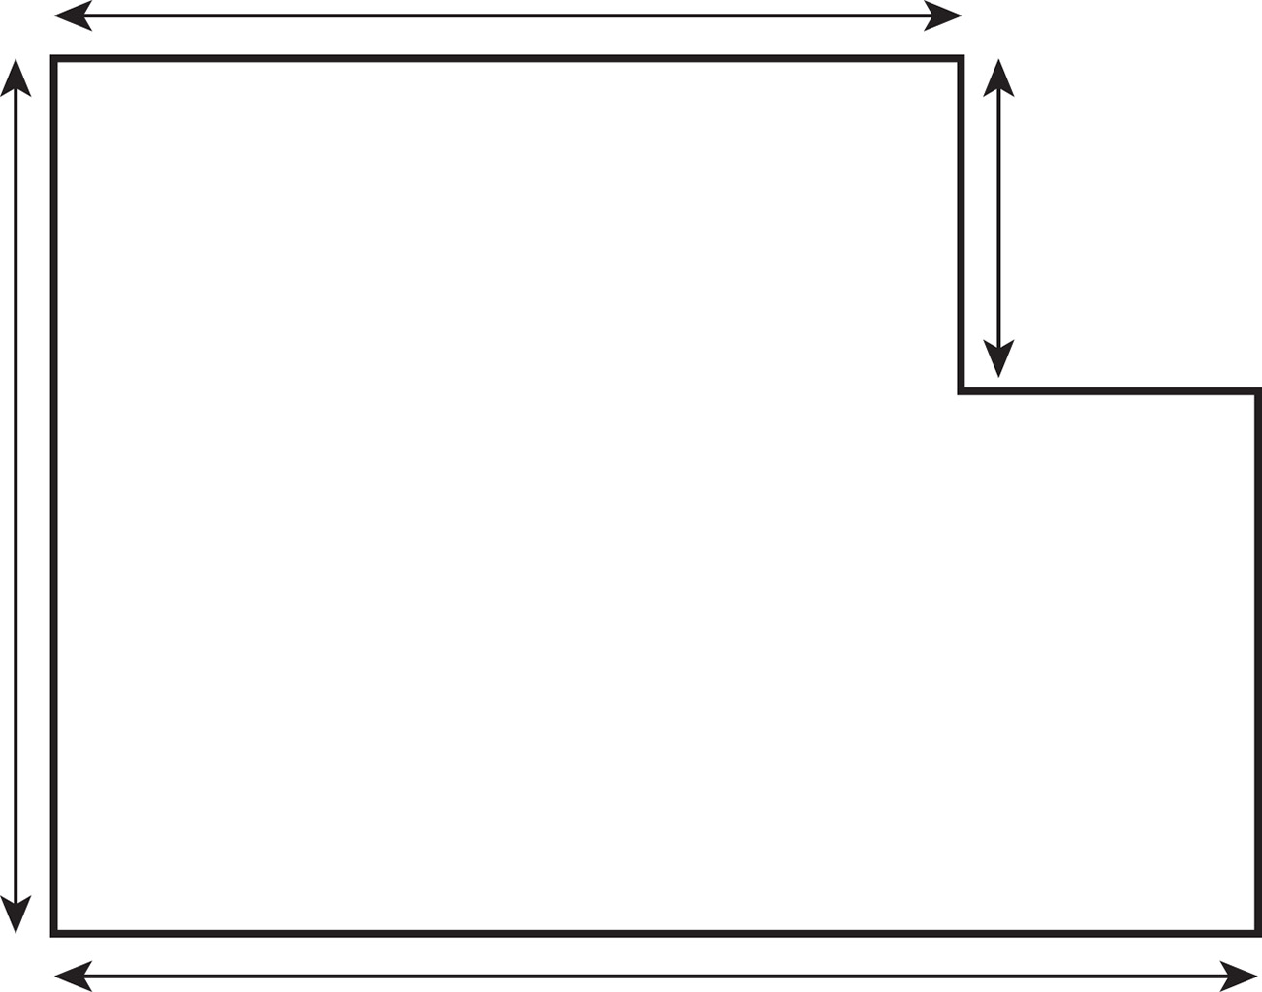
Area of compound shapes
EXPLORE
Handout
available
Find the area of the compound shape.
9 cm
4 cm
10 cm
12 cm
Notes:
This activity requires learners to find missing side lengths without being able to use the counting method.
Learners have the option of splitting the shape or subtracting the area of the missing corner from the area of the whole shape.
Learners work individually using mini whiteboards/their books to find out the area of the rectilinear shape.
Focus on what they can do. For example, could they find the missing dimensions and split the shape?
Remind learners that these questions will be worth a few marks and that they can get some marks for correct steps, even if they don’t answer the whole question.

Slide 8
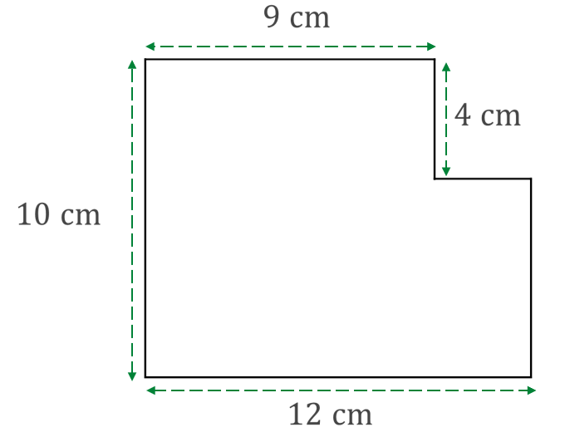
Methods 1 and 2 for (a)
EXPLORE
Handout
available
Method 1
Method 2
9 cm
9 cm
A₁ = 9 × 4
A₁ = 36 cm²
Or
4 cm
4 cm
A₁ = 9 × 10
A₁ = 90 cm²
10 cm
10 cm
A₂ = 12 × 6
A₂ = 72 cm²
A₂ = 3 × 6
A₂ = 18 cm²
6 cm
12 cm
12 cm
Total area
= 36 cm² + 72 cm²
= 108 cm²
Total area
= 90 cm² + 18 cm²
= 108 cm²
Notes:
This is optional slide to review two of the three different methods, step by step.

Slide 9
Method 3 for (a)
EXPLORE
Handout
available
Or
Method 3
9 cm
A₂ = 3 × 4
A₂ = 12 cm²
A₂
4 cm
A₁ = 12 × 10
A₁ = 120 cm²
10 cm
Total area
= 120 cm² – 12 cm²
= 108 cm²
12 cm
Notes:
This is optional slide to review two of the three different methods, step by step.

Slide 10
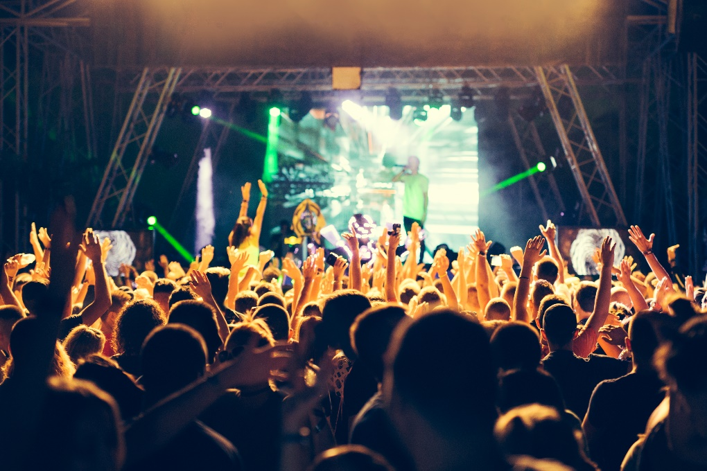
Crowd capacity
EXPLORE
Handout
available
An event company is looking for a venue for a music event.
Each venue can safely fit a maximum of 5 people per 1 m².
Tickets for the event are £30 each.
The company wants to make as much money as possible while ensuring safety.
Notes:
Guide learners to see that the crowd capacity is affected by the area of venue. Give other types of common problems about area in exams: ‘How many tins of paint are required to paint the wall…’, ‘How many tiles…’. Highlight that these types of questions often involve finding an area or perimeter and then using that measure to work out something practical like how much of a material is needed, costs, etc.

Slide 11
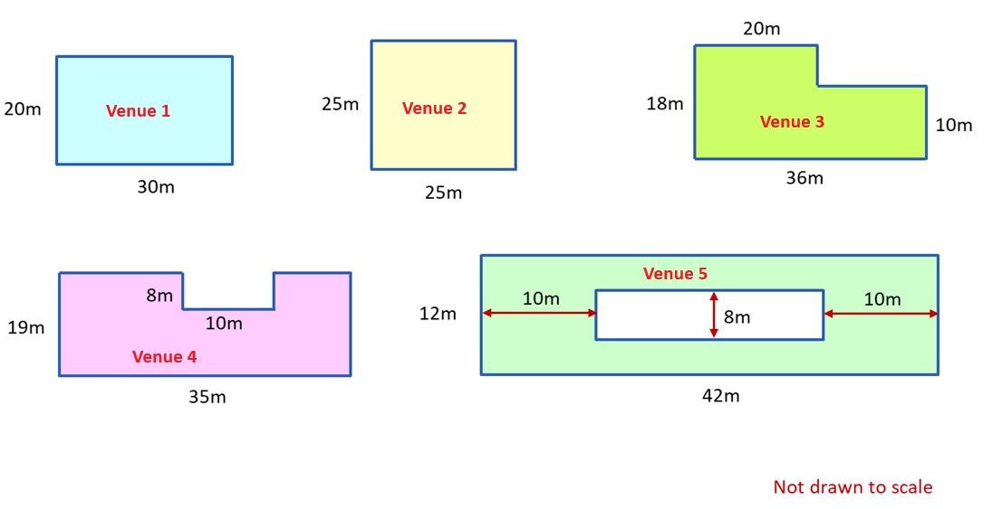
Which of the following venues will give the biggest income?
EXPLORE
Handout
available
Notes:
To allow learners space for working and extra drawing if needed, the handout for this activity should be printed on A3 papers.
Tutor to draw answers from learners and to ask different pairs of learners to feedback their method for one of the shapes. Emphasis on missing sides and how they worked these out.
Make the link to the complexity of FS questions – always involving amount of paint/tiles/cost, etc.
Tutor to emphasise that these questions are multi-mark questions and to reinforce the importance of trying to do at least some of the steps for each of the questions to get as many marks as possible.

Slide 12
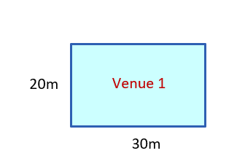
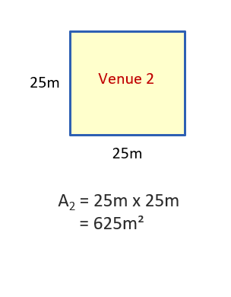
Answers – Venues 1 and 2
REVIEW
Handout
available
20m
Venue 1
30m
Area = 20 m × 30 m
= 600 m²
Area = 25 m × 25 m
= 625 m²
Notes:
Teacher to draw answers from students and to ask different pairs of students to feedback their method for one of the shapes. Emphasis on missing sides and how they worked these out.

Slide 13
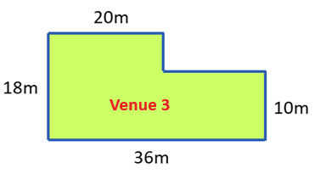
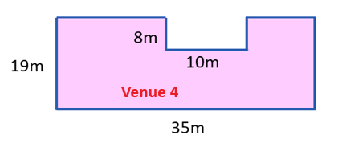
Answers – Venues 3 and 4
REVIEW
Handout
available
Area = (20 × 18) + (16 × 10)
= 520 m²
Area = (35 × 19) – (10 × 8)
= 585 m²
Notes:
Tutor to draw answers from learners and to ask different pairs of learners to feedback their method for one of the shapes. Emphasis on missing sides and how they worked these out.

Slide 14
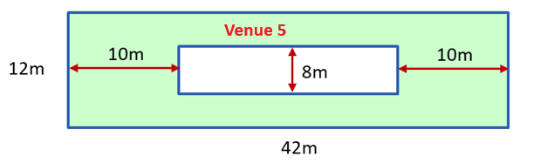
Answers – Venue 5
REVIEW
Handout
available
Area = (42 × 12) – (8 × 22)
= 328 m²
Notes:
Tutor to draw answers from learners and to ask different pairs of learners to feedback their method for one of the shapes. Emphasis on missing sides and how they worked these out.

Slide 15
Answers
REVIEW
Handout
available
The largest area of all the venues is venue 2.
Venue 2 has the biggest area and therefore the greatest capacity.
Area = 25 m × 25 m
= 625 m²
Each venue can fit a maximum of 5 people per 1 m².
625 m² × 5 = 3125 people
Tickets are £30 each and the company wants to maximise its income.
3125 × £30 = £93 750
Notes:
Tutor to make the link to the complexity of FS questions – always involving amount of paint/tiles/cost, etc.

Slide 16



Compound shapes
REVIEW
The blue areas are different because the shapes are different.
Is Ruby correct? Explain your answer.
3 cm
$${9 cm}^{2}$$
3 cm
3 cm
10 cm
10 cm
$${9 cm}^{2}$$
3 cm
10 cm
10 cm
Notes:
Tutor to make the link to the complexity of FS questions – always involving amount of paint/tiles/cost, etc.

Slide 17
Rectilinear shapes
KEY IDEA
To find the area of a rectilinear shape:
Split it up into rectangles
Calculate the area of each rectangle
Add all the areas together
If the question has one shape within another, subtract the area of the inner shape from the area of the outer shape
Notes:
Tutor to reinforce the process which should be followed to find the area of a compound shape.

Slide 18
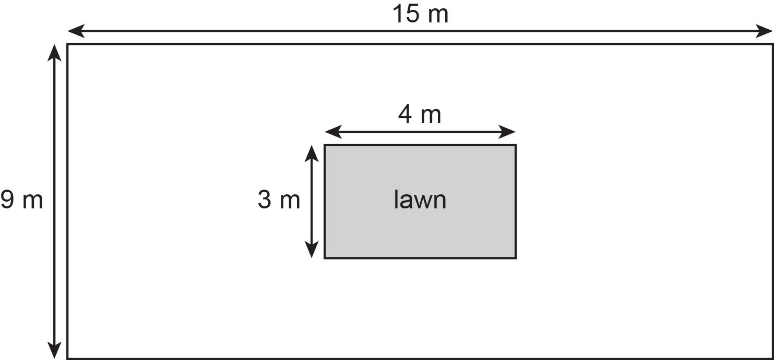
FS exam question guidance/tips
Handout
available
Look for perimeter/area/
volume key words
Alfie sells flooring for playgrounds.
He has this diagram of a playground.
Identify shapes and use formula for their area
Why do you need the area?
Look for added information
How much will it cost Alfie to cover the playground?
Use a reverse calculation to check your answer.
The playground is rectangular 9 m by 15 m.
The lawn is rectangular 3 m by 4 m.
Alfie will put flooring on all the space inside the playground but not on the lawn.
The flooring costs £36 per square metre.
Is your answer realistic?
Notes:
Learners may be overwhelmed by these types of multi-mark problem-solving questions and unsure how to begin.
Ask Learners if they have any general problem-solving tips for these types of questions and try to elicit general problem-solving/starting strategies.
Highlight that a 6-mark question is a question made up of 6 single steps and each of these steps is manageable if they work slowly and carefully.
Use the tips to talk through how this question (and other problem-solving measurement questions) could be approached and then allow learners time to attempt the question individually.
Handout is differentiated – option 1 is without the tips and option 2 includes the tips.

Slide 19
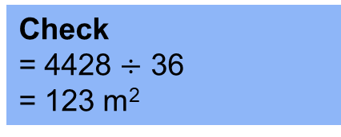
FS exam question guidance/tips
Area of playground
= 15 × 9
= 135 m²
Alfie sells flooring for playgrounds.
He has this diagram of a playground.
Cost of flooring
= 123 × £36
= £4428
Area of lawn
= 3 × 4
= 12 m²
Check
= 4428 $÷$ 36
= 123 m²
Area to be covered
= 135 – 12
= 123 m²
How much will it cost Alfie to cover the playground?
Use a reverse calculation to check your answer.
The playground is rectangular 9 m by 15 m.
The lawn is rectangular 3 m by 4 m.
Alfie will put flooring on all the space inside the playground but not on the lawn.
The flooring costs £36 per square metre.
Notes:
Optional worked answer.
Emphasise the importance of showing all steps, correct units, and checking by reverse calculation.

Slide 20
Checking your answer
KEY IDEA
In Functional Skills maths you are sometimes asked to check an answer.
This can be either carrying out the reverse operation or estimating your answer.
Reverse calculation example:
Calculation could be 12 × 8 = 96
Reverse check would be 96 ÷ 8 = 12
Estimation example:
Calculation could be 12 × 8 = 96
Estimation would be 10 × 10 = 100
Notes:
Examples to show the two ways learners may be asked to check answers.
Highlight that learners need to know both ways and the method to check will be explicitly stated in the question.
Highlight that reverse calculations use inverse operations and reiterate the rules for estimation.

Slide 21
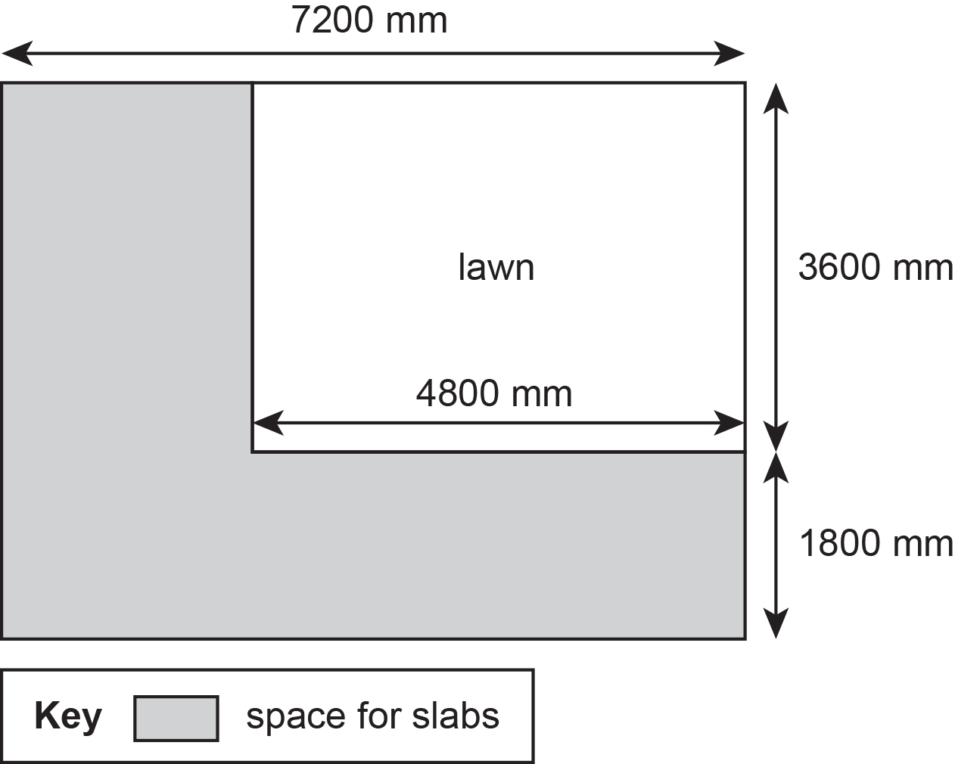
Practice question 1
PRACTICE QUESTION
Worksheet
available
Maninder wants to put slabs in part of her garden.
She has this sketch. All corners are right angles.
Each slab is in the shape of a square with sides of length 600 mm.
Maninder thinks she needs 65 slabs for this part of the garden.
Are 65 slabs enough for this part of the garden?
Show why you think this.
Notes:
Tutor to give learners the choice of 2 questions to answer from the 3 (or all 3 if time allows). The questions are of varying difficulty.
Tutor to reinforce to the class that this question is a 6-mark question so there are various opportunities to get marks.
Learners to think about all possible ways to get marks and to draw sketches, find missing lengths, work out the area of any part of the shape, etc.
Tutor to explain about follow through marks. FTM enable the learners to get marks for working done later in the question, even if their first answer is incorrect.
Encourage learners to highlight key words and information in the question so they understand exactly what is being asked.

Slide 22
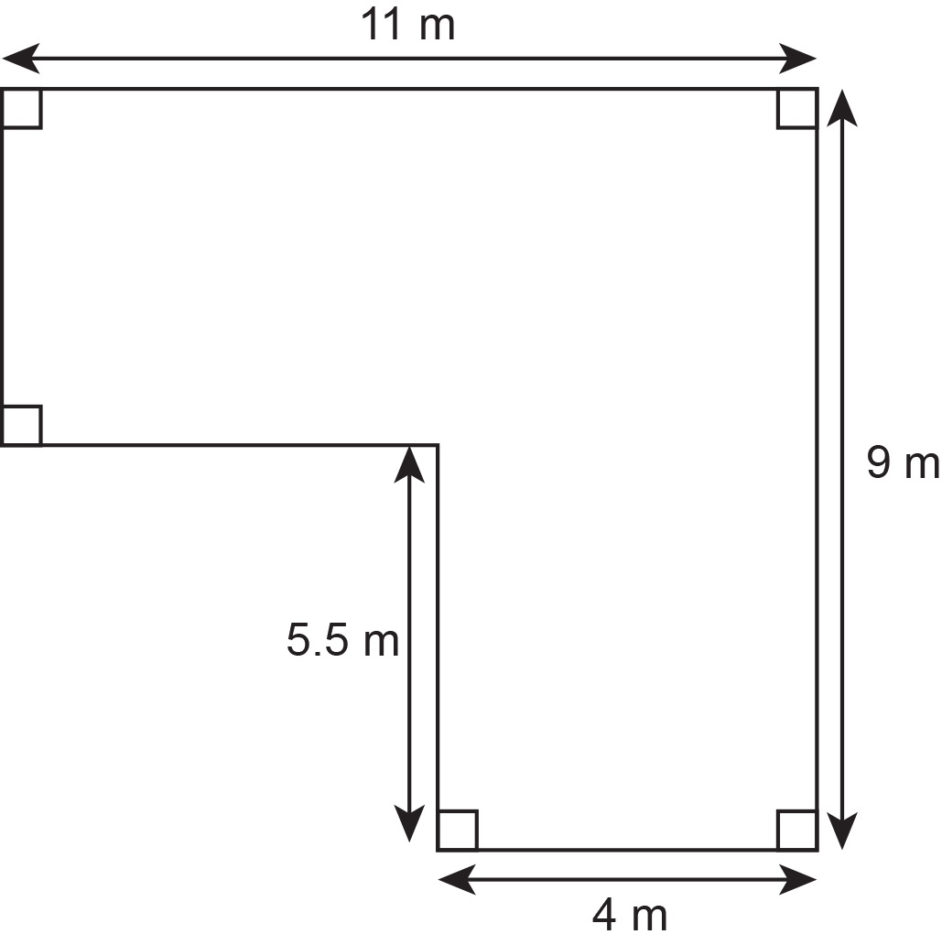
Practice question 2
PRACTICE QUESTION
Worksheet
available
Harpeet wants to put tiles on the ceiling of a room.
He has this sketch of the ceiling.
Harpeet knows one pack of ceiling tiles:
covers an area of 3.24 m²
costs £34.95.
Ceiling tiles can be cut and joined.
Calculate the total cost of the packs of ceiling tiles Harpeet has to buy.
Notes:
Tutor to give learners the choice of 2 questions to answer from the 3 (or all 3 if time allows). The questions are of varying difficulty.
Tutor to reinforce to the class that this question is a 6-mark question so there are various opportunities to get marks.
Learners to think about all possible ways to get marks and to draw sketches, find missing lengths, work out the area of any part of the shape, etc.
Tutor to explain about follow through marks. FTM enable the learners to get marks for working done later in the question, even if their first answer is incorrect.
Encourage learners to highlight key words and information in the question so they understand exactly what is being asked.

Slide 23
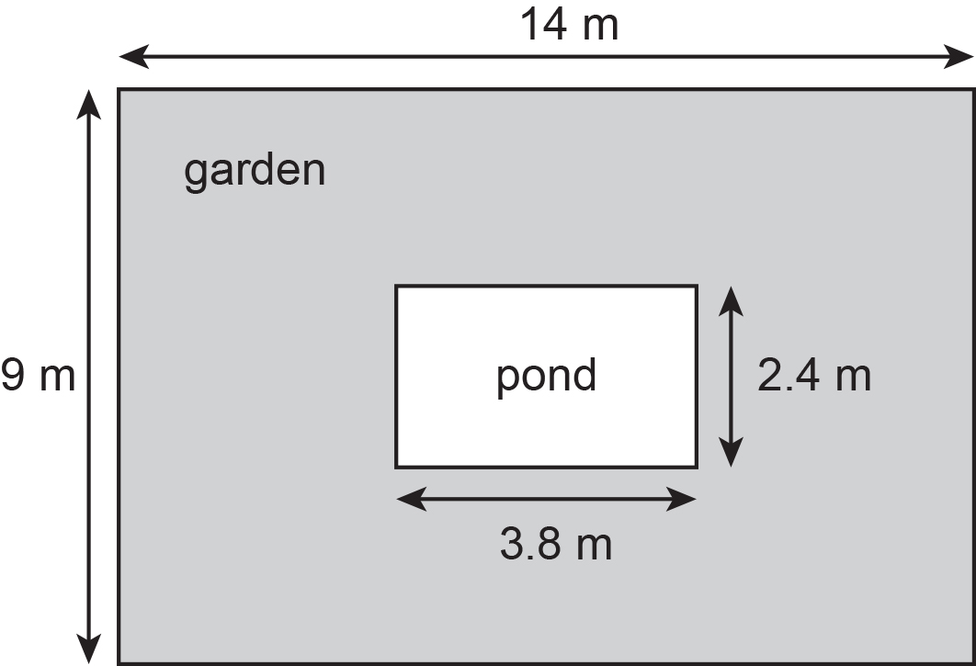
Practice question (3)
PRACTICE QUESTION
Worksheet
available
Here is a garden and a pond.
The garden and the pond are rectangular.
Kayla is covering the garden with grass seed.
She will not put any grass seed in the pond.
One box of grass seed covers 15 m² of garden.
Work out the number of boxes of grass seed Kayla needs to cover the garden.
Notes:
Tutor to give learners the choice of 2 questions to answer from the 3 (or all 3 if time allows). The questions are of varying difficulty.
Tutor to reinforce to the class that this question is a 5-mark question so there are various opportunities to get marks.
Learners to think about all possible ways to get marks and to draw sketches, find missing lengths, work out the area of any part of the shape, etc.
Tutor to explain about follow through marks. FTM enable the learners to get marks for working done later in the question, even if their first answer is incorrect.
Encourage learners to highlight key words and information in the question so they understand exactly what is being asked.

Slide 24
Practice question 1 – answers
Worksheet
available
Question | Process | Mark | Mark Grid | Evidence
 | Process to find missing length | 1 | A | 7200 – 4800 (= 2400) OR 3600 + 1800 (= 5400)
 | Begins process to work with dimensions | 1 or | B | e.g. 7200 ÷ 600 (= 12) or ‘2400’ ÷ 600 (= 4)
 | Develops solution | 2 or | BC | e.g. 7200 ÷ 600 (= 12) and 1800 ÷ 600 (= 3)
 | Process to find the number of slabs required for one of the areas or continues to work with dimensions | 3 or | BCD | e.g. ‘12’ × ‘3’ (= 36) OR 7200 ÷ 600 (= 12) and 1800 ÷ 600 (= 3) and ‘2400’ ÷ 600 (= 4)
 | Full process to find figures to compare | 4 or | BCDE | e.g. ‘12’ × ‘3’ + ‘6’ × ‘4’ (= 60)
 | Valid decision with accurate figure | 5 | BCDEF | e.g. Yes AND 60
Total marks for question |  | 6

Slide 25
Practice question 2 – answers
Worksheet
available
Question | Process | Mark | Mark Grid | Evidence
 | Process to find missing length | 1 | A | 11 – 4 (= 7) OR 9 – 5.5 (= 3.5)
 | Process to calculate 1 area | 1 or | B | 11 × ‘3.5’ (= 38.5) OR 9 × 4 (= 36) OR 5.5 × 4 (= 22) OR 11 × 9 (= 99) OR 5.5 × ‘7’ (= 38.5) OR ‘3.5’ × ‘7’ (= 24.5)
 | Process to calculate total area | 2 | BC | ‘38.5’ + ‘22’ (= 60.5) OR ‘99’ – ‘38.5’ (= 60.5) OR ‘36’ + ‘24.5’ (= 60.5)
 | Process to calculate number of packs needed | 1 or | D | {area} ÷ 3.24 (= 18.672…)
 | Process to calculate cost of ceiling tiles for whole number of packs | 2 or | DE | ‘19’ × 34.95 (= 664.05)
 | Accurate figure | 3 | DEF | 664.05
Total marks for question |  | 6

Slide 26
Practice question 3 – answers
Worksheet
available
Question | Process | Mark | Mark Grid | Evidence
 | Begins to work with area | 1 or | A | 14 × 9 (= 126) OR 2.4 × 3.8 (= 9.12)
 | Process to find both areas or the seed for one area | 2 or | AB | 14 × 9 (= 126) and 2.4 × 3.8 (= 9.12) OR ‘126’ ÷ 15 (= 8.4) or ‘9.12’ ÷ 15 (= 0.608)
 | Process to find area to seed or seed for two areas | 3 or | ABC | e.g. ‘126’ – ‘9.12’ (= 116.88) OR ‘126’ ÷ 15 (= 8.4) and ‘9.12’ ÷ 15 (= 0.608)
 | Full process to find amount of seed required | 4 or | ABCD | ‘116.88’ ÷ 15 (= 7.792) OR ‘8.4’ – ‘0.608’ (= 7.792)
 | Accurate figure | 5 | ABCDE | 8 (boxes)
Total marks for question |  | 5

Slide 27
Lesson review:
Area of squares, rectangles and rectilinear compound shapes
Level 1
Objectives
Explore the area of squares, rectangles and compound rectilinear shapes
Understand the concepts of area and use them in a range of problem-solving situations
Suggested further steps/areas to work on
Area of triangular and compound triangular shapes
Notes:
Tutor to close the lesson by referring to the objectives of the lesson.
Class discussion to re-cap the key learning points.

Slide 28
Lesson 18:
Credits
Photo acknowledgements:
123RF.com: Pawel Kazmierczak; Shutterstock.com: Dagmara_K , Ekler, Naddya, Studio DMM Photography, Designs & Art
Text acknowledgements:
Pearson Edexcel Functional Skills, Practice paper – Mathematics Level 1 Section B (Calculator) PRACL1/01 Question 3, Pearson Edexcel Functional Skills, Practice Set 3 – Mathematics Level 1 Section B (Calculator) PRACL1/C03 Question 6, Pearson Edexcel Functional Skills, Past Paper 3 – Mathematics Level 1 (Calculator) PMAT1/C02 Question 6, Pearson Edexcel Functional Skills, Past Paper 1 – Mathematics Level 1 (Calculator) PMAT1/C01 Question 3

