Slide 1


Lesson 4:
Mean and range Level 1
Objectives
To understand how and when to calculate the mean
To understand that range is the data spread and not an average
Use appropriate checking procedures and evaluate their effectiveness at each stage

Slide 2
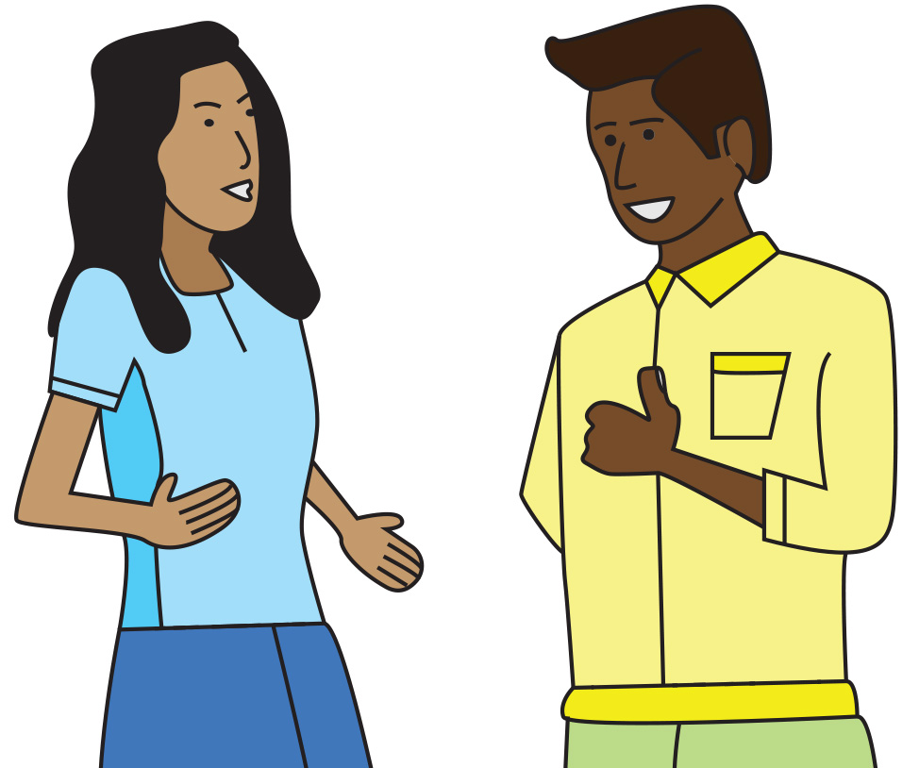
What is average?
DISCUSS
Hi! How are you?
Oh, you know – pretty average today.
What do you think Parvis means when he says ‘average’?
Notes:
Whole group discussion about the nature of averages. This lesson is designed to explore the different averages and their possible uses, but especially the mean. It is likely that learners will ask about median and mode – the teacher can approach this as appropriate for the class – feel free to encourage discussion on these, but specify that for the purpose of this qualification, we will only be looking at mean and range. Invite them to explore other average measures after the lesson.
The discussion should start to draw out learners’ previous knowledge about averages. Learners often know how to calculate averages, even if they get the names mixed up. Do they know what an average is and when to use each average?
The first two slides are to explore the nature of average. In the first slide, Parvis feels average. This cannot be quantified with numbers, but it does allow for discussion of what the nature of ‘average’ is.
You might prompt the discussion by asking: Does Parvis feels fabulous? Does Parvis feel terrible? This could start the idea of the middle ground – somewhere between terrible and amazing.
Could we calculate how Parvis feels? Not easily, but we could give his feelings a rating on a scale (1 being terrible and 10 being wonderful) – where would Parvis be on this scale?

Slide 3
What is average?
DISCUSS
How did you do in your maths test?
Average!
What do you think Parvis means by average in this case? Has anything changed?
3
Notes:
Asking how Parvis did in his maths test allows the class to start exploring the concept of an average. The score can be quantified, as can the grade. It is unlikely that learners will know if their maths test results are actually average or not, but it does allow them to think about how the scores might be ordered to see if they are average.
Does Parvis’ response of ‘Average!’ refer to how he feels he did, or does he know his grade and score? (Learners should move on from the abstract middle ground introduced in the previous slide to thinking about a quantified average).
Grades and scores can be used to find averages. How? This gives the class the opportunity to explore exactly how averages are calculated and to think about scores and grades.
Is there a way to see if Parvis has done averagely well on his math test? Can learners think how this might be done? Explore this with the class.
Would it be possible to find out the average for the class? The college? The country? How?
There is a lot of scope here for discussion and the tutor should take this opportunity to explore the class’s previous knowledge.

Slide 4
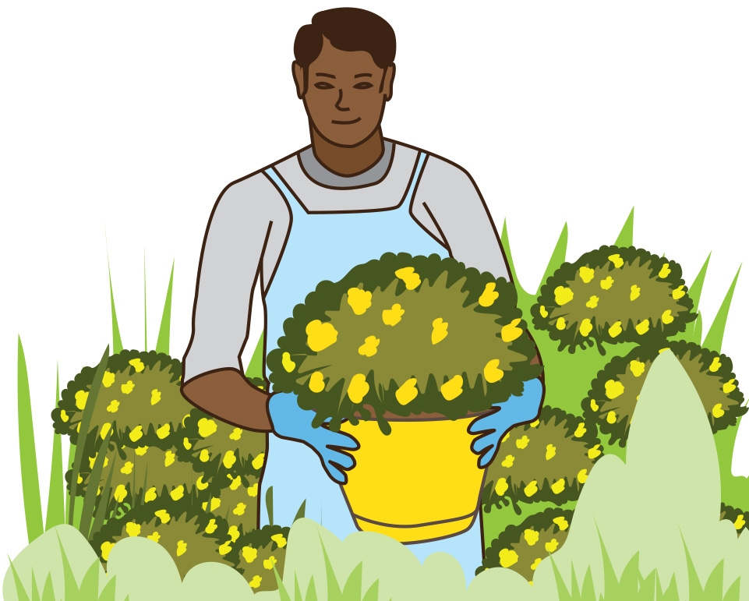
Garden centre
DISCUSS
James is starting work at a
garden centre.
A customer wants a flower that
is not too tall or too short.
How could James approach this?
Notes:
This slide introduces the context of the lesson, which revolves around a garden centre. In doing so, learners are introduced to averages within a real-life work context.
The scenario is that James has started to work here, and there are various activities and discussions around James’ tasks, which can be solved using averages and range.
Discuss with the class how James could do this.
One possible solution is to attempt to find the average height of a number of flowers and then choose one that is about that size. The class could come to this conclusion during the discussion.
The next slide explicitly tells the class that they should use an average or averages. You may want to skip this slide and rely on the group to come to this conclusion.
If the class decides that an average would be a good way to find a flower that is not too tall or too short, then you may wish to display the next slide to confirm their decision.

Slide 5
James’ friends offer to help
You could find the average height.
Good idea!
Notes:
This slide is optional and can be skipped if the class has already come to this conclusion, and you do not feel that there is a need to confirm their decision.
It could be used to explicitly tell the class that finding the average height of a number of flowers is the best way to select one that is not too short or too tall, if the class were unable to find a solution to the task.

Slide 6
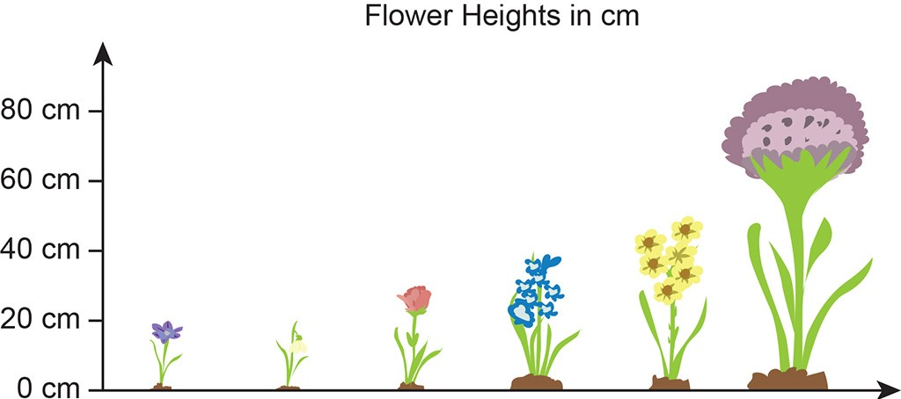
Heights of flowers
DISCUSS
90 cm
50 cm
40 cm
30 cm
20 cm
20 cm
Crocus Snowdrop Tulip Hyacinth Daffodil Allium
Notes:
A range of flowers of different heights has been selected. The class may be able to determine the modal value (20 cm) and the median value (35 cm). The median is not written here, but learners may deduce that the 30 cm and 40 cm flowers are the middle heights, and so the median is in the middle of these two values.
The focus of this lesson is mean and range, so try to stick to those two – again – do not dissuade from exploring mode and median if the learners are aware and check misconceptions that may arise that may lead to mix up as to which average is calculated in which manner and when to use.
It does not matter at this stage if they can see this as they have the opportunity to explore this in the next slide

Slide 7
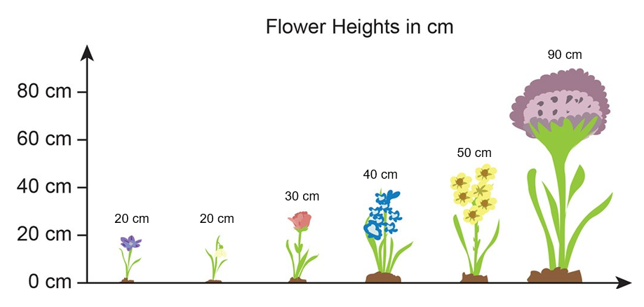
Heights of flowers
YOUR
TURN
Parvis says:
The average is 42 cm.
Jane says:
The average is 20 cm.
Maya says:
The average is 35 cm.
Kenji says:
The average is 70 cm.
Crocus Snowdrop Tulip Hyacinth Daffodil Allium
Working in pairs: What have James’ friends calculated?
How can the results help James?
Notes:
This slide shows all three averages calculated as well as the range.
Parvis has calculated the mean, Jane the mode, Maya the median, and Kenji has calculated the range.
Learners are to work in pairs to identify what has been calculated.
This will expose their prior knowledge level. During the learners’ discussions, the tutor should listen and take notes of any ideas or calculations that are being made for the class discussion afterwards.
The slide is also designed to expose the misconception that range is an average. The range is visually apparent in the slide, and time should be dedicated to thinking about why the range is not an average, and possible uses for the range.
A use for range will be addressed later in the lesson, and so the depth to which it is discussed at this point is up to the tutor’s discretion. For example, if learners have a strong opinion or in-depth knowledge of range and its function within statistical analysis, explore this further. However, it is sufficient at this stage simply to explore the fact that range is not an average.
Once time is up, a discussion should take place about what learners have found and how useful each of the averages might be.
The modal value of 20 cm is of little value to James, as these are the shortest flowers.
The mean is 42 cm (rounded from 41.6), and the median is 35 cm. Discuss which is better to use in this case. There is no one true answer here, but exploration through discussion is essential as learners begin to think about how different averages can supply different information.

Slide 8
Heights of flowers
YOUR
TURN
One of the flowers has been removed.
What are the mean and range figures for this data set now?
Can you show checks for your calculations?
Crocus Snowdrop Tulip Hyacinth Daffodil
Notes:
Why has removing one flower affected the data? Encourage and provoke responses and discussion about outliers and data being skewed – the data now has a lower range and so the values are all closer to each other without an ‘outlier’. Discuss what an outlier is.
How can you check – discuss reverse calculations, estimations and sense checking (Is it a reasonable answer? Does your answer make sense?).

Slide 9

Heights of flowers
YOUR
TURN
Handout
available
The garden centre is comparing the heights of other categories of flowers:
Roses: 101 cm, 123 cm, 97 cm, 140 cm, 92 cm
Dahlias: 15 cm, 97 cm, 39 cm, 18 cm, 46 cm, 21 cm
Poppies: 96 cm, 24 cm, 48 cm, 51 cm, 69 cm, 42 cm, 54 cm
Anemones: 11.3 cm, 12.1 cm, 13.2 cm, 11.7 cm
Calculate the mean and range for each of these categories.
Check each answer by doing a reverse calculation.
What do your calculations tell you about the heights of the different categories of flowers?
Notes:
Simple exercise for learners to practise calculating means and ranges (feel free to change values for easier/harder challenges).
Ask learners to check that they have carried out their calculations accurately by doing reverse calculations – discuss how they would do this (e.g. multiply the mean by the number of data points, then subtract each of them from the total).
Note the data is deliberately not ordered. Discuss this as a likely occurrence with RAW data.
The final category deals with decimals – can learners add up with decimals by hand or do they require a calculator? You know your cohort.
When discussing, ensure to ask learners in each case whether the mean average figure they have arrived at represents the data well? Ask why.
When learners have completed their calculations, ask them to comment on what this tells them. Which are the tallest, smallest, most and least varied in height?
Answers:
1) Rose: mean = 110.6 cm, range = 48 cm
Dahlias: mean = 39.3 cm, range = 82 cm
Poppies: mean = 54.9 cm, range = 72 cm
Anemones: mean = 12.1 cm, range = 1.9 cm
2) For instance, rose: 110.6 × 5 = 553 = the total of all the roses’ height.
3) Roses are in general the tallest flower among the four on average, whereas anemones are the shortest. Dahlias’ height varies a lot, which means that there can be very tall and very short dahlias. On the contrary, anemones’ height is quite consistent. In other words, they don’t differ a lot in terms of height.

Slide 10

Mean and range
YOUR
TURN
KEY IDEA
Mean:
Tells you the typical or ‘average’ value from a set of data
Calculate it by adding up the values of each piece of data and dividing by how many pieces of data there are
Range:
Tells you how spread out the values are in a set of data
Calculate it by subtracting the smallest from the largest figure in the set

Slide 11
Time of customers’ stay
James has been given a table of information about the average length of stay of customers.
Survey | Time (in minutes) |  |  |  |  |  | Mean
A | 26 | - | 32 | 24 | 20 | 30 | 26
B | 26 | 32 | - | 26 |  |  | -
Survey A consisted of six customers and survey B consisted of four customers.
Unfortunately, three entries are missing from the table.
In survey A, 6 customers were timed and their mean visit time was 26 minutes.
In survey B, 4 customers were timed.
The overall mean of the combined data was 26.8 minutes.
Can you work out what the three missing values are?
Notes:
This exercise is designed to test learners' understanding of the mathematical structure of mean.
Ask the learners to work alone for a few minutes before discussing what they have done or what they think with their partner.
This may lead to a productive struggle, as this is a little tricky. Allow time for the learners to solve the problem, but scaffold by asking questions should the task become too much.

Slide 12
Time of customers’ stay
YOUR
TURN
Handout
available
Survey | Time (in minutes) |  |  |  |  |  | Mean
A | 26 | - | 32 | 24 | 20 | 30 | 26
B | 26 | 32 | - | 26 |  |  | -
The overall mean of the combined data was 26.8 minutes.
Work by yourself at first and see if you can complete the table.
Talk to your partner about what you have done and why.
If your answers are the same, talk to each other and explain how you got your answers.
Notes:
Give the learners some time to work alone.
Once they have worked on the problem alone, learners will then explain their answer to their partner.
If the pair agrees, then each learner must explain in their own words what they did. If they disagree, then they must work out why they disagree and see if they can come to an agreement.
The tutor will observe and listen to what the learners are saying, taking note of common errors or correct calculations, which will help with the review.

Slide 13
Time of customers’ stay
REVIEW
Survey | Time (in minutes) |  |  |  |  |  | Mean
A | 26 |  | 32 | 24 | 20 | 30 | 26
B | 26 | 32 |  | 26
24
28
28
The overall mean of the combined data was 26.8 minutes.
Notes:
Here, the tutor should bring the class's ideas together, before confirming the correct answers.
It could be useful to question the whole group to bring ideas together, or the tutor could ask a successful pair to demonstrate what they did.
Focus of discussions is methods used & reasoning behind them. If learners struggle, use probing questions and scaffolding as appropriate
When discussions have run their course, use the animations to confirm the correct answers.
Answer for row A is 24
Calculation is:
26 x 6 = 156
All current numbers add up to 132
156 − 132 = 24
Answer for row B (missing time) is 28
Find the mean for all 10 combined
10 × 26.8 = 268
All 9 add up to 240
268 − 240 = 28
Answer for row B (missing average) is 28

Slide 14

Which delivery service?
DISCUSS
The garden centre wants to choose the most consistent delivery service to use.
They have used two local ones and recorded their delivery times.
Moving Target Delivery |  |  | Glossop Delivery
Delivery Day | Hours Taken |  | Delivery Day | Hours Taken
Monday | 2 |  | Monday | 4
Tuesday | 2 |  | Tuesday | 4
Wednesday | 5 |  | Wednesday | 5
Thursday | 4 |  | Thursday | 3
Friday | 7 |  | Friday | 4
Working with a partner, think about which service you would choose.
You must be able to justify your answer.
Notes:
The more consistent delivery service will be the better service to use. Glossop Delivery has the smaller range (2 hours, compared to 5 hours for Moving Target) and is therefore the more consistent.
The mean and median delivery time for both of these firms is 4 hours, so there is no difference in terms of the average times.
The role of the tutor is to listen to the learners' reasoning while they have their thinking and discussion time, and then to use this to facilitate the discussion of which service they would choose.

Slide 15
Practice question (1)
PRACTICE QUESTION
Handout
available
Sarah has a snack at work each day.
She has this information about the snacks she had last week.
day | Mon | Tue | Wed | Thu | Fri
snack | banana | chocolate | biscuit | cake | crisps
number of calories | 105 | 260 | 49 | 257 | 234
Sarah thinks the mean number of calories in these snacks is more than 200.
Is she correct?
Show why you think this.
No.
(105 + 260 + 49 + 257 + 234) ÷ 5
= 905 ÷ 5
= 181 (so less than 200)
Notes:
This is a Level 1 question.

Slide 16
Practice question (2)
PRACTICE QUESTION
Handout
available
Here is a set of data.
14.3 | 17.2 | 9.4 | 15.6 | 19.5
Calculate the range of this set of data.
(b) Use estimation to show a check of your answer.
range = largest – smallest
= 19.5 – 9.4
= 10.1
To estimate 19.5 – 9.4:
19.5 ~ 20 and 9.4 ~ 9
20 – 9 = 11
11 is close to 10.1
Notes:
This is a Level 1 question.

Slide 17
Practice question (3)
PRACTICE QUESTION
Handout
available
Juliet wants to check her gas bill.
She has this information.
month | May | June | July | August | September | October
units used | 430 | 276 | 205 | 168 | 261 | 565
Juliet thinks the mean number of units she used for the 6 months was more than 300.
(a) Is Juliet correct?
Show why you think this.
(b) Use a reverse calculation to show a check of your mean.
a) Yes.
mean = total ÷ frequency
= 317.5 unit
So more than 300 units
b) 317.5 × 6 = 1905
Notes:
This is a Level 1 question.

Slide 18
Practice question (4)
PRACTICE QUESTION
Handout
available
Scott is a journalist.
He is writing an article about fish and chip shops in his town.
The table shows the prices of a standard portion of fish and chips in 5 local shops.
shop | A | B | C | D | E
cost (£) | 7.60 | 6.25 | 5.85 | 6.65 | 8.00
Scott thinks the mean price of a standard portion of fish and chips in these 5 shops is £6.85.
Is Scott correct?
Show why you think this.
No.
(7.60 + 6.25 + 5.85 + 6.65 + 8.00) ÷ 5
= 34.35 ÷ 5
= £6.87 (not £6.85)
Notes:
This is a Level 1 question.

Slide 19
Lesson review:
Mean and range Level 1
Objectives
To understand how and when to calculate the mean
To understand that range is the data spread and not an average
Use appropriate checking procedures and evaluate their effectiveness at each stage
Suggested further steps/areas to work on
Frequency tables

Slide 20
Lesson 4:
Credits
Photo acknowledgements
Shutterstock.com: SimpleEPS
Text acknowledgements
Pearson Edexcel Functional Skills, Practice Paper 1 Mathematics Section B (Calculator) PRACL1/01, Question 10; Pearson Edexcel Functional Skills, Past Paper Level 3 - Mathematics Level 1 (non-calculator) PMAT1/N03 Question 2; Pearson Edexcel Functional Skills, Past Paper 3 - Mathematics Level 1 (Calculator) PMAT1/C03 Question 9; Pearson Edexcel Functional Skills, Practice Paper 2 - Mathematics Level 1 (Calculator) PRACL1/C02 Question 9

