Slide 1
T LEVEL IN SCIENCE
Development of contextualised Core Skills - Research

Slide 2
Lesson 1
Introduction to protein analysis

Slide 3
Learning intentions - lesson 1
Apply common protein analysis methods.

Slide 4
Overview - lesson 1
Learn what proteins are and how peptide bonds form.
Carry out the Biuret test and record/share results.
Compare qualitative vs quantitative data.

Slide 5
Starter
What do you understand by the scientific method?

Slide 6
What is the scientific method?
The scientific method is a simple process scientists use to ask questions, test ideas, and use evidence to reach reliable conclusions.
The method involves:
Setting a hypothesis.
Carrying out a literature review.
Testing the hypothesis through an experiment.
Analysing results.
Reviewing results against a literature review to draw conclusions.

Slide 7
Amino acids
Building blocks of proteins with unique side chains.
Share common structure: amino group, carboxyl group, and R group.
20 standard amino acids differ by R-group properties.
Classified as essential (must come from diet) or non-essential (made by body).

Slide 8
Amino acids worksheet
For each amino acid:
highlight the carboxyl group (–COOH) using a unique colour or symbol
identify the R group (side chain) — this is what makes each amino acid different.

Slide 9
Amino acids worksheet answers
Review your answers to the Amino acids worksheet.
On a mini whiteboard, write the amino acid name of any of the diagrams where you made an error.

Slide 10
Peptide bonds
A covalent bond that links amino acids together in a chain.
Formed between the amine group of one amino acid and the carboxyl group of another.
Occurs during a condensation reaction as water is removed as the peptide bond is formed.

Slide 11
Quick quiz
Name the bond between two amino acids.
What type of reaction forms a peptide bond?
Name the functional groups involved in forming a peptide bond.
State one role of proteins in the body.

Slide 12
Quick quiz answers
Name the bond between two amino acids. Peptide bond
What type of reaction forms a peptide bond? Condensation
Name the functional groups involved in forming a peptide bond. Amine group (-NH₂) and carboxyl group (-COOH)
State one function of proteins in the body. Examples: Enzymes (catalysts), structural support, transport, signalling.
Any queries? Add them to your mini whiteboard.

Slide 13
Biuret test for proteins
Work in pairs.
Read the SOP (Standard Operating Procedure) Biuret test for proteins.
Complete the experiment.
Complete the results table given in the SOP.
When the task is complete, clear and clean your bench.

Slide 14
Share results
Go to Mentimeter.
Enter the names of the food items that tested positive.

Slide 15
Importance of following SOPs
Did the results differ between groups?
Why can results differ?
Does it matter if the results are different?

Slide 16
Result analysis: qualitative data
Proteins are made of amino acids linked by peptide bonds.
The Biuret test is a quick qualitative test that tells us whether peptide bonds are present or not — it gives a colour change but does not give any numbers.
Qualitative data is descriptive information you observe, not measure. Examples: colour change, texture, appearance.
Think: words, not numbers.

Slide 17
SOP Biuret and colorimetry
The results of the Biuret test can be tested further using a colorimetry test. A colorimetry test will give data such as:
Milk protein estimates:
  Whole milk: ~30–35 mg/mL
  Semi-skimmed: ~28–32 mg/mL
  Skimmed: ~27–30 mg/mL
  Plant-based milks: Lower protein (often <10 mg/mL).
How does this data differ from your Biuret test data?

Slide 18
Quantitative data
Numerical, measurable information. It tells you how much, how many, or what value something has. Examples: temperature, mass, concentration, number of cells, percentage.
Think: numbers, measurements.
When you use a colorimeter, you don’t just see a colour change - you get numerical readings (absorbance or % transmission). This means the data collected using colorimetry is quantitative data.

Slide 19
Qualitative or quantitative?
Qualitative = colour change, words, yes/no
Quantitative = numbers, measurements
Which type of data is useful in these situations?
Quick check for protein in school lunches
Accurate protein measurement for baby formula labels.

Slide 20
Application in industry
Discuss in pairs.
What other applications in industry would need qualitative and quantitative data?
Enter one example into the Collaborative Wall.

Slide 21
Plenary
In your notebooks, write the following terms learnt in this lesson. Write what you understand about these terms. If you are unsure, then ask.
Protein.
Peptide bond.
Condensation reaction.
Qualitative.
Quantitative.

Slide 22
Homework - lesson 1
Using a traditional search engine, find a website that gives details of proteins in baby formula.
Note the key information and the website address.

Slide 23
Lesson 2
Evaluating scientific sources and methods

Slide 24
Learning intentions - lesson 2
Evaluate the reliability and reproducibility of scientific methods.
Practise using colorimetry to collect accurate quantitative data.

Slide 25
Overview - lesson 2
Compare two scientific sources and judge their quality.
Run a practical and discuss the reliability of results.
Write a conclusion using key terms and peer feedback.

Slide 26
Harvard referencing style – Websites
A literature review is part of the scientific method. It is important to reference sources in a literature review.
Referencing usually uses the Harvard system. This is what you should include if referencing a website.
Author/Organisation. (Year). Page title. Available at: URL (Accessed: Date).

Slide 27
Harvard referencing style - example
Khan Academy. (n.d.) Orders of protein structure. Available at: https://www.khanacademy.org/science/biology/macromolecules/proteins-and-amino-acids/a/orders-of-protein-structure (Accessed: 6 December 2025)
n.d. means that there is no specific date on the website. If that is the case, then instead of the date, you put n.d. in the brackets.

Slide 28
Write a Harvard reference task
For your homework, you found an article and took notes of the website. Access that website.
Collect the information you need to write the reference for the website using the Harvard referencing system.
Pass to one of your peers.

Slide 29
Peer review of the Harvard reference
Look at the Harvard reference you have been given.
Does it follow the correct structure and have all of the correct information?
Author/Organisation. (Year). Page title. Available at: URL (Accessed: Date).
Annotate with any changes needed.

Slide 30
Quality of information
Today we’re looking at how scientists test ideas and how we check if information is trustworthy.
This matters because in science — and in a literature review — we must judge the quality of different sources.
Scientific information quality can be affected by how it is collected.

Slide 31
Evaluating a method
To trust the data, the method used to obtain the data needs to be evaluated.
What controls were in place? (blank, path length, reagent composition).
Were replicates used?
Was data analysis explained (e.g., regression)?
Did they follow standardised procedures?
Can the experiment by done in a different lab and obtain similar or the same results?

Slide 32
Harvard referencing style – articles
Author, Initial(s). (Year). ‘Article title’, Journal Name, Volume(Issue), pages.
If the article has more than one author, then each author needs to be named. Note the use of punctuation in this example.
Surname, Initials., Surname, Initials. and Surname, Initials.
When there are numerous authors (usually if more than four) you can give the first name in full and add ‘et al’

Slide 33
Jaime’s blog laboratory report reference
Wheaton, J. (n.d.) Rapid Biuret screening of milk proteins. Nutrition Insights, University of Moochester. Available at: https://blogs.moochester.ac.uk/nutrition-insights (Accessed: March 2026).

Slide 34
Quantitative report – milk protein
Work in pairs.
Read through the report. Identify any terms that you don’t understand.
Discuss the methodology. Complete the table evaluating the methodology used for collecting the information.
Use the Evaluation of Jamie’s blog laboratory report to help you.

Slide 35
Peer review of milk protein report
Work in pairs.
Read through the evaluation that you have been given.
Use a highlighter pen to indicate where correct information has been given and where the content is evaluative.
Write comments directly onto the table if there are any issues identified.

Slide 36
Key terms to evaluate sources
Repeatable means you get almost the same result when you repeat the experiment under the same conditions —same person, same equipment, same method, same environment.
Reproducible means someone else can do the same experiment — using the same method — and get similar results, even if they use different equipment, work in a different lab, or are a different person.

Slide 37
More key terms to evaluate resources
Validity means your experiment actually measures what it was supposed to measure. Valid results come from using the correct method, controlling variables, and removing errors.
Systematic error is the same mistake happening every time. It affects accuracy and makes results less valid.
Accuracy means how close your result is to the true or correct value. If your equipment is wrong or there is a systematic error, your results will not be accurate.

Slide 38
SOP colorimetry
Read the SOP colorimetry.
Carry out the practical individually or in pairs/small groups.
Complete the results table.
Clean and clear your bench when finished.

Slide 39
Reliability – recap
Reliability means how consistent and repeatable your results are. If you did the experiment again — using the same method, equipment, and conditions — you should get very similar results each time.
How reliable is your data? Let’s compare with the data from the Quantitative report – milk protein.

Slide 40
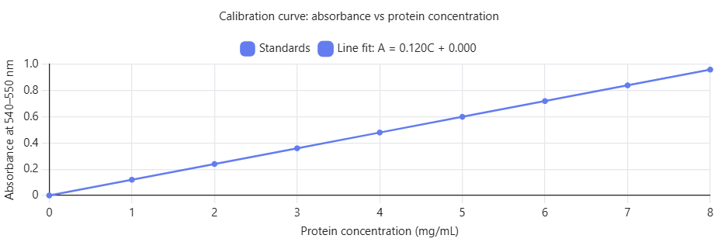
Graph – calibration curve

Slide 41
Writing a conclusion
Say what your results show.
Use evidence: include your data and compare this with the results of the Quantitative report – milk protein. Remember to reference your source.
Comment on reliability: Were your repeats repeatable? Are the results reproducible?
Finish with: “Overall, my results are (reliable/partly reliable/not reliable) because…”

Slide 42
Homework - lesson 2
Read the Brand X report.
Evaluate the methodology used. Complete the table.
Use the key terms to evaluate sources.

Slide 43
Lesson 3
Evaluating sources of information

Slide 44
Learning intention - lesson 3
Apply credibility criteria to evaluate sources of information.

Slide 45
Overview - lesson 3
Review evaluations of methodologies.
Review own Brand X evaluation.
Evaluate sources of information using the CRAAP criteria.

Slide 46
How good is the evaluation?
On the next page is an evaluation of the Brand X report.
How good is it?
On your mini whiteboard, write the mark you would give it (from 1–6).

Slide 47
Rate this evaluation?
The method says it used the Biuret test, but it doesn’t really explain how it was done, so it’s hard to tell if it was carried out properly. There are no repeated tests, so we can’t see if the results were consistent. The data isn’t very helpful because it only gives one score for each milk and doesn’t show how much protein was actually there. Because of this, someone else trying to do the same test wouldn’t easily get the same results. The conclusion claims that Brand X has the most protein, but there isn’t enough detail or clear evidence to support this.

Slide 48
Is this evaluation better or worse?
The method is clear and well controlled, making the results repeatable because the repeats are very similar. The detailed steps, correct wavelength, calibration curve, and reagent blank make the experiment reproducible, as someone else could follow it and get similar results. The measurements are accurate because background error was removed and proper calculations were used. This makes the data valid, as it correctly measures protein concentration. Overall, the results are reliable because they are consistent, reproducible, and supported by accurate evidence.

Slide 49
Review your homework?
Look at your Brand X evaluation completed for homework.
Having seen other examples of evaluations, how does yours compare?
On your mini whiteboard, write the mark you would give it (from 1–6).

Slide 50
Key terms for evaluating methodologies
Validity – the test measures what it is supposed to measure. The method matches the aim of the experiment.
Bias – something unfair influences the results. This can make the results one-side or unbalanced.
Accuracy – the result is close to the real or true value. Accurate results come from good equipment and careful work.

Slide 51
Create a new evaluation
Work in pairs.
Create a new evaluation of the Brand X report methodology. Include reference to reliability, repeatability, bias, accuracy and validity.

Slide 52
Peer review the new evaluation
Pass your evaluation to another pair.
Review the evaluation. On your mini whiteboard, write the mark you would give it (from 1–6).
Add comments to the evaluation and suggest how it can be improved (if it is given a mark below 6).

Slide 53
Lactase as an enzyme
Some globular proteins are enzymes, which speed up chemical reactions in living organisms.
Lactase is an enzyme that breaks down lactose into glucose and galactose during digestion in the human small intestine.
Similar enzyme proteins are found in other organisms, showing that enzymes are essential for life.
Discuss
How do we know this is true?

Slide 54
How do we know this is true?
To find reliable information about a protein’s function and the studies done on it, scientists use trusted research sources, not general websites.
The National Centre for Biotechnology Information (NCBI) is an academically recognised database used find scientific, peer‑reviewed information.
Google scholar gives access to credible sources of information.

Slide 55
What is a credible source?
Credibility is the quality of being trusted and believed. It is usually because it is based on expertise and reliability.
In science, that can mean it is subject to rigorous peer review, has been cited several times in other sources, is used by governments or national bodies.

Slide 56
Evaluating sources using CRAAP
Helps you check if a source is credible using five criteria:
Currency – Is it recent?
Relevance – Does it relate to your topic and meet your needs?
Authority – Is it from a credible source or expert?
Accuracy – Is it supported by evidence and free of errors?
Purpose – Is it unbiased and clear in its intent?

Slide 57
Use the CRAAP criteria
Work in pairs.
Review the credibility of the Brand X report using the CRAAP criteria.

Slide 58
Reminder of the CRAAP criteria
Currency – Is it recent?
Relevance – Does it relate to your topic and meet your needs?
Authority – Is it from a credible source or expert?
Accuracy – Is it supported by evidence and free of errors?
Purpose – Is it unbiased and clear in its intent?

Slide 59
CRAAP evaluation of Brand X report
It is up to date.
It is relevant to protein testing.
It is written by scientists, but they work for the company tested.
It uses a recognised method, but data is limited.
The purpose may be biased because it was company‑funded.
Useful for understanding the method, but with limitations.

Slide 60
CRAAP evaluation of lactase research
Look at Source 1
All ✔
Comments: peer-reviewed, recent, highly cited; strong methodology and data.

Slide 61
Evaluate other lactase sources
Work in groups.
Evaluate the other four sources in the CRAAP evaluation of lactase research sources.
Complete the CRAAP table for each.

Slide 62
Which source is the most credible?
Individually select the source you think is the most credible, based on your group CRAAP evaluation.
Access the poll. Vote for your selected source.

Slide 63
Writing an evaluation
Describe what went well in the method.
Comment on reliability (how consistent the results are).
Comment on repeatability (same person, same method, and same results).
Comment on reproducibility (others repeating the method and getting similar results).
Identify limitations and suggest specific improvements.

Slide 64
An evaluation of the credibility of the Brand X report
This source is up to date and relevant to protein analysis. The author is credible, which supports reliability. However, the accuracy is limited because only a small amount of data is shown. There may also be bias because the research was funded by the company involved. Overall, the source is useful, but it has limitations.

Slide 65
Model evaluation
This source is relevant to lactose digestion as it explains the molecular mechanisms of lactase action. Although published in 2018 and not fully current, the core biochemical principles remain valid. It was written by scientists and published in a peer‑reviewed journal, giving it strong authority and reliability. The data are accurate, based on established laboratory techniques with clearly presented results. The purpose is scientific and non‑commercial, making the source unbiased. However, it focuses only on molecular mechanisms and not clinical or dietary implications.

Slide 66
Write an evaluation
Work in pairs. You will be allocated one of the sources you used today.
Complete a short evaluation of that source.
Make sure you consider currency, relevance, authority, accuracy and purpose.
Aim for 5–6 sentences total.

Slide 67
Review the evaluation
Work in pairs.
Review the completed evaluation.
Did it consider currency, relevance, authority, accuracy and purpose?
Was it accurate?
Write comments and return to the original pair.

Slide 68
Homework
Use Google Scholar.
Find two articles about the nutritional value of milk.
Evaluate each source is using the CRAAP criteria.
Include the citation for each source in Harvard style.

Slide 69
Lesson 4
How to make an experiment reliable

Slide 70
Learning intentions - lesson 4
Apply knowledge of enzymes to identify independent, dependent, and control variables in a practical investigation.
Use practical skills to carry out an enzyme investigation and collect data to demonstrate repeatability and reproducibility.

Slide 71
Overview - lesson 4
Review homework.
Categorise SOP content into independent, dependent and control variables.
Complete an enzyme–substrate practical.

Slide 72
What is CRAAP?
What does each letter in the CRAAP criteria stand for?
Write your answers on your mini whiteboards.

Slide 73
CRAAP terms
Currency
Relevance
Authority
Accuracy
Purpose.

Slide 74
Homework review
Pass your homework to a peer for review.
For each source, use a highlighter pen to show where CRAAP criteria has been used correctly.
Use a black or blue pen to annotate any part of the homework you think is incorrect.
Return the annotated homework task to the original learner.

Slide 75
Proteins as enzymes
Enzymes work because their tertiary structure folds into a specific shape that fits only their substrate.
Their activity depends on temperature, pH (each has an optimum), and the amount of substrate available.
If the enzyme’s shape changes, it can’t work properly - and if there is very little substrate, the enzyme has fewer collisions, so the reaction will be slow.

Slide 76
How could we test enzyme activity?
Work in pairs.
Think of possible experiments to test enzyme activity. Write your ideas in your notebooks.
Remember, a reliable experimental design includes:
Independent variable – what you change.
Dependent variable – what you measure.
Control variables – what you keep the same.

Slide 77
Variables
A reliable experimental design includes:
independent variables – what you change
dependent variables – what you measure
control variables – what you keep the same.

Slide 78
Categorise the variables
You will get three sticky notes. Label them as:
independent variables
dependent variables
control variables.
Look through your experiment ideas. Categorise the content according to the type of variable and add to the relevant sticky note.

Slide 79
Reliability in experiments
How do the identified variables contribute to reliable experiments?

Slide 80
How variables make experiments reliable
Independent variable: what you change. Only change one independent variable so you can clearly see its effect.
Dependent variable: what you measure. Shows the outcome of an experiment and how it responds to the change made.
Control variables: what you keep the same. Keep factors constant to ensure that any change in the dependent variable is caused by the independent variable - not something else.

Slide 81
Practical catalase enzyme reaction
Individually read the SOP catalase enzyme reaction. Is anything unclear?
Highlight the independent, dependent and control variables in the SOP.
Will this practical produce reliable, reproducible and repeatable data?

Slide 82
Practical task
Working in pairs.
Follow the SOP catalase enzyme reaction to carry out the experiment.
Complete the results table.
Collect data from two other pairs and update the results table.
Clean and clear your bench and equipment.

Slide 83
Recap
Ensure your notebooks are updated with the following terms:
Currency
Relevance
Authority
Accuracy
Purpose
Independent variables – what you change
Dependent variable – what you measure
Control variables – what you keep the same.

Slide 84
Homework - lesson 4
Use a video or a web page to revise or learn how to calculate the mean and the standard deviation.
Practise the skill. Calculate the mean and standard deviation of your three sets of data.
Finally, provide a Harvard‑style citation for the video or web page you used.

Slide 85
Lesson 5
Interpreting and presenting scientific data

Slide 86
Learning intentions - lesson 5
Be able to calculate mean, standard deviation and identify anomalies in data.
Apply Excel tools to analyse data and create clear graphs that help explain results.

Slide 87
Overview - lesson 5
Practise calculating mean and standard deviation, first on whiteboards and then in Excel.
Identify and remove anomalies and see how they change results.
Create graphs in Excel and use them to explain what data shows.

Slide 88
Calculate the mean
Calculate the mean of the following values:
14
15
16
15
14
Write your answer on your mini white boards.

Slide 89
Calculate the standard deviation
Calculate the standard deviation of the following values:
14
15
16
15
14
Write your answer on your mini white boards.

Slide 90
Importance of mean and standard deviation to reliability
Reliable experiments use repeats so we can spot anomalies and judge consistency.
The mean and standard deviation can show anomalies.
Both help you judge the reliability of your experiment.

Slide 91
Excel calculations
Open a new Excel worksheet.
Follow the demonstration on how to calculate the mean and standard deviation in Excel.

Slide 92
Excel calculations task – Table 1
Open a new Excel worksheet and title it Table 1.
Copy the data from Table 1 of the Results analysis worksheet.
Calculate the mean and standard deviation for this table.
Use the completed first row to check that your formulas are working correctly.

Slide 93
Excel calculations task: Tables 2 and 3
Repeat the steps for Tables 2 and 3.
Check your answers.

Slide 94
Anomalies
An anomaly is a result that doesn’t fit the pattern of the other data. It looks very different from the rest and often happens because of a mistake, equipment problem, or uncontrolled factor.
If most results are close together but one value is much higher or lower, that value is an anomaly and should not be included in calculations because it can make the data less reliable.

Slide 95
How to deal with anomalies
Exclude them from the data that is used to calculate the mean.

Slide 96
Identify anomalies task
Look closely at Table 3.
Identify any values that do not follow the pattern.
When you find an anomaly, write it on your mini whiteboard.

Slide 97
Recalculate
Recalculate the mean and standard deviation for Table 3, this time leaving out the anomalies.

Slide 98
Table 4 Excel calculations
Open a new Worksheet in Excel.
Enter the data for Table 4.
Calculate the mean and standard deviation.
Exclude any anomalies.
Enter your answers into Mentimeter.

Slide 99
Table 4 mean and standard deviation
Go to Mentimeter.
Enter the following values you calculated for Table 4:
Mean
Standard deviation

Slide 100
Drawing a conclusion from data
Work in pairs.
Look at Table 1 in your Results analysis worksheet.
Write a conclusion about the enzyme’s activity based on your data.
Record your conclusion on your mini whiteboard.

Slide 101
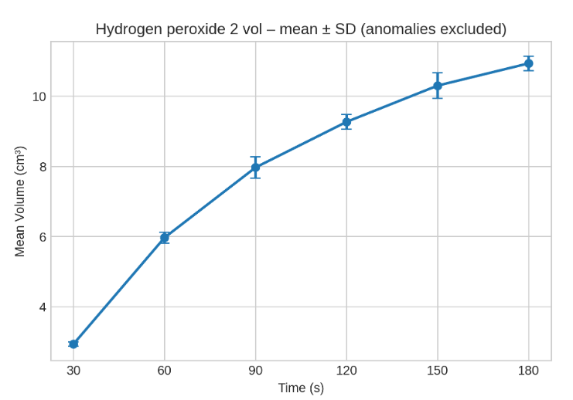
Graph of Table 1 results

Slide 102
Benefits of graphs over tables
Graphs, such as line graphs or scatter graphs, allow trends, patterns and anomalies to be identified more easily than when data is presented in tables, supporting clearer interpretation and more informed conclusions.

Slide 103
Principles of scientific graph construction
A clear title that explains what the graph is showing.
Labelled axes with the correct units (e.g. time in seconds).
A suitable scale so the data points are spaced clearly and evenly.
A line of best fit to show the overall trend or pattern in the data.
Standard error or standard deviation error bars to indicate the reliability and variation in the results.

Slide 104
Drawing graphs in Excel
Open your Table 1 Worksheet in Excel.
Follow the teacher demonstration to create a graph.

Slide 105
Create a graph
Open your Table 2 Worksheet in Excel.
Create a graph from your data.

Slide 106
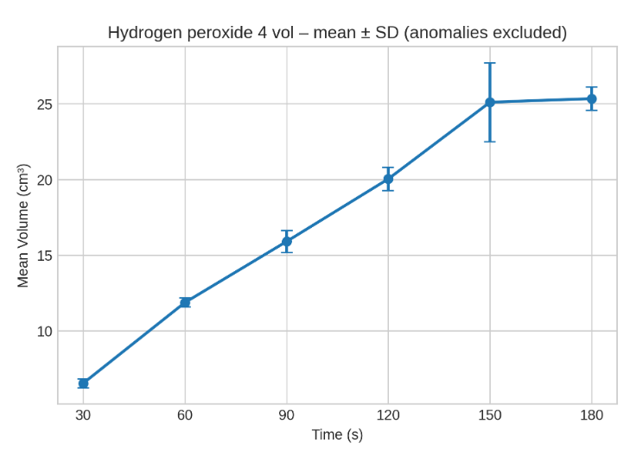
Expected graph for Table 2 data

Slide 107
Create graphs for further data
Create graphs from your data for Tables 3 and 4.

Slide 108
Analyse your graph
Work in pairs.
Share your graphs.
Discuss any differences and reasons for differences.

Slide 109
Write a conclusion
Continue to work in pairs.
Together, write a conclusion for each graph.
Each conclusion must:
  describe the overall trend
  explain the pattern of the graph – refer to this as the effect of substrate concentration on the rate of reaction
  comment on the reliability of the data – use terms such as reproducibility, repeatability if possible.

Slide 110
Conclusion graph from Table 3
At 6 vol, oxygen production increases quickly at first and then slows, showing a high reaction rate. The higher substrate concentration increases enzyme activity compared with lower volumes. The repeats were similar, so the data is repeatable and likely reproducible. Overall, the results are reliable and valid.

Slide 111
Conclusion graph from Table 4
At 8 vol, oxygen production rises the fastest, giving the highest reaction rate. The greater substrate concentration clearly increases enzyme activity. Repeats were very consistent, showing strong repeatability and likely reproducibility. Overall, the results are reliable and valid.

Slide 112
Graph carousel
Move to a graph in the classroom and review the pattern it shows.
Write a conclusion on the paper next to the graph.
Move to the next graph.
Read the conclusion written by the previous pair.
Improve the conclusion if needed—make it clearer, more accurate, or better quality.
Move to a third graph and repeat the process.
When finished, write the final versions of each conclusion in your notebook.

Slide 113
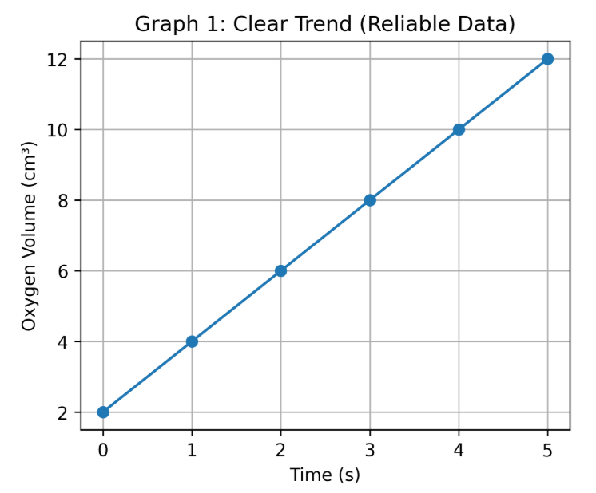
Graph 1

Slide 114
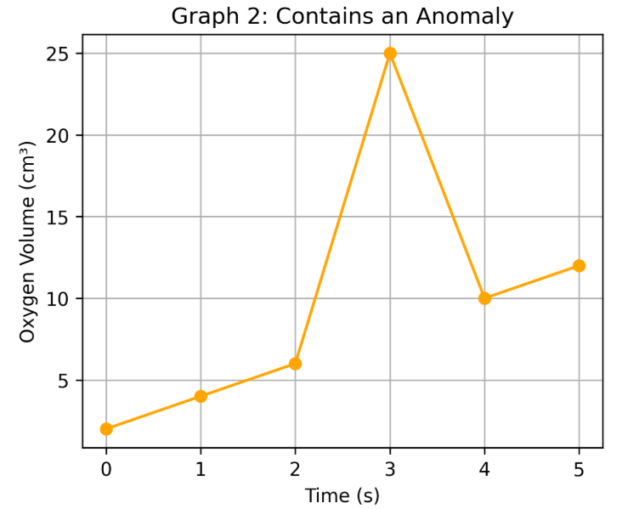
Graph 2

Slide 115
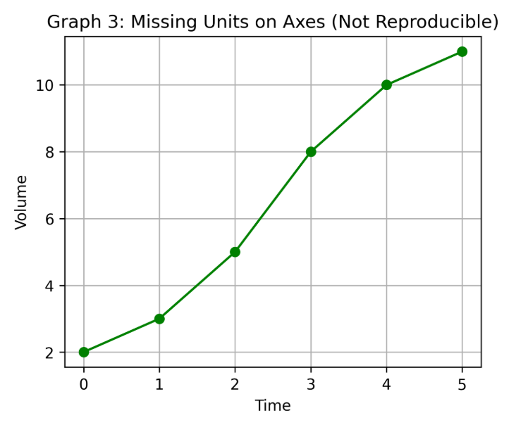
Graph 3

Slide 116
Summarising
Review the graph summarising all of the data you have been given.
Interpret the validity of the data (Is it repeatable? Reproducible? Reliable? Valid?).
Write a clear conclusion based on what the graph shows.
Hand in your conclusion.

Slide 117
Lesson 6
Evaluating scientific evidence

Slide 118
Learning intention - lesson 6
Use evidence from scientific abstracts to judge how reliable a study is.

Slide 119
Overview - lesson 6
Analyse a short scientific report to identify its key parts (aim, method, results, conclusion).
Write your own clear summary using evidence from the report.
Evaluate scientific abstracts to decide whether their conclusions are reliable.

Slide 120
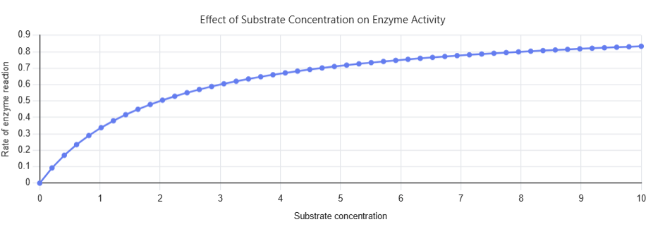
Analyse the graph
Look at this graph.
Describe the overall trend.
Explain the pattern of the graph.

Slide 121
Compare your conclusion
Work with another learner.
Compare your conclusions.
Are there any similarities?
Are there any differences?
What might be the reasons for the differences?
Can you improve the conclusion?

Slide 122
Short report
Read the Short report silently.
We will now read it together.
Does anyone want to read it aloud?

Slide 123
Short report analysis
We will highlight the text in Word when we notice something significant.
Yellow = aim
What the investigation is trying to achieve, its purpose.
Light Blue = method
What was done / how data were collected or measured.
Green = key results
What was found (data‑based statements).
Magenta = conclusion
What the results mean / interpretation linked to the big idea.

Slide 124
Short report analysis table
Category | Report section | Quoted evidence | How is it this category
Aim. | Abstract Aim section. | ‘To make this concept accessible…’ ‘The aim of this investigation was to determine whether catalase substrate specificity ….’ | States the purpose of the investigation.

Slide 125
Enzyme article abstract task
Work in pairs.
Read the Enzyme article abstract.
Analyse the content. Classify the content into aim, method, key results, and conclusion.
Complete the analysis table.
Save the document with a new file name.

Slide 126
Importance of referencing sources
Shows honesty; you are not claiming someone else’s work as your own.
Avoids plagiarism, a key requirement in T Level Science assessments.
Supports scientific evidence; others can check where the information came from.
Good scientific practice with links to ethics, integrity and professionalism.

Slide 127
Harvard referencing-the basics
Harvard referencing is commonly used in science because it is clear, consistent and traceable.
In‑text citation:(Author, Year)
Example: (Smith, 2023)

Slide 128
Harvard style – referencing
Book
Author, Initial(s). (Year). Title. Place: Publisher.
Journal Article
Author, Initial(s). (Year). ‘Article title’, Journal Name, Volume(Issue), pages.
Website
Author/Organisation. (Year). Page title. Available at: URL (Accessed: Date).

Slide 129
Paraphrasing content task
Continue to work in pairs.
Add a column to your Enzyme article abstract analysis completed earlier.
In this column, paraphrase each piece of content.
When complete, produce a summary.
Cite the content used from the original abstract.

Slide 130
Peer marking of Enzyme article abstract summary
Swap places with another pair and read their summary.
Give feedback based on this checklist.
Content includes aim, method, results, conclusion.
All content is necessary. Nothing important is missing.
Structure and clarity:
  Ideas in a logical order.
  Clear, concise writing.
  Scientific meaning is accurate and easy to understand.

Slide 131
Why is evidence important?
To draw strong scientific conclusions, we must use clear, reliable evidence. This same skill is essential when carrying out a literature review.
A literature review is a short summary of what scientists already know about a topic. It involves reading trustworthy sources, picking out the important ideas, and showing what the research agrees on, disagrees on, and what is still unknown.

Slide 132
Abstract analysis task
Work in pairs.
Go to the first station. Read the abstract.
With your partner, decide if the conclusion is valid.
Choose the most important piece of evidence that helped you decide.
Write your answers on the Abstract analysis worksheet (decision, evidence, reference).
Move to the next station and repeat the task when directed.

Slide 133
Purpose of a literature review
Shows what is already known about a scientific topic.
Checks if sources are reliable (peer‑reviewed, quality data, and trustworthy authors).
Helps you pick out key ideas to support your project or practical task.
Identifies gaps or disagreements in current research.

Slide 134
Structure of a literature review
Short summary of key findings from selected sources.
Evaluation of each source (age, reliability, sample size, and method).
Clear themes showing how studies link or differ.
Correct referencing, e.g. Harvard.

Slide 135
Literature review task
Use your Abstract analysis worksheet to choose the key evidence from each abstract.
Produce a literature review.

Slide 136
Lesson 7
Research proposals

Slide 137
Learning intention - lesson 7
Understand how errors and gaps in information affect the quality of scientific arguments.

Slide 138
Overview - lesson 7
Identify errors and missing information in short extracts.
Discuss why method or data gaps weaken explanations.
Create and review a simple research idea.

Slide 139
Review of studies
Give one example of a change of how studies reviewed were linked or how they differed.
Submit your idea on Mentimeter.

Slide 140
Recap from previous lessons: Strong scientific argument
Clear method.
Reliable data.
Logical reasoning.
Evidence links to conclusion.

Slide 141
Gaps and error in research
When you look for weak points, you notice missing information or poor methods.
Spotting errors (like incorrect measurements or assumptions) helps make the scientific argument stronger.
Finding gaps leads to better experiments and new research questions.

Slide 142
Key terms
Validity: whether the test actually measures what it is supposed to measure. Controlled variables and the correct method lead to a valid experiment.
Accuracy: how close a measurement is to the true value. This requires calibrated equipment and correct technique.
Precision: how close repeated measurements are to each other. A low standard deviation.

Slide 143
More key terms
Reliability: whether results are consistent across repeats. This requires enough repeats with similar results.
Repeatability: same person, same method, same equipment, same results, internal consistency.
Reproducibility: different people/labs/equipment with the same pattern of results, external consistency.

Slide 144
Types of error
Human error: mistakes made by people (misreading scales, transcription errors, and incorrect technique).
Instrumental error: faulty, uncalibrated, or poorly maintained equipment causing inaccurate data.
Sampling error: Samples that are not representative, inconsistent, or biased (e.g. different enzyme batches).
Systematic error: consistent shift in results in the same direction (often due to set-up or equipment).
Random error: unpredictable fluctuations affecting precision (timing variation or small volume differences).

Slide 145
Reviewing information for gaps and errors
The Three enzyme studies extracts includes a ‘model’ that has been reviewed for errors and gaps.
Follow the demonstration of how to use the information provided to complete the table. The table will categorise the errors and gaps identified.

Slide 146
Three enzyme studies extracts
Work in pairs.
Select one of the Three enzyme studies extracts.
For each, highlight any gaps or errors.
If you identify any, classify each as either method, data, interpretation or context.
Complete the analysis table.

Slide 147
Check your enzyme study analysis
Read the Three enzyme studies expected results for the extract you selected.
Compare the completed analysis table with yours. Do you spot any differences? If so, think about why that might be.
Prepare to feedback to the rest of the class.

Slide 148
What is the impact of a gap or error?
Continue to work in pairs.
Select one of the enzyme studies. It can be the one you worked on before or a different one.
Select one of the gaps or errors from the analysis table. Discuss the potential impact of that gap or error. Record it in your notebook.
Prepare to give feedback to the rest of the class.

Slide 149
Research questions and hypotheses
Research question: a clear question based on what you want to investigate.
Hypothesis (plural hypotheses): a testable prediction based on what you already know.

Slide 150
How to create a research question
Find gaps or errors in past research. This could be missing data, weak methods, mistakes, unclear results or poor controls.
Turn these into new questions to investigate.
Say what is the specific problem and the variables that are going to be measured.
Example: Does amylase work faster at pH 7 than pH 5?

Slide 151
Writing a hypothesis
A good hypothesis is a clear statement (not a question) that makes a testable prediction about how the independent variable (IV) will affect the dependent variable (DV).
Example: If the pH is closer to neutral, then amylase will work faster.

Slide 152
Hypothesis
Look at these hypotheses' examples:
Chocolate may cause skin problems.
Students who attend lessons have higher grades than those who do not attend.
Amylase will denature at a lower pH.

Slide 153
Task – research proposal
Work in groups.
Choose ONE of the three short abstracts from the analysis worksheet.
Choose ONE gap or error from your chosen abstract that you want to improve.
Complete the Research proposal template. You will find helpful hints in each section to guide your writing.

Slide 154
Peer assessment of research proposal
Swap your completed Research proposal template with another group.
Use the Research proposal peer review checklist to assess their work.
For each criterion, give a mark from 1–5 and a reason.
Be fair, specific, and helpful. When you finish, pass the checklist and template back to the original group.

Slide 155
Plenary
Work individually (no partners for this task).
Write a short summary of your research proposal.
Include:
  Your research question.
  Your hypothesis.
  The key idea of your procedure.
  One sentence on why your experiment is important.
Make sure your summary is clear and in your own words.
Hand your summary in to the teacher before you leave.

Slide 156
Lesson 8
Applying research skills to sugars

Slide 157
Learning intention - lesson 8
Be able to apply research skills to sugars.

Slide 158
Overview - lesson 8
Use a word cloud to explore terminology associated with reliable sources.
Research scientific methods used to detect sugars in food.
Conduct a Benedict’s test.
Discuss ways to adapt an experiment to give quantitative results

Slide 159
What is a reliable source?
Go to the word cloud application.
Write three features of a reliable source.

Slide 160
Key requirements of a reliable source
Currency.
Relevance.
Authority.
Accuracy.
Purpose.

Slide 161
Research task
Work individually.
Research scientific methods used to detect sugars in food.
Use credible sources that demonstrate a reproducible and repeatable methodology.
You need one method that will provides qualitative results and another that provides quantitative results.
Complete the Sugars research findings table.

Slide 162
Peer review the research findings
Review the completed Sugars research table.
Complete the Peer reviewer comments section.

Slide 163
What are the differences?
Work in pairs.
Discuss the difference(s) between the qualitative and quantitative examples researched.
Note the differences that led to different types of data on the Sugars research table.

Slide 164
Benedict’s test
Work in pairs.
Follow the SOP Benedict’s test. Carry out the experiment.
Record the qualitative results.
Clean your workspace when completed.
Place your test tubes in the space provided.

Slide 165
Benedict’s test – health and safety
Benedict’s solution may irritate the eyes and skin.
Hot water bath (80°C) presents a burn risk.
Always wear safety goggles.
Handle hot test tubes carefully using tongs or a holder.

Slide 166
Adapting an experiment
Work in pairs.
Discuss ways in which the experiment could be adapted to produce quantitative results.
You can look back at your research results to help you.
Select one option to share with the rest of the class.

Slide 167
Lesson 9
Evaluating and improving sugar testing methods

Slide 168
Learning intention - lesson 9
Understand how experiments can be improved to give different results.

Slide 169
Overview - lesson 9
The requirements of a good SOP.
Review SOPs for errors and omissions.
Research methodologies used to achieve an aim. Carry out a CRAAP evaluation on sources.
Create a SOP.
Write an evaluation of a SOP.

Slide 170
Recap; What is the scientific method?
The scientific method is a simple process scientists use to ask questions, test ideas, and use evidence to reach reliable conclusions.
The method involves:
setting a hypothesis
carrying out a literature review
testing the hypothesis through an experiment
analysing results
reviewing the results against a literature review to draw conclusions.

Slide 171
What is a good SOP?
Write your key requirements of a good SOP on your mini whiteboard.

Slide 172
Review SOPs
Work in pairs.
Look at the Four SOPs you have been given. What issues do you identify?
  Are there any omissions?
  Are there any errors?
  Is anything unclear?
  Complete the table provided.

Slide 173
How did you do?
Look at the Answers to four SOPs.
Review these against your answers.
Note any differences and anything you missed.
Be prepared to feedback to the class.

Slide 174
Research methodologies
Work in pairs.
Research the methodologies used to achieve the same aim as the SOPs you have just been reviewing.
Select four sources and complete a CRAAP evaluation for these.

Slide 175
Create a SOP
Work in pairs.
Select one of the methodologies you researched. Create a SOP for the experiment.
Put your SOP onto a flip chart using marker pens.

Slide 176
Peer review the SOP
Pass your flip chart to another pair.
Review the SOP. Use a coloured pen to note any issues – errors, omissions, lack of clarity.
Pass to another pair.
Repeat the process.
Each SOP will be reviewed twice.

Slide 177
Evaluate the SOP
You will be given a SOP that has two sets of comments.
Produce a written evaluation of the SOP.
Pass your evaluation and the SOP flip chart to the original pair.

Slide 178
Review your SOP
Look at all the feedback you received:
Two sets of annotations.
The evaluation.
Review the comments. Are any changes needed to the SOP? Make the changes that are needed.

Slide 179
Next lesson
In the next lesson:
You will be reviewing information using the CRAAP criteria.
You will be evaluating methodologies.
You will be producing a research proposal.
Go back through your notes for the previous lessons and note if there is anything unclear.

Slide 180
Lesson 10
Research proposal for sugar testing

Slide 181
Learning intention - lesson 10
Be able to produce a research proposal for sugar testing.

Slide 182
Overview - lesson 10
Review several literature sources – 30 minutes.
Review scientific information and produce a written evaluation of each – 30 minutes.
Produce a research proposal – 40 minutes.
Peer review a research proposal – 15 minutes.

Slide 183
Any questions?
Do you have any questions about the prior learning?

Slide 184
Literature sources review
Look through the literature sources provided.
Review the sources using the CRAAP criteria.
Complete the CRAAP evaluation form for each source.

Slide 185
Methodologies review
Look through the information provided.
Produce an evaluation of each.

Slide 186
Research proposal
Review the information to identify a gap in research.
Produce a research proposal that applies a good scientific method, based on everything you have learned in previous lessons.
Complete the Research proposal template.

Slide 187
Peer review the research proposal
Pass the research proposal to a peer for review.
The peer reviewer should complete the Research proposal peer review checklist.
When you receive the feedback, note any changes that may need to be made.
Hand in everything to the teacher, who will give you feedback later.

Slide 188


Acknowledgements
PRODUCED BY
FUNDED BY
Cambridge Academy for Science and Technology has produced this resource on behalf of the Education and Training Foundation
This programme is funded by the Department for Education
ET-FOUNDATION.CO.UK

