Slide 1
T LEVEL IN ANIMAL CARE AND MANAGEMENT
Supporting Special Education Needs and Disabilities (SEND) learners to carry out animal observations

Slide 2
Lesson 1
Risks and normal behaviour

Slide 3
Aim
By the end of this set of 10 lessons, you will be able to carry out a behavioural assessment taking into account normal and atypical behaviour.

Slide 4
Lesson one aim
Understand the importance of personal safety when working with animals.

Slide 5
Lesson one overview
Why do we observe animals?
What is normal behaviour in animals?

Slide 6
Routines task
Work as a group.
For the routine you have been given:
discuss the steps you would go through to carry out the routine.
ensure these are written down.
feedback to other groups.

Slide 7
What is a risk?
The chance that something harmful, dangerous or unwanted may happen.
Risk assessments are designed by taking into consideration how likely the event is to happen and how serious the outcome would be.

Slide 8
Routines task risk
Refer back to your description of a routine.
Now write down the risks to you of carrying out that routine.

Slide 9
Contribute ideas
Now swap the routine with another group.
Carry out the same task writing down risks to you of carrying out that routine.
Contribute ideas from both tasks on to the Livewall.

Slide 10
Importance of observing animals
Before we handle animals, we observe them to protect ourselves and to make sure that both the animal and we are always safe.
Examples
Ensuring there isn’t someone else that can scare the animal you are about to handle.
Ensuring that another animal can’t enter the enclosure where the animal is that you are working with.

Slide 11
Animals’ safety and wellbeing
We need to observe animals to ensure they are safe and their wellbeing is considered.
What could this mean?

Slide 12
Reasons for observations of animals
Understanding normal behaviour
Group dynamics
Space utilisation
Access to food
Signs of stress
Signs of illness and injury
Enrichment utilisation.

Slide 13
Animal task
Work in groups. Each group will be allocated one of the following animals:
Rabbit
Cat
Sheep
Chicken
Bearded Dragon
Donkey.
On a blank piece of paper, create a list of everything you would expect to see that animal do.

Slide 14
Define normal behaviour
Normal behaviour is that expected of animals that are physically and psychologically healthy. Normal behaviours tell us that an animal is happy, healthy and relaxed in its environment.

Slide 15
Normal behaviours task
Swap the list you have completed with another group.
Think about what we have learnt about normal behaviour.
Put a mark next to anything which is normal for that animal species.
Pass this to another group to repeat the process.

Slide 16
Researching normal behaviour
Research the normal behaviour of a new animal.
Previous animal | New animal
Rabbit | Horse
Cat | Lion
Sheep | Cow
Chicken | Peacock
Bearded dragon | Iguana
Donkey | Zebra

Slide 17
Behaviour similarities
Prey
Found in large groups.
Often herbivorous.
Flight behaviours.
Awareness of potential threats.
Predator
Generally found alone or in smaller groups.
Often carnivorous.
Display hunting behaviours.

Slide 18
New routines task
For one of the below write a process that someone working with the animal should follow:
Feed a snake.
Catch and restrain an alpaca.
Pick out a goat’s foot.
Catch a budgie.
Clean out the ferrets.

Slide 19
Lesson one homework
Consider three ways an animal’s behaviour changes when an individual interacts with it.

Slide 20
Lesson 2
Influences on animal behaviour

Slide 21
Lesson two aim
Be able to identify the influences on animal behaviour.

Slide 22
Lesson two overview
Recap normal behaviours.
Discuss internal and external influences on animal behaviour.
How do different animals present stress?
Create visual displays of how stress is influenced by internal and external behaviours.

Slide 23
Recap on activity
Any issues with the description of a person working with an animal from the last lesson?

Slide 24
Starter activity
Identify three normal behaviours of a prey species.

Slide 25
Starter answers
Moving as a group.
Grazing.
Being vigilant.

Slide 26
Internal Influences
Internal influences are factors within the animal’s self that determine how it approaches a situation or reacts to a stimuli.
These could be:
Genetics/Breed traits – Greyhounds vs Chihuahua.
Health status – Pain response.
Age – Old animals vs young animals.
Hormones – Oestrus vs Testosterone.

Slide 27
Internal influences activity
Look at the Internal influences cards.
Match each situation to an internal influence.

Slide 28
Summary of internal influences
Genetics / breed trait.
Health status.
Age.
Hormones.

Slide 29
Recap on human influences
Access the Word cloud application.
Input three ways animal behaviour changes when an individual interacts with it.

Slide 30
External Influences
Animals are also affected by external influences such as:
Humans – fear, anticipation.
Environment – new location, new substrates or enrichment.
Group dynamics – introduction of new animals, bullying.
Food – food guarding, enrichment utilisation, affect of diet on behaviour.

Slide 31
External influences activity
Look at the External influences cards.
Match each situation to an internal influence

Slide 32
External influences summary
Human influences.
Environment.
Group dynamics.
Food.

Slide 33
Relationship
It is important to consider that some external influences may result in an internal influence.
Example:
A new cat moves in and enters a cat’s garden. The cat may feel the need to mark their territory all around your house.
A bitch in season walks past a house with a dog. The entire dog may not eat and feel stressed that he cannot get to it.

Slide 34
Signs of stress
Stress happens when animals must make intense or long-lasting changes in their body or behaviour to deal with their surroundings.
Stress can be presented in a variety of ways depending on the animal.
Write down any signs of stress you can think of. You have two minutes.

Slide 35
Stress checklist
Self-assess your list of signs of stress against those on the Signs of stress handout.
How many signs did you identify?

Slide 36
Stress situations task
In groups, take a piece of flipchart paper.
Produce a drawing that clearly shows the relationship between external influences and internal influence.
On your drawing, show the signs the animal would display – include what you would notice or see in the animal.
Explain why this stressful situation might happen.
You are allowed to use no more than five words but can use drawings.

Slide 37
Share your drawing
Move to a new group. Explain your drawing to everybody in the group.
Listen carefully and take notes; ask questions if you need clarification.
Return to your original group.
Share the information you learnt with your group. A scribe writes all notes on one sheet of paper.
Take a copy of the notes.

Slide 38
Influences summary
Internal influences
Factors within the animal, such as health, age, hormones and genetics, that affect behaviour.
External influences
Factors external to the animal that affect an animal’s behaviour such as food, humans and the animal’s environment.
Relationship
How these work together to influence the animal.

Slide 39
Lesson 3
Atypical behaviour

Slide 40
Lesson three aim
Understand causes of atypical behaviour.

Slide 41
Lesson three overview
Review normal behaviour of animals.
Watch a video to observe the behaviour displayed.
Create a video with a voice over on animal behaviour and complete a peer review of a video.
Read and evaluate a case study and provide feedback on this.

Slide 42
Normal behaviour review
Individually complete the Normal behaviour quick quiz.

Slide 43
Self assessment activity answers
Are hormones considered an internal or an external factor that influences behaviour? Internal
Identify three signs of stress. Pacing, increased heart rate, feather plucking, panting, hair loss.
Is breed classed as an internal or external factor? Internal
Are visitors in a zoo classed as an internal or external factor? External
Is food an internal or an external factor on behaviour? External

Slide 44
Video task
Watch the video. Note the following on the Observation template:
Animal species.
Behaviour observed.
Cause of behaviour.
Headphones are available if you need to watch independently.

Slide 45
Definitions
Atypical behaviours are those that fall outside the normal behavioural repertoire or are excessive, absent, or out-of-context.
Stereotypical behaviour includes repetitive behaviours that are not functional or have no purpose.
(The Open Sanctuary Project, n.d. Accessed: 8 December 2025)

Slide 46
Stereotypical behaviour
Can happen for a number of reasons:
Poor / inappropriate environment.
Lack of mental stimulation.
Inability to perform natural behaviours.
Stress, anxiety or fear.
Social deprivation.
Health / pain related issues.
Early life experience.
Reinforcement and habit formation.

Slide 47
Video activity
You will now watch two more videos. For each, note the following on the Observation template:
The behaviour.
The cause.
Whether you think the behaviour is stereotypical. Why?
Headphones are available if you need to watch independently.

Slide 48
Research task
Research an animal you are interested in. Find out:
Its normal behaviour.
Its atypical behaviour.
Why the atypical behaviour arise.
From your research, produce a short script that you will use for a presentation.

Slide 49

Adding a voice over to a presentation

Slide 50
Create a presentation
Create a slide summarising your key research findings.
Insert the image of the animal into your slide.
Add a voice over of your script.
Add your script to the Notes section of the slide.

Slide 51
Peer review
Review at least two videos.
Is the content clear and located in an appropriate position on the slide?
Does the slide summarise key points?
Are the points clearly shown with an appropriate size font?
Are the notes easy to follow?
Make notes to give to the group that created the presentation.

Slide 52
Collie case study task
Read the collie case study
Highlight what you feel are the key points.
  What are the internal factors?
  What are the external factors?

Slide 53
Formulate a response
Work in pairs.
From the Collie case study, identify:
Normal behaviour.
Atypical behaviour.
Internal factors.
External factors.
Hand in your answers.

Slide 54
Observation homework
In preparation for our next lesson observe an animal for 10 minutes and write down everything that they do.

Slide 55
Lesson 4
Sampling methods

Slide 56
Lesson four aim
Understand the suitability of different behavioural sampling methods when using ethograms.

Slide 57
Lesson four overview
Learn about ethograms and how they are used.
Create an ethogram.
Observe Capuchin monkeys and chimpanzees using different sampling methods.

Slide 58
Ethograms
What is an ethogram?
Animal behaviour – What the animal is doing or how they are reacting.
Ethology – study of animal behaviour.
Ethos – character.
Ology – study of.

Slide 59
What are ethograms?
A list, catalogue or encyclopaedia of an animal’s behaviour. An ethogram creates an inventory of actions, movements and patterns that an animal exhibits.

Slide 60
Why do we use ethograms?
To monitor animal behaviour and collect data.
Health records – to understand when animals may be behaving oddly or might be ill.
Research – to determine the effects of enrichment, new enclosures and new introductions.

Slide 61
Creating an ethogram
On an ethogram template, a list is produced of all known behaviours carried out by the species to be observed. This could be from primary or secondary research.
This list includes a name for the behaviour (e.g., interaction) and a description of the expected signs of the behaviour (e.g., with another animal). This description is known as the key and could be abbreviated (e.g., WAA).

Slide 62
Using a key
You need to be specific with what a behaviour is in your individual ethogram. For example:
Contact – does that mean contact with another member of the group, contact with another species, contact with a keeper/human?
Moving – does that mean walking, running, jumping, climbing?
Grooming – does that mean self-grooming or allogrooming?

Slide 63
Writing a key task
Refer back to your homework observations.
Select three behaviours you observed. For each, write a clear description that matches what the animal was doing.
Now go to the Livewall.
Write one of your descriptions in Livewall.

Slide 64
Types of ethograms
There are many different types of ethograms. Each has a different purpose.
Focal – one individual is observed.
Scan – a group is observed at predetermined time intervals we record everything every individual is doing.
Ad libitum – opportunistic (unplanned) observation of a behaviour.

Slide 65
Inputting ethogram
Look at the Chimpanzee normal behaviours handout.
Follow as I input these into an Ethogram template.
You can input on yours as well.

Slide 66
Observation by scan sampling
Watch the Chimpanzee behaviour video, Session 2. You may need to use headphones.
Complete the ethogram template using the scan sampling method. This means observing the animals and record everything each individual does at 30-second intervals.
I will give you prompts every 30-seconds.

Slide 67
Capuchin behaviours task
Watch the Capuchin behaviours video. You may need to use headphones.
Note all the behaviours seen. Write a ‘Key’ for each behaviour.
Now work in pairs and compare what each of you produced.
Agree the descriptions and complete the Capuchin behaviour handout.

Slide 68
Observation by focal sampling
Watch the Popeye capuchin video.
At one-minute intervals record everything that “Popeye” is doing. Popeye is clearly labelled for you on the video.

Slide 69
Suitability of sampling methods
What are the pros and cons of focal and scan sampling methods.

Slide 70
Lesson four homework
Give two different scenarios where scan sampling should be used when working with animals.
Give two different scenarios where focal sampling should be used when working with animals.

Slide 71
Lesson 5
Recording methods

Slide 72
Lesson five aim
Understand the appropriate times to use instantaneous, timed and continuous sampling.

Slide 73
Lesson five overview
Review sampling methods.
Create an ethogram for a rabbit.
Observe the rabbit using different recording methods and reflect on each method.
Identify the best recording and sampling method to use in different scenarios.

Slide 74
Scan sampling recap
Select one scan sampling scenario from your homework.
Access the Livewall and write the example in there.

Slide 75
Focal sampling recap
Select one focal sampling scenario from your homework.
Access the Livewall and write the example in there.

Slide 76
Recording behaviour methods
Scan and focal sampling is about who you observe. Today, we are looking at the methods to record the observations.
Continuous – all behaviours are recorded for the entire period.
Instantaneous – behaviour is only recorded at specific moments in time.
Timed – behaviour is recorded for a set time window.

Slide 77
Rabbit behaviour research
Individually research behaviours that we would anticipate seeing captive rabbits performing.

Slide 78
Creating a Key for rabbits
Now work in pairs.
Discuss your findings. Use these to create a Key for a rabbit ethogram.

Slide 79
Create a continuous ethogram
This is where we continually record everything that happens.
On the video there are four rabbits. Look at the Rabbit identification handout to choose one to observe and record.
Add the key to the Continuous ethogram template.

Slide 80
Using a continuous ethogram
Watch the Rabbit behaviour video. There are no voices or words on the video, so you shouldn’t need headphones.
On your Continuous ethogram template (with the Key), make a mark next to every behaviour that rabbit displays.

Slide 81
Review of recording
Work with a partner that selected the same rabbit.
Compare your completed Continuous ethogram templates.
Update the Continuous ethogram template with new recordings if needed.

Slide 82
Reflection of continuous ethograms
Reflect on the process of using a Continuous ethogram template.
Complete the Observation reflection sheet.

Slide 83
Instantaneous ethograms
This is where we choose a specific time span and identify everything that happens at that point.
Add the key to the Instantaneous ethogram template.
Watch the Rabbit behaviour video again.
Complete the Instantaneous ethogram template every 30-seconds.

Slide 84
Review of instantaneous ethograms
Work with a partner that selected the same rabbit.
Compare your completed Instantaneous ethogram templates.
Update the Instantaneous ethogram template with new recordings if needed.

Slide 85
Reflection of instantaneous ethograms
Reflect on the process of using an Instantaneous ethogram template.
Complete the Observation reflection sheet.

Slide 86
Timed ethograms
This is generally used in combination with other methods. It is good for targeting specific behaviours such as how long has been spent performing a specific behaviour.
Select one behaviour you have previously seen the rabbit display.
Watch the video again. Record on the Timed ethogram template each time you observe that behaviour.

Slide 87
Review of timed ethograms
Work with a partner that selected the same rabbit.
Compare your completed Timed ethogram templates.
Update the Timed ethogram template with new recordings if needed.

Slide 88
Reflection of timed ethograms
Reflect on the process of using a Timed ethogram template.
Complete the Observation reflection sheet.

Slide 89
Observations summary
Sampling methods – who you are observing.
Scan.
Focal.
Recording methods – how you are recording what is observed.
Continuous.
Instantaneous.
Timed.

Slide 90
Choosing the right approach
Look at the Scenario identification handout.
For each of the scenarios identify:
Which recording method should be used and why.
Which sampling method should be used and why.

Slide 91
Lesson 6
Data presentation and analysis

Slide 92
Lesson six aim
Use Excel software to interpret and analyse data.

Slide 93
Lesson six overview
Welfare needs matching activity.
Use AI and traditional searches to find out about giraffes.
Review an ethogram for a giraffe.
Ethogram analysis.

Slide 94
Welfare needs matching activity
Select the most appropriate welfare need that appears to be missing from the scenario.

Slide 95
Using AI to search
Ask clear questions.
Be specific and give context.
Use follow up questions.
Refine or expand answers.
Explore multiple perspectives.
Compare, summarise, or analyse topics.
Verify results.

Slide 96
Giraffe behaviour – AI search
Complete a search using Artificial Intelligence on the
behaviour of giraffes.
Record findings on the handout.

Slide 97
Using internet searches appropriately.
Use specific keywords.
Be clear and precise.
Evaluate sources carefully.
Use trusted websites like universities, government sites, zoos, and reputable organisations.
Check multiple sources.
Compare information for accuracy.

Slide 98
Search terms
Quotation marks
The search will look for exact terminology within its results if you use “” either side of your search term.
And
Results include both terms searched for.
Minus (-)
Removes unwanted results (example jaguar – car) – only gives animal results.

Slide 99
Giraffe behaviour – traditional search
Use a traditional search to check the validity of the information that AI has given you.
Record findings on the Research log template.

Slide 100
Interpreting the Giraffe ethogram
Read the Giraffe ethogram.
Identify normal and atypical behaviour.
Complete the table on the Giraffe ethogram.

Slide 101
Ethogram analysis
Answer the Ethogram analysis questions using the ethogram as a source for the answers.

Slide 102
Completing an analysis
Analysis involves breaking something down to understand it better and make informed conclusions.
The process involves:
breaking down the information.
looking for patterns or connections.
making sense of information.
drawing conclusions or making decisions.

Slide 103
Giraffe analysis
Open an Excel spreadsheet.
Follow the demonstration on creating a chart to analyse giraffe behaviour.

Slide 104
Ethogram analysis revisited
Now answer the Ethogram analysis questions again.
This time, use the pie charts you have created to answer the questions.

Slide 105
Report
Create a report detailing what behaviours have been observed in the giraffe.
Within the report embed the pie chart created in the last task.

Slide 106
Giraffe peer review
Pass your report to another learner.
Review the report. Annotate if anything is unclear, there is evidence missing or conclusions are incorrect.
Pass to another learner and repeat.
Review the comments on your report, note any changes that would need to be made.

Slide 107
Validity of data
Read the Enhanced giraffe scenario.
Now work in pairs.
Discuss changes that could be made to the ethogram and the observation and recording process to overcome any issues.
Produce a written summary of the discussion points and conclusions and hand it in.

Slide 108
Lesson 7
Using enrichment to modify animal behaviour

Slide 109
Lesson seven aim
Understand how enrichment can be used to modify behaviour.

Slide 110
Lessons seven overview
Watch videos comparing giraffes in different habitats.
Explore different types of enrichment.
Determine the most suitable enrichment for a giraffe.
Design enrichment for different animals.

Slide 111
Giraffe videos
Watch and listen to the two videos of giraffes.
In your notebooks, write what you observe about the habitat.
Transcripts are available for the videos.

Slide 112
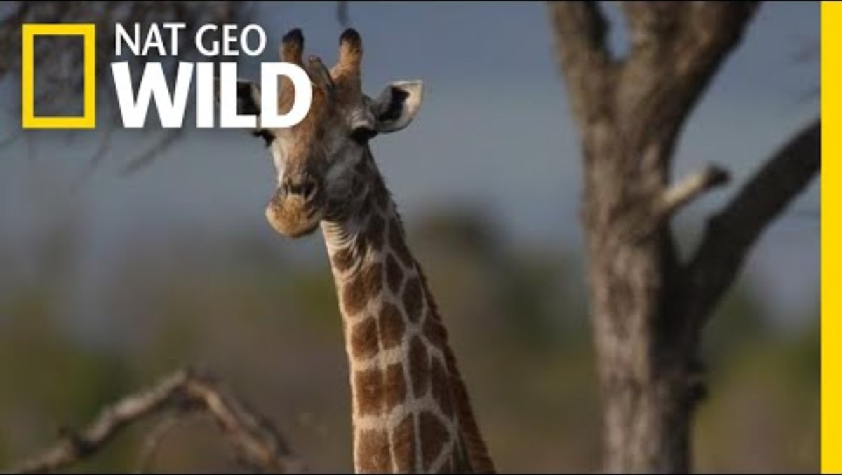
Giraffe in the wild video

Slide 113
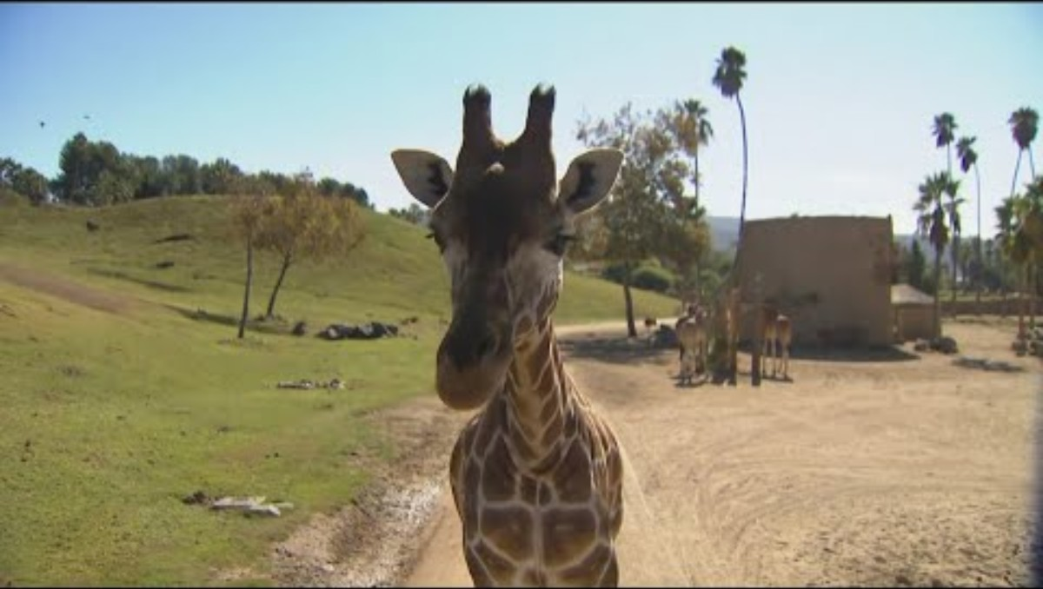
Giraffe in a zoo video

Slide 114
What is the purpose of enrichment?
Improve an animal’s welfare.
Enhance an animal’s captive environment.
  Improve physical welfare.
  Improve mental wellbeing.

Slide 115
Types of enrichment
Food based
Encourages natural foraging and problem solving.
Sensory enrichment
Engages senses beyond taste.
Physical enrichment
Encourages movement and natural stretching.
Social and cognitive enrichment
Promotes interaction and mental stimulation.
Seasonal and Environment Enrichment
Changing the environment.

Slide 116
Enrichment task
Look at the three enrichment ideas in the Giraffe enrichment activity.
Fill in the review table for each one.
Choose the best enrichment to give the giraffes based on the Giraffe Ethogram and the Enhanced giraffe scenario you studied previously.

Slide 117
Enrichment scenarios
Read the Enrichment scenarios. Select one to work with.
On flip chart paper, create a mind map of enrichment ideas that could be used to support the identified animal.
From the mind map select the three best options.
Review each of the three using the criteria in the Giraffe enrichment activity.

Slide 118
Prepare a presentation
You should prepare a short presentation on the three final enrichment ideas.
Give details on both the enrichment ideas as well as a justification of why they should be selected.

Slide 119
Reviewing the presentation
Watch each presentation.
Individually complete the Feedback form.

Slide 120
The winner is….
Based on the votes cast, this is the winner for each group.
Why do you think that was the winner?

Slide 121
Next steps
We will be creating enrichment and observing how well the animal responds.

Slide 122
Homework for lesson seven
Select an animal from the collection for a live observation.
Produce an ethogram for use in the next lesson.

Slide 123
Lesson 8
Observing a live animal

Slide 124
Lesson eight aim
Be able to observe animal behaviour following the introduction of enrichment.

Slide 125
Lesson eight overview
Revisit risk assessments.
Observe an animal.
Create enrichment.
Determine the effect the enrichment had on the animal.

Slide 126
Sampling and recording methods
Sampling methods
Scan and focal – who you are observing.
Recording methods
Continuous and instantaneous – how you are observing.

Slide 127
Key terms used in a risk assessment
In your notebooks make a note of key terms you associate with conducting a risk assessment.

Slide 128
Risk assessment example
Activity | Personnel Affected | Hazards | Harm caused | Risk Rating | Existing Control Measures | Residual Risk Rating | Additional Actions

Slide 129
Plan
Read the Live observation scenarios.
Plan your live observation, including a risk assessment.
Review the ethogram you created for homework to ensure it is valid for the scenario.
Now work in groups. Compare your ethograms and agree a common approach.

Slide 130
Create an enrichment activity
Discuss and agree on the enrichment to be made for the activity.
Create the enrichment.

Slide 131
Conducting a live observation
Individually observe the animal.
The enrichment will then be added to the enclosure.
Complete another observation of the animal on a new copy of the same ethogram.

Slide 132
Discussion of results
Work in pairs with someone who was observing the same animal.
Compare your ethograms.
Discuss reasons for any differences.
Update your work to reflect the outcomes of the discussion.

Slide 133
Presentation of results
Produce two pie charts:
One for before enrichment.
One for after enrichment.
Produce a report discussing what you observed, incorporating the pie charts.

Slide 134
Peer review of live observation
Review someone else's report. Use the Peer review of live observation checklist.
Provide feedback. Use the Constructive feedback sentence starters to help you to phrase the feedback.

Slide 135
Homework for lesson eight
Review the feedback provided by your peers.
Identify one strength that the feedback highlights.
Note any changes that need to be made to the report.
Note any questions to ask peer reviewers for clarification.

Slide 136
Next steps
In the next lesson, we will be watching animals in zoos over a webcam.
If you want to familiarise yourself with this, you can watch the Penguin camera at Edinburgh Zoo.

Slide 137
Lesson 9
Penguin observation

Slide 138
Lesson nine aim
To be able to plan for and carry out an observation on penguins in a zoo.

Slide 139
Lesson nine overview
Homework review.
Research the normal and atypical behaviours of penguins.
Work in pairs to create an ethogram.
Observe penguins through a webcam. Analyse and report on results of observation.
Risk assessment for live observation.

Slide 140
Homework review
Access Livewall.
Refer to your homework. Select one strength identified through the peer review. Enter this into Livewall.

Slide 141
Penguin behaviours
Individually read the Penguins case study.
Carry out research into the normal and atypical behaviours of penguins. Complete the Research findings table.

Slide 142
Ethogram for penguins
Work in pairs.
Discuss your research findings.
Use this to create an ethogram for your allocated observation sampling method. Complete the template.

Slide 143
Peer review the ethogram for penguins
Access the ethogram of your allocated pair. This could be digitally or a printed copy.
Review the ethogram. Annotate if you see any issues, but also if you see good points.
Return to the original pair.
Review your feedback and make changes if needed.

Slide 144
Observe the penguins
In your pairs, access the live webcam of penguins at Edinburgh zoo.
Carry out a 20-minute observation using the allocated sampling method.
One of you will observe whilst the other records. Ensure that each of you spend at least five minutes on each role.

Slide 145
Analyse the penguin observation data
Open a new Excel workbook.
Carry out analysis of the observation data in Excel.
Produce a report to the zoo to summarise the findings and drawing conclusions.

Slide 146
Benefits and limitations of sampling method
For a group with another pair that used a different sampling method.
Discuss the benefits and limitations of each sampling method.
Agree which method was the most suitable.

Slide 147
Potential hazards when observing penguins
Individually make a list of potential hazards for a keeper carrying out an observation of penguins at Edinburgh zoo.
Select three hazards. Enter these three into the word cloud application.

Slide 148
Next lesson
In the next lesson, you will be given a new case study.
You will work individually to
plan an observation of goats in their environment.
carry out research into goat behaviour.
create an ethogram.
observe goats and record the observation.
analyse the results and produce a report.
You will then peer review the work of another learner.

Slide 149
Lesson10
Problem solving through animal observation

Slide 150
Lesson overview
Read the scenario and clarify if there is any terminology you do not understand.
Develop a plan for the observation.
Research the normal and atypical behaviours of goats.
Create an ethogram.
Complete a risk assessment.
Carry out a 20-minute observation of goats.
Analyse the data and produce a report.
Peer review the work of others.
Review feedback and make amendments if needed.

Slide 151


Acknowledgements
PRODUCED BY
FUNDED BY
Warwickshire College Group has produced this resource on behalf of the Education and Training Foundation
This programme is funded by the Department for Education
ET-FOUNDATION.CO.UK

