Slide 1


Lesson 7:
Multiplication and estimation
Level 1
Objectives
Explore, evaluate and select different representations for multiplication
Apply various methods and representations to a singular context using integers and decimals
Apply efficient mastery methods to questions in different contexts
Apply estimation, inversion and rounding to check accuracy of answers
Notes:
Tutor guidance for lesson introduction:
Request confident/fluent learner read lesson objectives to the group.
Reiterate and clarify learning objectives.

Slide 2
Vocabulary check
YOUR
TURN
What other words or phrases mean to multiply?
Let’s add some vocabulary:
3 × 7 = 21
21 ÷ 7 = 3
Notes:
Discussion about prior knowledge relating to multiplication:
Tutor to facilitate a brief discussion around prior knowledge of multiplication e.g. vocabulary (factors, product, multiples, etc.):
'What other words or phrases mean ‘to multiply?’ Answers may include ‘times’, ‘lots of’, ‘just keep adding up’, etc.
Consolidate these words and expressions on the board and reinforce that these all mean the same thing: relate to their usefulness in decoding worded questions.
SUGGESTION: write a multiplication question on the board i.e. 3 × 6 = 18 and annotate with correct vocabulary answers from learners. Establish all learners are aware of the meaning of factors and product in this example.
Reverse the question and confirm learners are aware of the equivalent division fact.

Slide 3
Method check
YOUR
TURN
What methods do you already have for solving this problem?
12 × 6
Notes:
Discussion about prior knowledge relating to multiplication:
Tutor to facilitate a brief discussion investigating previous methods for simple multiplication problems, e.g. long, grid, broken-window, chunking.
Tutor to scribe different methods supplied from learners. Comment on effectiveness and efficiency of the methods given. If not supplied, highlight that this problem can be thought of as 10 × 6 add 2 × 6 = 60 add 12 = 72, so that learners begin to establish fluency with multiplying by 10 as a shortcut.
Emphasise that all written methods are simply algorithms for separating numbers into place value and multiplying single digits, before adding component parts together.
All methods scribed by the tutor should be able to demonstrate that this problem was broken down into 10 × 6 add 2 × 6 and 60 and 12 were added to arrive at 72.
This insight is critical to the lesson.

Slide 4
Question
YOUR
TURN
Where do you use multiplication?
Can you give me some examples from real life?
Where else in maths do you use multiplication?
Notes:
Discussion about why we need multiplication:
Explain WHY multiplication is so integral to Functional Skills maths – multiplication is key to understanding proportionality, which is the core concept behind fractions, decimals, ratio, proportion and area. Annotate the board with answers, enough so that learners see that multiplication (and division) are found in every aspect of the curriculum.
Consolidate that multiplication is essential in every discipline within maths and learners need to be fluent in order to succeed.

Slide 5
True or false?
YOUR
TURN
✔
5.6 × 100 = 560
✖
100 × 50.6 = 506.0
2.3 × 100 = 10 × 23
✔
✖
56 ÷ 100 = 0.056
8600 ÷ 100 = 86
✔
Notes:
All learners should attempt the first true or false quiz. Learners to answer in pairs. Provide mini whiteboards if possible.
Tutor to lead discussion on arising misconceptions: answers are animated.

Slide 6
True or false?
YOUR
TURN
✔
343 ÷ 100 = 34.3 ÷ 10
✖
100 × 50.6 = 506.0
5.53 × 100 = 55.3 ÷ 100
✖
100 × 2.213 = 2213 ÷ 10
✔
✖
10 × 3.1 × 10 = 310 ÷ 10
Notes:
OPTIONAL TASK:
Tutors to decide whether learners are able to attempt these more challenging questions in the same format.

Slide 7
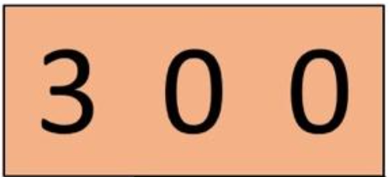
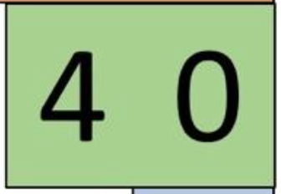
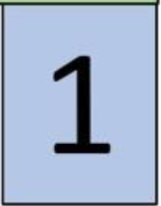
Place value
YOUR
TURN
hundreds
tens
units
Notes:
Write a 3-digit number onto the animated tiles provided above. Keep all digits <5 so carry-over is not introduced yet on the following slide, e.g. 341
Check vocabulary of the place value columns with learners (animated).
Ask learners to describe the meaning of the digits relevant to their place value; e.g. ‘What is the value of each digit?’, ‘What is the value of the 4?’
Discuss sequential orders of magnitude.
Use the animation to reveal that it can be deconstructed into its place value; 300 and 40 and 1, and discuss that the ‘1’ means ‘1 lot of 1’, ‘4’ means ‘4 lots of 10’ and the ‘3’ means ‘3 lots of 100’.

Slide 8
YOUR
TURN
How do we do 341 × 2 without writing anything down?
Repeated addition
6 0 0
6 0 0
2
3 0 0
8 0
4 0
1
3 0 0
4 0
1
300 × 2 = 600
4 0
4 0
8 0
40 × 2 = 80
1
1
2
1 × 2 = 2
Notes:
Tutor to demonstrate that multiplying by a relatively small factor e.g. 2 or 3 can be performed by repeated addition.
Reinforce how numbers are deconstructed into their place values.

Slide 9
YOUR
TURN
What about 341 × 6?
x 6
1 0 0 0
8 0 0
4 0
6
3 0 0
2 0 0 0
2 0 0
4 0
x 6
4 0
4 0
1
x 6
6
6
Notes:
Explain that multiplying by larger factors (e.g. >3) using repeated multiplication can be done but is inefficient and time consuming.
Consolidate with learners that 300 × 6 is more efficient and less error-prone than 300 + 300 + 300 + 300 + 300 + 300
Explain that 300 × 6 can be completed with mental arithmetic by calculating 3 × 6 = 18 but then completing with the trailing zeroes (avoid saying ‘adding’) because it is actually 6 lots of 300 and therefore needs the two zeroes adding to confirm the place value.
Consolidate this method with learners with the 40 × 6 = 24 with a zero, is an efficient way to multiply by 40 by breaking it down into × 4 then × 10, as it is critical to the algorithms that will follow.
Take time to discuss the ‘carry-over’ of the hundred column in the final answer (800 + 200 = 1000) and that learners can fluently embed this step into their methodology.

Slide 10


YOUR
TURN
What about 341 × 13?
3 0 0
× 10
× 3
3 0 0
4 0
× 10
× 3
4 0
1
× 10
1
× 3
9 0 0
3 0 0 0
3 0 0 0
9 0 0
5 0 0
4 0 0
2 0
2 0
1 0 0
3
1 0
1 0
3
Notes:
Discuss multiplying by factors greater than 9, i.e. 2-digits.
Explain/discuss that this is the same method but has to be repeated for each of the multiplier’s digits.
Ask the question ‘What are the values of the digits in 13?’ Make sure all learners are efficient at deconstructing it into 10 and 3.
To reinforce that the algorithm is a more efficient method, take time to go through this procedure, repeating previous work for the 10 and for the 3, before adding to an answer.
Emphasise that with increased steps comes the increased likelihood of making an error and that this method takes too much time.
Arrive at the conclusion that a more efficient written method is needed i.e. an algorithm but the place value is important to understanding why the algorithm works.

Slide 11
Talking numbers
YOUR
TURN
How would you calculate the answers without writing anything down?
3 × 23 =
23 × 100 =
0.23 × 10 =
What does multiplying by 10 or 100 do to the number?
3 × 0.23 =
Which question creates a smaller number than the original? Why?
Notes:
Misconceptions to pull out
Adding 0 when multiplying by 10
Multiplying makes the answer bigger
Discussion points
Repeated addition
How to check (estimation)

Slide 12
What is multiplication?
YOUR
TURN
Essentially, repeated addition.
But when we are working with big numbers, this isn’t always the best approach.
Discussion point – why?
For example look at this array…
Rather than counting each circle, how else could we view this?
Notes:
Discussion around what multiplication is and why we need it.
Introduce the array as a way of showing why we use multiplication and discuss alternatives to counting individual circles, for example:
•Count how many there are in each column (or row), then add same number for each subsequent column (or row)
Leading to:
•Multiply the number in each column (or row) by the number of rows (or columns)
Leading to:
•Multiply the number of columns by the number of rows
Explain that it doesn’t matter which option you use (rows x columns, or columns × rows), the answer will be the same.

Slide 13
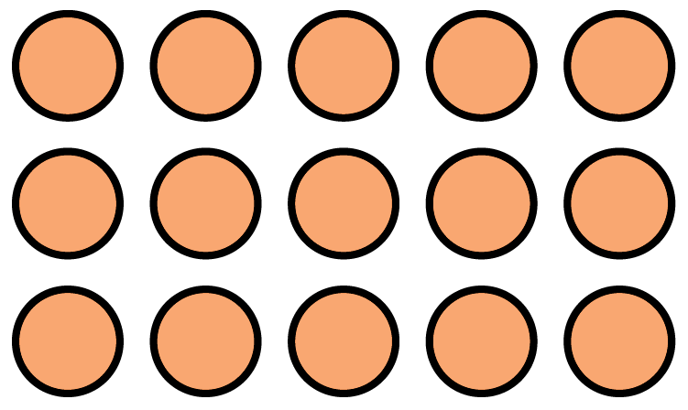

What is multiplication?
YOUR
TURN
Notes:
Optional slide to further discuss.
Ask learners to create as many ways as possible of grouping the array (factor pairs).

Slide 14
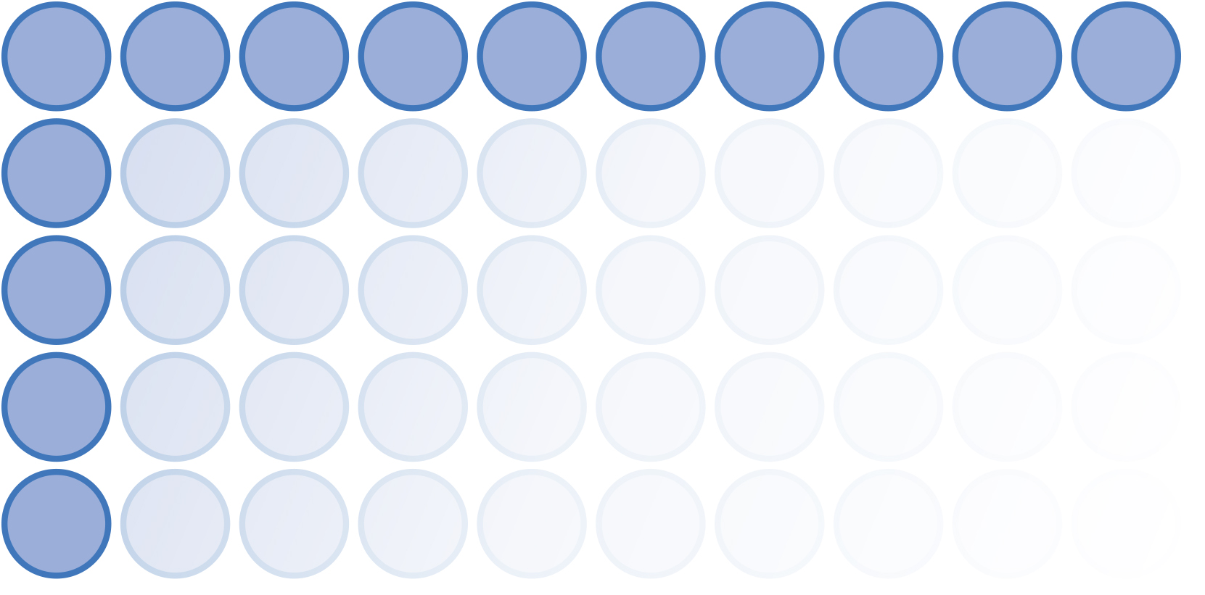
Another model
YOUR
TURN
When we have decimals, an array isn’t the best model because we can’t easily count or predict answers.
What other models can we use when we can’t count?
Notes:
A key learning point is for learners to understand that an array is a discrete model where multiplication is an efficient replacement for repeated addition.
Discuss that decimals are a continuous measure and counting no longer works. The image is to visualise a transition from discrete to continuous and now requires an algorithm.

Slide 15
Area model
YOUR
TURN
When we have decimals, an array is not the best model,
so we use an area model e.g.
3.4
4
2
2.74
Notes:
Introduce the idea of an area model. If appropriate, make the link with calculating the area of a rectangle.

Slide 16
Another model
YOUR
TURN
We can use an area model to think about multiplying decimals by breaking numbers down:
2 × 3.4
4 × £2.74
3
0.4
2
0.7
0.04
2 × 3
2 × 0.4
4 × 2
4 × 0.7
4 × 0.04
6
0.8
4
8
2.8
0.16
2
6.8
£10.96
Notes:
Demonstrate the use of an area model to decompose these two calculations according to place value.
Use the animation to facilitate the demonstration, asking learners to provide the result of each sub-calculation.

Slide 17
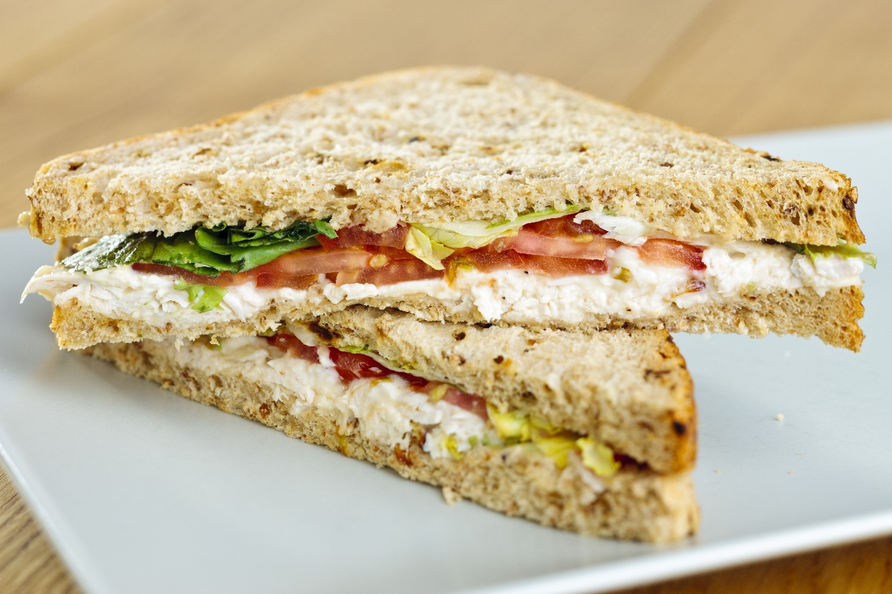
Using the area model for money calculations
YOUR
TURN
Aisha buys 8 sandwiches for a group of visitors to her workplace.
Each sandwich costs £3.26.
What is the total cost of the sandwiches?
Use an area model to answer this question.
Notes:
Ask learners to use the area model to attempt this question – providing support where necessary.
Discuss whether they found the method helpful, and when they might use it.
Answer: £3.26 × 8 = £26.08

Slide 18
Rounding and estimation checks
YOUR
TURN
When multiplying, we should always carry out a simple rounding check to see whether our answers are sensible.
What does ‘sensible’ mean?
How do we carry out a rounding check?
Notes:
Discuss with learners what a rounding check is, what a sensible answer means and how to carry out checks.
Ensure learners round factors and not the result.
Confirm that learners understand a rounding check should be carried out using mental arithmetic.

Slide 19
Starter
YOUR
TURN
6? Which digits can take the place of the ‘?’
How can we round them to the nearest ten?
0 | 1 | 2 | 3 | 4 | 5 | 6 | 7 | 8 | 9
✖
Notes:
Ask learners to suggest values to follow the decimal point, and discuss whether they would round up to the next whole number, or round down.
This slide explores rounding a 2-digit number to the nearest 10. Discuss, then reveal the 10 possible digits that could follow the digit 6 (i.e. 60).
Check for and clarify any misconceptions around 0 or 10 being on the list.
Use the animation to reveal the digits 0 to 4 and discuss whether these would result in rounding up or down – and why.
Animate further to show that 5 belongs in a second equal grouping that results in rounding up. Ask learners to justify why 5 rounds up.
Be careful to explain that the digits 0–4 do not ‘round down’ but disappear or are replaced with zeroes where appropriate.
Relate to money for clarity e.g. ‘£63 is closest to which £10 note?’ ‘£68 is closest to which £10 note?’

Slide 20
Rounding
YOUR
TURN
£
Round this number to the nearest ……………….…….
0 | 1 | 2 | 3 | 4 | 5 | 6 | 7 | 8 | 9
✖
Answer: £
Notes:
Tutors may ask their own questions (enter your own questions in the Question box) or take suggestions from the class. Money is a comfortable context to use at this point but the ‘£’ may be removed.
Ask learners to round the amount firstly to the nearest pound, and then to the nearest ten-pence.
Practise rounding numbers using the rule until all learners are comfortable and fluent.

Slide 21
Estimation
YOUR
TURN
ROUND
What is a sensible estimate for 3.8 × 5.1?
4
5
3.8 × 5.1 ≈ 4 × 5
≈ = 20
✔
Check: 3.8 × 5.1 = 19.38
Notes:
Consolidate the previous slides with a worked example of how to perform and justify a rounding check for decimal numbers if required.
Explain the ‘approximately equals to’ symbol.

Slide 22
YOUR
TURN
Rounding and estimation checks
Use your place value cards set to create a pair of random two-digit numbers.
Place them on the paper.
Round the numbers before multiplying.
Check your estimation.
52 × 97
T H T U
50 × 100 = 5 0 0 0
T H T U
52 × 97 = 5 0 4 4
Check:
Notes:
Hand out place value cards and have learners work in pairs or threes.
Learners should select random cards to make a pair of two or three digit numbers that they then place on a sheet of paper or mini whiteboard and perform a clear rounding check before using a calculator to verify their answers as pictured.
Ensure learners annotate with correct place value label to validate the ‘sensibility’ of their answer.
Ask learners to include decimal points to their cards to increase difficulty.
Practise until skill is secure and feedback/select questions and methods and/or incorrect answers to challenge misconceptions.

Slide 23

Practice
YOUR
TURN
Handout
available
Set 1
Set 2
35 × 7
7 × 36
70 × 35
72 × 36
720 × 36
£721 × 36
3.5 × 7
7.5 × 36
70 × 3.5
£7.20 × 3.60
£720 × 3.60
72.1 × 3.6
Notes:
Ask learners to work in pairs to estimate the answers to these questions by rounding.
Learners who are confident in estimating calculations involving integers can move straight on to set 2 – involving decimals.
Answers:
Set 1:
1) 35 × 7 = 245
2) 7 × 36 = 252
3) 70 × 35 = 2450
4) 72 × 36 = 2592
5) 720 × 36 = 25 920
6) £721 × 36 = £25 956
Set 2:
1) 3.5 × 7 = 24.5
2) 7.5 × 36 = 270
3) 70 × 3.5 = 245
4) £7.20 × 3.60 = £25.92
5) £720 × 3.60 = £2592
6) 72.1 × 3.6 = 259.56

Slide 24
Practice
YOUR
TURN
Handout
available
Estimate the answers to these calculations, then calculate the exact answer.
How close was your estimate? Is your answer sensible?
Rachel works at a shop and is paid £7.60 per hour. She works for 12 hours a week.
Work out how much Rachel is paid.
Ahmed is fitting a new carpet in his living room, it is a rectangle shape.
The room is 4.5 m by 5.2 m.
How many square metres does he need?
Adam changes £180 into Euros.
The exchange rate is £1 to €1.13.
How many Euros does he receive?
Notes:
Ask learners to estimate the answers to each of these questions.
They should then carry out an exact calculation (remind them of the area model) and see how close their estimation is.
Answers:
1) £7.60 × 12 = £91.2
2) 4.5 × 5.2 = 23.4 metres squared
3) 180 × 1.13 = €203.4

Slide 25

Method selection
KEY IDEA
There are many methods we could select when multiplying numbers.
For example:
Repeated addition
Area models
Column
Grid
Lattice
Ratio table
Notes:
Discussion with learners on what current method they would use. Explore whether their method would change depending on the question.

Slide 26
How many ways?
YOUR
TURN
1650 × 19 =
Notes:
Discuss commutative properties of either 1650 groups of 19 or 19 groups of 1650. What methods have you used – how confident are you in multiplying? What do you believe you need to be more fluent and confident? Identify common misconceptions e.g. 0 × 9 = 0 and forgetting the zero in long multiplication. Did anyone use a distributive method 1650(10 + 10 − 1) or ratio tables?

Slide 27

Exam question (1)
YOUR
TURN
Handout
available
Answer ALL questions. Write your answers in the spaces provided.
Marli travels to college by bus.
She has this information about ticket prices.
Price of a weekly ticket = £12
Price of 4 daily tickets
= 4 × £3.40
= £13.60
So Marli saves £1.60
ticket prices
daily ticket £3.40
weekly ticket £12
monthly ticket £54
Marli will travel to college 4 days next week.
She buys a weekly ticket instead of 4 daily tickets.
How much money does Marli save in total?
You must show your working.
Notes:
Use these exam questions to practise skills and knowledge learned in the lesson.
The solution to the problem can be revealed through the animation and discussed.

Slide 28
Exam question (2)
YOUR
TURN
Handout
available
John works Monday to Friday.
He buys his lunch on his way to work.
Each day John buys a sandwich, a bottle of water and a bag of crisps.
Shop A:
Price = £2.85 + 60p + 85p
= £4.30
Shop B:
Price = £3
So John saves £1.30 per day.
Over 5 days he saves
5 × £1.30 = £6.50
So he doesn’t save £7.50 per week.
Shop A
any sandwich £2.85
a bottle of water 60p
a bag of crisps 85p
Shop B
£3 meal deal
any sandwich
a bottle of water
a bag of crisps
John thinks he will save more than £7.50 a week if he buys his lunch each day from shop B instead of shop A.
Is John correct?
You must show your working.
28

Slide 29
Lesson review:
Multiplication and estimation
Level 1
Objectives
Explore, evaluate and select different representations for multiplication
Apply various methods and representations to a singular context using integers and decimals
Apply efficient mastery methods to questions in different contexts
Apply estimation, inversion and rounding in order to check accuracy of answers
Suggested further steps/areas to work on
Division
Under/over estimates
Significant figures

Slide 30


Lesson 7:
Credits
Photos acknowledgements
Shutterstock.com: ProKasia
Text acknowledgements
Pearson Edexcel Functional Skills, Past Paper 3 – Mathematics Level 1 (Non-calculator) PMAT1/N03 Question 1
Pearson Edexcel Functional Skills, Practice Paper 1 – Mathematics Level 1 (Calculator) PRACL1/C01 Question 4

