Slide 1


Lesson 30:
Expand and factorise
Objectives
Simplify algebraic expressions to maintain equivalence by multiplying a single term over a bracket
Simplify algebraic expressions to maintain equivalence by multiplying a single term over a bracket and collecting like terms
Simplify algebraic expressions to maintain equivalence by taking out common factors.
Notes:
Tutor guidance for lesson introduction:
Request a confident/fluent learner to read lesson objectives to the group.
Reiterate and clarify learning objectives.

Slide 2







INTRODUCTION
Student sample thinking
Expand 3(x + 4)
Alicia says the answer is 3x + 4.
Alicia is not correct?
Can you explain why?
$x +4$
$3$
$$x$$
1
1
1
1
$=3x+12$
$$x$$
1
1
1
1
$$x$$
1
1
1
1
Notes:
Allow learners to discuss their thinking in pairs. Draw on key misconception where students do not multiply the 3 by the 4. Get learners to use the algebra tiles (if you have them) or mathbot online to model.

Slide 3




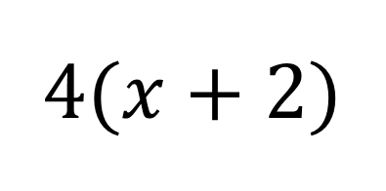




MODEL
Using algebra tiles in arrays to represent multiplication
$4(x+2)$
Array representations​
Area model
$x +2$
$x +2$
$$x$$
1
1
$4$
$4$
4x
+ 8
$$x$$
1
1
$$x$$
1
1
$$x$$
1
1
Notes:
This slide is key to establish the different names of the models (array and area). Both will be included in the card sort activity later. Again, emphasis on the key misconception of not fully expanding. Support with the area model – ask learners to use algebra tiles to model this themselves through discussion.

Slide 4



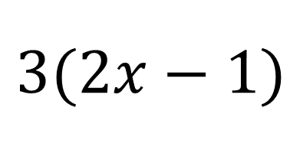







MODEL
Using algebra tiles in arrays to represent multiplication
$3(2x−1)$
Array representations​
Area model
$2x −1$
$2x −1$
$$x$$
$$x$$
-1
$3$
$3$
6x
-3
$$x$$
$$x$$
-1
$$x$$
$$x$$
-1
Notes:
This example has been included to show difference in algebra tiles and model when negatives are introduced.

Slide 5
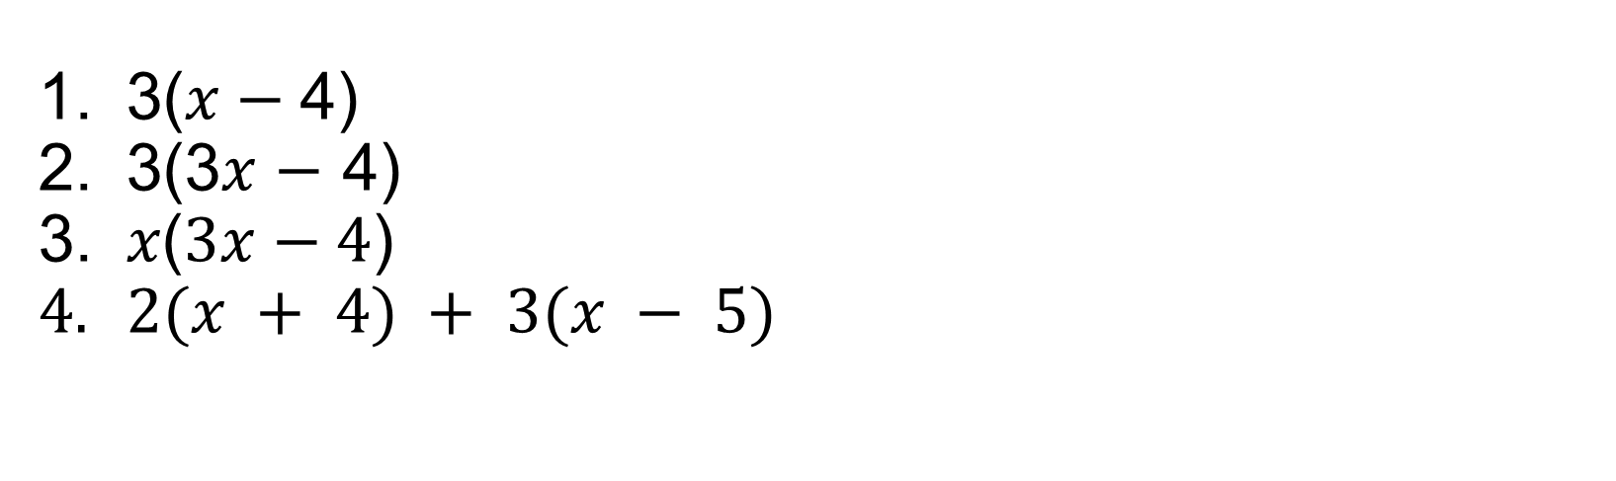
EXPLORE 1
Using algebra tiles in arrays to represent multiplication
3($x−$4)
3(3𝑥 $−$ 4)
𝑥($3x−4$)
$2(x + 4) + 3(x − 5)$
Use algebra tiles to create:​
1 array representations​
2 an area model.
Notes:
Tutor guidance:
If learners do not have access to physical algebra tiles, the tutor should provide them with access to internet to use the mathsbot website: https://mathsbot.com/manipulatives/tiles

Slide 6

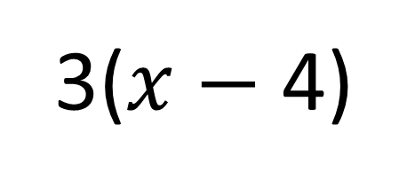







EXPLORE 1
Using algebra tiles in arrays to represent multiplication
3($x−$4)
Array representations​
Area model
$x −4$
$− 4$
$$x$$
$3$
$$x$$
-1
-1
-1
-1
$3$
3x
-12
$$x$$
-1
-1
-1
-1
$$x$$
-1
-1
-1
-1
3x
-12
Notes:
Use learner-led feedback to discuss the solutions to the exploration activity

Slide 7
















EXPLORE 1
Using algebra tiles in arrays to represent multiplication
$3 (3x− 4)$
Array representations​
$3x− 4$
$x x x −4$
$3$
$$x$$
$$x$$
$$x$$
-1
-1
-1
-1
$$x$$
$$x$$
$$x$$
-1
-1
-1
-1
$$x$$
$$x$$
$$x$$
-1
-1
-1
-1
$$3x$$
$− 4$
Area model
$3$
9x
-12
Notes:
Use learner-led feedback to discuss the solutions to the exploration activity

Slide 8





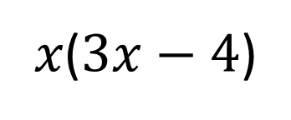


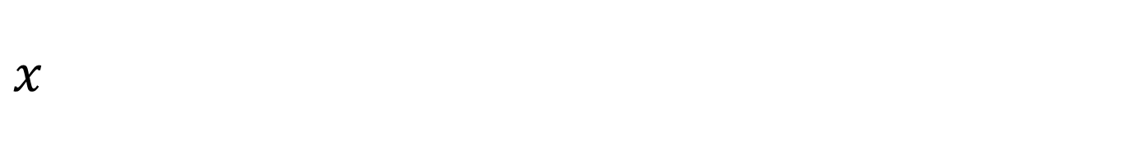




EXPLORE 1
Using algebra tiles in arrays to represent multiplication
𝑥($3x−4$)
$3x− 4$
Array representations​
$x x x −4$
$x$
$x$²
$x$²
$x$²
$$−x$$
$$−x$$
$$−x$$
$$−x$$
$$3x$$
$− 4$
Area model
3x²
- 4x
$x$
Notes:
Use learner-led feedback to discuss the solutions to the exploration activity. This example is key in introducing indices/quadratic form.

Slide 9




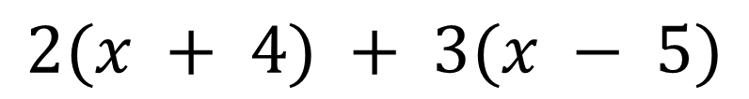














EXPLORE 1
Using algebra tiles in arrays to represent multiplication
$$2(x + 4) + 3(x − 5)$$
Array representations​
$x−5$
$x+ 4$
$$x$$
-1
-1
-1
-1
-1
$2$
$$x$$
1
1
1
1
$+$
$3$
$$x$$
-1
-1
-1
-1
-1
$$x$$
1
1
1
1
$$x$$
$$x$$
-1
-1
-1
-1
-1
$+ 4$
$$x$$
Area model
$−5$
2x
+8
3x
- 15
$2$
$+$
$3$
= 5$x−7$
Notes:
Use learner-led feedback to discuss the solutions to the exploration activity. Simplification – key misconception – address with the use of collecting the algebra tiles together to get 5x, reinforce abstractly with the area model.

Slide 10
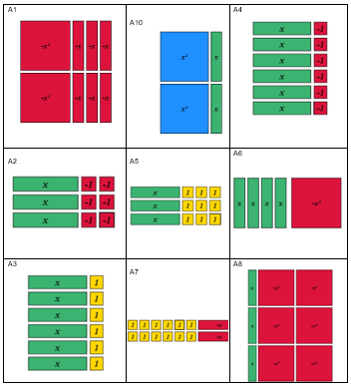
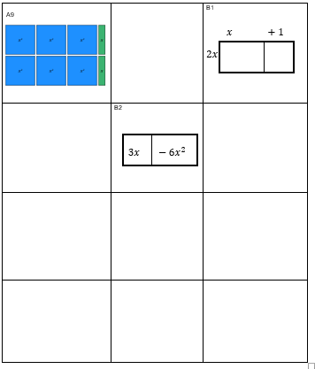
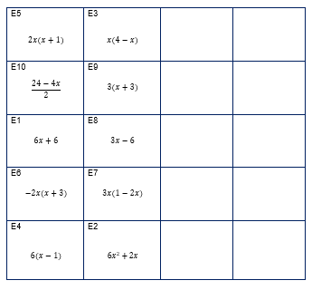
EXPLORE 2
Card sort
Use the cards to match equivalent expressions and diagrams into sets of four. Use the blank cards to fill in any that are missing.
Each set should include:
Factorised expression
Expanded expression
Array representation
Area model
Notes:
Circulate and support learners where needed during this activity.

Slide 11




DISCUSS
A1
x
+3
-x2
-x
$$\text{-}\text{x}$$
$$\text{-}\text{x}$$
-2x
-2x²
-6x
-x²
-x
$$\text{-}\text{x}$$
$$\text{-}\text{x}$$
E6
-2x²-6x
-2x(x+3)
Notes:
Answers
Discussion points: Are there any equivalent expressions? Why do they represent the same expression?
Discussion on factorising: In how many ways can you arrange the tiles to make rectangles?

Slide 12
DISCUSS
A2
x
x
-2
-1
-1
x
-1
-1
3
3x
-6
x
-1
-1
E8
3x-6
3 (x-2)
Notes:
Answers
Discussion points: Are there any equivalent expressions? Why do they represent the same expression?
Discussion on factorising: In how many ways can you arrange the tiles to make rectangles?

Slide 13
DISCUSS
A3
1
x
+1
x
x
1
+6
6
6x
x
1
x
1
x
1
x
1
E1
6x+6
6(x+1)
Notes:
Answers
Discussion points: Are there any equivalent expressions? Why do they represent the same expression?
Discussion on factorising: In how many ways can you arrange the tiles to make rectangles?

Slide 14

DISCUSS
A4
x
x
-1
-1
x
-1
$$6$$
6x
-6
x
-1
x
-1
x
-1
x
-1
E4
6x-6
6(x-1)
Notes:
Answers
Discussion points: Are there any equivalent expressions? Why do they represent the same expression?
Discussion on factorising: In how many ways can you arrange the tiles to make rectangles?

Slide 15
DISCUSS
A5
x
+3
x
1
1
1
x
1
1
1
3
3x
+9
x
1
1
1
E9
3(x+3)
3x+9
Notes:
Answers
Discussion points: Are there any equivalent expressions? Why do they represent the same expression?
Discussion on factorising: In how many ways can you arrange the tiles to make rectangles?

Slide 16


DISCUSS
A6
4
-x
x
4x
-x²
x
x
x
x
$$\text{-}\text{x}\text{2}$$
E3
x(4-x)
$$\text{4-}\text{x}\text{2}$$
Notes:
Answers
Discussion points: Are there any equivalent expressions? Why do they represent the same expression?
Discussion on factorising: In how many ways can you arrange the tiles to make rectangles?

Slide 17



DISCUSS
A7
6
$$\text{-}\text{x}$$
2
12
-2x
1
1
1
1
1
1
-x
1
1
1
1
1
1
$$\text{-}\text{x}$$
E10
$$\frac{\text{24-4}\text{x} }{\text{2}}$$
2(6-x)
Notes:
Answers
Discussion points: Are there any equivalent expressions? Why do they represent the same expression?
Discussion on factorising: In how many ways can you arrange the tiles to make rectangles?

Slide 18


DISCUSS
A8
B2
-x²
1
-2x
x
$$\text{-}\text{x}\text{2}$$
3x
3x
-6x²
$$\text{-}\text{x}\text{2}$$
-x²
x
x
-x²
-x²
E7
3x(1-2x)
3x-6x²
Notes:
Answers
Discussion points: Are there any equivalent expressions? Why do they represent the same expression?
Discussion on factorising: In how many ways can you arrange the tiles to make rectangles?

Slide 19







DISCUSS
A9
B2
3x
+1
$$\text{x}\text{2}$$
$$\text{x}\text{2}$$
$$\text{x}\text{2}$$
x
2x
$$\text{6}\text{x}\text{2}$$
+2x
$$\text{x}\text{2}$$
$$\text{x}\text{2}$$
$$\text{x}\text{2}$$
x
E2
6x²+2x
2x(3x+1)
Notes:
Answers
Discussion points: Are there any equivalent expressions? Why do they represent the same expression?
Discussion on factorising: In how many ways can you arrange the tiles to make rectangles?

Slide 20




DISCUSS
B1
A10
x
+1
$$\text{x}\text{2}$$
x
$$\text{2}\text{x}\text{2}$$
2x
+2x
$$\text{x}\text{2}$$
x
E5
2x(x+1)
$$\text{2}\text{x}\text{2}\text{+2}\text{x}$$
Notes:
Answers
Discussion points: Are there any equivalent expressions? Why do they represent the same expression?
Discussion on factorising: In how many ways can you arrange the tiles to make rectangles?

Slide 21




















EXPLORE 3
Practice: expanding single brackets
EXPLORE 3
Expanding Single Brackets
(a) | (b) | (c) | (d)
Expand | Expand | Expand | Expand
(e) | (f) | (g) | (h)
Expand | Expand | Expand | Expand
(i) | (j) | (k) | (l)
Expand | Expand | Expand | Expand
(m) | (n) | (o) | (p)
Expand | Expand | Expand | Expand and simplify
(q) | (r) | (s) | (t)
Expand and simplify | Expand and simplify | Expand and simplify | Expand and simplify
$$2(x+5)$$
$$3(6−x)$$
$$x(x−3)$$
$$a(5+a)$$
$$2a(b−7)$$
$$−2 (x+6)$$
$$5(2x−y)$$
$$4x(2+x)$$
$$−3(x^{2}+4)$$
$$6a(a+2b)$$
$$2x(x^{2}+3y)$$
$$ab(8−a)$$
$$−x(3+x)$$
$$−2(5−x)$$
$$3x^{2}y(2x−6y)$$
$$4\left(x+2\right)+3(x+6)$$
$$4\left(8+x\right)+3(x−1)$$
$$6\left(1+2x\right)−2(x+5)$$
$$7\left(3x+2\right)−4(x−2)$$
$$6x\left(x+4\right)−x(7−2x)$$
21

Slide 22













































DISCUSS
Expanding Single Brackets
(a) | (b) | (c) | (d)
Expand | Expand | Expand | Expand
(e) | (f) | (g) | (h)
Expand | Expand | Expand | Expand
(i) | (j) | (k) | (l)
Expand |  | Expand | Expand
(m) | (n) | (o) | (p)
Expand | Expand | Expand | Expand and simplify
(q) | (r) | (s) | (t)
Expand and simplify | Expand and simplify | Expand and simplify | Expand and simplify
$$2(x+5)$$
$$3(6−x)$$
$$x(x−3)$$
$$a(5+a)$$
$$2x+10$$
$$18−3x$$
$$x^{2}−3x$$
$${5a+a}^{2}$$
$$2a (b−7)$$
$$−2 (x+6)$$
$$5(2x−y)$$
$$4x(2+x)$$
$$2ab−14a$$
$$−2x−12$$
$$10x−5y$$
$$8x+4x^{2}$$
$$−3(x^{2}+4)$$
$$6a(a+2b)$$
$$2x(x^{2}+3y)$$
$$ab(8−a)$$
$$−3x^{2}−12$$
$$6a^{2}+12ab$$
$$2x^{3}+6xy$$
$$8ab−a^{2}b$$
$$−x(3+x)$$
$$−2(5−x)$$
$$3x^{2}y(2x−6y)$$
$$4\left(x+2\right)+3(x+6)$$
$$−3x−x^{2}$$
$$−10+2x$$
$$6x^{3}y−18x^{2}y^{2}$$
$$4x+8+3x+18$$
$$7x+26$$
$$4\left(8+x\right)+3(x−1)$$
$$6\left(1+2x\right)−2(x+5)$$
$$7\left(3x+2\right)−4(x−2)$$
$$6x\left(x+4\right)−x(7−2x)$$
$$32+4x+3x−3$$
$$6+12x−2x−10$$
$$21x+14−4x+8$$
$$6x^{2}+24x−7x+2x^{2}$$
$$7x+29$$
$$10x−4$$
$$17x+22$$
$$8x^{2}+17x$$
Notes:
Answers. Please use discussion points here to draw on common errors seen/observed during circulation.

Slide 23



Exam questions: Question 1
REVIEW
Worksheet
available
Expand $5(2m−3)$
10m - 15
Factorise $3n+12$
$$3(n+4)$$
Notes:
Factorising: in how many ways can you arrange the tiles to make rectangles?

Slide 24
Exam questions: Question 2
REVIEW
Worksheet
available
  Expand x(x – 4)
  Factorise 15y – 10
x² – 4x
5(3y – 2)

Slide 25


Exam questions: Question 3
REVIEW
Worksheet
available
Expand $2(a+d)$
$$2a+2d$$
Factorise $6y^{2}−5y$
$$y(6y−5)$$

Slide 26
Exam questions: Question 4
REVIEW
Worksheet
available
Expand and simplify (2x + 1)(3x – 2)
Factorise x² + 6x + 9
6x² − x – 2
(x + 3)²

Slide 27
Lesson review:
Expand and factorise
Objectives
Simplify algebraic expressions to maintain equivalence by multiplying a single term over a bracket
Simplify algebraic expressions to maintain equivalence by multiplying a single term over a bracket and collecting like terms
Simplify algebraic expressions to maintain equivalence by taking out common factors.
27

Slide 28

Expand and factorise
Credits
Photos
Shutterstock.com: Vectorfair.com
Text Acknowledgements
Pearson Education Ltd: Pearson Edexcel GCSE (9-1) In Mathematics (1MA1) Foundation (Non-Calculator) June 2019 Paper 1F, Pearson Education Ltd: Pearson Edexcel GCSE (9-1) In Mathematics (1MA1) Foundation (Non-Calculator) May 2020 Paper 1F, Pearson Education Ltd: Pearson Edexcel GCSE (9-1) In Mathematics (1MA1) Foundation (Non-Calculator) November 2021 Paper 1F, Pearson Education Ltd: Pearson Edexcel GCSE (9-1) In Mathematics (1MA1) Foundation (Calculator) November 2017 Paper 2F

