Slide 1


Lesson 23:
Exchange rates
Objectives
Use graphs to convert currency
Understand how to use double number lines to provide insight into solving currency conversion problems
Use approximation to check currency conversion calculations

Slide 2
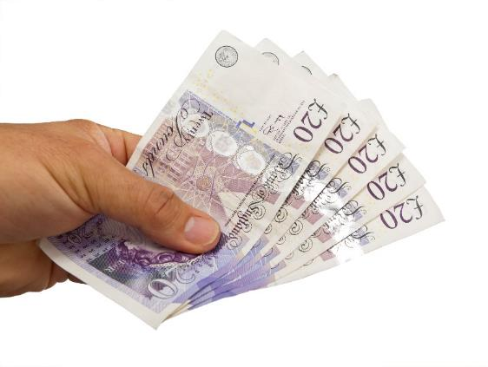
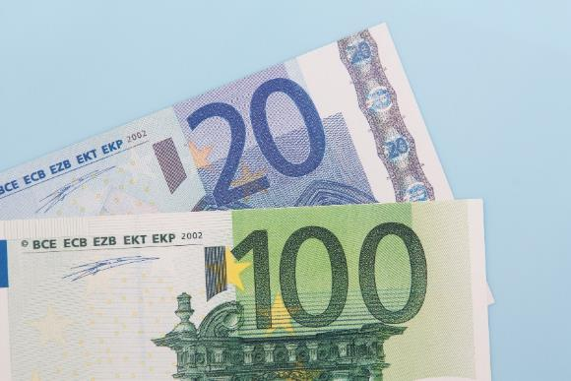
Introduction
What do you see?
Notes:
Alex has saved some spending money to go travelling. Show learners this image and then ask, ‘What do you see?’
The aim is to stimulate conversations around the context. Learners are encouraged to share their own experiences.
Have they been abroad?
Did they exchange money themselves?
Did they spend money and try to work out how much it would be in British Pounds?
Is it better to exchange in the UK or in the destination country?
What does the image show?
What currencies do they know and in which countries are they used?
Some learners may pick up on the exchange rate of the currency shown in the picture. This provides an opportunity to recognise learners’ different starting points. Building on their prior learning is key to a mastery approach (Key Principle 2).
Note: This activity is based on a simplified exchange rate, which fluctuates. Discuss this briefly with learners.

Slide 3

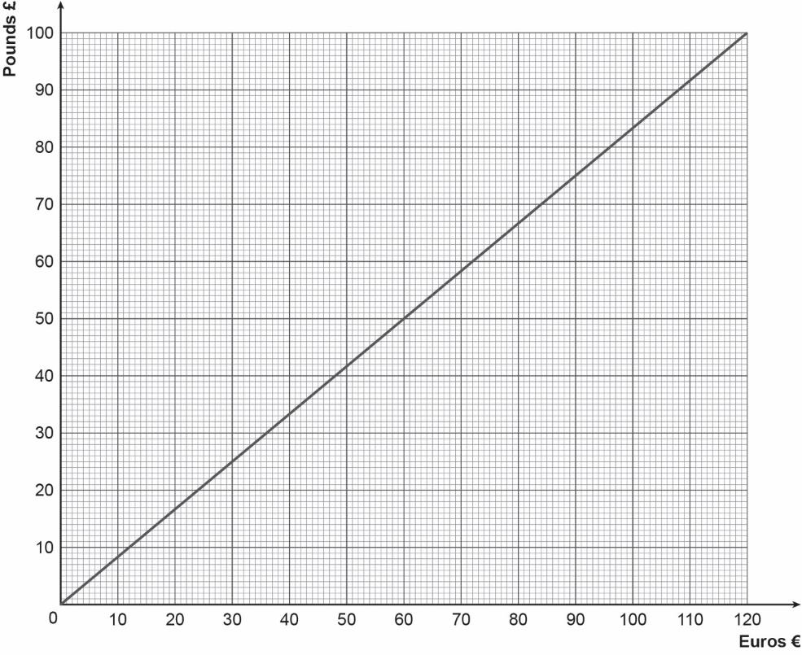
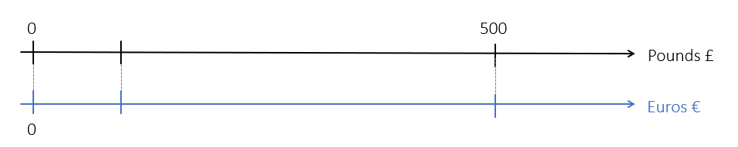
How much is my money worth in Euros?
Handout
available
Using the graph, calculate how much £500 is worth in Euros.
Make sure you can explain your thinking! Share your thinking with your partner.
Remember that you can draw extra lines on the graph, or you can use tables or number lines to help you.
£ | 0 | 1 | 2 | 5 | 10 | 20 | 50 | 100 | 500
€
<CfEM_AW_L14_014>
Notes:
In pairs learners will calculate, using the graph provided, how much £500 is worth in Euros and will construct tables or use a double number line to explain their thinking. A link to ratio notation is made: £1 : €1.20.
This graph activity is an important building block for the construction and use of double number lines.
Give learners a few minutes on their own to think about how to tackle the problem, before pairing learners. Ask pairs of learners to explain their approach to each other and agree on an approach for finding the costs of £500 in Euros. They should write their method for finding a solution on their mini whiteboards. As learners work through the problem, identify any learners who use one of the approaches described on Slides 4–7. These learners can be called on when these methods are covered in Discuss 1.

Slide 4
Class method 1 for Explore 1
DISCUSS
0
1
2
5
10
20
50
100
500
Pounds £
Euros €
0
1.20
2.40
6
12
24
60
120
600
Notes:
Slides 4–8
Groups feed back on how they calculated the conversion of £500 to Euros.
What methods did you use to find values beyond £120?
What do you wonder now?
What did you notice about the different pairs of numbers in your tables?
Using your table and, by extension, the double number line, how could you work out the exchange rate of British Pounds to Euros?
Using your table and, by extension, the double number line, how could you work out the exchange rate from Euros to British Pounds?
Address the class as a whole and, using the table and double number line, either on the whiteboard or using an app (GeoGebra), show the progression from table to double number line to graph.
Call upon learners to share their thinking and explain their way of working. Learners can model their thinking on Slide 8.
To consolidate, capture the different methods on a double number line on the board or use the one provided on Slide 8. Slides 4–7 show different approaches using an animated double number line. These approaches can be discussed in any order. Ask learners who have used a similar method to describe the thinking behind the method.
A double number line is used to illustrate learners’ own approaches and to examine alternative approaches that may not have been used within the class. Mathematical representations, such as double number lines, allow leaners to develop an understanding of multiplicative structure (Key Principle 1). Encourage learners to think about the different approaches in terms of efficiency. Learners may change the way they approach problems if they see a way of thinking that is more efficient or easier to understand. It is important to value and make sense of learners’ different ways of thinking (Key Principle 2).
Emphasise the proportional relationship between Euros and British Pounds. Point out the constant of proportionality noting that the arrows show the relationship between the two currencies.

Slide 5


Class method 2 for Explore 1
DISCUSS
$$×50$$
0
10
500
Pounds £
Euros €
0
12
600
$×5$0

Slide 6


Class method 3 for Explore 1
DISCUSS
$$×5$$
0
100
500
Pounds £
Euros €
0
120
600
$$×5$$

Slide 7
Class method 4 for Explore 1
DISCUSS
0
100
500
Pounds £
× 1.2
× 1.2
Euros €
0
120
600

Slide 8
Class method 5 for Explore 1
DISCUSS
0
500
Pounds £
Euros €
0
Notes:
Learners who have used a different method can share their way of tackling the problem.

Slide 9

Spot the mistake
‘I know that you can exchange £500 for $400 if the exchange rate is 1.25 dollars for every pound.’
Explain why they are wrong.
Can you use a double number line to show your thinking?
Notes:
‘Spot the mistake’ activity – learners work independently.
Learners work independently at first, then share their work and ideas, discuss and explain.
This activity intends to highlight a common misconception by allowing learners to evaluate a statement, using a double number line to work in reverse.
This activity will also allow learners to create their own definition of how to convert currency correctly.
Note: This activity is based on a simplified exchange rate, which fluctuates. Discuss this briefly with learners.

Slide 10

Class methods for Explore 2
REVIEW
‘I know that you can exchange £500 for $400 if the exchange rate is 1.25 dollars for every pound.’
0
500
Pounds £
USD $
0
To convert Pounds (£) to Dollars ($, USD), we multiply the given value of Pounds by 1.25 because of 1 British Pound Sterling = 1.25 US Dollars.
Notes:
Using the double number line explore learner thinking and reasoning. Learners use the double number line to explain their thinking. Learners may create and share their own definition of how to convert currency.
A double number line is used to illustrate learners’ own approaches again. It is important to reiterate that this can be used for illustration of a range of approaches.

Slide 11
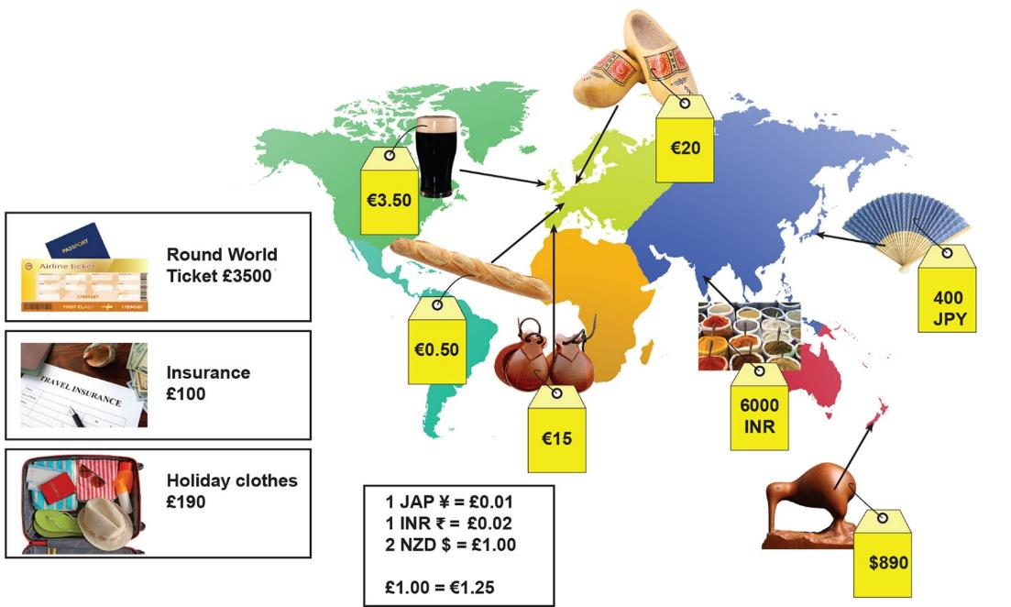
Cost of trip activity
YOUR
TURN
Handout
available
During his travels, Alex bought some souvenirs.
Alex now wants to know how much the entire trip cost in pounds.
Work out how much Alex spent in total.
Explain your thinking to your partner.
Notes:
Learners work out how much Alex has spent in total in pounds. Learners share their thinking and discuss.
Learners complete this task in pairs. Depending on confidence and competence you can ask learners to convert all or choose a given number of souvenirs.
While learners are working, pay particular attention to any thinking that will be helpful to share in the review section of the lesson. Note that an extension question can be projected if required.
Make sure that learners explain their approach to their partner, working together to agree to a solution and develop their own understanding. If you notice that one learner is answering all the questions, or that they are not working collaboratively, ask a learner to explain a question that has been answered by their partner. Observe learners as they complete this task, but do not intervene unless necessary. As learners work on the task, notice how they illustrate their strategy.

Slide 12

Extension activity
YOUR
TURN
Handout
available
Alex is thinking about travelling to Canada for work, to visit another office.
Alex has £250 left over from their last trip and decides to change this to Canadian Dollars.
Alex gets 400 CAD$.
How many Canadian Dollars does Alex get for £1?
Notes:
This activity can be utilised if some learners are working at a faster pace than others. Again, they can collaborate and must clearly show their thinking. Pay particular attention to how they approach this problem.
This activity is optional and can be used for differentiation.

Slide 13

Cost of trip
REVIEW
Notes:
Bring the class together and consolidate their learning. First, clarify the concept of this kind of proportional reasoning problem.
Some learners will have different answers. Go through some examples where rounding may have been used. Consolidate rounding rules within the review.
Ensure that learners understand the impact of rounding and discuss how this may affect the final answer.
Discuss strategies that learners have applied to work through this activity, such as:
Did they first add all of the Euro prices, or did they work them out separately?
How would this affect the final answer?
Did they use the exchange rate stated on the handout or did they revert to Explore 1?
Who completed the extension (if anyone) and how did they approach this task?
What methods did they use?
Did they use a double number line for any of their workings?
Now capture the ways of thinking of the various pairs of learners for each of the problems of (you may use the double number lines in the slides or draw one on the main whiteboard if it is useful). Once again, it is important to make sense of and capture learners’ ways of thinking – not to prescribe a best method.

Slide 14
Class method for clogs
DISCUSS
0
1
2
4
16
Pounds £
Euros €
0
1.25
2.50
5
20

Slide 15
Class method for…
DISCUSS
0
Pounds £
??
0

Slide 16
Final Totals…
DISCUSS
Item | Cost £
Ticket | 3,500.00
Insurance | 100.00
Holiday Clothes | 190.00
Souvenirs | 600.20
Total | 4,390.20

Slide 17
Exam question 1
PRACTICE QUESTION
Worksheet
available
The trainers cost $60
The exchange rate is $1 = £0.749
Rehan says,
‘The trainers cost less than £40.’
Rehan is wrong.
Using a suitable approximation, show working to explain why.
Notes:
Learners work independently. Depending on time and on the ability of learners in the group, you may choose only two of the questions for the class to do. They may choose to draw a double number line to help in identifying the multiplier.
When completed, ask learners whether they have used a different approach to that used prior to the lesson when solving exchange rate problems. How has their thinking changed? What have they learned about multiplicative structure?
Discuss where else this approach may work. Where have they used it before? Where would they use it in future?

Slide 18
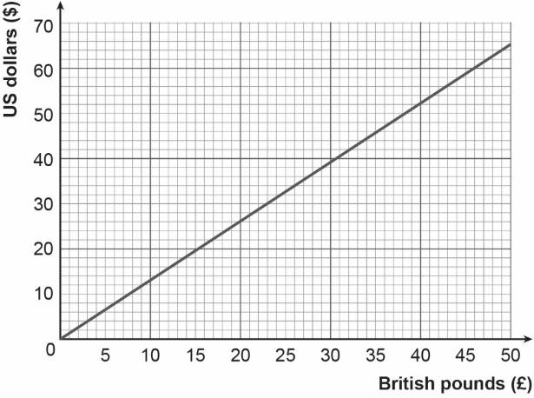
Exam question 2
PRACTICE QUESTION
Worksheet
available
This graph can be used to change between US dollars ($) and British pounds (£).
<CfEM_AW_L14_020>
Rosie bought a ring in the USA.
She paid 345 US dollars.
Work out in pounds the amount Rosie paid for the ring.

Slide 19
Exam question 3
PRACTICE QUESTION
Worksheet
available
Liz goes on holiday to South Africa.
Liz wants to change £850 into South African Rand.
She wants to get as many 200 Rand notes as possible.
The exchange rate is £1 = 18.53 Rand.
Work out the greatest number of 200 rand notes that Liz can get for £850

Slide 20


Exam question 1: Solution
REVIEW
$$×60$$
0
0.7
42
Pounds £
Dollars $
0
1
60
$$×60$$
No, the trainers cost more than £40 because $60 equals approximately £42.
Notes:
Learners who have used a different method can share their way of tackling the problem.

Slide 21
Exam question 1: Solution
REVIEW
0.7
40
0
Pounds £
÷ 0.7
÷ 0.7
Dollars $
0
1
57.14
No, the trainers cost more than £40 because $57.14 is less than $60.
Notes:
Learners who have used a different method can share their way of tackling the problem.

Slide 22
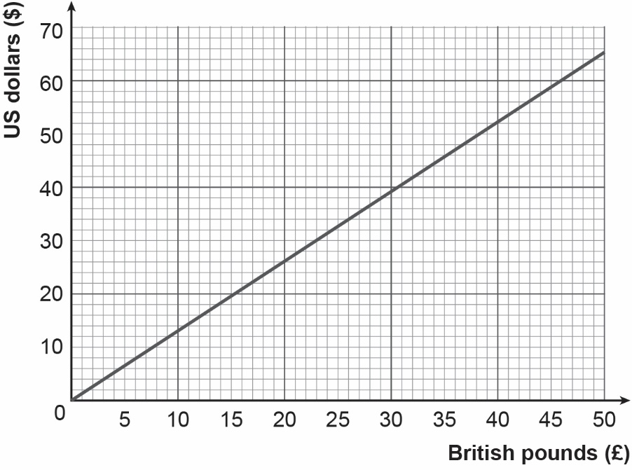
Exam question 2: Solution
REVIEW
$30 = £23 x 100 = £230
$45 = £34.50
£230 + £34.50 = £264.50
Notes:
Learners who have used a different method can share their way of tackling the problem.

Slide 23
Exam question 2: Solution
REVIEW
0
30
258.75
Pounds £
× 0.75
× 0.75
Dollars $
0
40
60
Notes:
Learners who have used a different method can share their way of tackling the problem.
From mark scheme:
Method mark awarded for taking a correct reading from the graph that shows conversion of an amount in $ to £
Method mark awarded for a complete method, e.g. attempts to read from the graph using numbers that sum to 345 and finds the sum of their readings, e.g. 6 × 50 + 45
Accuracy mark for answer in the range 258 to 275
Condone incorrect money notation if the meaning is clear

Slide 24
Exam question 3: Solution
REVIEW
$$×60$$
0
1
850
Pounds £
Rands R
0
18.53
15,750.50
$$×60$$
15,750.50 ÷ 200 = 78 (.7525)
Notes:
Learners who have used a different method can share their way of tackling the problem.

Slide 25
Exam question 3: Solution
REVIEW
0
1
850
Pounds £
× 18.53
× 18.53
Rands R
0
18.53
15,750.50
15,750.50 ÷ 200 = 78 (.7525)
Notes:
Learners who have used a different method can share their way of tackling the problem.
From mark scheme:
Process mark awarded for process to find the number of rand, e.g. 850 × 18.53 (= 15750.5)
OR for process to find number of £, e.g. 200 ÷ 18.53 (= 10.79 …)
Process mark awarded for process to find the number of rand notes,
e.g. ‘15750.5’ ÷ 200 (=78.7 …)
OR 850 ÷ ’10.79 …’ (=78.7 …)
Accuracy mark awarded for correct answer only

Slide 26
Lesson review:
Exchange rates
Objectives
Use graphs to convert currency
Understand how to use double number lines to provide insight into solving currency conversion problems
Use approximation to check currency conversion calculations
Suggested further steps/areas to work on
Interpret and use a conversion graph

Slide 27
Lesson 23:
Credits
Text acknowledgements
Pearson Education Ltd: Pearson Edexcel
Slide 17: GCSE (9-1) in Mathematics (1MA1) Foundation (Calculator) Paper 1F, November 2019, Question 12
Slide 18: GCSE (9-1) in Mathematics (1MA1) Foundation (Calculator) Paper 3F, November 2020, Question 18
Slide 19: GCSE (9-1) in Mathematics (1MA1) Foundation (Calculator) Paper 3F, June 2019, Question 21
Photo acknowledgements
123RF.com: Matt Burgess; Alamy Images: designer491, Anthony Brown; Shutterstock.com: Africa Studios, Juergen Faelchle, Kaesler Media, Kristina Ismulyani, Marcus Mainka, Girish Menon, Natapob, Cherkas, Watthano, Maarten Zeehandalaar

