Slide 1


Lesson 4:
Best buys
Objectives
Investigate pricing structures for items that come in different sizes to determine what is the best buy
Solve simple best buy problems using efficient methods and ratio tables.
This lesson has been designed for students to practice number skills without a calculator.

Slide 2


INTRODUCTION
Introduction
Handout
available
I eat one packet of crisps per day at college and each one costs £0.90
What else can you find?
Day
1
Cost £
0.90
Notes:
Learners are introduced to the topic through discussion and exploration. The ratio table serves as a starting point here and allows learners to explore possible answers.
Encourage learners to work at whatever level is accessible. Some may say ‘I can work out one week’, others may work out the cost for a year.
This activity will stimulate discussion and allows participation from all learners. It allows for differentiation.
Give learners a few minutes to think about how to tackle the problem individually, before pairing them. Ask pairs of learners to explain their thinking to each other. They should demonstrate their thinking on their mini whiteboards. They may use the ratio table or show their thinking in their won way.
As learners work through the problem, identify any misconceptions.
Learners share their thinking or method of working and discuss. Ask some learners to share their workings either on the whiteboard perhaps using a visualiser (if available).
What do you notice when learners share their workings?
Are there any misconceptions arising that you need to address?

Slide 3
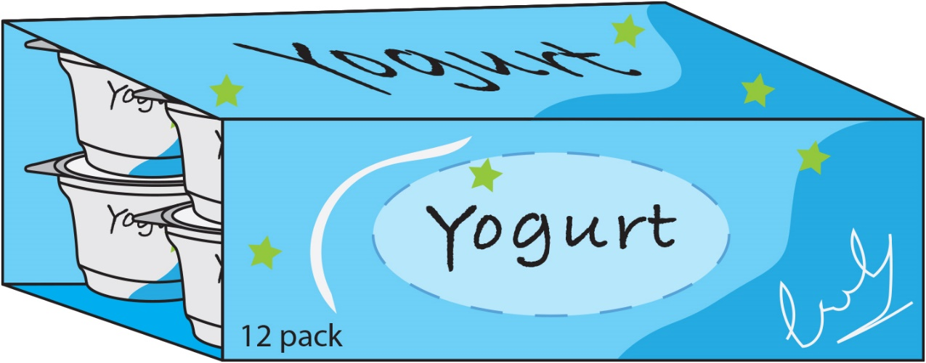

EXPLORE
Which is better value for Money?
Handout
available
£2
£6
Notes:
A pack of 3 yoghurts costs £2 and a pack of 12 yoghurts costs £6.
Which is the better value?
Learners work in pairs and discuss their approaches.
This activity intends to highlight a common misconception that you have to find the unitary method to compare costs. It allows learners to evaluate a statement and to explore the underlying multiplicative relationship (Key Principle 1) between the original and new value.
Considering additive approaches that learners are already familiar with (Key Principle 2), alongside strategies that involve multiplicative reasoning supports them in developing both their fluency and understanding (Key Principle 4) as they learn to recognise when and how to apply additive and multiplicative approaches.

Slide 4

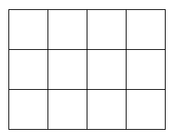


Arrays
DISCUSS
£2.00
£4.00
£6.00
£8.00
Pack of 3
£2.00
Pack of 12
£6.00
Notes:
The tutor models first using the arrays to show that the unitary method (although it works) is not always the most efficient.
This method also allows learners to access multiplicative reasoning and allows them to make connections (e.g. factors and multiples) as well as understanding the importance of fluency (times tables).

Slide 5
Using ratio tables
DISCUSS
Yoghurts
Price £
3
6
9
12
2
4
6
8
So, 4 packs of 3 yoghurts will cost £8.00
A pack of 12 yoghurts costs £6.00
Notes:
Using a ratio table to illustrate the use of multiplication rather than the unitary method will allow learners to work well without a calculator and will underpin their understanding of multiplicative reasoning. The same skills/connections are needed here as discussed on the previous slide.
Ask learners questions such as:
Would you use all of these steps?
What could you do differently?
Can you go backward from the 12 pack to the 3 pack? How would you do this?
This allows learners to really think about the relationship of the numbers with a simpler example before moving on to the more difficult main task.
A ratio table is used to illustrate approaches. It is important to reiterate that this used for illustration of a range of approaches. Although the ratio table is provided it is only intended to be used to capture learners’ thinking, not as a ‘method’. The ratio table does, however, suggest multiplicative approaches and is encouraged to be used, learners’ own diagrams, if appropriate, can be used to capture their own thinking.
What is important is that the learners understand what they, and their peers, have done.

Slide 6

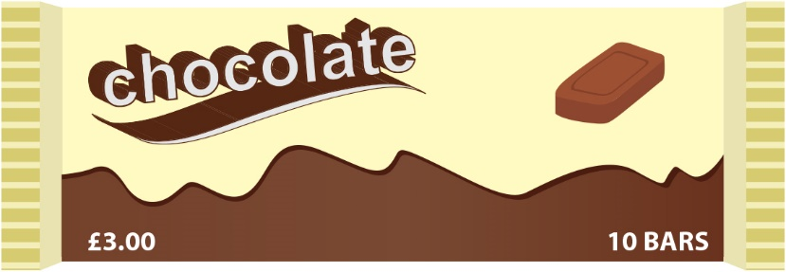
Chocolate bars
EXPLORE
Handout
available
A tutor wants to buy 45 chocolate bars for their learners as a thank you for their hard work during the term.
She finds 2 prices:
4 pack of Dairy Milk bars:
£1.25
10 pack of Dairy Milk bars:
£3.00
The tutor looks at both offers and says, ‘They are both the same so I can buy either one’.
Her partner says, ‘No, the 10 pack is better value for money!’
Who is right? Work in pairs and show how they found their answers.
Notes:
Learners are encouraged to show workings for both deals. The following slide will capture two ways of working. While learners are thinking and discussing this, try and capture different approaches and encourage students to share them at the end of the activity.
This activity will stimulate discussion, especially around the price (as both actually work out at £15 for the amount required) but will allow learners to consider additional bars/ left over amounts and/or discuss whether or not calculating unit prices is more appropriate or not. This activity will stimulate thinking and allow learners to engage in the discussion, independent from their mathematical ability. Reasoning and thinking skills are required and encouraged.

Slide 7

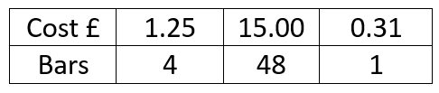


Ratio tables
DISCUSS
Teacher | Partner
Notes:
First, let the learners discuss their ideas, followed by the sharing of their methods with the class either using the whiteboard or a visualiser. These review slides are optional, depending on how you share learner responses and whether you want to utilise the prepared ratio tables.
Discuss the strategies that learners developed for completing the task. Discuss what other points may influence their decision.
Use the example working and explore them with the learners.
How did the teacher get to 48 and 50?
Why did her partner lay it out differently?
Why did her partner not work out the price of 1 first?
The cost of an item should be proportional to the quantity bought, and it will be in this case as the 4 pack is 31.25p and the large pack is 30p but often with these types of offer, there is waste to consider. Look for learners who are bringing the real world context of waste into their discussion.
Did the learners opt for using a ratio table using multiplication and/or division, addition and/or subtraction rather than the unitary method or did they opt for the last one?

Slide 8
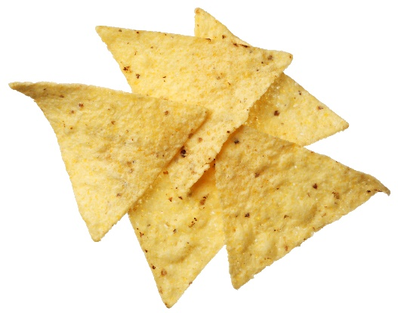
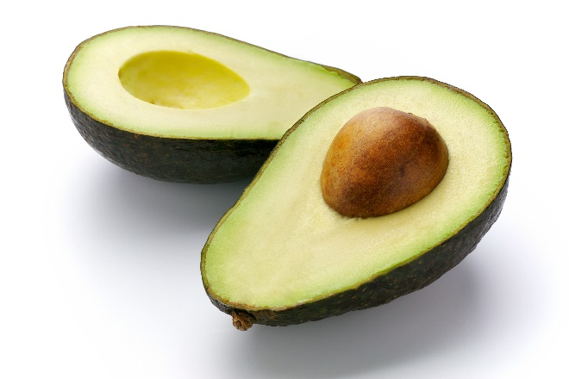
Party snacks
YOUR
TURN
Handout
available
You are meeting up with some friends. Everyone is bringing something. You decided to make an avocado dip.
You need to buy the ingredients to make the avocado dip to serve with some tortilla chips and lemonade.
Use ratio tables to work out:
  the best value for the ingredients
  the best value on tortilla chips
  the cheapest lemonade by finding the cost per 100 ml
Notes:
In small groups, learners are introduced to the task of buying the ingredients to make an avocado dip to serve with some tortilla chips and lemonade. They are asked to use ratio tables to work out the best value for the ingredients and to also work out the cheapest lemonade by finding the cost per 100 ml.
Avocado Dip
6 avocados (packs of 3, £1.80; packs of 2, £1.50 and one avocado is 70 p)
4 limes (net of 5 is 85p, one is 18 p)
600 g of chips (200 g is £1.20 and 360 g is £2)
Lemonade (2 litres is £1.99; 24 x 330 ml is £7.50 and, 8 x 330 ml is £3.50). Extension: carbon footprint of 6 avocados. (The carbon footprint of 6 avocados is 1419.6 g.)
Are costs proportional to size?
Which is the best buy?
Are the prices fair? Why or why not?
What other factors might you consider? For example, waste? Airmiles?
If the prices were fair, how would you change the prices to be fair?

Slide 9
EXPLORE
Party snacks
one avocado: 70p
Avocados
Amount | 1 | 2 | 3 | 6
Cost £ | 0.70 | 1.40 | 2.10 | 4.20
pack of 2: £1.50
Amount | 1 | 2 | 4 | 6
Cost £ | 0.75 | 1.50 | 3.00 | 4.50
pack of 3: £1.80
Amount | 1 | 3 | 6
Cost £ | 0.60 | 1.80 | 3.60
Notes:
Let learners share their methods with the class either using the whiteboard or a visualiser. These review slides are optional, depending on how you share learners’ responses and whether you want to use the prepared ratio tables.
Discuss the strategies that learners developed for completing the task. Discuss what other points may influence their decision.
Did learners opt for using a ratio table using multiplication and/or division rather than the unitary method, or did they opt for the latter?
Ask learners to think about questions such as:
Why did you opt for this method?
How else could you have solved this problem?
Why did/didn’t you use ratio tables?
A ratio table is used to illustrate approaches. It is important to reiterate that this used for illustration of a range of approaches. Although the ratio table is provided it is only intended to be used to capture students’ thinking, not as a ‘method’. The ratio table does, however, suggest multiplicative approaches and is encouraged to be used. Learners’ their own diagrams, if appropriate, can capture their own thinking.
What is important is that the learners understand what they, and their peers, have done.

Slide 10
EXPLORE
Party snacks
Limes
one lime: 18p
Amount | 1 | 2 | 3 | 4
Cost £ | 0.18 | 0.36 | 0.54 | 0.72
pack of 5: 85p
Amount | 4 | 5
Cost £ | 0.68 | 0.85
Notes:
Let learners share their methods with the class either using the whiteboard or a visualiser. These review slides are optional, depending on how you share learners’ responses and whether you want to use the prepared ratio tables.
Discuss the strategies that learners developed for completing the task. Discuss what other points may influence their decision.
Did learners opt for using a ratio table using multiplication and/or division rather than the unitary method, or did they opt for the latter?
Ask learners to think about questions such as:
Why did you opt for this method?
How else could you have solved this problem?
Why did/didn’t you use ratio tables?
A ratio table is used to illustrate approaches. It is important to reiterate that this used for illustration of a range of approaches. Although the ratio table is provided it is only intended to be used to capture students’ thinking, not as a ‘method’. The ratio table does, however, suggest multiplicative approaches and is encouraged to be used. Learners’ their own diagrams, if appropriate, can capture their own thinking.
What is important is that the learners understand what they, and their peers, have done.

Slide 11
EXPLORE
Party snacks
Tortilla chips
200 g for £1.20
Amount g | 200 | 400 | 600
Cost £ | 1.20 | 2.40 | 3.60
360 g for £2.00
Amount g | 120 | 360 | 720 | 600
Cost £ | 0.67 | 2.00 | 4.00 | £3.33
Notes:
Let learners share their methods with the class either using the whiteboard or a visualiser. These review slides are optional, depending on how you share learners’ responses and whether you want to use the prepared ratio tables.
Discuss the strategies that learners developed for completing the task. Discuss what other points may influence their decision.
Did learners opt for using a ratio table using multiplication and/or division rather than the unitary method, or did they opt for the latter?
Ask learners to think about questions such as:
Why did you opt for this method?
How else could you have solved this problem?
Why did/didn’t you use ratio tables?
A ratio table is used to illustrate approaches. It is important to reiterate that this used for illustration of a range of approaches. Although the ratio table is provided it is only intended to be used to capture students’ thinking, not as a ‘method’. The ratio table does, however, suggest multiplicative approaches and is encouraged to be used. Learners’ their own diagrams, if appropriate, can capture their own thinking.
What is important is that the learners understand what they, and their peers, have done.

Slide 12
EXPLORE
Party snacks
2 litres – £1.99
Lemonade
Amount ml | 100 | 1000 | 2000
Cost £ | 0.10 | 1.00 | 1.99
24 × 330 ml – £7.50
Amount ml | 100 | 330 | 7920
Cost £ | 0.09 | 0.31 | 7.50
8 × 330 ml – £3.50
Amount ml | 100 | 330 | 2640
Cost £ | 0.13 | 0.44 | 3.50
Notes:
This part of the activity is more challenging than the previous stages and may be used as an extension activity if appropriate, depending on class composition as this will require a deeper understanding of multiplicative reasoning than in the previous examples.
Let learners share their methods with the class either using the whiteboard or a visualiser.
Discuss the strategies that learners developed for completing the task. Discuss what other points may influence their decision.
Did learners opt for using a ratio table using multiplication and/or division, addition and/or subtraction rather than the unitary method, or did they opt for the latter?
Ask learners questions such as:
Why did you opt for this method?
How else could you have solved this problem?
Why did/didn’t you use ratio tables?
The ratio table is used to illustrate approaches. It is important to reiterate that this is used for illustration of a range of approaches.

Slide 13
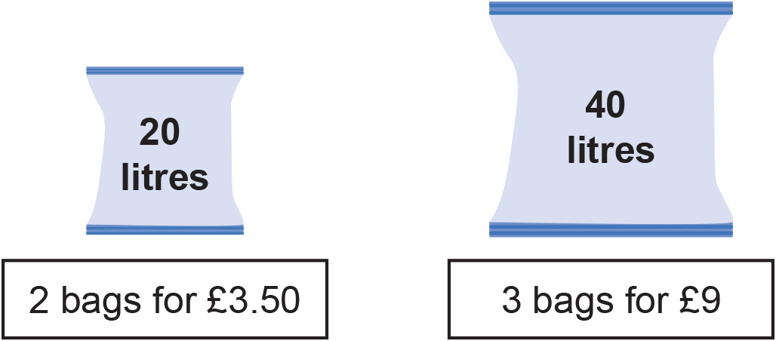
Practice question
REVIEW
Worksheet
available
A shop sells compost in 20 litre bags and in 40 litre bags.
One day the shop had two special offers for the compost.
Which offer is the better value for money?
You must show how you get your answer.
Notes:
GCSE exam questions have been selected for learners to attempt at the end of the lesson that link directly to the objectives explored.
The tutor can differentiate where required.
Once all groups have attempted the questions, draw them together to summarise the learning.
Clarify the concept of these kinds of proportional reasoning problems.
Capture the ways of thinking for each of the problems of various pairs (you may use the ratio tables in the ppt presentation or draw one on the main whiteboard).
It is important to make sense and capture students’ ways of thinking, not to prescribe a best method.

Slide 14
Practice question
REVIEW
Worksheet
available
Here are the costs of the same type of batteries in two shops.
Shop A
Pack of 4 batteries
£1.60
Shop B
Pack of 6 batteries
£2.70
Harry needs to buy at least 30 batteries.
He assumes that he has to buy batteries in whole packs.
Harry wants to buy the batteries as cheaply as possible from the same shop.
Which shop should he buy the batteries from, shop A or shop B?
You must show all your working.
Notes:
GCSE exam questions have been selected for learners to attempt at the end of the lesson that link directly to the objectives explored.
The tutor can differentiate where required.
Once all groups have attempted the questions, draw them together to summarise the learning.
Clarify the concept of these kinds of proportional reasoning problems.
Capture the ways of thinking for each of the problems of various pairs (you may use the ratio tables in the ppt presentation or draw one on the main whiteboard).
It is important to make sense and capture students’ ways of thinking, not to prescribe a best method.

Slide 15
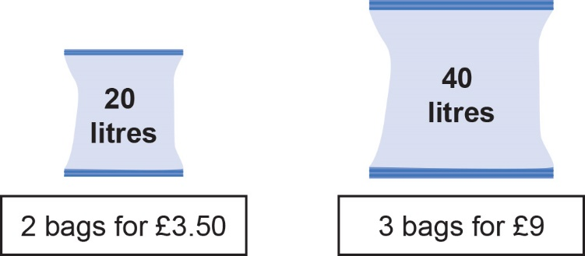
Practice question
REVIEW
A shop sells compost in 20 litre bags and in 40 litre bags.
One day the shop had two special offers for the compost.
2x 20 litre bags for £3.50
Amount L | 11.4L | 40L
Cost £ | £1 | £3.50
3 x40 litre bags for £9.00
Amount L | 13.3L | 120L
Cost £ | £1 | £9
It is better value for money to buy 3 bags for £9 as you will get almost 2 litres more per £1
Which offer is the better value for money?
You must show how you get your answer.
Notes:
GCSE exam questions have been selected for learners to attempt at the end of the lesson that link directly to the objectives explored.
The tutor can differentiate where required.
Once all groups have attempted the questions, draw them together to summarise the learning.
Clarify the concept of these kinds of proportional reasoning problems.
Capture the ways of thinking for each of the problems of various pairs (you may use the ratio tables in the ppt presentation or draw one on the main whiteboard).
It is important to make sense and capture students’ ways of thinking, not to prescribe a best method.

Slide 16
Practice question
REVIEW
Here are the costs of the same type of batteries in two shops.
Shop A: Pack of 4 for £1.60
Shop A
Pack of 4 batteries
£1.60
Shop B
Pack of 6 batteries
£2.70
Harry needs to buy at least 30 batteries.
He assumes that he has to buy batteries in whole packs.
Harry wants to buy the batteries as cheaply as possible from the same shop.
Which shop should he buy the batteries from, shop A or shop B?
You must show all your working.
Shop B: Pack of 6 for £2.70
Shop A: Pack of 4 for £1.60
Amount | 4 | 8 | 16 | 32
Cost £ | 1.60 | 3.20 | 6.40 | 12.80
Shop B: Pack of 6 for £2.70
Amount | 6 | 12 | 18 | 24 | 30
Cost £ | 2.70 | 5.40 | 8.10 | 10.80 | 13.50
It is better value for money to buy from shop A at £12.50 for 32 batteries, compared to Shop B at £13.50 for 30 batteries.
Notes:
GCSE exam questions have been selected for learners to attempt at the end of the lesson that link directly to the objectives explored.
The tutor can differentiate where required.
Once all groups have attempted the questions, draw them together to summarise the learning.
Clarify the concept of these kinds of proportional reasoning problems.
Capture the ways of thinking for each of the problems of various pairs (you may use the ratio tables in the ppt presentation or draw one on the main whiteboard).
It is important to make sense and capture students’ ways of thinking, not to prescribe a best method.

Slide 17
Lesson review:
Best buys
Objectives
Investigate pricing structures for items that come in different sizes to determine what is the best buy
Solve simple best buy problems using efficient methods and ratio tables.

Slide 18

Lesson 4: Best buys
Credits
Photos
Shutterstock.com: mayakova, matin, Davydenko Yuliia, DenisMArt
Text Acknowledgements
Pearson Education Ltd: Pearson Edexcel GCSE (9-1) In Mathematics (1MA1) Foundation (Calculator) November 2019 Paper 2F, Pearson Education Ltd: Pearson Edexcel GCSE (9-1) In Mathematics (1MA1) Foundation (Calculator) June 2020 Paper 3F

