Slide 1


Lesson 3:
Scatter graphs
Level 2
Objectives
Draw and interpret scatter diagrams including lines of best fit
Recognise positive and negative correlation

Slide 2

Data collection
Why do companies or researchers collect data?
What do they normally do with their data?
Notes:
This is a THINK-PAIR-SHARE activity.
Tutor to encourage learners to think about data collection and why? Learners then discuss with their pair and share with the class.
Key points: data collection enables companies/researchers to make informed decisions. It enables them to analyse how they are doing and enables them to see trends.
Once data is collected it is often presented in the form of a chart/graph as this makes it easier to analyse.
Discuss with learners different ways of presenting data.

Slide 3

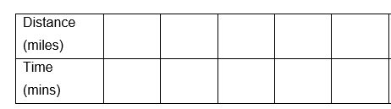
Task 1 – data collection
YOUR TURN
Handout
available
‘The further away from college you live, the longer it takes to get to college.’
What do you think?
Collect data from other learners in the class and record this data on the worksheet.
Record on the table how far away from the college each person lives in miles and how long it takes them to get to college in minutes.
Notes:
Tutor to allow the learners time to think about the statement. What do they think? How can we find out?
They may (but probably won’t) suggest using a scatter graph. Don’t mention scatter graphs yet.
As a class they are going to find out if the statement is true.
Tutor to hand out the worksheet. Learners can work in pairs to go and collect the data by asking all the other learners in the class. They need to record this on the table.
This data will then be put to the side while the class interprets some scatter graphs. They will then return to this data and construct their scatter graph.
If they don’t know how many miles away they live they could look this up on their phones from a mapping app.

Slide 4







Say what you see
DISCUSS
$$×$$
$$×$$
$$×$$
$$×$$
$$×$$
$$×$$
$$×$$
$$×$$
$$×$$
$$×$$
Notes:
Start with an open question – what can they see on the slide?
Some learners may immediately say that it’s a scatter graph. Probe for information about what a scatter graph is and what it shows.
Probe for the content of the scatter graph:
What is it showing? (Encourage learners to engage with the context)
What do the crosses represent?
What does the cross above 14 years mean? (One person who has 14 years in education earns £30 000. Highlight that this is just one person – it doesn’t mean that everyone with 14 years of education earns £30 000. Refer to 15 years – 3 people with different salaries are shown here.)
Is the scatter graph showing any sort of trend or pattern?
What is missing from the graph to help show a pattern? (Line of best fit)
Reinforce that a scatter graph shows the relationship between two variables (in this case, as years of education increases, earnings increase).
Scatter graphs may also include anomalies (also called ‘outliers’) – What is an anomaly?
Ask if they can say which point is an obvious anomaly. (The person with 12 years education earning £80 000 – much more than most people with 12 years education could expect to earn.)
Ask the learners if they recognise what this type of graph is and what this type of graph can be used to show; encourage them to engage in the context.

Slide 5






Interpreting a scatter graph
DISCUSS
$$×$$
$$×$$
$$×$$
$$×$$
$$×$$
$$×$$
$$×$$
$$×$$
$$×$$
$$×$$
Notes:
Explain that the line of best fit has now been drawn on the scatter graph. Discuss how this is a matter of judgement but needs to go close to as many points as possible.
Ask learners questions to get them to interpret the graph:
What salary could someone with 13.5 years of education expect to earn?
Ask learners to think about this and show their responses on mini whiteboards. Ask for volunteers to say how they worked this out.
Reveal and explain the animated red line to show it’s likely to be just over £20 000.
Make sure that the learners know that they need to draw lines on the graphs.
How many years of education would you expect someone on a salary of £50k to have?
Again, ask learners to think about this and show their responses on mini whiteboards. Ask for volunteers to say how they worked this out.
Reveal and explain the animated red line to show it’s likely to be nearly 16 years.
What about the salary of someone with 30 years of education?
Explain that there is no data here beyond 18 years of education, so we cannot say if the same trend continues.

Slide 6
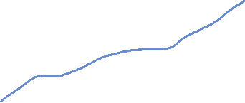
DISCUSS
Ruby has drawn a line of best fit for each of these scatter graphs. She is not sure which is correct. Can you help her? Discuss.
I have drawn the line of best fit.
Notes:
Sample learner thinking – Ruby thinks she has drawn the line of best fit on these graphs. Are they correct? Why/why not?
Encourage learners to think about each and discuss with their pair.
Class feedback.
Discuss the examples of line of best fit on these graphs. How can they be corrected?
Not going through the middle of the points. Should be approx. same number of points on either side. Doesn’t need to go through the origin. Angle is too steep.
THIS IS CORRECT, Ruby has got this one right.
The line is too low. The angle is good and follows the trend but needs to be higher.
A line of best fit must be a straight line.

Slide 7
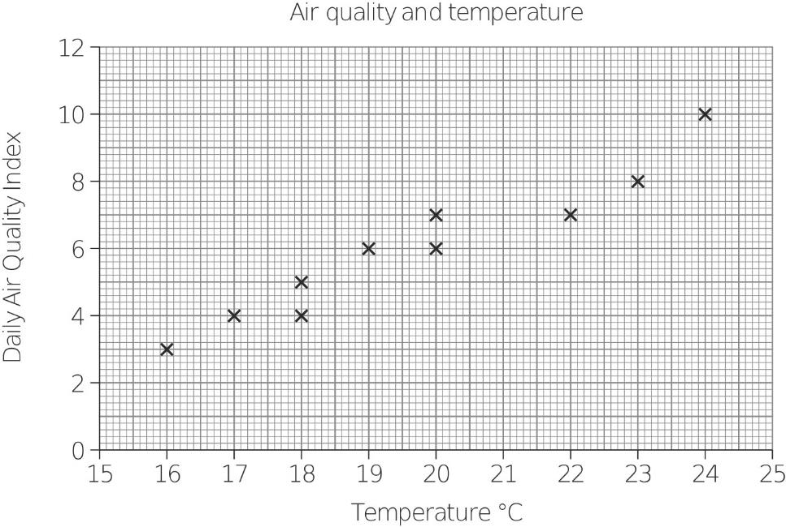
DISCUSS
Dev says that just one of these is a correct scatter graph.
Ruby says both are correct. Who is right? Why?
A
B
Notes:
Discuss the common misconceptions – drawing line of best fit through origin. A lot of learners think the line of best fit must go through the origin. Explain that this is not the case. Graph B is correct.

Slide 8

Guidelines for drawing a line of best fit
KEY IDEA
A line of best fit…
ignores any outliers
reflects the trend of the data
must be balanced
(should have points above and below the line at both ends of the line)
should not be forced to pass through any specific data points, or to pass through zero.

Slide 9
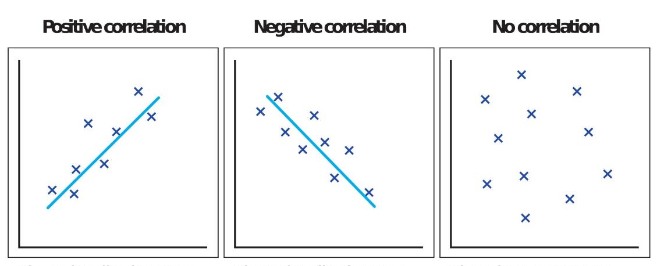
Types of correlation
Discuss
Positive correlation
Negative correlation
No correlation
Correlations can be strong or weak.
Notes:
Discuss the different types of correlation that can be shown using a scatter graph, as shown on the slide.
Discuss what is meant by positive correlation, negative correlation and no correlation – provide example to illustrate each, e.g.:
Rainy weather and number of umbrellas sold – positive correlation
Sunny weather and number of hot drinks sold – negative correlation
Number of children and number of dogs in a family – no correlation
Mention that sometimes the graphs show weak correlation and strong correlation – if correlation is strong, then all the points will be close to the line of best fit.

Slide 10
YOUR TURN
Types of correlation – your examples
Task: In pairs think of some different scenarios that are examples for positive, negative and no correlation.
Sketch the scatter graphs making sure you label the axes. Indicate if there is a positive, negative or no correlation.
Energy used
Positive correlation
Time on treadmill
Notes:
On whiteboards or in their exercise books ask the learners to think of some different scenarios for each correlation.
Can they sketch these scatter graphs and put the variables on the axes. Scales are not needed, just a sketch reinforcing their understanding of the correlations and making them think about possible real-life examples. Use animation to show the example of energy used on a treadmill.
Learners can then share some of these with the class showing their sketches and what the variables are and what the correlation is.

Slide 11
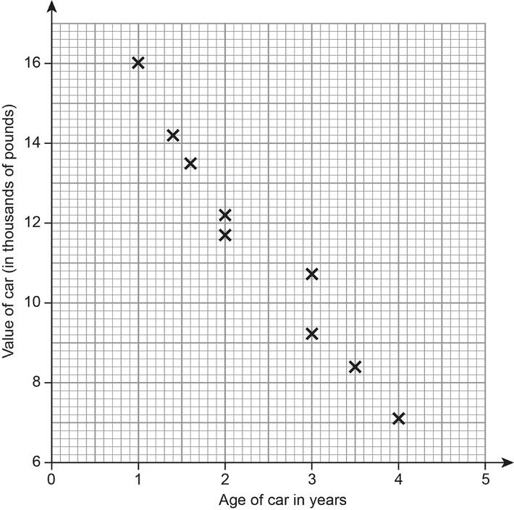






DISCUSS
Compare the two scatter graphs
$$×$$
$$×$$
$$×$$
$$×$$
$$×$$
$$×$$
$$×$$
$$×$$
$$×$$
$$×$$
Notes:
Discuss the first graph – what information does it show? What is the general trend of the data points?
Compare the two scatter graphs. What is the same? What is different?

Slide 12
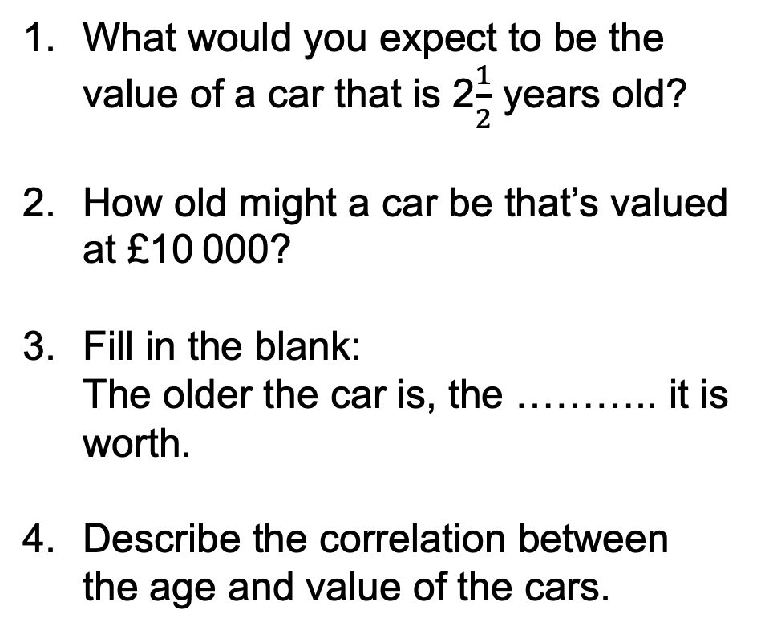
DISCUSS
Age and value of cars
What would you expect to be the value of a car that is 2$\frac{1}{2}$ years old?
How old might a car be that’s valued at £10 000?
Fill in the blank:
  The older the car is, the ……….. it is worth.
Describe the correlation between the age and value of the cars.
Notes:
Repeat the discussion using this graph.

Slide 13
Correlation
KEY IDEA
Scatter graphs can show positive correlation or negative correlation. This can be weak or strong correlation.
The closer to a straight line the points are the stronger the correlation.
A scatter graph could also show no correlation.
Notes:
Ensure that learners understand what shows that a correlation can be weak or strong and that there may be no correlation.

Slide 14
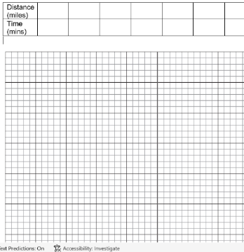
YOUR TURN
Continue with the previous handout
The further away from college you live, the longer it takes to get to college.
Task:
On the handout, construct a scatter graph from the class data.
Think of all the things you need to do to get full marks.
What is the correlation? Draw a line of best fit.
Think of some questions you could ask from the graphs.
Swap with your pair and peer-assess their scatter graph. Would they have got full marks?
Ask your pair some questions that they can answer from their graph.
Full mark checklist:
linear scale ☑
axes labelled ☑
accurate plotting ☑
Notes:
Tell the learners to go back to the handout with the class data on.
Learners are now to construct their scatter graph. What is the correlation? Learners to draw a line of best fit.
Learners are then to note down some questions that they could ask their pair from the graph. For example: How many minutes should it take someone who lives 5 miles away to get to college? How many miles away would you expect someone to live if it took them 20 mins to get to college?
Learners then swap graphs and peer assess. Animations show the full mark checklist. Reiterate that it doesn’t matter what information is on either axis and it doesn’t matter if someone uses a different scale to someone else as long as they are linear.
Learners spend a few minutes asking each other questions from their graphs.

Slide 15
Discuss
FS exam question tips (1)
In your exam you are often asked to draw a diagram and interpret it. It doesn’t say ‘draw a scatter graph’. What are the clues that help you know it is a scatter graph?
Exam question:
Jana is writing a report about wages.
She has this information about the ages and weekly pay of eight men.
Jana wants to draw a diagram to see if there is a relationship between age and weekly pay for these eight men.
Draw a suitable diagram for Jana.
What type of correlation describes the relationship between age and weekly pay for these men?
Clues that help you know it is a scatter graph:
Key words: correlation or relationship
Graph paper provided
2 variables
(b) What type of correlation describes the relationship between age and weekly pay for these men?
Age (years) | 27 | 41 | 32 | 19 | 46 | 37 | 24 | 53
Weekly pay (£) | 470 | 686 | 514 | 295 | 612 | 578 | 338 | 615
15
Notes:
PRACL2/C03 Q12
Exam tips about scatter graph questions.
Class is to read the exam question and then think about the questions in the blue box. Tutor to allow the learners a bit of thinking time before leading a class discussion.
Animations on the slide provide answers.
Discuss the clues: 2 lots of data, graph paper, key words: correlation or relationship

Slide 16

Discuss
FS exam question tips (2)
Age (years) | 27 | 41 | 32 | 19 | 46 | 37 | 24 | 53
Weekly pay (£) | 470 | 686 | 514 | 295 | 612 | 578 | 338 | 615
700
600
500
400
300
200
100
0
What other things do you have to think about when drawing a scatter graph? Discuss.
Weekly pay (£)
Linear scale on axes
Accurate plotting of points
Titles on axes
×
0 10 20 30 40 50
Age
16
Notes:
PRACL2/C03 Q12
What other things do you have to think about when constructing a scatter graph?
Linear scale – discuss with learners what linear means.
Accurate plotting of points – learners need to be careful.
Learners must label axes (it doesn’t matter which axis is used for each lot of data).
A title is good practice but they will not lose marks without.

Slide 17
Exam question (1)
YOUR
TURN
Handout
available
Steve is writing a report about TV viewing.
He has the following information.
Number of people in the household | 3 | 5 | 5 | 6 | 5 | 2 | 4 | 2
Number of TVs in the household | 2 | 3 | 4 | 4 | 5 | 1 | 3 | 2
Steve thinks there is a relationship between the number of people and
the number of TVs in a household.
Draw a suitable diagram for Steve.
Describe the relationship between the number of people and the number of TVs in a household.
Notes:
Learners now answer 2 FS exam questions.
PMAT2/C05
Tutor to give worksheet out.

Slide 18
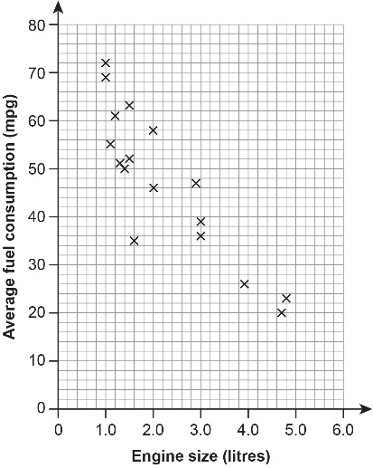
YOUR
TURN
Exam question (2)
Handout
available
Here is the information for another car
engine size 2.3 litres, average fuel consumption 36 mpg.
Plot this information on the scatter graph.
Draw a line of best fit on the scatter graph.
Mikael buys a car with an engine size of 4.2 litres.
Use your line of best fit to estimate the average fuel consumption of this car.
What type of correlation is shown in this scatter diagram?
Tick [✔] a box to show your answer.
unlikely negative even neutral positive likely
The scatter diagram shows some information about the engine size in litres and average fuel consumption in miles per gallon (mpg) of some cars.
Notes:
Learners now answer 2 FS exam questions.
PMAT2/C04
Tutor to give worksheet out.

Slide 19
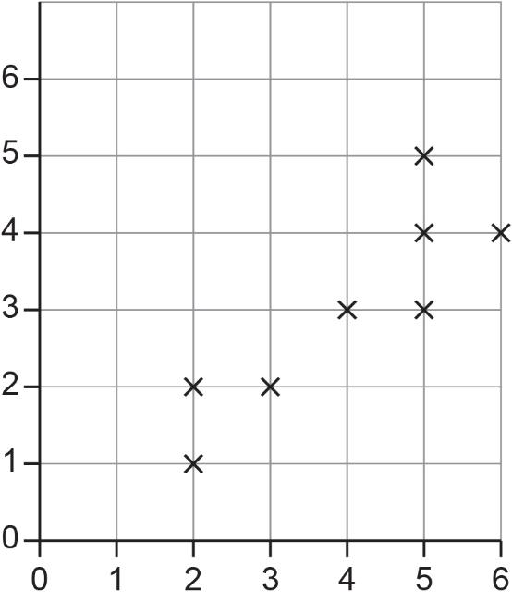
YOUR
TURN
Exam question (1) – Answers
Steve is writing a report about TV viewing.
He has the following information.
Number of people in the household | 3 | 5 | 5 | 6 | 5 | 2 | 4 | 2
Number of TVs in the household | 2 | 3 | 4 | 4 | 5 | 1 | 3 | 2
Steve thinks there is a relationship between the number of people and the number of TVs in a household.
Draw a suitable diagram for Steve.
Number of TVs in the household
Describe the relationship between the number of people and the number of TVs in a household.
Positive correlation.
Number of people in household
Notes:
Use to discuss answers and methods used with the class and highlight any misconceptions.

Slide 20
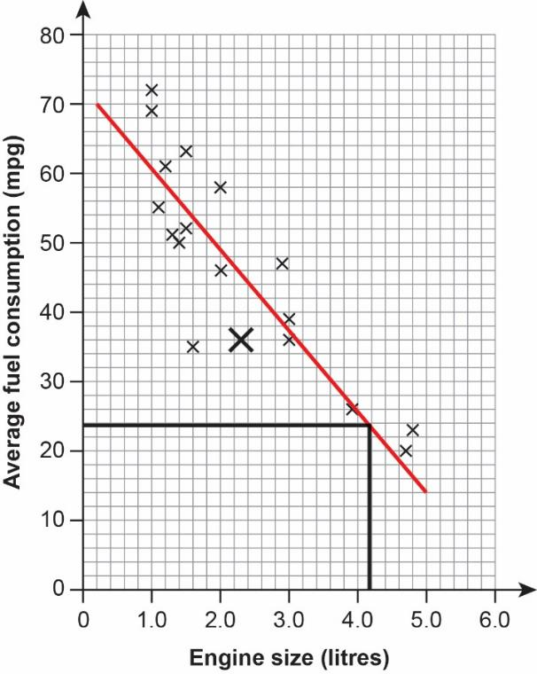
YOUR
TURN
Exam question (2) – Answers
Here is the information for another car
engine size 2.3 litres, average fuel consumption 36 mpg.
Plot this information on the scatter graph.
Draw a line of best fit on the scatter graph.
Mikael buys a car with an engine size of 4.2 litres.
Use your line of best fit to estimate the average fuel consumption of this car.
  Approx. 22–26 mpg – answer has to fit learners’ line of best fit.
What type of correlation is shown in this scatter diagram?
Tick [✔] a box to show your answer.
unlikely negative even neutral positive likely
The scatter diagram shows some information about the engine size in litres and average fuel consumption in miles per gallon (mpg) of some cars.
✓
Notes:
Use to discuss answers and methods used with the class and highlight any misconceptions.

Slide 21
Lesson review:
Scatter graphs
Level 2
Objectives
Draw and interpret scatter diagrams including lines of best fit
Recognise positive and negative correlation

Slide 22
Lesson 3:
Credits
Text acknowledgements
Pearson Edexcel Functional Skills, Practice Paper 3 - Mathematics Level 2 (Calculator) PRACL2/C03 Question 12, Pearson Edexcel Functional Skills, Past Paper 5 - Mathematics Level 2 (Calculator) PMAT2/C05 Question 3, Pearson Edexcel Functional Skills, Past Paper 4 - Mathematics Level 2 (Calculator) PMAT2/C04 Question 3
Photo acknowledgements
Shutterstock.com: Optimarc, Tomislav Zidanic; Pearson Education Ltd: PDQ Digital Media Solutions Ltd

