Slide 1


Lesson 31:
Solving equations
Objectives
Understand the steps needed to solve an equation
Solve one-step and multi-step equations
Use visual representations to provide insight into solving equations

Slide 2
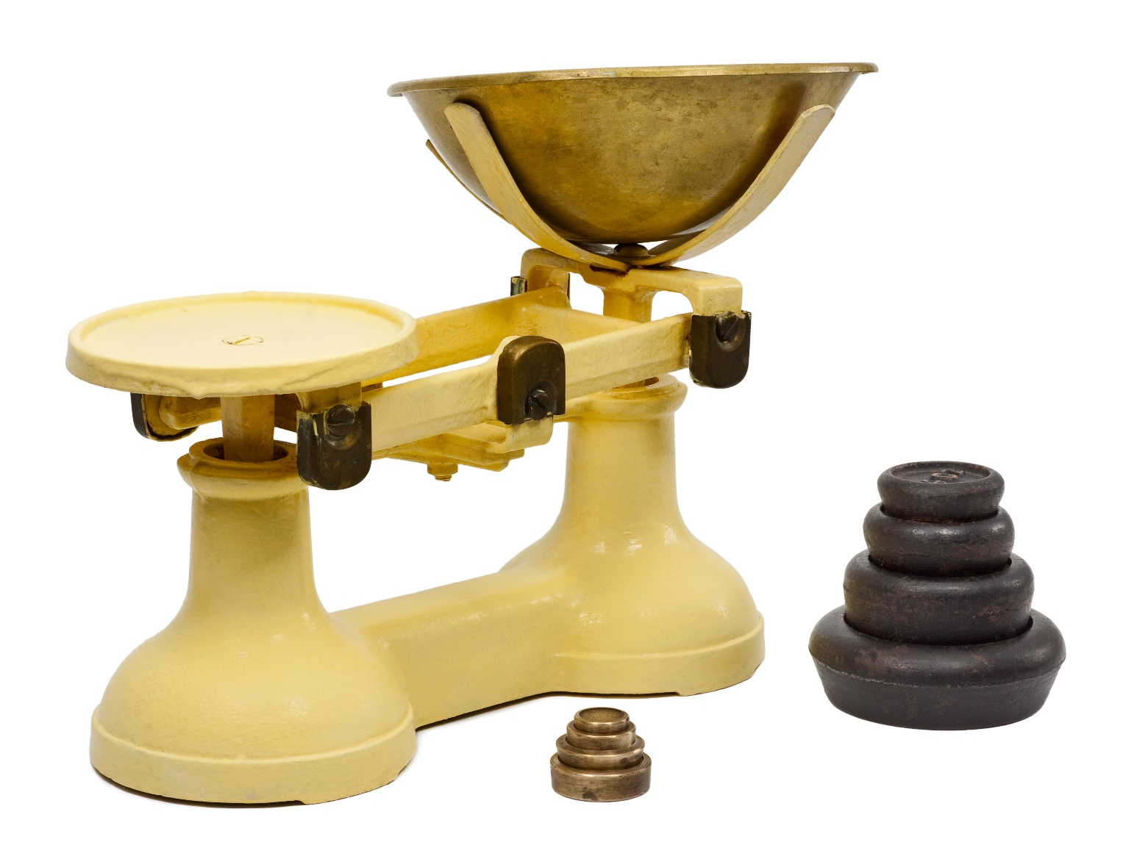
Weighing it up
Notes:
Begin by showing learners the picture of a balance scale. Tell learners that such scales had been used since 1890s. In those times, people went to the grocers to buy food such as flour, sugar and rice. The grocer used a set of weights like the one shown in the picture to measure the ingredients. They were also used in people’s homes when cooking. The shopkeeper would put, for example, the flour in the bowl on one side and the weights would be placed on the other side. When the scale was balanced, it meant that the mass of the flour was equal to the mass of the weights.
Ask learners what a grocer had to do if a customer wanted 10 oz of flour. How would the grocer measure out the flour with the balance scale? What weights should be placed on the scale?
Tell learners that they will be using the concept of ‘balance’ to help them solve equations.

Slide 3
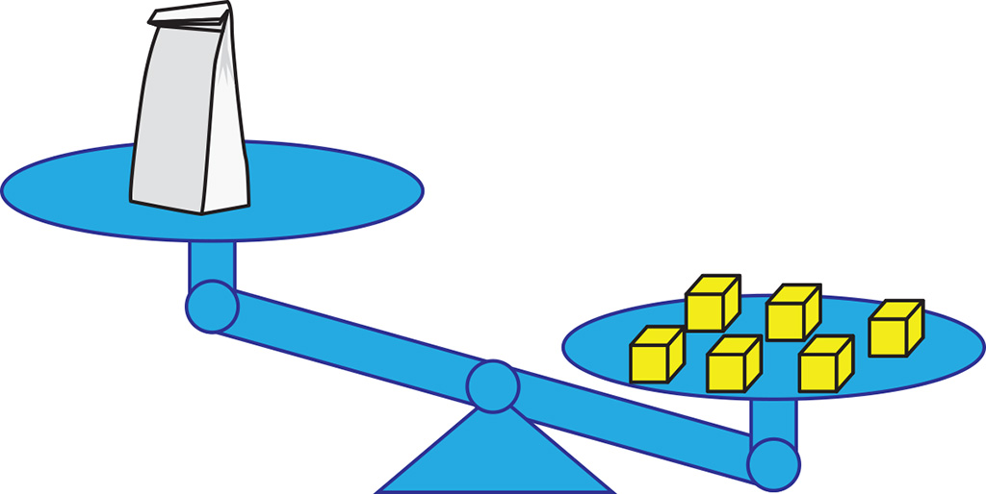
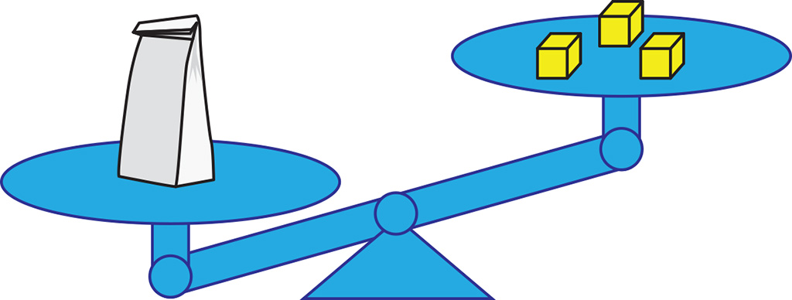
Solving equations
What can you say about the scales?
Notes:
Explain to learners that in this lesson they will use visual examples of weighing scales and concrete manipulatives to help them solve equations. First, they will use scales, but for harder equations they will use algebra tiles.
Introduce the notion of scales. Explain that one yellow cube is equivalent to one unit. The bag could contain the flour or rice mentioned in the last slide.
Ask learners about the two scales. How are the two scales different? Are the scales balanced? What can they say about the weight of the bag? What do they need to do to make the scales balanced?
Note: The findings from Action Research indicate that tutors may be worried about using of algebra tiles with learners. Learners, however, tend not to see the introduction of algebra tiles as a confirmation of their lack of understanding, but a pragmatic tool to support their learning.
The assumption here is that learners have already been introduced to algebra tiles.

Slide 4
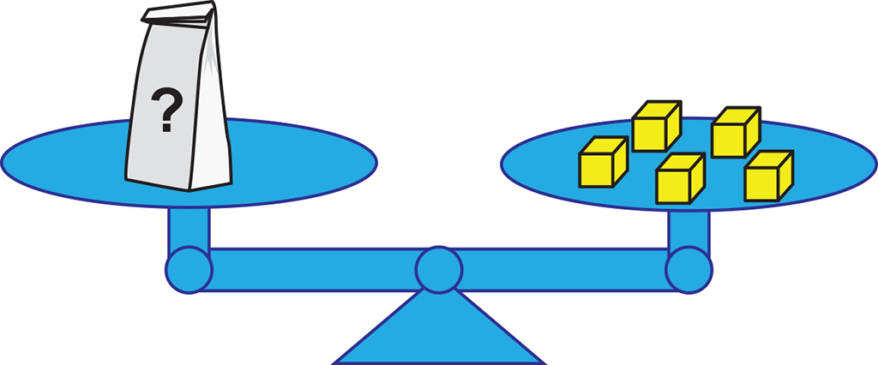
Balance
How much does the bag weigh?
Notes:
Tutors may want to ask learners to describe the picture on the slide. What can they say about the scales? Can they describe how much the bag weighs?
If necessary, include the prompt, “If both sides weigh the same…” / “If both sides are equal…”
Tutors may wish to emphasise that, since scales are balanced, this means the mass of bag on the left is equal to the total mass of cubes on the right.

Slide 5
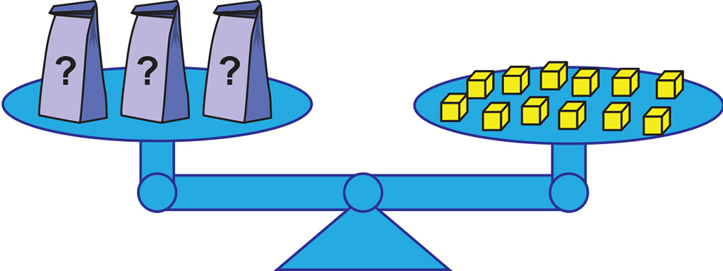
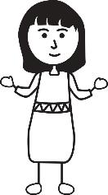

DISCUSS
Mass of one bag
Dev and Ruby want to find out the weight of one bag.
Ruby
Dev
I just think about a number which multiplies by 3 to make 12
I have a better way. I take off two from both sides of the scale
Write a balanced equation for the bags and the cubes.
Notes:
Ask learners discuss Ruby and Dev’s suggestions in pairs. Then have pairs share their thoughts with the class.
Ask learners if the scales would stay balanced if they did what Dev suggested, and explain why or why not. Point out that 2 bags is not equal to 2 cubes. This represents a common mistake.
Model Ruby’s suggestion and show that it will keep the scale balanced.
Emphasise it is only when the scales are balanced that an exact value for the bag can be worked out.
Point out that carrying out Ruby’s suggestion is the same as dividing both sides by 3. Divide 3 by 3 to get 1 bag, and 12 by 3 to get 4 cubes.
Encourage learners to write an equation for the bags and the cubes on mini whiteboards. Check that they understand what an equation is, and what the equation needs to have. Ask learners what they need to do to both sides of the equation to solve it, while keeping the equation balanced. [Divide both sides by 3]

Slide 6
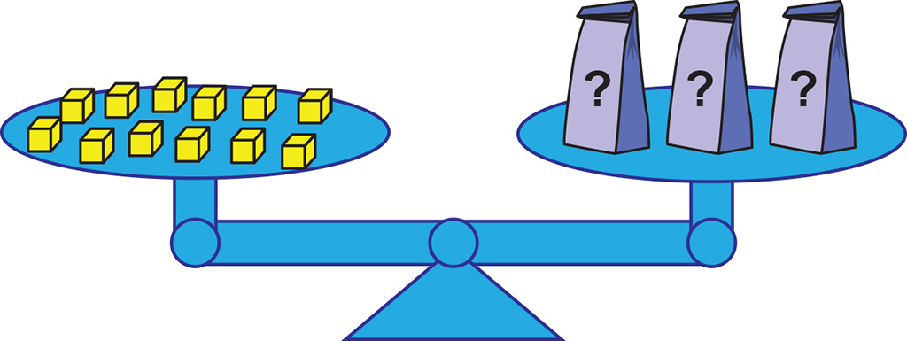
DISCUSS
Mass of one bag
The bags are on the left now.
What difference does this make to the equation and solution?
6
Notes:
Tutors may want to mention that we feel more comfortable when the unknown is on the left because we read English from left to right.
The scale remains balanced, and the weights remain equal. Algebra tiles can be used in the same way.

Slide 7

Solving equations
KEY IDEA
When solving equations, we need to keep both sides balanced or equal.
Any operation done to the left side of the equation must also be done to the right.
Notes:
Learners are expected to solve simple equations by using inverse operations or transforming both sides in the same way (e.g. 5x = 15). They are also expected to solve linear equations with integer coefficients including unknowns on both sides (e.g. 6x +5 = 2x +7).
The aim is for learners to be aware of the explicit steps needed to achieve the answer. The emphasis is on the process, not just the answer. The lesson should also raise awareness that an equation can be read from left to right or the other way round.
Learners should understand that the equal sign can not only indicate a computational result. It also shows that both sides of the equation have the same value.

Slide 8
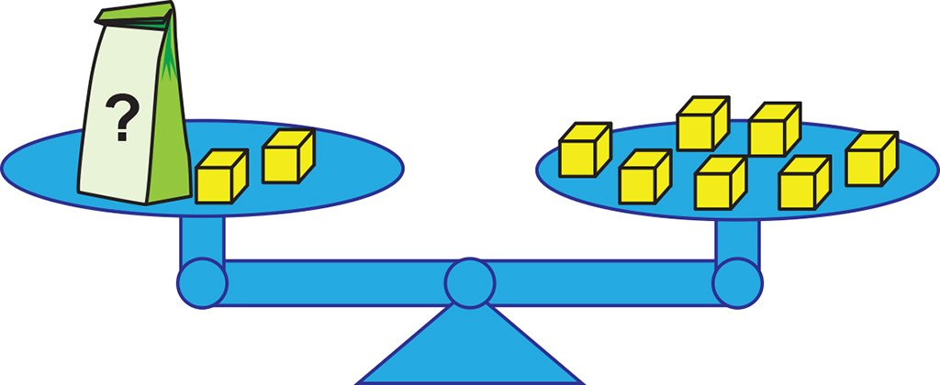

Algebra tiles
EXPLORE
How can you find the weight of the bag?
How can you use the algebra tiles to find the weight of the bag?
$$=$$
Notes:
Provide learners with algebra tiles if they are available. Hand out mini-whiteboards at the same time.
Explain how algebra tiles can also be used to figure out unknown values.
Take time to emphasise:
The connection between the bag, the yellow weights and the algebra tiles. The bar represents the weight of the bag.
The equal sign shows the scales are balanced.
Tutors may use https://mathsbot.com/manipulatives/tiles to demonstrate if algebra tiles are not available.

Slide 9
Algebra tiles – key
EXPLORE
= 1
= –1
= x
= –x
= x²
= –x²
Notes:
Note: The assumption is that the algebra tiles were introduced in an earlier lesson. This slide is simply a reminder. If learners have not used algebra tiles before, spend some time explaining what the tiles represent.

Slide 10
Algebra tiles and equations
EXPLORE
Use the tiles to represent an equation.
Show how to solve the equation using one step.
x + 2 = 7
=
– 2 – 2
x = 5
Notes:
Ask learners to think about what they need to do to solve the equation. Allow them to first try solving the equation independently.
Use the animation to connect the tiles with the equation, in particular emphasise
This is a one step equation –
Removing the tiles is equivalent to subtracting 2 in the algebraic solution

Slide 11
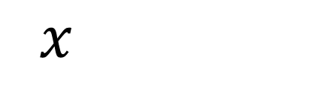

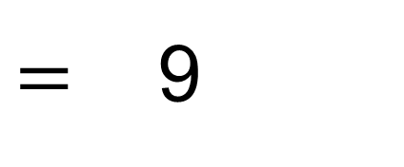
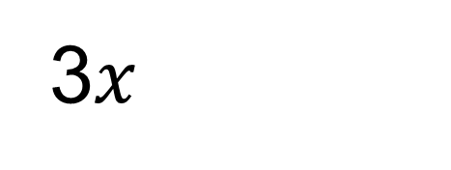


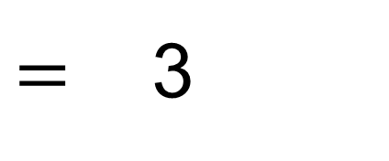
One-step equations
EXPLORE
$=$ 9
3$x$
$$=$$
÷ 3 ÷ 3
$$=$$
$=$ 3
$x$
$$=$$
Notes:
Ask learners to think about what they need to do to solve the equation. Allow them to first try solving the equation independently. Then show learners the animation, explaining each step of the process.
Point out that here the equation can be solved in one step – by dividing both sides by 3. It is useful to write ‘÷3’ to show the process.

Slide 12








Solving one step equations with tiles
YOUR
TURN
a) Solve the equations. Use algebra tiles to help you.
$$x+2=11$$
$$4=x+1$$
$$x=9$$
$$x=3$$
$$3x=15$$
$$2x=6$$
$$x=5$$
$$x=3$$
Notes:
Ask learners to solve the equations on this slide independently. The algebra tiles can be used to help them. It is fine if learners cannot finish answering all of the questions in time. Go through as a class. Invite some learners to share their solutions.

Slide 13








Solving one step equations
YOUR
TURN
b) Solve the equations.
$$3x=15$$
$$8=4x$$
$$x=5$$
$$x=2$$
$$4+x=11$$
$$2x=10$$
$$x=7$$
$$x=5$$
Notes:
Ask learners to solve the equations on this slide independently, without the use of algebra tiles. It is fine if learners cannot finish answering all of the questions in time. Go through as a class. Invite some learners to share their solutions.

Slide 14
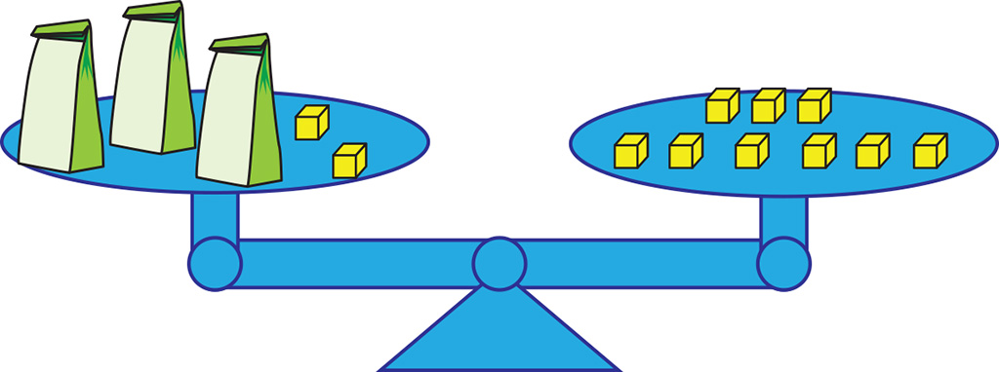
Solving more equations
EXPLORE
Use algebra tiles to represent the bags and the cubes on the scale.
Can you write an equation for the algebra tiles?
Can you solve the equation?
Notes:
Ask learners to try representing the picture using algebra tiles and writing an equation. Have some learners share their equations. A solution will be shown in the next slide.

Slide 15
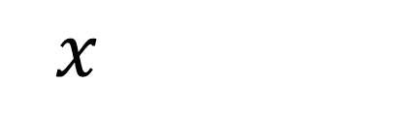



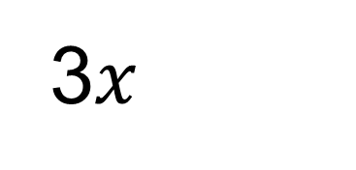

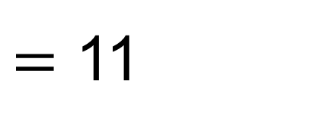
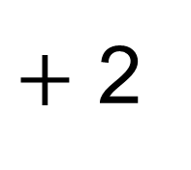


Solving equations in two steps
EXPLORE
$+$ 2
3$x$
$=$ 11
$$=$$
– 2 – 2
$$=9$$
$$=$$
3$x$
÷ 3 ÷ 3
$$=$$
$x$
$$=3$$

Slide 16
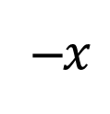

Zero pairs
EXPLORE
What is the total value of each pair of tiles?
1
–1
–$x$
$$x$$
The total value is 0.
The total value is 0.
Notes:
Discuss what to do if there is $–x$ or negative numbers in an equation.
Emphasise that we cannot just remove $–x$ or negative numbers to balance; we need to add $x$ or positive numbers in order to create ‘zero pairs’.

Slide 17







Solving equations in two steps with tiles
YOUR
TURN
a) Solve the equations. Use algebra tiles to help you.
$$2x+1=11$$
$$4=x–1$$
$$x=5$$
$$x=5$$
$$16=3x+1$$
$$2x–1=7$$
$$x=5$$
$$x=4$$
Notes:
Ask learners to solve the equations on this slide independently. The algebra tiles can be used to help them. It is fine if learners cannot finish answering all of the questions in time. Go through as a class. Invite some learners to share their solutions.

Slide 18








Solving equations in two steps
YOUR
TURN
b) Solve the equations.
$$5x+1=16$$
$$2x−2=10$$
$$x=3$$
$$x=6$$
$$3+2x=11$$
$$7=4x−1$$
$$x=4$$
$$x=2$$
Notes:
Ask learners to solve the equations on this slide independently, without the use of algebra tiles. It is fine if learners cannot finish answering all of the questions in time. Go through as a class. Invite some learners to share their solutions.

Slide 19


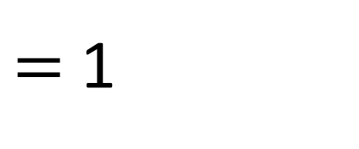
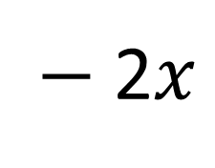


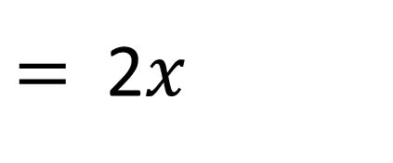




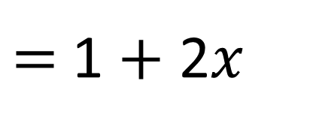


Solving equations in three steps
EXPLORE
7
$−$2$x$
$=$1
$+$ 2$x$
$$=$$
$+$ 2$x$
7
$=$1 $+$ 2$x$
$$−1$$
$$−1$$
$=$2$x$
6
$$÷2$$
$$÷2$$
$$=$$
$$= x$$
3
Notes:
Learners may have difficulty with -2x. Teachers could ask
How can we change -2x to a positive value (whilst keeping the equation balanced)?

Slide 20
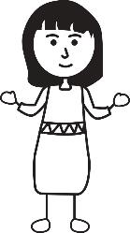
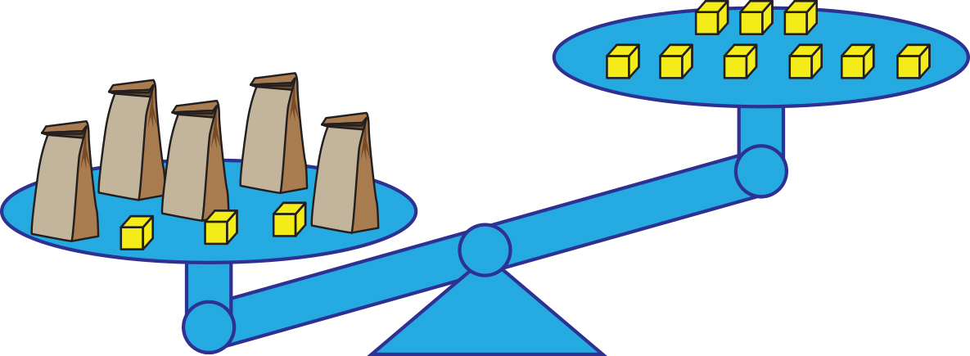
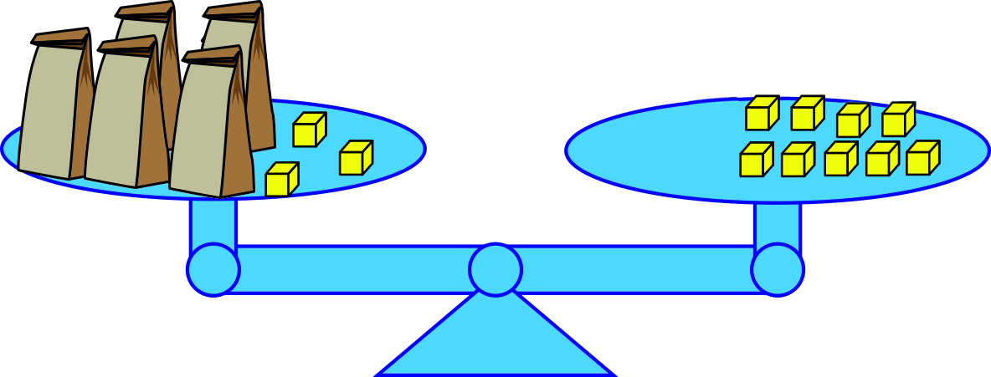


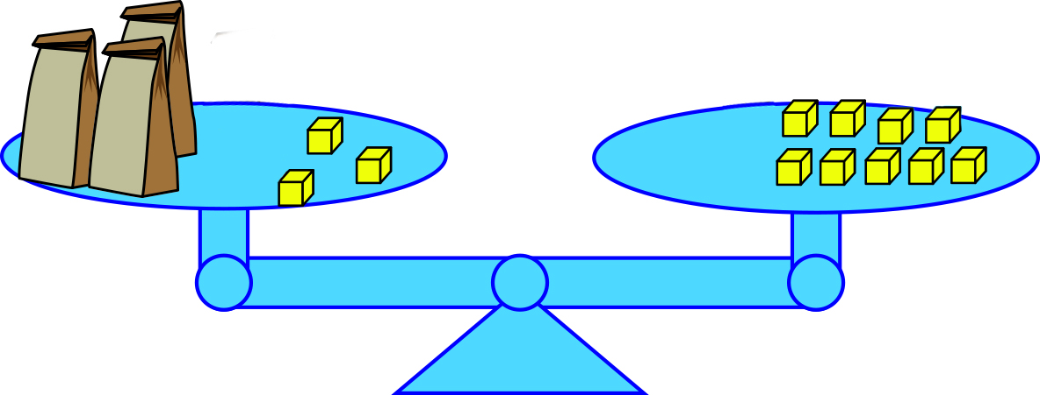

DISCUSS
Weighing it up: 5x + 3 = 9 + 2x
5x + 3 = 9 + 2x
The first thing is to subtract 2x from the left side, so 5x + 3 = 9.
Ruby
5x + 3 = 9
Dev
I would do the same, but get a different result. 3x + 3 = 9.
3x + 3 = 9
Notes:
Discuss Ruby’s approach and whether it is correct.
Reveal the scales for Ruby’s approach and discuss. Highlight the unbalanced scale and Ruby’s misconception.
Next, discuss what Dev did and whether it is correct.
Reveal the scales for Dev’s approach to clarify and discuss. Highlight the removal of two bags from each side to keep the scales balanced.
Teachers may wish to model the use of algebra tiles to model the process and complete the solution of the equation (including drawing them, as if in an exam situation)

Slide 21

Solving equations
YOUR
TURN
Handout
available
Solving equations
You may work in pairs.
Solve the equations.
For (n) and (o), create your own equation.
Sort the equations by the number of steps required to solve them.
a) x + 3 = 5 | b) 2x + 7 = 11 | c) 4x = 8
d) 8 = 10 – 2x | e) x – 3 = 5 | f) 3x – 1 = 5
g) 4x + 3 = 2x + 7 | h) 5x + 2 = 4x + 3 | i) 6 = x + 3
j) 10 = 2x | k) 7 – 2x = 1 | l) 9 = 6x + 3
m) 7x – 3 = 7 + 2x | n) | o)
Notes:
Tutors can decide whether to give out all two pages at once, or just the first page followed by a discussion of learners’ answers.
The rectangles (n) and (o) are blank on the second page of the worksheet. Ask learners to create equations for these spaces.
Ask learners to solve the equations, then sort the equations by the number of steps required to solve them.
Once learners have had sufficient time for the task, ask some pairs to share which questions they found difficult.

Slide 22
Solving equations answers (a–c)
REVIEW
a) x + 3 = 5 x + 3 – 3 = 5 – 3 (subtract 3) x = 2 (1 step) | b) 2x + 7 = 11 2x + 7 – 7 = 11 – 7 (subtract 7) 2x ÷ 2 = 4 ÷ 2 (divide by 2) x = 2 (2 steps) | c) 4x = 8 4x ÷ 4 = 8 ÷ 4 (divide by 4) x = 2 (1 step)

Slide 23
Solving equations answers (d–f)
REVIEW
d) 8 = 10 – 2x 8 + 2x = 10 – 2x + 2x (add 2x) 8 + 2x – 8 = 10 – 8 (subtract 8) 2x ÷ 2 = 2 ÷ 2 (divide by 2) x = 1 (3 steps) | e) x – 3 = 5 x – 3 + 3 = 5 + 3 (add 3) x = 8 (1 step) | f) 3x – 1 = 5 3x – 1 + 1 = 5 + 1 (add 1) 3x ÷ 3 = 6 ÷ 3 (divide by 3) x = 2 (2 steps)

Slide 24
Solving equations answers (g–i)
REVIEW
g) 4x + 3 = 2x + 7 4x + 3 – 2x = 2x + 7 – 2x (subtract 2x) 2x + 3 – 3 = 7 – 3 (subtract 3) 2x ÷ 2 = 4 ÷ 2 (divide by 2) x = 2 (3 steps) | h) 5x + 2 = 4x + 3 5x + 2 – 4x = 4x + 3 – 4x (subtract 4x) x + 2 – 2 = 3 – 2 (subtract 2) x = 1 (2 steps) | i) 6 = x + 3 6 – 3 = x + 3 – 3 (subtract 3) x = 3 (1 step)

Slide 25
Solving equations answers (j–l)
REVIEW
j) 10 = 2x 10 ÷ 2 = 2x ÷ 2 (divide by 2) x = 5 (1 step) | k) 7 – 2x = 1 7 – 2x + 2x = 1 + 2x (add 2x) 7 – 1 = 1 + 2x – 1 (subtract 1) 6 ÷ 2 = 2x ÷ 2 (divide by 2) x = 3 (3 steps) | l) 9 = 6x + 3 9 – 3 = 6x + 3 – 3 (subtract 3) 6 ÷ 6 = 6x ÷ 6 (divide by 6) x = 1 (2 steps)

Slide 26
Solving equations answers (m)
REVIEW
m) 7x – 3 = 7 + 2x 7x – 3 – 2x = 7 + 2x – 2x (subtract 2x) 5x – 3 + 3 = 7 + 3 (add 3) 5x ÷ 5 = 10 ÷ 5 (divide by 5) x = 2 (3 steps)
One-step equations | a, c, e, i, j
Two-step equations | b, f, h, l
Three-step equations | d, g, k, m

Slide 27
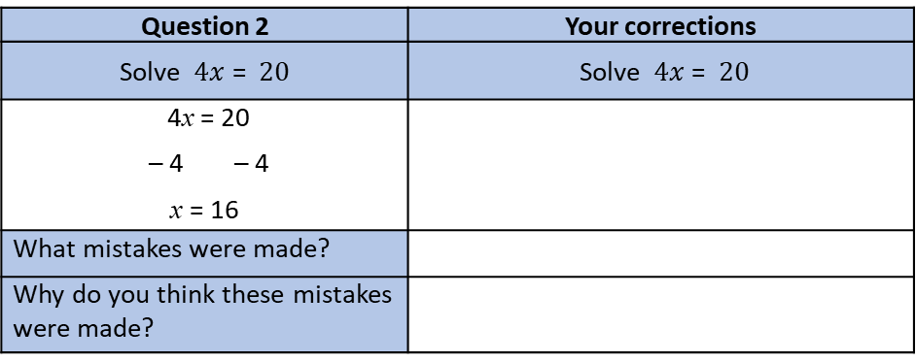
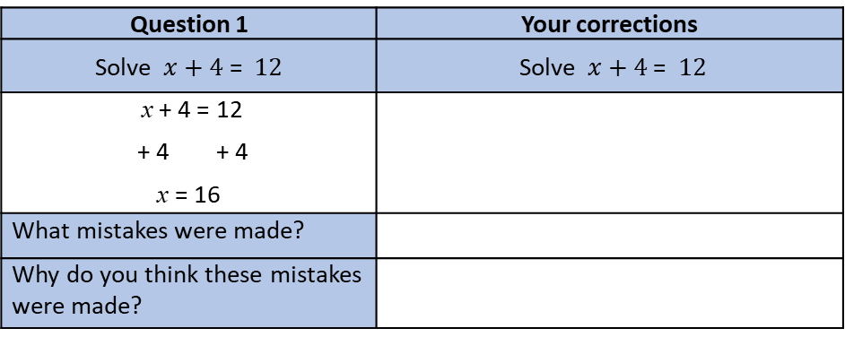
Spot the mistake
YOUR
TURN
Handout
available
Spot the mistake
There is a mistake in the working for each question.
Spot the mistake.
Show the correct working.
Question 1 | Your corrections
Solve $x+4$ = $12$ | Solve $x+4$ = $12$
x + 4 = 12 + 4 + 4 x = 16
What mistakes were made?
Why do you think these mistakes were made?
Question 2 | Your corrections
Solve $4x$ = $20$ | Solve $4x$ = $20$
4x = 20 – 4 – 4 x = 16
What mistakes were made?
Why do you think these mistakes were made?
Notes:
Cut out the question cards. Ask learners to work in pairs and give one card to each pair.

Slide 28
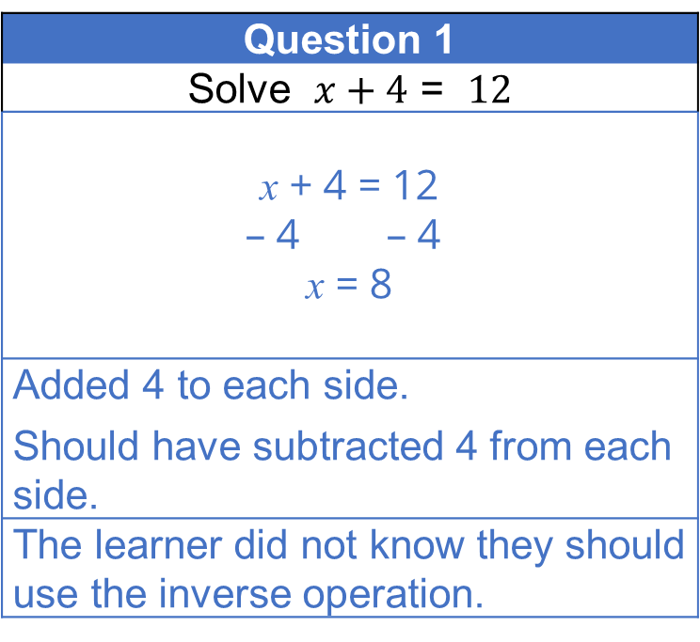
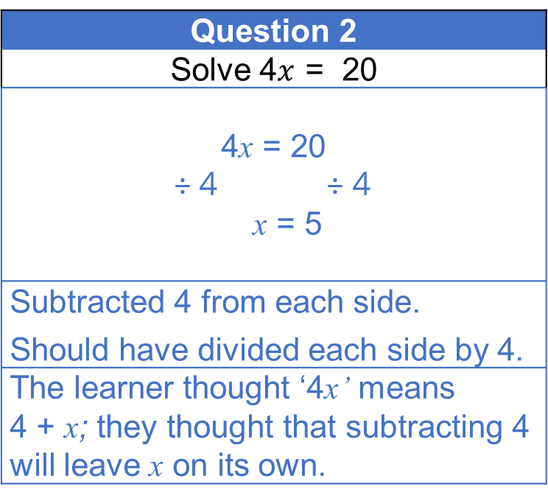
Spot the mistake answers (1–2)
REVIEW
Question 1
Solve $x+4$ = $12$
x + 4 = 12
– 4 – 4
x = 8
Added 4 to each side. Should have subtracted 4 from each side.
The learner did not know they should use the inverse operation.
Question 2
Solve 4$x$ = 20
4x = 20
÷ 4 ÷ 4
x = 5
Subtracted 4 from each side. Should have divided each side by 4.
The learner thought ‘4x’ means 4 + x; they thought that subtracting 4 will leave x on its own.
How would you avoid making these mistakes?
Notes:
Have pairs share their responses.
Encourage them to explain where a mistake was made in the incorrect version and give advice. Ask learners to identify which misconceptions may have led to this mistake. Why might someone make that mistake? What does that mistake show about the person’s understanding of solving equations?
Ask learners for an example of a mistake they have made when trying to solve an equation.

Slide 29
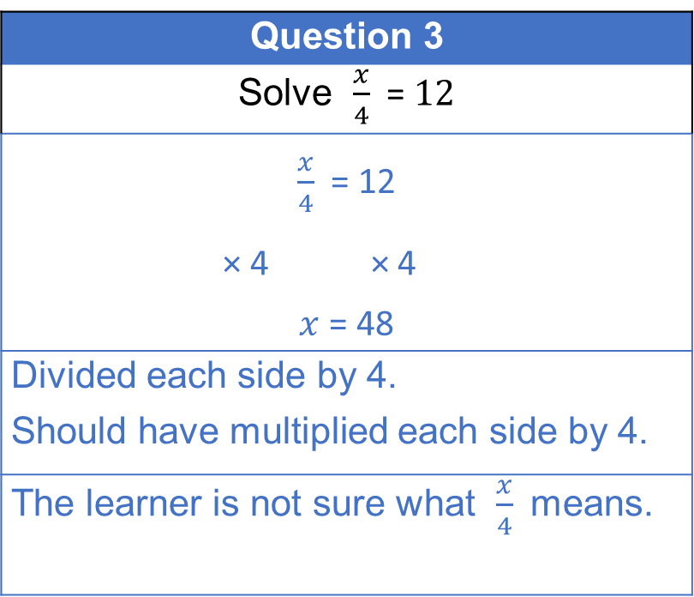
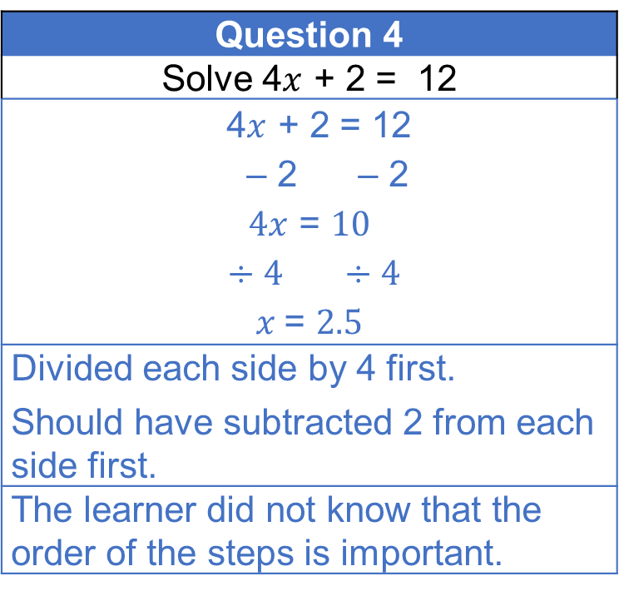
Spot the mistake answers (3–4)
REVIEW
Question 3
Solve $\frac{x}{4}$ = $12$
$\frac{x}{4}$ = 12
× 4 × 4
$x$ = 48
Divided each side by 4. Should have multiplied each side by 4.
The learner is not sure what $\frac{x}{4}$ means.
Question 4
Solve 4$x$ + 2 = 12
4$x$ + 2 = 12
– 2 – 2
$4x$ = $10$
$÷4$ $÷4$
$x$= $2.5$
Divided each side by 4 first. Should have subtracted 2 from each side first.
The learner did not know that the order of the steps is important.
How would you avoid making these mistakes?

Slide 30
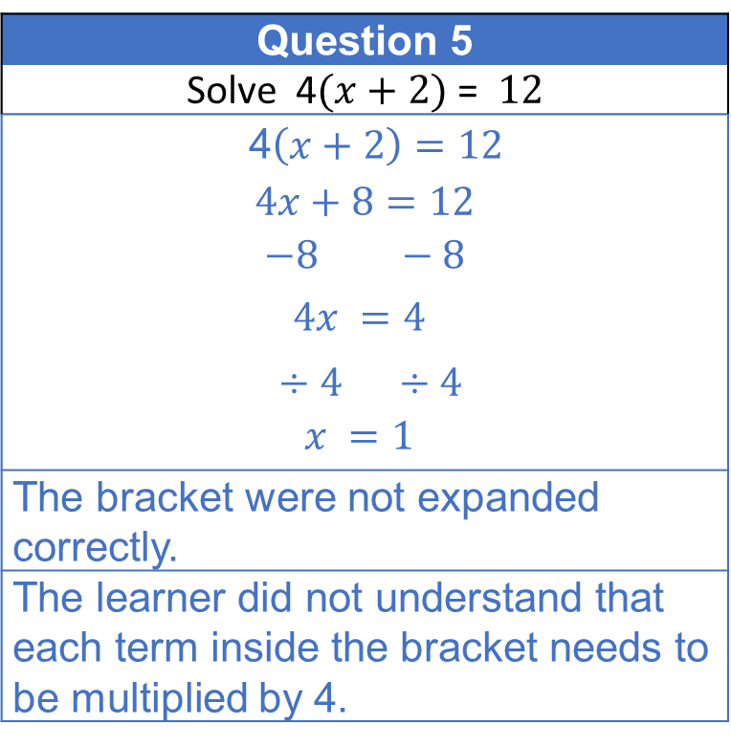
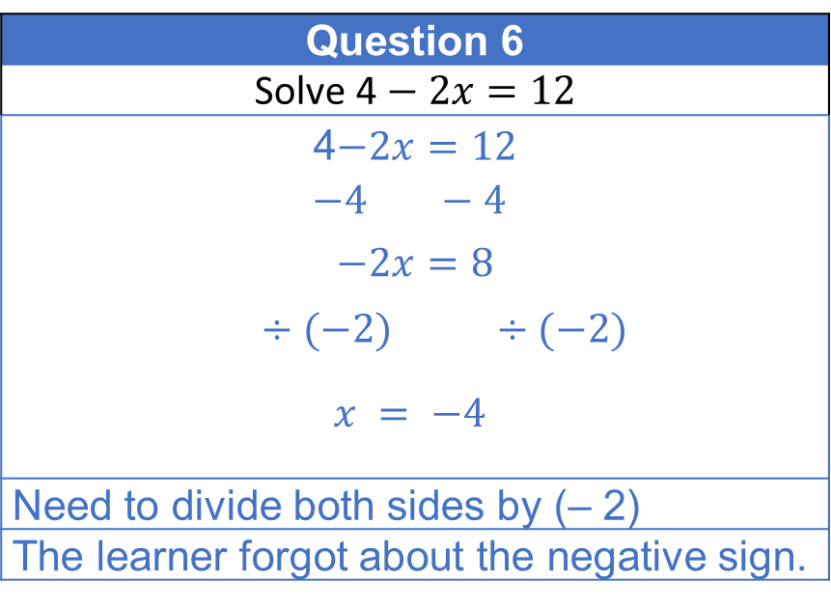
Spot the mistake answers (5–6)
REVIEW
Question 5
Solve 4$(x+2)$ = $12$
4$\left(x+2\right)=12$
$4x+8=12$
$$−8 −8$$
$$4x =4$$
$÷4$ $÷4$
$$x =1$$
The bracket were not expanded correctly.
The learner did not understand that each term inside the bracket needs to be multiplied by 4.
Question 6
Solve 4$− 2x=12$
4$−2x=12$
$$−4 −4$$
$$−2x=8$$
$÷(−2)$ $÷(−2)$
$$x = −4$$
Need to divide both sides by (– 2)
The learner forgot about the negative sign.
How would you avoid making these mistakes?

Slide 31
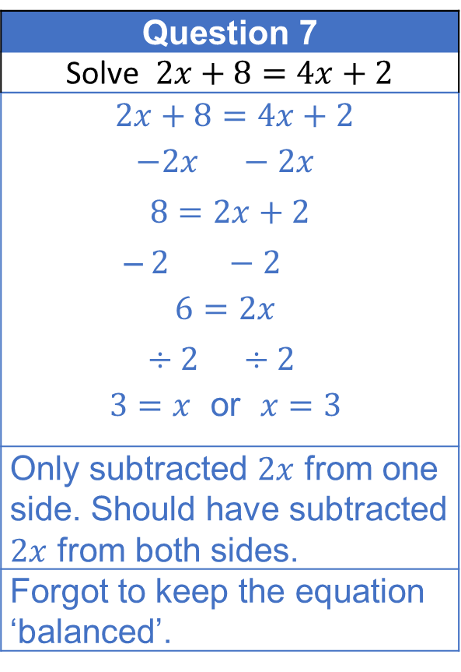
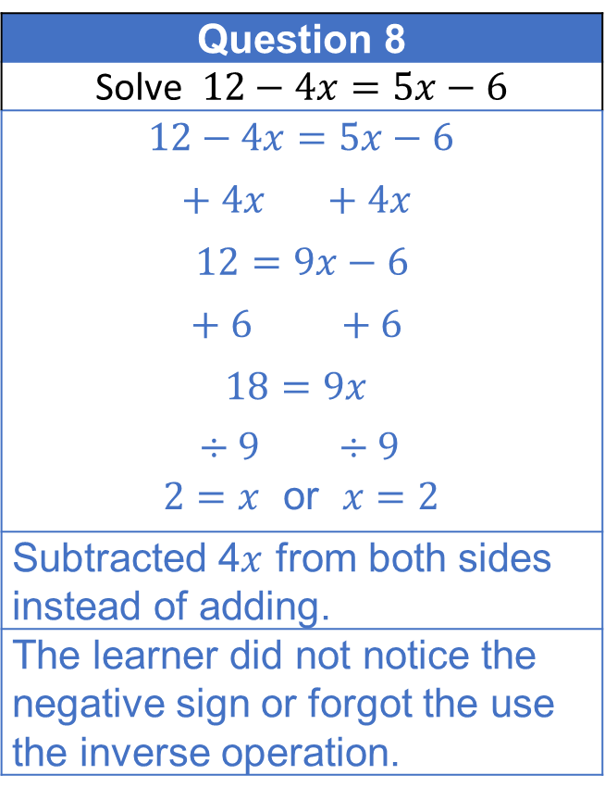
Spot the mistake answers (7–8)
REVIEW
Question 7
Solve $2x+8=4x+2$
$2x+8=4x+2$
$$−2x −2x$$
$$8=2x+2$$
–$2 −2$
$$6=2x$$
$÷2$ $÷2$
$3=x$ or $x=3$
Only subtracted $2x$ from one side. Should have subtracted $2x$ from both sides.
Forgot to keep the equation ‘balanced’.
Question 8
Solve $12−4x=5x−6$
$$12−4x=5x−6$$
$$+ 4x +4x$$
$$12=9x−6$$
$$+ 6 +6$$
$$18=9x$$
$÷9$ $÷9$
$2=x$ or $x=2$
Subtracted 4$x$ from both sides instead of adding.
The learner did not notice the negative sign or forgot the use the inverse operation.
How would you avoid making these mistakes?

Slide 32
Summary
REVIEW
Which question did you find the most challenging?
We solve equations to find the value of an unknown,
such as x.
just x on just one side of the equation.
In our working, the aim is to end with
If there are x’s on both sides, decide which side to ’collect’ the x’s.
Keep the equations balanced —
whatever is done to one side, needs to be done to the other side.

Slide 33
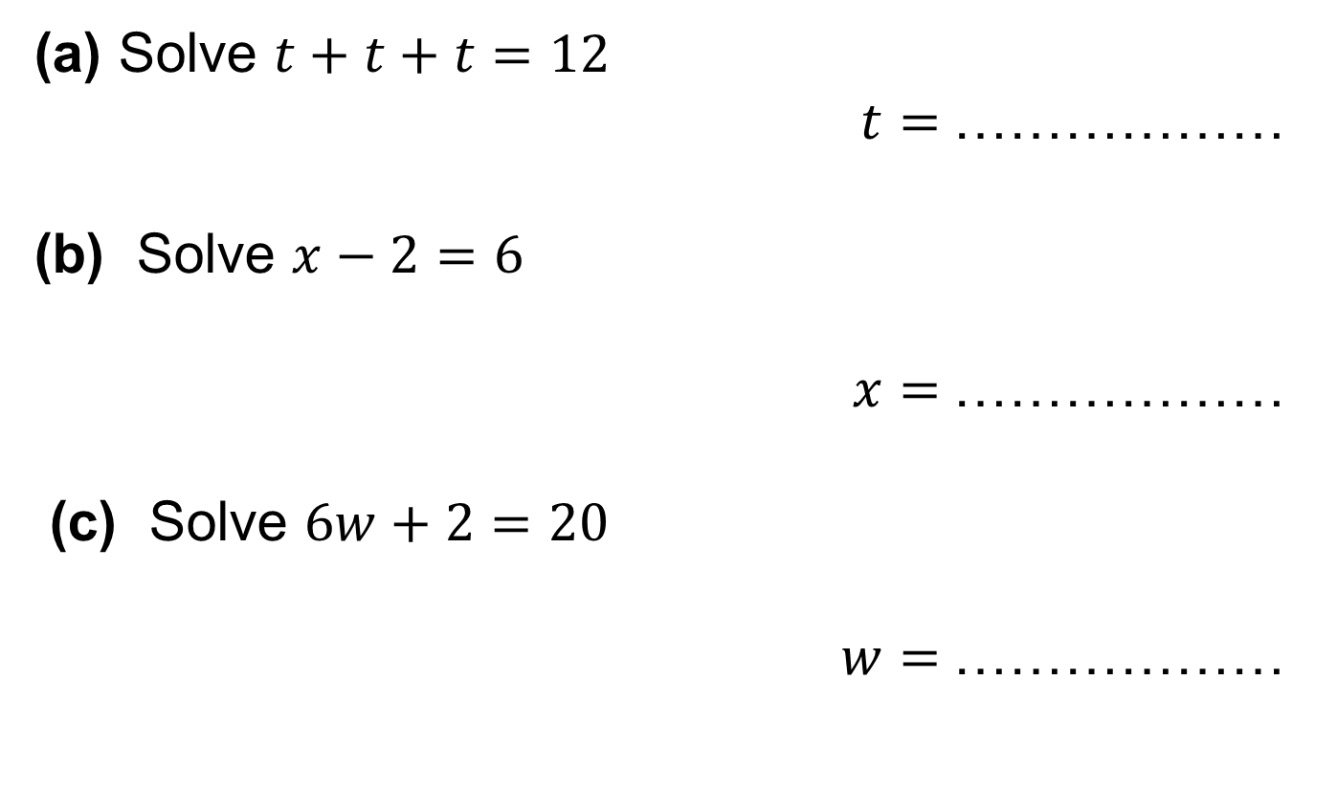
Practice question (1)
PRACTICE QUESTION
Worksheet
available
(a) Solve $t+t+t=12$
$t=$………………
(b) Solve $x−2=6$
$x=$………………
(c) Solve $6w+2=20$
$w=$………………
4
8
3

Slide 34
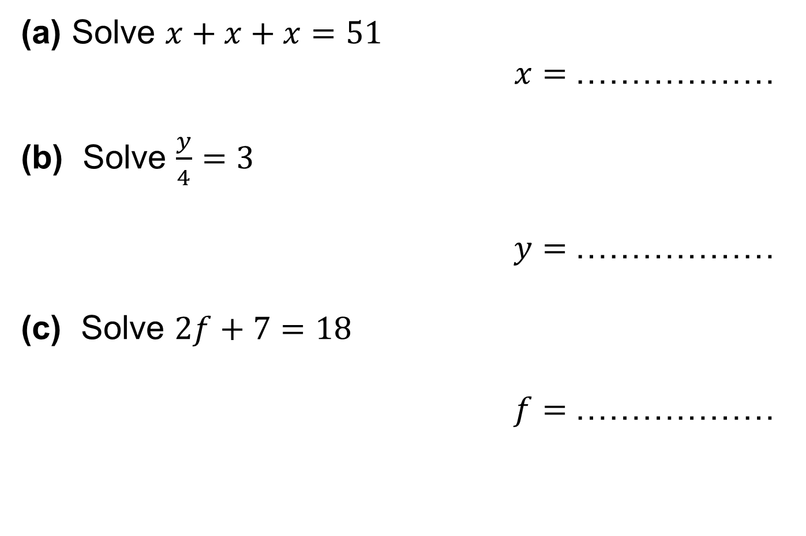
Practice question (2)
PRACTICE QUESTION
Worksheet
available
(a) Solve $x+x+x=51$
$x=$………………
(b) Solve $\frac{y}{4}=3$
$y=$………………
(c) Solve $2f+7=18$
$f=$………………
17
12
5.5

Slide 35

Practice question (3)
PRACTICE QUESTION
Worksheet
available
(a) Solve $4w+2=2w+7$
$w=$………………
2.5

Slide 36
Lesson review:
Solving equations
Objectives
Understand the steps needed to solve an equation
Solve one-step and multi-step equations
Use visual representations to provide insight into solving equations

Slide 37
Lesson 31:
Credits
Photo acknowledgements
Shutterstock.com: Darren Pullman, Vectorfair.com
Text acknowledgements
Pearson Education Ltd: Pearson Edexcel GCSE (9-1) In Mathematics (1MA1) Foundation (Non-Calculator) Paper 1F, Q10 June 2019
Pearson Education Ltd: Pearson Edexcel GCSE (9-1) In Mathematics (1MA1) Foundation (Non-Calculator) Paper 2F, Q11 June 2018
AQA: GCSE Mathematics (Linear) 4365/1F, Q12c November 2014

