Slide 1



Lesson 9:
Basic fractions
Level 2
Objectives
Understand what a fraction is and be able to link this to proportion
Find a fraction of an amount

Slide 2

Complete the Frayer model
Handout
available
Definition | Facts and characteristics
Example | Non-examples
Fraction
Notes:
Introduce this activity as a recap on fractions. Break into small groups. Each group completes a Frayer model printed on A3 paper (see handout). Ask learners to think about what a fraction is and go through what each section is looking for. Encourage learners to represent their ideas visually.
Learners record their ideas in each of the four sections for 10 minutes. You can provide coloured pencils and markers to encourage pride in the presentation in their work. Ask groups to swap their Frayer models or leave theirs on their desk and move around to look at other groups’ ideas. Give them a further 5 minutes to update their models.
Invite learners in two or three groups to present their ideas. Different pictures or representations of fractions, circles, triangles, bars and also a number line, are emphasised. If learners have not used diagrams, model this for them on the board.
Discuss mathematical language commonly used when discussing the topic of fractions – numerator, denominator, simplify and equivalence.

Slide 3
Representing fractions
3
Numerator. Used to determine the number of parts out of the whole.
What is this digit called?
5
Denominator. Used to determine how many parts make up a whole.
What is this digit called?
0
1
Notes:
Review Frayer models and highlight possible misconceptions. Break down what a whole number and a fraction are. Discuss what we mean by a fraction of an amount.

Slide 4
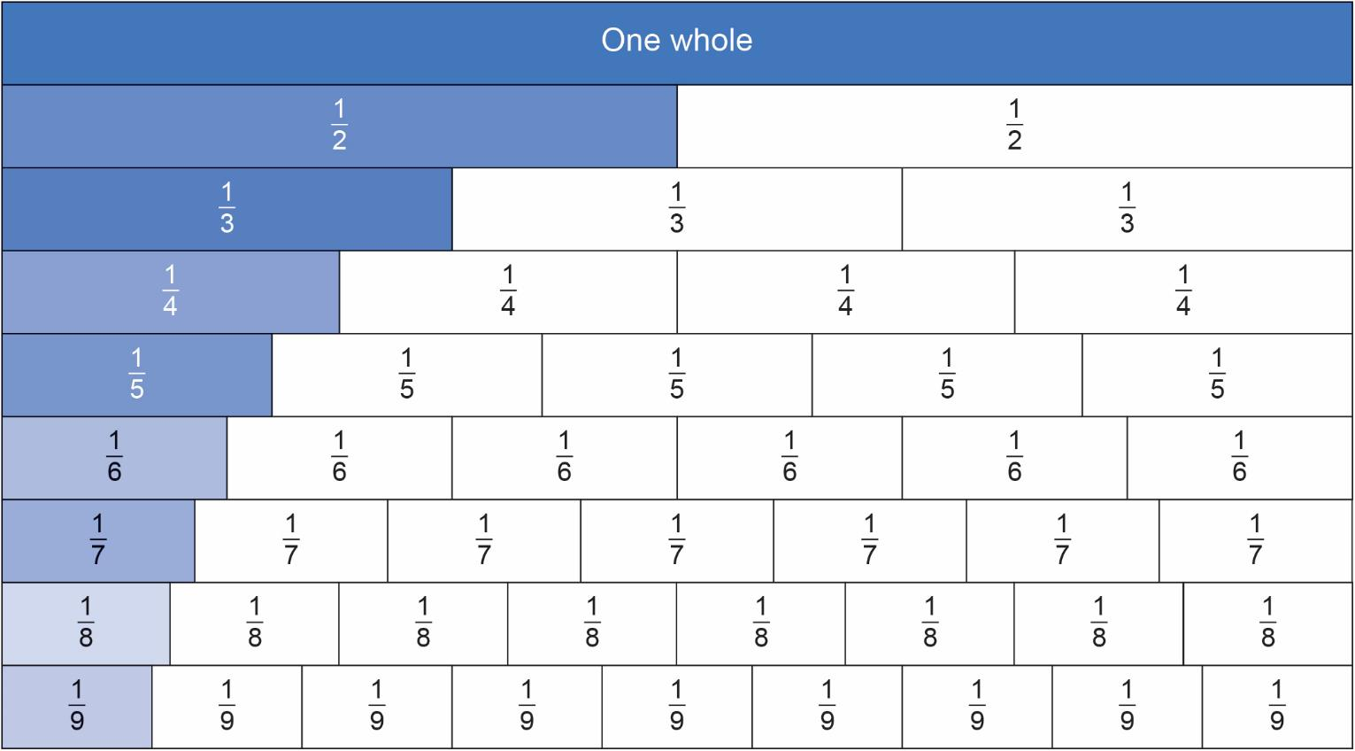
Fraction wall
Notes:
Create a fraction wall or use this slide or www.visnos.com/demos/fraction-wall and ask “What fractions of the whole do these bars represent? Is there a pattern in their numerators and denominators?”

Slide 5
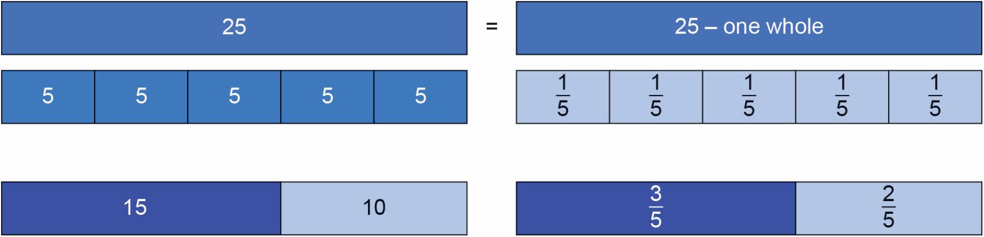
A fraction as part of a whole: Introducing the bar model
Notes:
Introduce the bar model and talk through how 25 can be divided into 5 parts - or 1/5 of the whole amount.
Learners begin to appreciate that the fraction of an amount depends on the size of the whole. Here learners see the whole as 25 and compare the values of fifths 1/5 of 25 = 5 and three fifths 3/5 of 25 = 15 and two fifths 2/5 of 25 = 10 making the whole of 25.

Slide 6

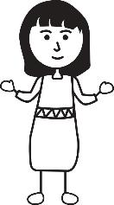
Ruby’s mistake
Worksheet
available
Ruby says, for each shape the blue part shaded represents one third.
Ruby is not correct? Can you explain why?
Notes:
Ask learners to discuss the fraction of each shape shaded and decide whether or not it is one third – and why. Learners should be prepared to explain their reasoning.

Slide 7
Ruby’s mistake
Ruby says, for each shape the blue part shaded represents one third.
Ruby is not correct? Can you explain why?
Notes:
Emphasise for a fraction the parts must be equal in size.

Slide 8

Fractions
KEY IDEA
Fractions can be represented as a diagram
in different ways: circles, bars, triangles, etc.
Each part in a fraction is of equal size.
The number of parts shaded is the numerator.
The line in the middle of a fraction means
‘out of’.
The total number of parts that the whole is split into is the denominator.
Notes:
Emphasise that fraction parts must be equal.

Slide 9
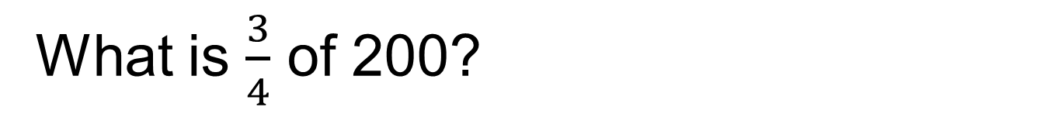

Fraction of an amount without a calculator
DISCUSS
What is $\frac{3}{4}$ of 200?
$$\frac{3}{4}$$
50
50
50
50
200
Answer = 150
Notes:
Animations to bring bar model in gradually.
Teachers could model on the white board.
Before showing animations – ask the learners how they can present the question in a bar model?
Ask learners to help label the bar.
How would it be divided up?
What would the total bar be worth?
What would each section be worth?

Slide 10
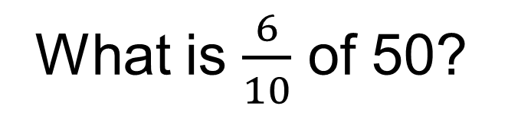

Fraction of an amount with a calculator
DISCUSS
What is $\frac{6}{10}$ of 50?
$\frac{6}{10}$
5
5
5
5
5
5
5
5
5
5
50
Answer = 30
Notes:
Animations to bring bar model in gradually.
Teachers could model on the white board.
Before showing animations – ask the learners how they can present the question in a bar model?
Ask learners to help label the bar.
How would it be divided up?
What would the total bar be worth?
What would each section be worth?

Slide 11
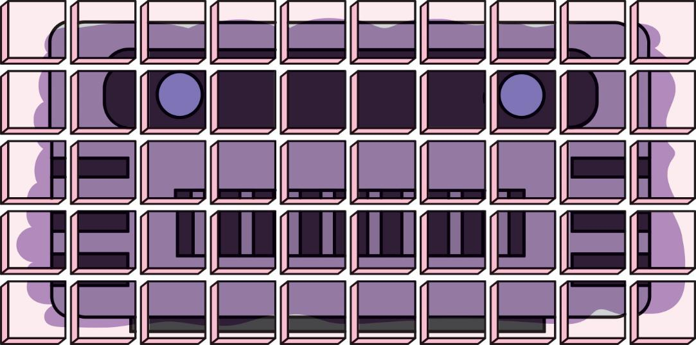
Rusty the robot cake
The Rusty the robot cake has 50 servings.
Notes:
Start the activity by showing the class the Rusty the robot cake (50 servings), sold in slices at the college café. Tell learners that this cake represents £20.
The handout has varying amounts of the cake sold that week in the café.
Learners use the bar models on the handout to work out the fraction of cake sold each day and then the value of cake sold each day, e.g. Monday there are 28/50 left over, so 22 (50 – 28) pieces were sold. The value of the cake sold is 22/50 × 20 = £8.80.

Slide 12
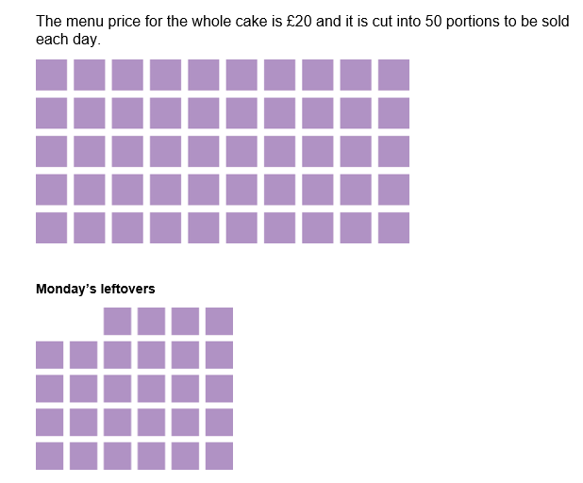
Rusty the robot cake activity
Handout
available
The college café orders one Rusty the robot cake every day and records their sales on the Rusty the robot cake handout.
Work out the fraction of the whole cake sold each day.
What is the value of the cake sold each day if the whole cake costs £20?
Notes:
The purpose of the activity is for learners to find a fraction of an amount using the context of the café and money. This activity will take 15 minutes, in pairs.

Slide 13
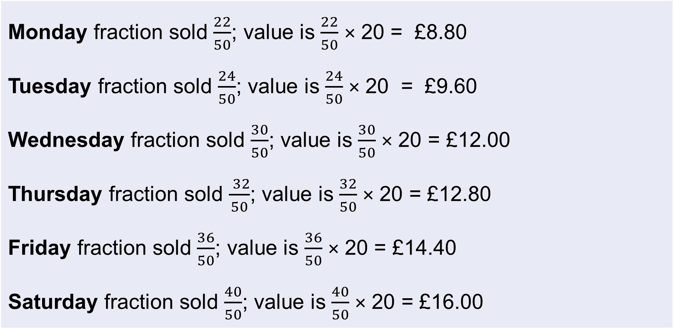
Answers
Monday fraction sold $\frac{22}{50}$; value is $\frac{22}{50}$ × 20 = £8.80 Tuesday fraction sold $\frac{24}{50}$; value is $\frac{24}{50}$ × 20 = £9.60 Wednesday fraction sold $\frac{30}{50}$; value is $\frac{30}{50}$ × 20 = £12.00 Thursday fraction sold $\frac{ 32}{50}$; value is $\frac{32}{50}$ × 20 = £12.80 Friday fraction sold $\frac{36}{50}$; value is $\frac{36}{50}$ × 20 = £14.40 Saturday fraction sold $\frac{40}{50}$; value is $\frac{40}{50}$ × 20 = £16.00

Slide 14
Exam question 1
Practice
Worksheet
available
Alex is the manager of a hospital canteen.
He reviews the meals the patients choose.
On Monday there were 240 patients in total.
1
of these patients chose pasta.
3
3
of these patients chose beef stew.
8
The other patients chose chicken.
How many patients chose chicken on Monday?
70
Notes:
Learners work through the exam question in pairs.
When the learners have answered this question, ask them whether they have used an approach to answering this question that is different to what they have tried before. Did they use a bar model? How has their thinking changed? What have they learned about fractions?

Slide 15
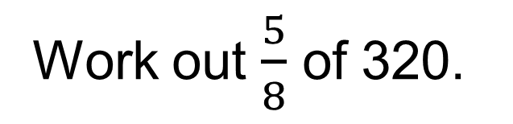
Exam question 2
Practice
Work out $\frac{5}{8}$ of 320.
Answer: 200
Notes:
Share some further examples of bar model questions if needed.

Slide 16
Lesson review:
Basic fractions
Level 2
Objectives
Understand what a fraction is and be able to link this
to proportion
Find a fraction of an amount
Suggested further steps/areas to work on
Interpret and use fractions in another context

Slide 17
Lesson 9:
Credits
Text acknowledgements:
Pearson Edexcel Functional Skills, Practice Set 1 – Mathematics Level 2 (Non Calculator) PRACL2/01, Pearson Edexcel Functional Skills, Past Paper 2 – Mathematics Level 1 (Non Calculator) PMAT1/N02 Question 10, Pearson Edexcel Functional Skills, Past Paper 3 – Mathematics Level 1 (Calculator) PMAT1/C03 Question 10, Pearson Edexcel Functional Skills, Past Paper 3 – Mathematics Level 3 (Non Calculator) PMAT3 N03 Question 3, Pearson Edexcel Functional Skills, Past Paper 5 – Mathematics Level 1 (Calculator) PMAT1/C05 Question 8

