Slide 1


Lesson 11:
Multiplication and estimation
Objectives
Explore, evaluate and select different representations for multiplication.
Apply various methods and representations to a singular context using integers and decimals.
Apply efficient mastery methods to questions in different contexts.
Apply estimation, inversion and rounding to check accuracy of answers.
Notes:
Tutor guidance for lesson introduction:
Request confident/fluent learner read lesson objectives to the group.
Reiterate and clarify learning objectives.

Slide 2
Vocabulary check
YOUR
TURN
What other words or phrases mean to multiply?
Let’s add some vocabulary:
3 × 7 = 21
21 ÷ 7 = 3
Notes:
Discussion about prior knowledge relating to multiplication:
Tutor to facilitate a brief discussion around prior knowledge of multiplication e.g. vocabulary (factors, product, multiples etc.):
'What other words or phrases mean ‘to multiply?’ Answers may include ‘times’, ‘lots of’ ‘just keep adding up’ etc.
Consolidate these words and expressions on the board and reinforce that these all mean the same thing: relate to their usefulness in decoding worded questions.
SUGGESTION: write a multiplication question on the board i.e. 3 × 6 = 18 and annotate with correct vocabulary answers from learners. Establish all learners are aware of the meaning of factors and product in this example.
Reverse the question and confirm learners are aware of the equivalent division fact.

Slide 3
Method check
YOUR
TURN
What methods do you already have for solving this problem?
12 × 6
Notes:
Discussion about prior knowledge relating to multiplication:
Tutor to facilitate a brief discussion investigating previous methods for simple multiplication problems, e.g. long, grid, broken-window, chunking.
Tutor to scribe different methods supplied from learners. Comment on effectiveness and efficiency of the methods given. If not supplied, highlight that this problem can be thought of as 10 × 6 add 2 × 6 = 60 add 12 = 72, so that learners begin to establish fluency with multiplying by 10 as a shortcut.
Emphasise that all written methods are simply algorithms for separating numbers into place value and multiplying single digits, before adding component parts together.
All methods scribed by the tutor should be able to demonstrate that this problem was broken down into 10 × 6 add 2 × 6 and 60 and 12 and were added to arrive at 72.
This insight is critical to the lesson.

Slide 4
Question
YOUR
TURN
Where do you use multiplication?
Can you give me some examples from real life?
Where else in maths do you use multiplication?
Notes:
Discussion about why we need multiplication:
Explain WHY multiplication is so integral to GCSE maths – multiplication is key to understanding proportionality, which is the core concept behind fractions, decimals and ratio & proportion e.g. number sense. These skills are crucial underpinning in almost all other topic areas, such as algebra (expanding, factorising, solving equations etc.) and geometry (area, internal/external angles, trigonometry etc., and cover most of the Foundation curriculum.
Annotate the board with answers, enough so that learners see that multiplication (and division) are found in every aspect of the curriculum
Consolidate that multiplication is essential in every discipline within maths and learners need to be fluent in order to succeed

Slide 5
True or false?
YOUR
TURN
✔
5.6 × 100 = 560
✖
100 × 50.6 = 506.0
2.3 × 100 = 10 × 23
✔
✖
56 ÷ 100 = 0.056
8600 ÷ 100 = 86
✔
Notes:
All learners should attempt the first true or false quiz. Learners to answer in pairs. Provide mini white-boards if possible.
Tutor to lead discussion on arising misconceptions: answers are animated

Slide 6
Starter
YOUR
TURN
✔
343 ÷ 100 = 34.3 ÷ 10
✖
100 × 50.6 = 506.0
5.53 × 100 = 55.3 ÷ 100
✖
100 × 2.213 = 2213 ÷ 10
✔
✖
10 × 3.1 × 10 = 310 ÷ 10
Notes:
OPTIONAL TASK:
Tutors to decide whether learners are able to attempt these more challenging questions in the same format.

Slide 7
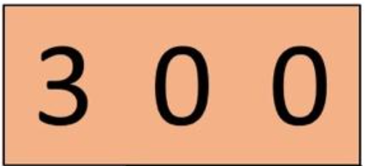
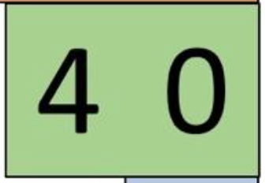
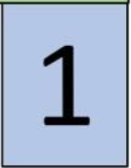
Place value
YOUR
TURN
hundreds
tens
units
Notes:
Write a 3-digit number onto the animated tiles provided above. Keep all digits <5 so carry-over is not introduced yet on the following slide, e.g. 341
Check vocabulary of the place value columns with learners (animated).
Ask learners to describe the meaning of the digits relevant to their place value; e.g. ‘What is the value of each digit?’, ‘What is the value of the 4?’
Discuss sequential orders of magnitude.
Use the animation to reveal that it can be deconstructed into its place value; 300 and 40 and 1, and discuss that the ‘1’ means ‘1 lot of 1’, ‘4’ means ‘4 lots of 10’ and the ‘3’ means ‘3 lots of 100’.

Slide 8
YOUR
TURN
How do we do 341 × 2 without writing anything down?
Repeated addition
6 0 0
6 0 0
2
3 0 0
8 0
4 0
1
3 0 0
4 0
1
300 × 2 = 600
4 0
4 0
8 0
40 × 2 = 80
1
1
2
1 × 2 = 2
Notes:
Tutor to demonstrate that multiplying by a relatively small factor e.g 2 or 3 can be performed by repeated addition.
Reinforce how numbers are deconstructed into their place value.

Slide 9
YOUR
TURN
What about 341 × 6?
x 6
1 0 0 0
8 0 0
4 0
6
3 0 0
2 0 0 0
2 0 0
4 0
x 6
4 0
4 0
1
x 6
6
6
Notes:
Explain that multiplying by larger factors (e.g. >3) using repeated multiplication can be done but is inefficient and time consuming.
Consolidate with learners that 300 × 6 is more efficient and less error-prone than 300 + 300 + 300 + 300 + 300 + 300
Explain that 300 × 6 can be completed with mental arithmetic by calculating 3 × 6 = 18 but then completing with the trailing zeroes (avoid saying ‘adding’) because it is actually 6 lots of 300 and therefore needs the two zeroes adding to confirm the place value.
Consolidate this method with learners with the 40 × 6 = 24 with a zero, is an efficient way to multiply by 40 by breaking it down into × 4 then × 10, as it is critical to the algorithms that will follow.
Take time to discuss the ‘carry-over’ of the hundred column in the final answer (800 + 200 = 1000) and that learners can fluently embed this step into their methodology.

Slide 10


YOUR
TURN
What about 341 × 13?
3 0 0
× 10
× 3
3 0 0
4 0
× 10
× 3
4 0
1
× 10
1
× 3
9 0 0
3 0 0 0
3 0 0 0
9 0 0
5 0 0
4 0 0
2 0
2 0
1 0 0
3
1 0
1 0
3
Notes:
Discuss multiplying by factors greater than 9, i.e. 2-digits.
Explain/discuss that this is the same method but has to be repeated for each of the multiplier’s digits.
Ask the question ‘What are the values of the digits in 13?’ Make sure all learners are efficient at deconstructing it into 10 and 3.
To reinforce that the algorithm is a more efficient method, take time to go through this procedure, repeating previous work for the 10 and for the 3, before adding to an answer.
Emphasise that with increased steps comes the increased likelihood of making an error and that this method takes too much time.
Arrive at the conclusion that a more efficient written method is needed i.e. an algorithm but the place value is important to understanding why the algorithm works.

Slide 11
Talking numbers
YOUR
TURN
How would you calculate the answers without writing anything down?
3 × 23 =
23 × 100 =
0.23 × 10 =
What does multiplying by 10 or 100 do to the number?
3 × 0.23 =
Which question creates a smaller number than the original? Why?
Notes:
Misconceptions to pull out
Adding 0 when multiplying by 10
Multiplying makes the answer bigger
Discussion points
Repeated addition
How to check (estimation)

Slide 12
What is multiplication?
YOUR
TURN
Worksheet
available
Essentially, repeated addition.
But when we are working with big numbers, this isn’t always the best approach.
Discussion point – why?
For example look at this array…
Rather than counting each circle, how else could we view this?
Notes:
Discussion around what multiplication is and why we need it.
Introduce the array as a way of showing why we use multiplication and discuss alternatives to counting individual circles, for example:
- Count how many there are in each column (or row), then add same number for each subsequent column (or row)
Leading to:
- Multiply the number in each column (or row) by the number of rows (or columns)
Leading to:
- Multiply the number of columns by the number of rows
Explain that it doesn’t matter which option you use to (rows x columns, or columns x rows), the answer will be the same.

Slide 13


What is multiplication?
YOUR
TURN
Notes:
Optional slide to further discuss
Ask learners to create as many ways as possible of grouping the array (factor pairs).
Use the handout to explore further how an array can be translated into a ratio table and used as a method of calculation

Slide 14
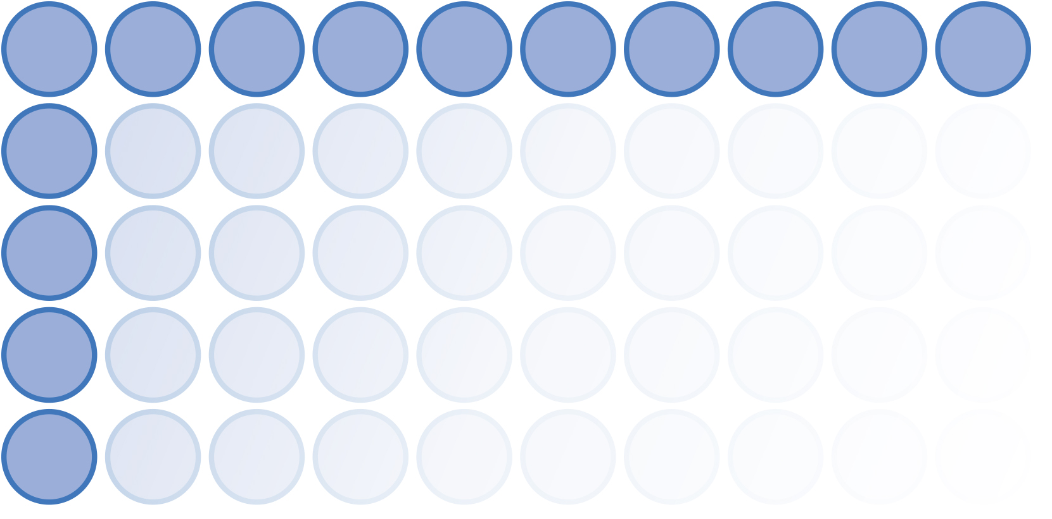
Another model
YOUR
TURN
When we have decimals, an array isn’t the best model because we can’t easily count or predict answers.
What other models can we use when we can’t count?
Notes:
A key learning point is for learners to understand that an array is a discrete model where multiplication is an efficient replacement for repeated addition.
Discuss that decimals are a continuous measure and counting no longer works. The image is to visualise a transition from discrete to continuous and now requires an algorithm.

Slide 15
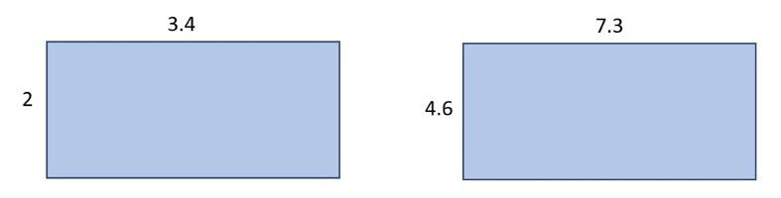
Area model
YOUR
TURN
When we have decimals, an array is not the best model,
so we use an area model e.g.

Slide 16
Another model
YOUR
TURN
We can use an area model to think about multiplying decimals by breaking numbers down:
2 × 3.4
4.6 × 7.3
3
0.4
7
0.3
2 × 3
2 × 0.4
6
4
28
1.2
0.8
33.58
2
6.8
0.6
4.2
0.18

Slide 17
Rounding and estimation checks
YOUR
TURN
When multiplying, we should always carry out a simple rounding check to see whether our answers are sensible.
What does ‘sensible’ mean?
How do we carry out a rounding check?
Notes:
Discuss with learners what a rounding check is, what a sensible answer means and how to carry out checks.
Ensure learners round factors and not the result.
Confirm that learners understand a rounding check should carried out using mental arithmetic.

Slide 18
Starter
YOUR
TURN
6? Which digits can take the place of the ‘?’
How can we round them to the nearest ten?
0 | 1 | 2 | 3 | 4 | 5 | 6 | 7 | 8 | 9
✖
Notes:
This slide explores rounding a 2-digit number to the nearest 10. Discuss, then reveal the 10 possible digits that could follow the digit 6 (ie 60).
Check for and clarify any misconceptions around 0 or 10 being on the list.
Use the animation to reveal the digits 0 to 4 and discuss whether these would result in rounding up or down – and why.
Animate further to show that 5 belongs in a second equal grouping that results in rounding up. Ask learners to justify why 5 rounds up.
Be careful to explain that the digits 0–4 do not ‘round down’ but disappear or are replaced with zeroes where appropriate.
Relate to money for clarity e.g. ‘£63 is closest to which £10 note?’ ‘£68 is closest to which £10 note?’

Slide 19
Rounding
YOUR
TURN
£
£
70
4
5
6?
Round this number to the nearest ……………….…….
0 | 1 | 2 | 3 | 4 | 5 | 6 | 7 | 8 | 9
✖
Answer: £
Notes:
Tutors may ask their own questions (enter your own questions in the Question box). Question may include two, three digit numbers, or decimal numbers according to the class’s needs. Money is a comfortable context to use at this point but the ‘£’ may be removed.
Practise rounding numbers using the rule until satisfies that all learners are comfortable and fluent.

Slide 20
Estimation
YOUR
TURN
ROUND
What is a sensible estimate for 3.8 × 5.1?
4
5
3.8 × 5.1 ≈ 4 × 5
≈ = 20
✔
Check: 3.8 × 5.1 = 19.38
Notes:
Consolidate the previous slides with a worked example of how to perform and justify a rounding check for decimal numbers if required.
Explain the ‘approximately equals to’ symbol

Slide 21
YOUR
TURN
Rounding and estimation checks
Use your place value cards set to create a pair of random two-digit numbers.
Place them on the paper.
Round the numbers before multiplying.
Check your estimation.
52 x 97
TH T U
50 x 100 = 5 0 0 0
THTU
Check: 52 x 97 = 5044
Notes:
Hand out place value cards and have learners work in pairs or threes.
Learners should select random cards to make a pair of two or three digit numbers that they then place on a sheet of paper or mini white-board and perform a clear rounding check before using a calculator to verify their answers as pictured.
Ensure learners annotate with correct place value label to validate the ‘sensibility’ of their answer.
Ask learners to include decimal points to their cards to increase difficulty.
Practise until skill is secure and feedback/select/ questions and methods and/or incorrect answers to challenge misconceptions.

Slide 22

Practice
YOUR
TURN
Handout
available
Set 1
Set 2
35 × 7
7 × 36
70 × 35
72 × 36
720 × 36
£721 × 36
£721 × 360
£3.5 × 7.00
3.5 × 7
7.5 × 36
70 × 3.5
£7.20 × 3.60
£720 × 3.60
72.1 × 3.6
£721.01 × 360.10
£3.55 × 7.05
Notes:
Ask learners to work independently on the handout, and then compare/discuss their answers with a partner.
Ensure learners are including rounding checks.
Learners who complete set 1 can move on to set 2.
When all learners have completed (at least) set A, discuss any shortcuts they took to find the answers. For example, once they had answered Q1, how did they find the answers to Q2 & Q3? This is an example of procedural variation.
Highlight that all the other answers could have been derived from Q1 by adding or subtracting, or by multiplying/dividing by 10 (or powers of 10).
Set 1:
1) 247
2) 252
3) 2470
4) 2592
5) 25 920
6) £25 956
7) £259 560
8) £24.7
Set 2:
1) 24.7
2) 270
3) 247
4) £25.92
5) £2592
6) 259.56
7) £259 635.701
8) £25.0275
1) £7.60 × 12 = £91.2
2) 4.5 × 5.2 = 23.4 m2
3) 180 × 1.13 = €203.4

Slide 23
Practice
YOUR
TURN
Handout
available
Rachel works at a shop and is paid £7.60 per hour. She works for 12 hours a week.
Work out how much Rachel is paid.
Ahmed is fitting a new carpet in his living room, it is a rectangle shape.
The room is 4.5 m by 5.2 m.
How many square metres does he need?
Adam changes £180 into Euros.
The exchange rate is £1 to €1.13.
How many Euros does he receive?
Notes:
These questions (also on Handout 3) give learners the opportunity to apply multiplication to worded problems.
Ask learners to work individually and check in pairs.
Ensure learners are including rounding checks with the above task

Slide 24

Method selection
KEY IDEA
There are many methods we could select when multiplying numbers.
For example:
Repeated addition
Arrays
Column
Grid
Lattice
Ratio table
Notes:
Discussion with learners on what current method they would use. Explore whether their method would change depending on the question.

Slide 25
How many ways?
YOUR
TURN
1650 x 19 =
Notes:
Discuss commutative properties of either 1650 groups of 19 or 19 groups of 1650. What methods have you used – how confident are you in multiplying? What do you believe you need to be more fluent and confident? Identify common misconceptions e.g. 0 × 9 = 0 and forgetting the zero in long multiplication. Did anyone use a distributive method 1650(10 + 10 − 1) or ratio tables.

Slide 26

Practice questions
YOUR
TURN
Handout
available
Shaheena is hiring a car for 9 days.
The cost is £24.99 per day plus 15p per mile.
She drove 200 miles in 9 days.
What is the total hire cost?
Harry is planning a holiday for 4 people for 7 days.
Here are the costs for the holiday for each person.
Travel £150
Hotel £50 for each day
Spending money £250
Work out the total cost of the holiday for 4 people for 7 days.
Notes:
Ask learners to work independently on the questions on slides 26 and 27.
Afterwards, discuss methods and provide answer sheets for learners to check their work.

Slide 27
Practice question
YOUR
TURN
Handout
available
The diagram shows a rectangular garden path.
120 cm
600 cm
Wasim is going to cover the Path with paving stones.
Each paving stone is a square of side 30 cm.
Each paving stone cost £2.50
Wasim has £220 to spend on paving stones.
Show that he has enough money to buy all the paving stones he needs.

Slide 28
Lesson review:
Multiplication and estimation
Objectives
Explore, evaluate and select different representations for multiplication.
Apply various methods and representations to a singular context using integers and decimals.
Apply efficient mastery methods to questions in different contexts.
Suggested further steps/areas to work on
Division
Under/over estimates
Significant figures

Slide 29


Lesson 11: Multiplication and estimation
Credits
Text acknowledgements
Pearson Education Ltd: Pearson Edexcel ​GCSE (9-1) In Mathematics (1MA1) Foundation (Non-Calculator) November 2021 Paper 1F, Pearson Education Ltd: Pearson Edexcel ​GCSE (9-1) In Mathematics (1MA1) Foundation (Calculator) November 2020 Paper 3F, Pearson Education Ltd: Pearson Edexcel ​GCSE (9-1) In Mathematics (1MA1) Foundation (Non-Calculator) May 2019 Paper 1F, Pearson Education Ltd: Pearson Edexcel ​GCSE (9-1) In Mathematics (1MA1) Foundation (Non-Calculator) November 2019 Paper 1F, Pearson Education Ltd: Pearson Edexcel ​GCSE (9-1) In Mathematics (1MA1) Higher Tier (Non-Calculator) May 2017 Paper 1H, Pearson Education Ltd: Pearson Edexcel ​GCSE (9-1) In Mathematics (1MA1) Foundation (Non-Calculator) May 2017 Paper 1F

