Slide 1



Lesson 7:
Basic fractions
Objectives
Understand what a fraction is and be able to link this
to proportion
Find a fraction of an amount
Find the whole amount from a fraction
Find a half without finding the whole by drawing a
bar model

Slide 2

Complete the Frayer model
Handout
available
Definition | Facts and characteristics
Example | Non-examples
Fraction
Notes:
Introduce this activity as a recap on fractions. Break into small groups. Each group completes a Frayer model printed on A3 paper (see handout). Ask learners to think about what a fraction is and go through what each section is looking for. Encourage learners to represent their ideas visually.
Learners record their ideas in each of the four sections for 10 minutes. You can provide coloured pencils and markers to encourage pride in the presentation in their work. Ask groups to swap their Frayer models or leave theirs on their desk and move around to look at other groups’ ideas. Give them a further 5 minutes to update their models.
Invite learners in two or three groups to present their ideas. Different pictures or representations of fractions, circles, triangles, bars and also a number line, are emphasised. If learners have not used diagrams, model this for them on the board.
Discuss mathematical language commonly used when discussing the topic of fractions – numerator, denominator, simplify and equivalence.

Slide 3
Representing fractions
3
Numerator. Used to determine the number of parts out of the whole.
What is this digit called?
5
Denominator. Used to determine how many parts make up a whole.
What is this digit called?
0
1
Notes:
Review Frayer models and highlight possible misconceptions. Break down what a whole number and a fraction are. Discuss what we mean by a fraction of an amount.

Slide 4
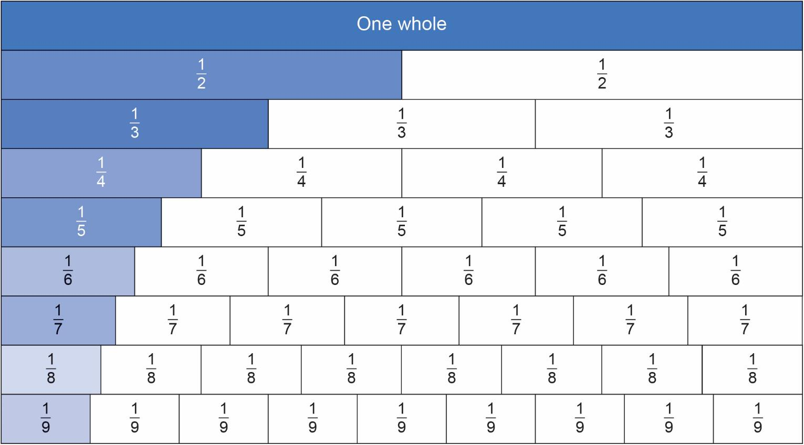
Fraction wall
4
Notes:
Create a fraction wall or use this slide or www.visnos.com/demos/fraction-wall and ask ‘What fractions of the whole do these bars represent? Is there a pattern in their numerators and denominators?’

Slide 5
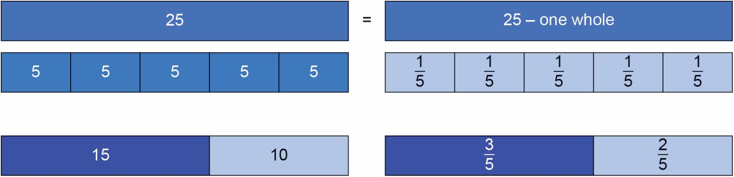
A fraction as part of a whole: Introducing the bar model
Notes:
Learners begin to appreciate that the fraction of an amount depends on the size of the whole. Here learners see the whole as 25 and compare the values of fifths 1/5 of 25 = 5 and three fifths 3/5 of 25 = 15 and two fifths 2/5 of 25 = 10 making the whole of 25.

Slide 6

Fractions
KEY IDEA
Fractions can be represented as a diagram
in different ways: circles, bars, triangles, etc.
Each part in a fraction is of equal size.
The number of parts shaded is the numerator.
The line in the middle of a fraction means
‘out of’.
The total number of parts that the whole is split into is the denominator.
Notes:
Emphasise that fraction parts must be equal.

Slide 7
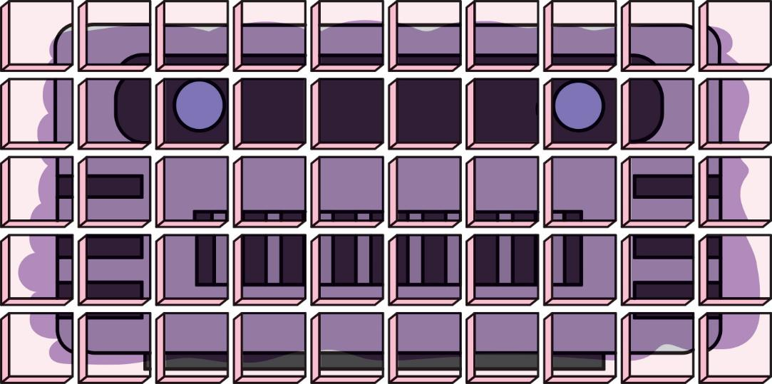
Rusty the robot cake
The Rusty the robot cake has 50 servings.
Notes:
Start the activity by showing the class the Rusty the robot cake (50 servings), sold in slices at the college café. Tell learners that this cake represents £20.
The handout has varying amounts of the cake sold that week in the café.
Learners use the bar models on the handout to work out the fraction of cake sold each day and then the value of cake sold each day, e.g. Monday there are 28/50 left over, so 22 (50 – 28) pieces were sold. The value of the cake sold is 22/50 × 20 = £8.80.

Slide 8
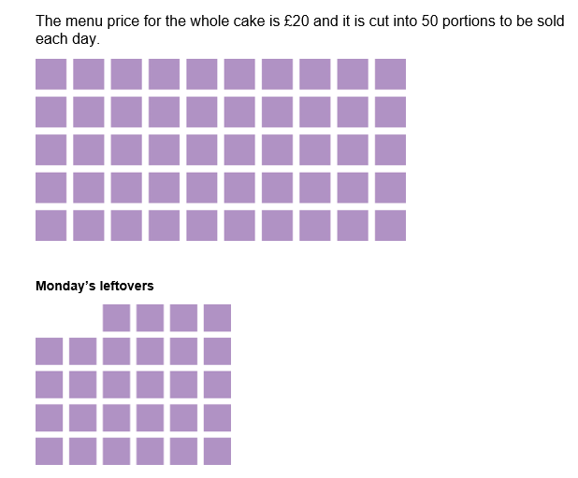
Rusty the robot cake activity
Handout
available
The college café orders one Rusty the robot cake every day and records their sales on the Rusty the robot cake handout.
Work out the fraction of the whole cake sold each day.
What is the value of the cake sold each day if the whole cake costs £20?
Notes:
The purpose of the activity is for learners to find a fraction of an amount using the context of the café and money. This activity will take 15 minutes, in pairs.

Slide 9
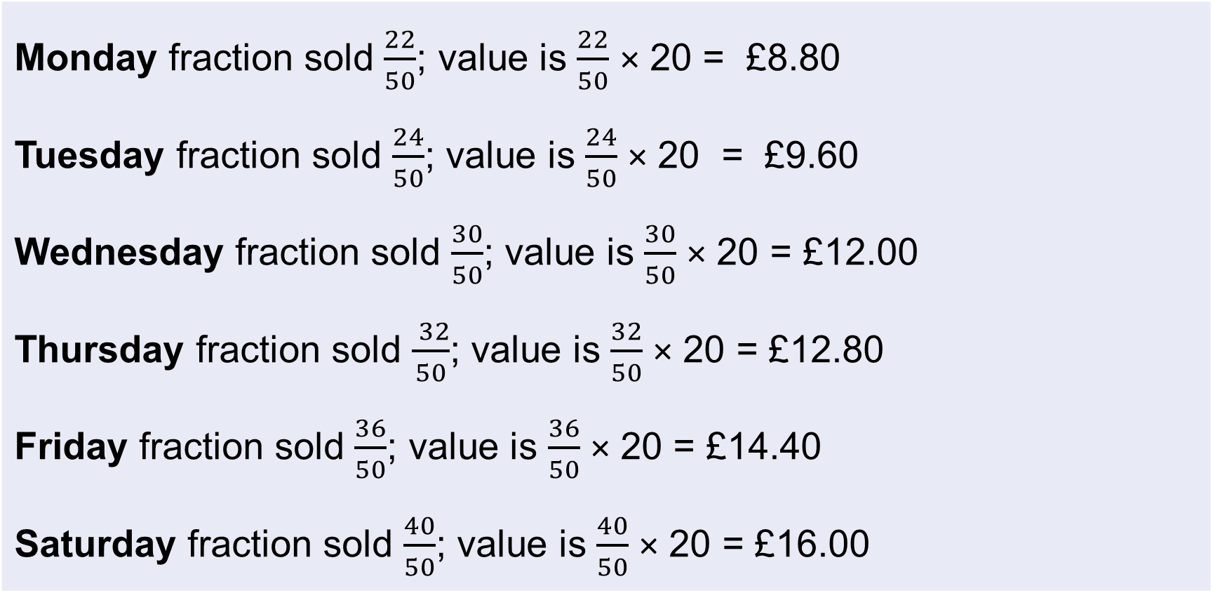
Answers
Monday fraction sold $\frac{22}{50}$; value is $\frac{22}{50}$ × 20 = £8.80 Tuesday fraction sold $\frac{24}{50}$; value is $\frac{24}{50}$ × 20 = £9.60 Wednesday fraction sold $\frac{30}{50}$; value is $\frac{30}{50}$ × 20 = £12.00 Thursday fraction sold $\frac{ 32}{50}$; value is $\frac{32}{50}$ × 20 = £12.80 Friday fraction sold $\frac{36}{50}$; value is $\frac{36}{50}$ × 20 = £14.40 Saturday fraction sold $\frac{40}{50}$; value is $\frac{40}{50}$ × 20 = £16.00

Slide 10

Finding half
DISCUSS
Can you find a half without finding the whole first?
of a cake costs £18.
What is the value of half of the cake?
$$\frac{3}{4}$$
£18
?
What are the different ways you could calculate the value of half the cake?
Notes:
Work with learners to explain that three parts represents £18 on the diagram and there are four parts in total. Ask learners what one half looks like on the diagram and how they might find this out, i.e. divide by three to find one part and times by two to find half.

Slide 11

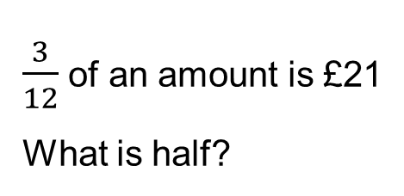
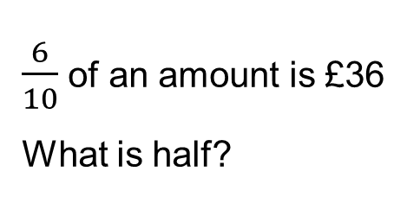

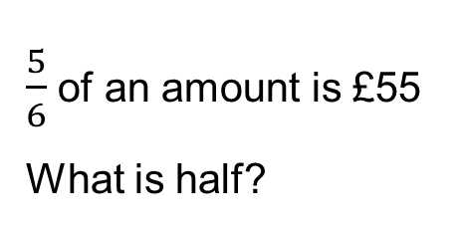
Finding half
YOUR
TURN
Handout
available
Can you find a half without finding the whole first? Draw bar models to help you.
$\frac{5}{6}$ of an amount is £55
What is half?
$\frac{7}{12}$ of an amount is £56
What is half?
$\frac{6}{10}$ of an amount is £36
What is half?
$\frac{3}{12}$ of an amount is £21
What is half?
$\frac{19}{20}$ of an amount is £38
What is half?
Notes:
Continue to develop understanding and use of bar models. Encourage class discussion and sharing of models.
The handout has space for learners to draw bar models.

Slide 12
Finding half answers 1
?
11
11
11
11
11
Half is £33
£55
?
8
8
8
8
8
8
8
£56
Half is £48

Slide 13
Finding half answers 2
?
6
6
6
6
6
6
6
£36
Half is £30
?
7
7
7
£21
Half is £42

Slide 14
Finding half answers 3
?
2
2
2
2
2
2
2
2
2
2
2
2
2
2
2
2
2
2
2
£38
Half is £20

Slide 15
Make your own problems
YOUR
TURN
Make your own bar model problems. Below are some examples of what you could do.
18
?
?
28
12
?
Notes:
Share some further examples of bar model questions if needed.

Slide 16
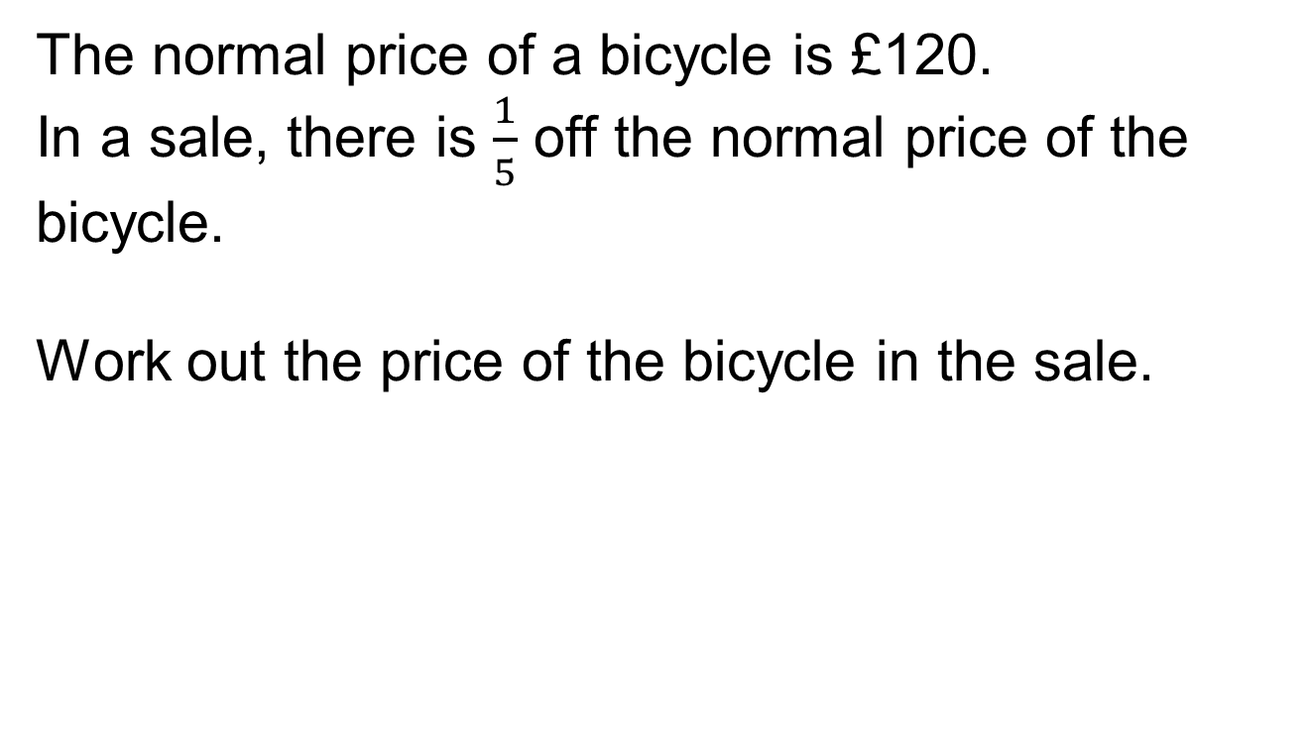
Exam question
PRACTICE QUESTION
Worksheet
available
The normal price of a bicycle is £120.
In a sale, there is $\frac{1}{5}$ off the normal price of the bicycle.
Work out the price of the bicycle in the sale.
£96.00
Notes:
Learners work through the exam question in pairs.
When the students have answered this question, ask them whether they have used an approach to answering this question that is different to what they have tried before. Did they use a bar model? How has their thinking changed? What have they learned about fractions?

Slide 17

Exam question
REVIEW
The normal price of a bicycle is £120.
In a sale, there is $\frac{1}{5}$ off the normal price of the bicycle.
Work out the price of the bicycle in the sale.
£120
Answer:
£120 ÷ 5 = 24
£120 – £24 = £96.00
?
Notes:
Share some further examples of bar model questions if needed.

Slide 18
Lesson review: Basic fractions
Objectives
Understand what a fraction is and be able to link this
to proportion
Find a fraction of an amount
Find the whole amount from a fraction
Find a half without finding the whole by drawing a
bar model
Suggested further steps/areas to work on
Interpret and use fractions in another context

Slide 19
Lesson 7:
Credits
Text acknowledgements
Slide 16: Pearson Edexcel Level 1/Level 2 GCSE (9-1) November 2019 1MA1/3F Mathematics Paper 3 (Calculator) Foundation Tier, Question 11b

