Slide 1


Lesson 44:
Scatter Graphs
Objectives
Draw and interpret scatter graphs
Draw and interpret line of best fit
Understand that correlation does not imply causation

Slide 2








Say what you see
DISCUSS
$$×$$
$$×$$
$$×$$
$$×$$
$$×$$
$$×$$
$$×$$
$$×$$
$$×$$
$$×$$
Notes:
Start with an open question – what can they see on the slide?
Some learners may immediately say that it’s a scatter graph. Probe for information about what a scatter graph is and what it shows.
Probe for the content of the scatter graph:
What is it showing? (Encourage learners to engage with the context)
What do the crosses represent?
What does the cross above 14 years mean? (One person who has 14 years in education earns £30,000. Highlight that this is just one person – it doesn’t mean that everyone with 14 years of education earns £30,000. Refer to 15 years – 3 people with different salaries are shown here.)
Is the scatter graph showing any sort of trend or pattern?
What is missing from the graph to help show a pattern? (Line of best fit)
Reinforce that a scatter graph shows the relationship between two variables (in this case, as years of education increases, earnings increase).
Scatter graphs may also include anomalies (also called ‘outliers’) – What is an anomaly?
Ask if they can say which point is an obvious anomaly. (The person with 12 years education earning £80,000 – much more than most people with 12 years education could expect to earn.)
Ask the learners if they recognise what this type of graph is and what this type of graph can be used to show; encourage them to engage in the context.

Slide 3






DISCUSS
Interpreting a scatter graph
$$×$$
$$×$$
$$×$$
$$×$$
$$×$$
$$×$$
$$×$$
$$×$$
$$×$$
$$×$$
Notes:
Explain that the line of best fit has now been drawn on the scatter graph. Discuss how this a matter of judgement but needs to go close to as many points as possible.
Ask learners questions to get them to interpret the graph:
What salary could someone with 13.5 years of education expect to earn?
Ask learners to think about this and show their responses on mini-whiteboards. Ask for volunteers to say how they worked this out.
Reveal and explain the animated red line to show it’s likely to be just over £20,000.
Make sure that the learners know that they need to draw lines on the graphs.
How many years of education would you expect someone on a salary of £50k to have?
Again, ask learners to think about this and show their responses on mini-whiteboards. Ask for volunteers to say how they worked this out.
Reveal and explain the animated red line to show it’s likely to be nearly 16 years
What about the salary of someone with 30 years of education?
Explain that there is no data here beyond 18 years of education, so we cannot say if the same trend continues.

Slide 4

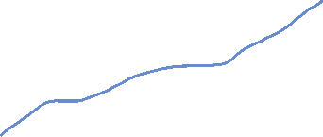
DISCUSS
Sarah has drawn a line of best fit for each of
these scatter graphs. Is she correct?
Worksheet
available
I have drawn the line of best fit.
Notes:
Sample student thinking – Sarah thinks she has drawn the line of best fit on these graphs. Are they correct? Why or why not?
Discuss the examples of line of best fit on these graphs.
How can they be corrected?
On the worksheet, draw the correct line of best fit.

Slide 5

Guidelines for drawing a line of best fit
KEY IDEA
A line of best fit …
ignores any outliers
reflects the trend of the data
must be balanced
(should have points above and below the line at both ends of the line.)
should not be forced to pass through any specific data points, or to pass through zero.

Slide 6
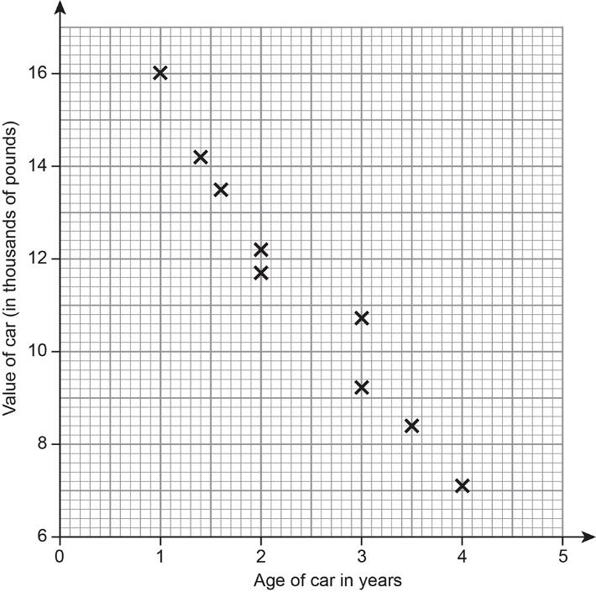






DISCUSS
Compare the two scatter graphs.
$$×$$
$$×$$
$$×$$
$$×$$
$$×$$
$$×$$
$$×$$
$$×$$
$$×$$
$$×$$
Notes:
Discuss the first graph - what information does it show? What is the general trend of the data points?
Compare the two scatter graphs. What is the same? What is different?

Slide 7
DISCUSS
Age and value of cars
What would you expect to be the value of a car that is 2½ years old ?
How old might a car be that’s valued at £10,000?
Fill in the blank:
  The older the car is, the ……….. it is worth.
Describe the correlation between the age and value of the cars.
Notes:
Repeat the discussion using this graph.

Slide 8
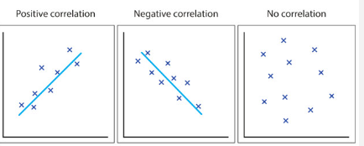
Types of Correlation
Discuss
Positive correlation
Negative correlation
No correlation
Correlations can be strong or weak
Notes:
Discuss the different types of correlation that can be shown using a scatter graph, as shown on the slide.
Discuss what is meant by positive correlation, negative correlation and no correlation – provide example to illustrate each, e.g.:
Rainy weather and number of umbrellas sold – positive correlation
Sunny weather and number of hot drinks sold – negative correlation
Number of children and number of dogs in a family – no correlation
Mention that sometimes the graphs show weak correlation and strong correlation – if correlation is strong, then all the points will be close to the line of best fit.

Slide 9
YOUR TURN
Types of Correlation
Task: In pairs think of some different scenarios that are examples for positive, negative and no correlation.
Sketch the scatter graphs making sure you label the axes. Indicate if there is a positive, negative or no correlation.
Energy used
Positive correlation
Time on treadmill
Notes:
On whiteboards or in their exercise books ask the learners to think of some different scenarios for each correlation. Can they sketch these scatter graphs and put the variables on the axes. Scales are not needed, just a sketch reinforcing their understanding of the correlations and making them think about possible real-life examples. Use animation to show the example of energy used on a treadmill.
Learners can then share some of these with the class showing their sketches and what the variables are and what the correlation is.

Slide 10
Correlation
KEY IDEA
Scatter graphs can show positive correlation or negative correlation. This can be weak or strong correlation.
A scatter graph could show no correlation.
The closer to a straight line the points are the stronger the correlation.
Notes:
Ensure that learners understand what shows that the correlation is weak or strong.

Slide 11
YOUR
TURN
Match the scatter graph to a description or draw the scatter graph on a blank axis if you can’t see it
Handout
available
Age of staff vs Salary
Weekly hours vs Weekly Pay
Basic Salary vs overtime worked
Salary vs Number of Packed lunches brought in
Storage space on laptop vs length of service
Notes:
Print graphs out and cut up for pairs of learners. Use the cards to hold up a graph that shows positive correlation, the strongest correlation and no correlation.
Ask the learners to match the descriptions with the correct graph.
There are no definite answers – ask learners for their reasoning for their choice of description.

Slide 12

Can a scatter graph be used to make predictions?
EXPLORE
If I study for 20 years I could earn more than £100,000?
Charlie thinks the graph can be used to predict that someone who has 20 years education and has an advanced degree earns over £100k. Is he correct?
Notes:
Discuss using the graph to make predictions; for example, ask how many years of education someone earning £60,000 is likely to have. How accurate is that prediction? What about the earnings of someone with 19 years of education? Or only 10 years of education? How accurate are these predictions? Why?
Ask what we could use to help us make more accurate predictions. Direct learners towards drawing a line of best fit. Ask a volunteer to come and draw in a line. Discuss whether it’s in the right place. What makes a good line of best fit?

Slide 13

Can a scatter graph be used to make predictions?
EXPLORE
If I leave school with 10 years of education I will be unemployed and won’t earn any money.
Sam thinks this graph predicts that someone who leaves school in Year 9 with 10 years of education would be unemployed and not earn any money. Is she correct ?
Notes:
Discuss using the graph to make predictions; for example, ask how many years of education someone earning £60,000 is likely to have. How accurate is that prediction? What about the earnings of someone with 19 years of education? Or only 10 years of education? How accurate are these predictions? Why?
Ask what we could use to help us make more accurate predictions. Direct learners towards drawing a line of best fit. Ask a volunteer to come and draw in a line. Discuss whether it’s in the right place. What makes a good line of best fit?

Slide 14
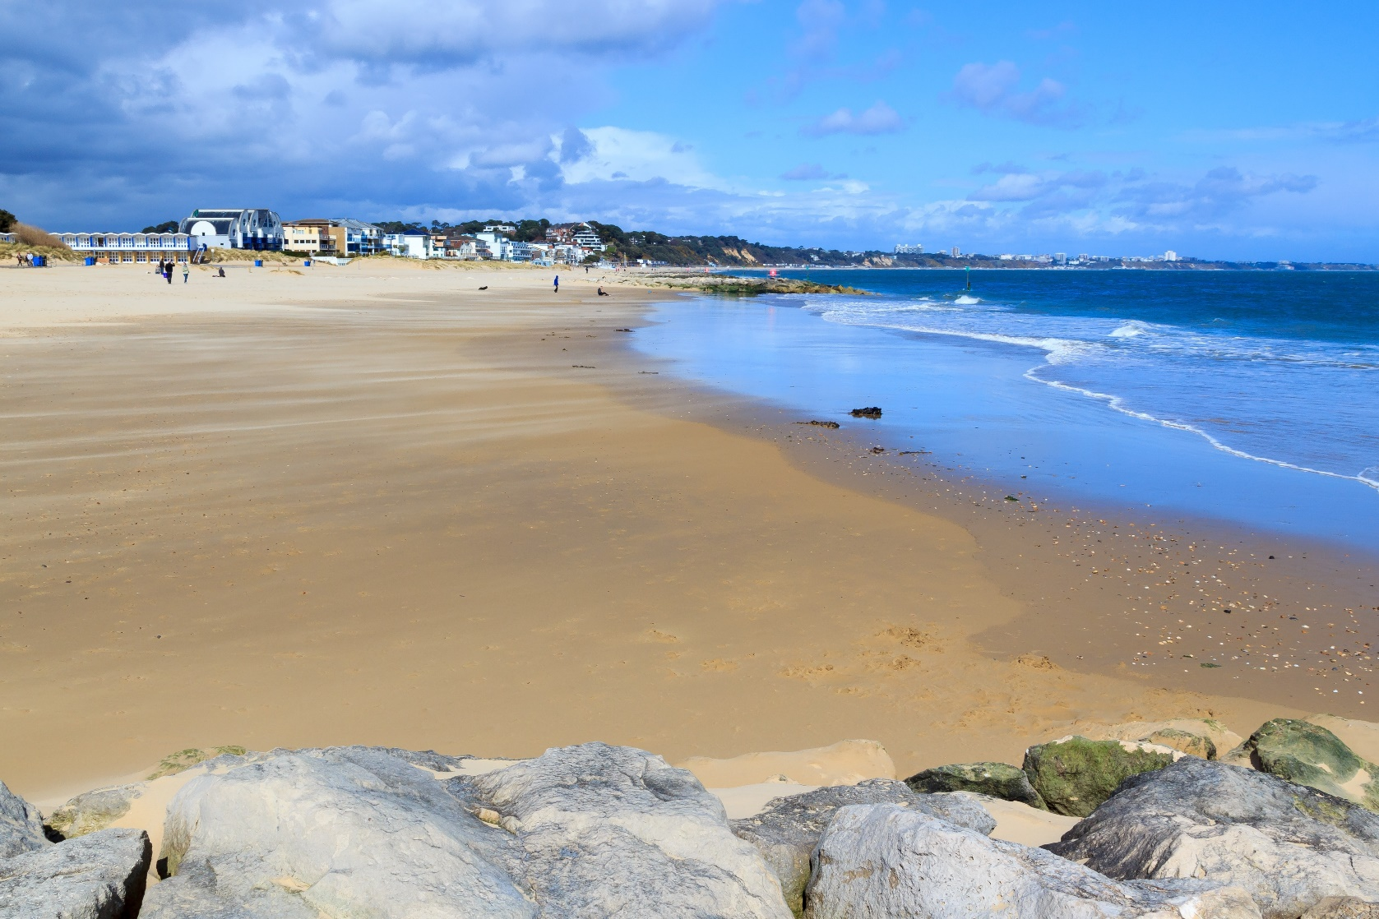
At the seaside
Think about a day out at the seaside.
Notes:
Engage the learners in a discussion about a day out at the seaside.
When might people decide to go to the beach? (when the weather is warm and sunny)
What things might they take with them?
What might they buy whilst they are there? (food, ice cream, coffee, suncream)

Slide 15
EXPLORE
Correlation and causation
temperature | 8 | 12 | 14 | 16 | 18 | 20 | 22 | 24 | 26 | 28 | 30 | 32 | 34 | 36 | 38
ice cream sales | 5 | 13 | 17 | 28 | 25 | 35 | 35 | 45 | 56 | 50 | 50 | 60 | 58 | 70 | 75
umbrella sales | 20 | 10 | 15 | 0 | 18 | 12 | 5 | 11 | 3 | 7 | 10 | 2 | 5 | 3 | 1
coffee sales | 58 | 60 | 52 | 53 | 44 | 49 | 48 | 50 | 43 | 41 | 46 | 38 | 35 | 36 | 33
jellyfish stings | 1 | 4 | 2 | 5 | 7 | 11 | 14 | 13 | 16 | 21 | 23 | 22 | 26 | 25 | 28
Notes:
Present the data in the table and ask learners (in pairs or small groups) to plot a scatter graph for two different sets of data, for example ice-cream sales and temperature. Each pair or small group produces a large scatter graph for two sets of data and presents what they think it shows to the class.
Identify those that have correlation and those that don’t.
Discuss the types of correlation and highlight those that have positive correlation.
Encourage the learners to describe the relationship between the two sets of data.

Slide 16
EXPLORE
Correlation and causation
Notes:
Discuss the relationship shown by this scatter graph.
It shows positive correlation between jellyfish stings and the sale of ice-creams.
Ask the question does this imply that one causes the other?
Why might ice-cream sales increase? – (warm day so more people buy them, more people, more people go to the seaside, etc.)
Why might jellyfish stings increase? – (warm day so more people buy them, more people, more people go to the seaside, etc.)
It just so happens that when it is warmer, more people eat ice cream, and more people go in the sea.
One does not cause the other.
In a similar way, discuss the other graphs and decide if one causes the other.

Slide 17
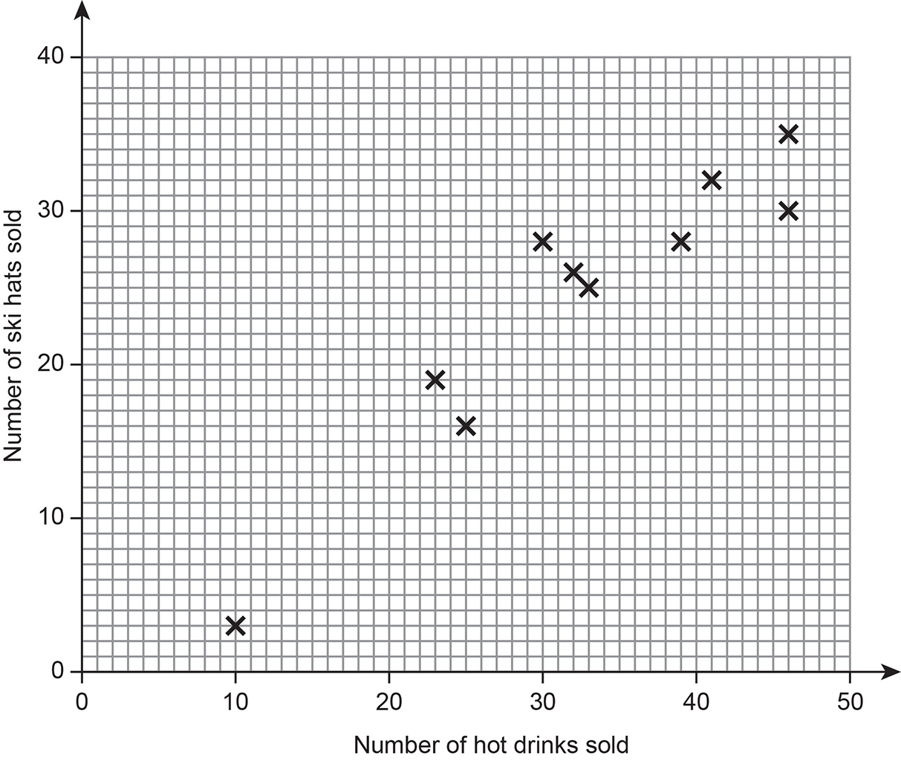
Practice question (1)
REVIEW
Worksheet
available
The Shorts Hut is a shop that sells sports clothing and has a customer café.
The manager plots some sales data in a scatter graph.
The graph shows the number of hot drinks sold and the number of ski hats sold each day for 10 days.
The manager says that this graph shows that an increase in the sale of hot drinks causes an increase in the sale of ski hats because the correlation is positive.
Explain why the manager is incorrect.
Notes:
Slides 17-19 contain GCSE exam questions for learners to work on independently, using the practice questions worksheet.

Slide 18
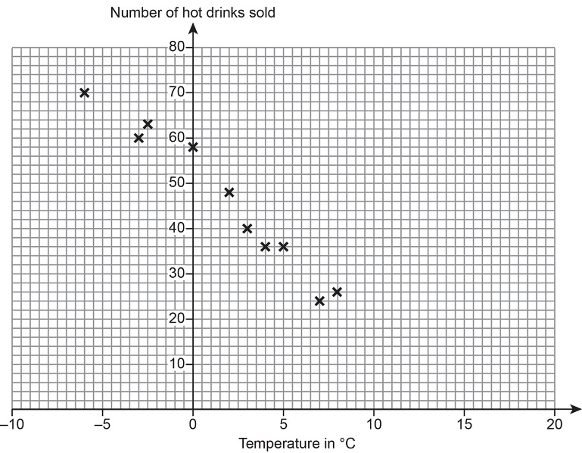
REVIEW
Practice question (2)
Worksheet
available
The manager plots another scatter graph showing the temperature, in °C at 9 a.m. and the number of hot drinks sold during the first hour on each of 10 days.
Draw a line of best fit on the scatter graph.
Estimate the number of hot drinks the café will sell when the temperature is 6°C.
Comment on how suitable the graph is for estimating the number of hot drinks sold when the temperature is more than 17°C.
  You must give a reason for your answer.
18

Slide 19
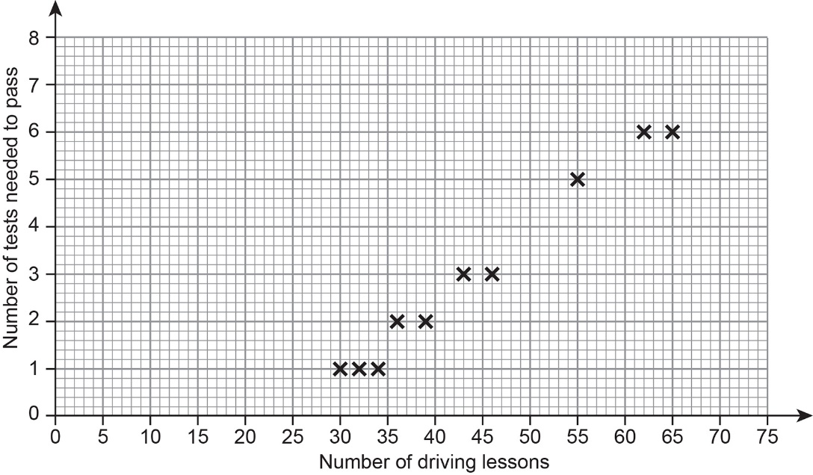
REVIEW
Practice question (3)
Worksheet
available
The Scatter graph shows the number of driving lessons and the number of tests needed to pass by 10 people.
What proportion of the 10 people passed on their first test?
Write down the types of correlation shown in the graph.
Use a line of best fit to estimate the number of tests needed to pass by a person who has 50 lessons.
Selma says:
“I can use the trend to predict the number of driving tests needed to pass for any number of driving lessons.”
Comment on their statement
19
19

Slide 20

Practice question (1) and (2) – Answers
REVIEW
The manager has confused correlation with causation
ii) In the range 28 to 33
  iii) Not suitable as gives a negative number of drink
Notes:
Use slide to discuss answers with learners.
Q1 The manager has confused correlation with causation
Q2
i) See line of best fit on the slide
ii) Answer in the range 28 to 33
iii) Not suitable as gives a negative number of drinks

Slide 21
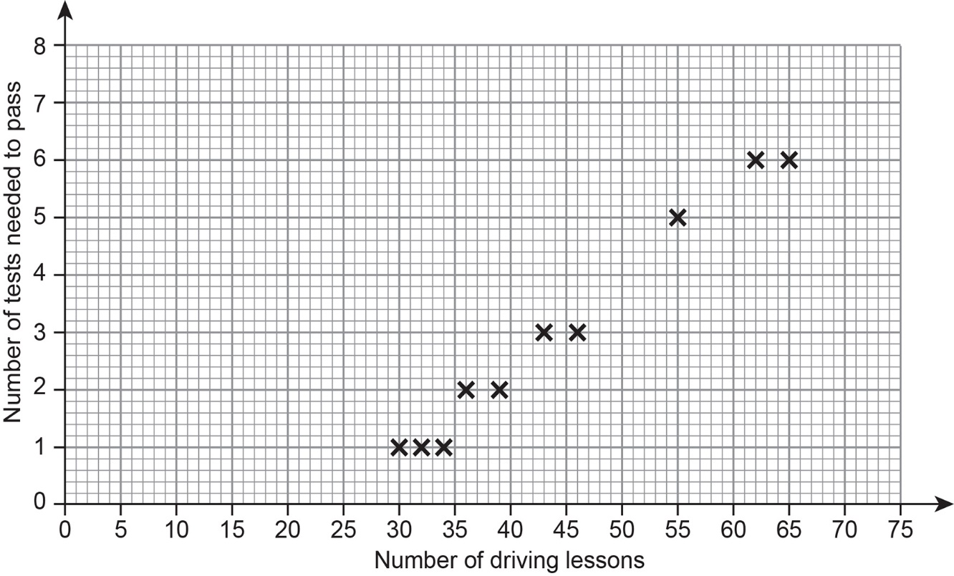
REVIEW
Practice question (2) - Answer
Worksheet
available
3/10 (or 30%)
Strong positive
4 lessons (can’t have 3.8!)
Selma says:
“I can use the trend to predict the number of driving tests needed to pass for any number of driving lessons.”
Not correct for those outside of the 30-65 lesson range. The graph suggests that for less than 28 lessons you would pass before you had taken the test once.
21
21
21
Notes:
Use slide to discuss answers with learners.
Q3:
3/10 (or 30%)
Strong positive
4 lessons
Not correct for those outside of the 30-65 lesson range. The graph suggests that for less than 28 lessons you would pass before you had taken the test once.

Slide 22
Lesson review:
Scatter Graphs
Objectives
Interpret scatter graphs
Draw and interpret line of best fit
Understand that correlation does not imply causation

Slide 23
Lesson 44:
Credits
Text acknowledgements
EDUQAS Education Ltd: EDUQAS examination paper 530001, June 2018, AQA Practice Paper Set 1 1F
Photo acknowledgements
Image for background: https://britishbeaches.uk/img/beach/515/515-566-o.jpg

