Slide 1


Lesson 27:
Directed Numbers
Objectives
To understand and use directed numbers in the context of temperature
To make valid generalisations about the effect of operations on directed numbers
Input equations with negative numbers effectively into a calculator

Slide 2
Horizontal and vertical number lines
DISCUSS
16
Vertical:
0
Horizontal:
−14
0
16
−14
Notes:
Display the horizontal and vertical number lines and ask where −14, 0 and 16 would go on each before revealing. Ask supplementary questions to check understanding, e.g.:
Where would 7 appear on each scale?
Where would -4 appear?
What about -18?
It’s important to introduce the idea of vertical number lines because these can aid learners in understanding that if a number is higher up (as opposed to rightward) then the value of the integer has a greater weighting than those below.
Encourage learners to draw their own number lines.
Misconceptions to look out for:
Confusion caused by the fact that the same symbol is used to denote the operation of subtraction (as in 5 − 3) and the fact that a particular number is negative (as in (−5) or ⁻5).
Thinking that ‘addition always makes the number bigger’ and ‘subtraction always makes the number smaller’.

Slide 3

Temperatures
DISCUSS
The temperature was taken in 4 different cities on the same day in January:
      Amsterdam: 1°C
      Brisbane: 29°C
      Calgary: −14°C
      Dubai: 16°C
Draw a vertical number line on your mini-whiteboards, with 0 in the middle.
Mark where each city would appear on the number line according to its temperature.
Notes:
Ask learners to use mini-whiteboards (or a sheet of paper) to draw a vertical number line and mark the cities on.
Check and address any errors or misconceptions.

Slide 4

Temperatures
DISCUSS
On the same day, it was −3° in Edinburgh.
Where would Edinburgh appear on the number lines?
How do you know?
Notes:
Once learners have sorted out the first four in order, introduce:
Edinburgh: −3°
Ask the learners: ‘Where does this value go? How do we know?’
Examples of questioning:
Would Edinburgh be placed closer to ‘0’ than Amsterdam? (This is referring to the relationship between the numbers and ‘0’).
If I went from Edinburgh to Dubai, would it be hotter or colder? How do you know?
The concept of crossing the zero is important in these questions so that learners can see the numbers in relation to where they lie on either side of the zero.
I start at Amsterdam and travel somewhere 15° colder; where am I?
Misconceptions:
Confusion is caused by the fact that the same symbol is used to denote the operation of subtraction (as in 5 − 3) and the fact that a particular number is negative (as in (−5) or ⁻5).

Slide 5

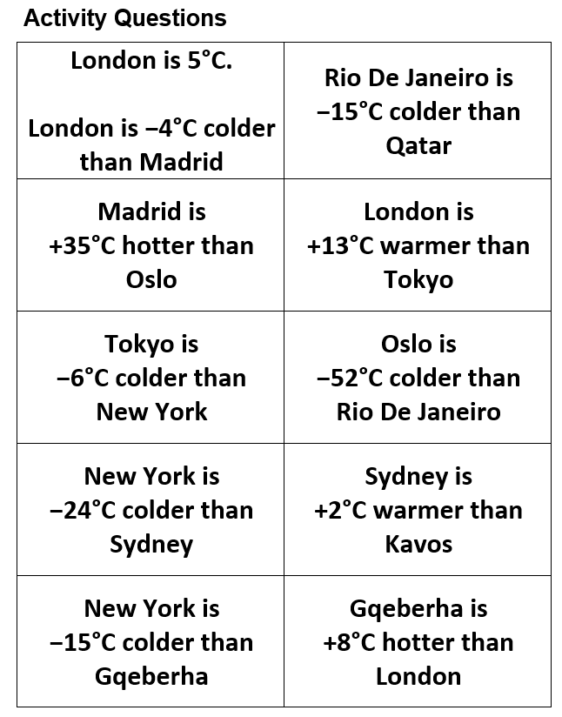
Activity 1: Identifying number movement
YOUR
TURN
Worksheet
available
Your task is to fill in your sheet with the correct city name and temperature using the clues provided.
You have been given only one piece of information: that London is 5°C.
Notes:
Use the activity questions to identify the 10 different cities and their temperatures using the information provided. The sheet begins by identifying that London is 5°C and then the learner must use the information they have to work out all entries.
Ensure that learners' notation of negative values is correct.
Learners can continue to use the number line should they need the scaffolding.

Slide 6
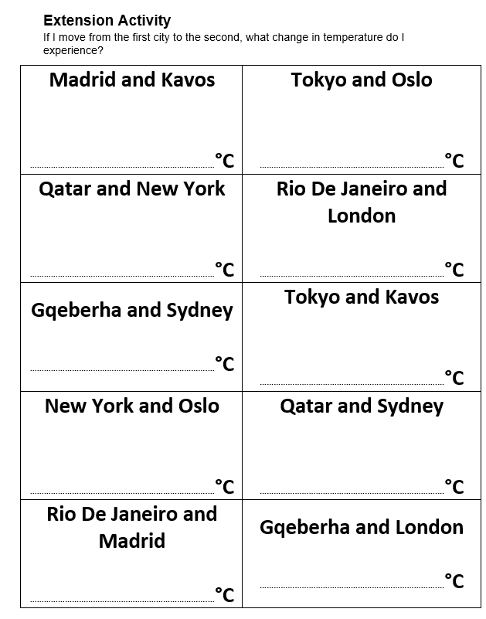
Activity 1: What’s the difference?
YOUR
TURN
Now that you have worked out the temperature for each city:
Calculate the differences in temperature between the cities on the extension sheet
Make sure you show whether the difference is positive (hotter) or negative (colder)
Notes:
The extension activity reverses the main activity in that the learners must identify what the range in temperature is and whether it is positive or negative.

Slide 7
Activity 2: Patterns and double-sided counters
EXPLORE
3
+ 3
+
= 6
Notes:
For the next activity, introduce learners to the manipulative double-sided counters and clarify that the yellow side represents +1 (or positive 1) and the red side represents −1 (or negative 1).
Ensure that the correct language is used (i.e. positive and negative rather than plus and minus). Be sure to get learners to carry over the symbols in front of the number (if there is no symbol depicting a negative, then the number is positive).
Model the use of the counters across a range of simple calculations (slides 7–17). As you do so, ask learners to replicate what you are showing them using the counters they have on their table.
Start by demonstrating the simple addition of 3 + 3 using the animation.
(NB. If double-sided counters are not available, an online version is available here: https://mathsbot.com/manipulatives/twoColourCounters)

Slide 8
Activity 2: Patterns and double-sided counters
EXPLORE
3
+ (−3)
+
Notes:
Now introduce negative integers using the red counters.
Highlight here that you are adding negative 3 to positive 3. Remind learners to replicate the slides with their double-sided counters.

Slide 9
Activity 2: Patterns and double-sided counters
EXPLORE
3 + (−3)
= 0
Notes:
Line the counters up underneath each other, and use the animation to demonstrate the concept of ‘zero pairs’, where yellow and red counters cancel each other out.

Slide 10
Activity 2: Patterns and double-sided counters
EXPLORE
3
+ (−2)
+
Notes:
Repeat the process with another calculation. Encourage learners to predict what will happen with each click of the animation.

Slide 11
Activity 2: Patterns and double-sided counters
EXPLORE
3 + (−2)
= 1
Notes:
Highlight here that there are only two red counters, so only two ‘zero pairs’ can be formed, with one yellow counter left. Therefore, the answer is positive 1.

Slide 12
Activity 2: Patterns and double-sided counters
EXPLORE
2
+ (−3)
+

Slide 13
Patterns and double-sided counters
EXPLORE
2 + (−3)
= −1

Slide 14
Double-sided counters
EXPLORE
3
− (−1)
−
Notes:
A new issue arises with the subtraction of a negative integer, which can be conceptually difficult for learners to grasp.
Point out that you cannot subtract a red counter from yellow counters.

Slide 15
Activity 2: Patterns and double-sided counters
EXPLORE
3 − (−1)
−
= 4
Notes:
To overcome this conceptual obstacle, point out that just as the learner can remove a ‘zero pair’ of counters, a zero pair can also be added.
It now becomes possible to subtract the red counter on the right, leaving positive 4 (or simply 4).

Slide 16
Activity 2: Patterns and double-sided counters
EXPLORE
3
− (−2)
−
Notes:
Provide one further example of subtracting a negative integer.

Slide 17
Activity 2: Patterns and double-sided counters
EXPLORE
3 − (−2)
−
= 5
Notes:
In this case, two zero pairs need to be added on.

Slide 18
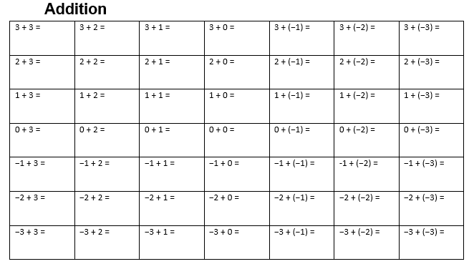
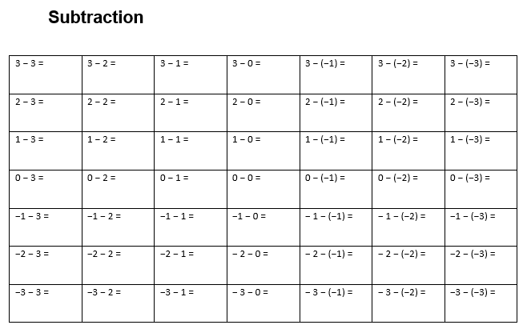
Activity 2: Patterns and double-sided counters
YOUR
TURN
Handout
available
Your next task is to identify patterns and to view how numbers move either side of the ‘0’ mark.
This activity allows you to use double-sided counters and ‘zero pairs’.
Once complete, discuss the patterns you can identify in these activities.
Notes:
This task is to allow learners to practise using double-sided counters and ‘zero pairs’.
Low numbers are purposely used to identify movement on either side of ‘0’. The idea is that learners will be able to see the numbers moving on a smaller scale and relate the movement to larger proportions.
The extension handout (multiplication and division) provides extension work for those who demonstrate clear understanding of addition and subtraction of directed numbers.

Slide 19
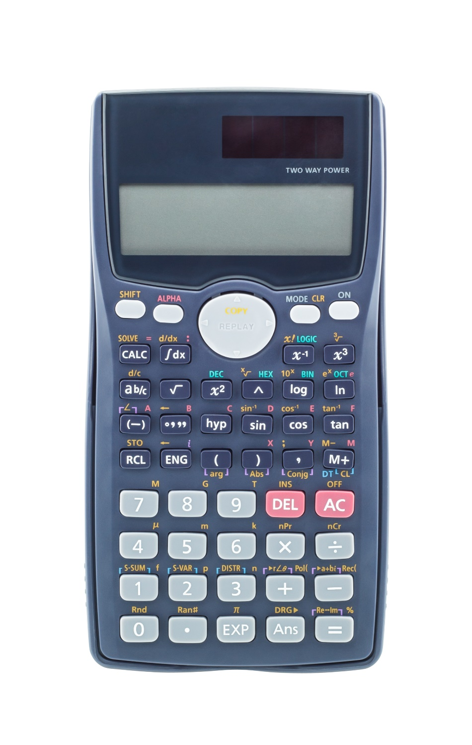

Calculator Skills
DISCUSS
KEY IDEA
It’s important to understand the functions of a calculator and how to use it efficiently.
This will help you when it comes to your calculator paper.
These are the main buttons used when inputting negative numbers.
Notes:
As a group, discuss how to input negative numbers and sums involving negative numbers into a calculator.
Ask learners to identify the highlighted keys on their own calculator.
Give them some calculations involving negative numbers to do.
Sums are left to the tutor's discretion, but it would be beneficial to use sums that the learners worked with in the previous activity.
This can be a calculator check activity to see if the learners have the correct answers, if not already discussed.
This is a very important lesson as it shows learners how to effectively use a calculator, a lesson that many learners have either not received or have covered only briefly.

Slide 20
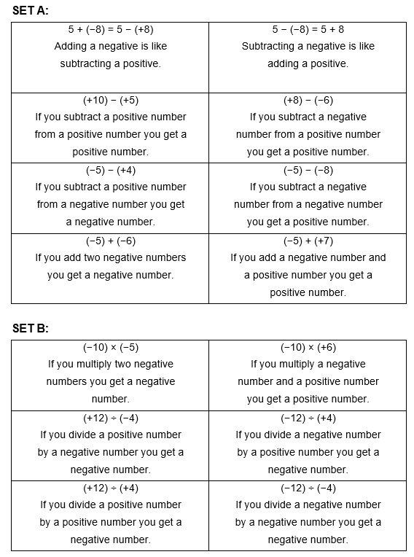
Activity 3: Always/Sometimes/Never
YOUR
TURN
Handout
available
Your next task is to sort out the cards you have been given into ‘Always’, ‘Sometimes’, and ‘Never’.
This will test your understanding of the rules around directed numbers.
Notes:
‘Always, Sometimes, Never’ activities are great for learners to logically think and use trial sums to understand misconceptions.
This activity is designed to detect learners’ misconceptions about negative numbers as they encounter them. Use this time to encourage discussion around the rules of directed numbers.
Start with set A (addition & subtraction). Set B can be used as an extension, if required.
Ask learners to work in pairs or threes and provide each group with a set of the cards.
Ask them to discuss the statement on each card and decide whether the statement is always true, sometimes true, or never true. Ask them to sort the cards into three groups on this basis.
If they think a statement is sometimes true, ask them to provide an example of when it is true, and an example of when it isn’t true.
After most learners have finished sorting the cards, ask the groups to explain which statements they sorted into each group. Where there is disagreement, ask learners to justify their responses.
Ensure that any misconceptions are highlighted and addressed through discussion.

Slide 21
Knowledge Check
REVIEW
is a negative number.
Which statement is correct?
Tick one box.
is always positive
is always negative
cannot be zero
could be positive or negative or zero
Notes:
Tutor to direct discussion to explore different values for ‘x’ to uncover misconceptions that learners have. This will be addressed during the next activity.
Misconceptions:
Confusion caused by the fact that the same symbol is used to denote the operation of subtraction (as in 5 − 3) and the fact that a particular number is negative (as in (−5) or ⁻5).
Thinking that ‘addition always makes the number bigger’ and ‘subtraction always makes the number smaller’.
Slide 22 will show this question with some worked examples.

Slide 22
Knowledge Check
REVIEW
is a negative number.
Which statement is correct?
Tick one box.
✗
is always positive
−11 + 10 = −1
✗
is always negative
−1 + 10 = 9
✗
cannot be zero
−10 + 10 = 0
✓
could be positive or negative or zero
Notes:
Tutor to direct discussion to explore different values for ‘x’ to uncover misconceptions that learners have. This will be addressed during the next activity.
Misconceptions:
Confusion caused by the fact that the same symbol is used to denote the operation of subtraction (as in 5 − 3) and the fact that a particular number is negative (as in (−5) or ⁻5).
Thinking that ‘addition always makes the number bigger’ and ‘subtraction always makes the number smaller’.

Slide 23
Exam Question Practice
REVIEW
Handout
available
1 Work out:
(a) −1 + 6
(b) 7 – −3
2 Circle the number that is 7 less than −12
−19 −5 5 19

Slide 24
Exam Question Practice
REVIEW
Handout
available
3 Complete the statement below using a number from this list.
−2 0 −6 6
−5 > ………………………………………….
4 Write the following numbers in order of size, smallest first.
0.4 0.5 0.06 0.444 0.46
………………… ………………… ………………… ………………… …………………
smallest

Slide 25
Exam Question Practice
REVIEW
Handout
available
5 Work out −2 − 5
Circle your answer.
−7 −3 3 7
6 Circle the number greater than −0.9
−0.901 −0.89 −0.91 −$\frac{9}{10}$

Slide 26
Exam Questions Answers
REVIEW
Slide 23
1a) 5
1b) 10
2) −19
Slide 24
3) −6
4) 0.06, 0.4, 0.444, 0.46, 0.5
Slide 25
5) −7
6) −0.89

Slide 27
Lesson review:
Directed Numbers
Objectives
To understand and use directed numbers in the context of temperature
To make valid generalisations about the effect of operations on direct numbers
How to input equations with negative numbers effectively into a calculator
Suggested further steps/areas to work on
Algebra

Slide 28
Lesson 27:
Credits
Text acknowledgements
AQA: GCSE Maths 8300/3F November 2019, Question 16 (Slide 21,22), GCSE Maths Paper 1F (Non-Calculator) November 2017, Question 4 (Slide 23 bottom), GCSE Maths Paper 1F (Non-Calculator) November 2018, Question 1 (Slide 25 top), GCSE Maths Paper 2F (Non-Calculator) November 2018, Question 2 (Slide 25 bottom)
OCR: GCSE (9-1) Mathematics J560/02 Paper 2 (Foundation) November 2020, Question 1 (Slide 23 top), GCSE (9-1) Mathematics J560/02 Paper 3 (Foundation) June 2018, Question 2b and 2c (Slide 24)
Photo acknowledgements
Shutterstock.com: Nong4, jan kranendonk, Natrot

