Slide 1


Lesson 2:
Mindsets, resilience and number sense
Objectives
Categorise attitudes into fixed or growth mindsets
Recognise that progress is maximised when in the growth zone
Use ratio tables to answer proportion questions
Understand the characteristics of mathematical resilience

Slide 2

What did we cover in lesson 1?
Recall
KEY IDEA
Strategies to overcome anxiety
Strategies for getting unstuck
It’s good to make mistakes
Number sense

Slide 3

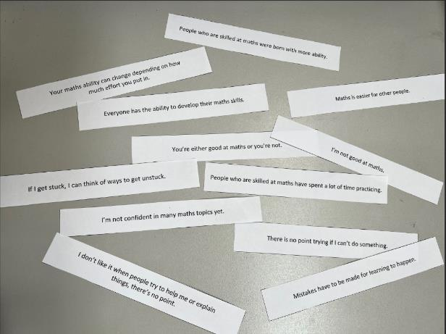
What mode is your brain in?
Activity
Handout
available
You have a set of statements in front
of you:
Mark each one with a T or an F, depending on which one is true or false for you.
Notes:
This activity is to determine what mindset the learner is in.
Equipment required – Handout 1 (Mindset statements).
Preparation – Cut up statement strips – one set for each learner.
Give out the statements to each learner.
Ask the learners to mark a T for true or an F for false on each statement. It is important that this is how they feel, what they think. It is personal.
This should take approximately 5 minutes.

Slide 4
What are the characteristics of a learner with a positive mindset?
Activity
Can you think of a scenario when you had a positive mindset?
Notes:
This is labelled as a positive mindset to encourage learners to think about previous success in their lives.
Task for learner – Think of a situation in which you were determined to win/achieve.
Explain to the person next to you what characteristics you had. Why were you successful?

Slide 5
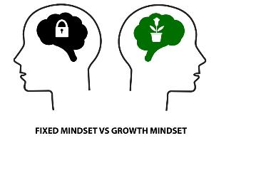
What mode is your brain in?
Review
Fixed Mindset
Growth Mindset
    Effort is pointless: Either you can do something, or you can’t
    Give up easily
    Don’t risk failing
    Stick to what you know
    It’s all about the end result & looking smart
    Effort is essential for learning, developing skills and achieving goals
    Persevere & try again
    Try to learn from errors
    Take on a challenge
    Learning from mistakes will improve the end result
Fear of failure,
self-imposed limits
Discover, experiment,
learn and grow
Notes:
This slide outlines the characteristics of fixed mindset and growth mindset.
Now you start to apply this to maths.

Slide 6
Mindset
Handout
available
Fixed
Growth
Notes:
Give each learner a copy of Handout 2.

Slide 7
Arrange your statements into the columns...
REVIEW
Mindset
Fixed
Growth
I’m not good at maths.
There is no point trying if I can’t do something.
Maths is easier for other people.
You’re either good at math or you’re not.
If there is something I can’t do there is no point in my trying.
I don’t like it when people try to help me or explain things; there’s no point.
People who are skilled at maths were born with more ability.
I’m not confident in many maths topics yet.
I have a go even if something seems challenging.
Everyone has the ability to develop their maths skills.
People who are skilled at maths have spent a lot of time practicing.
Mistakes have to be made for learning to happen.
Your maths ability can change depending on how much effort you put in.
If I get stuck, I can think of ways to get unstuck.
Notes:
Ask learners to place the statements under the correct headings.
If the learner has more Ts under fixed mindset, they have a predominantly fixed mindset in maths
If the learner has more Ts under growth mindset, they have a predominantly growth mindset in maths.
The learners can have a mixture of both. The learner may have a growth or fixed mindset in other aspects of their life and this activity is to make the learners more aware.

Slide 8
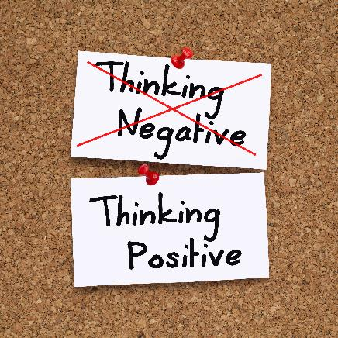

Mindset
Fixed
Growth
What mindset were you mostly in?
Notes:
Sometimes when learners are stuck, they get into a fixed mindset.
Encourage them to use the strategies from lesson 1 (anxiety and unstuck) to change the way they think.
It is important for learners to have a positive/growth mindset when learning.
It is important that learners believe in success.

Slide 9

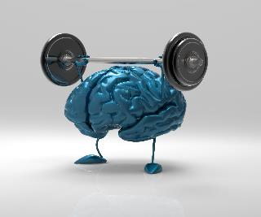

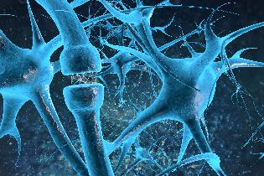
Anyone can learn maths!
Watch the video called
‘Everyone can do Maths’
by Jo Boaler
Notes:
Search for and show the online video: ‘IM2 MATH Everyone can do math Jo Boaler’. Watch from 0.35 to 4 mins.
The video is to explain that anyone can learn maths. What makes the difference is your belief in success and your attitude towards maths.
The more you practise the better you become.
The brain is a muscle that needs stimulation/exercise.
Synapses fire to create new neural pathways.

Slide 10
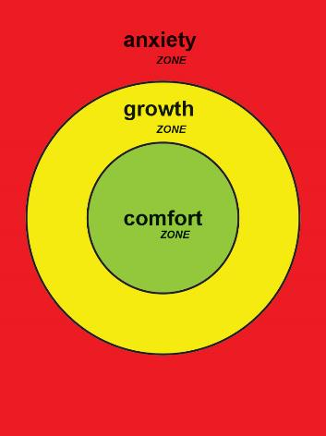
Growth Zone
Handout
available
Notes:
Introduce the image of the growth zone model.
Learners work in groups of 3 or 4
Give each group Handout 3 (the growth zone model printed on A3)

Slide 11

Growth Zone
YOUR
TURN
Your mission is to place the statements in the most
appropriate zone!
Notes:
Handout 4 (statements) and Handout 5 (exam questions) should be cut and laminated.
Learners should work in groups of 3 or 4. They are to put the statements in the zone that they feel appropriate. They are to do the same with the exam questions by thinking about how each exam question makes them feel. Through studying the growth zone model the learners will learn that to maximise learning they need to be in their growth zone.
This activity is to determine whether learners can identify which statements are most suited to a particular zone. Some statements might seem suitable in two zones. This prompts good discussion.
Ask learners to discuss where the statements should be placed.

Slide 12
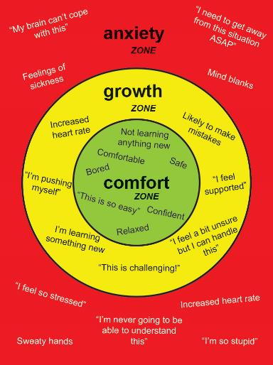
Example
REVIEW
Notes:
This is the exemplar of where the statements should be placed.
Important discussion
Discussion points – these may have arisen naturally as you circulated during the sorting activity. If they did not, you may want to discuss these after showing the ‘answer’ on this slide:
Everyone is different and may respond in unique ways. There are some very common feelings and emotions associated with each zone. The important thing is for a learner to be able to recognise where they are in each zone.
Do learners expect to be in their comfort zone the whole time they are in maths class? Is that desirable?
How do learners move themselves out of their comfort zone? How do they recover if they have been pushed into their anxiety zone?
How can we communicate about this in class in ways that are respectful and productive?
How can they use strategies from lesson 1 to support themselves.

Slide 13
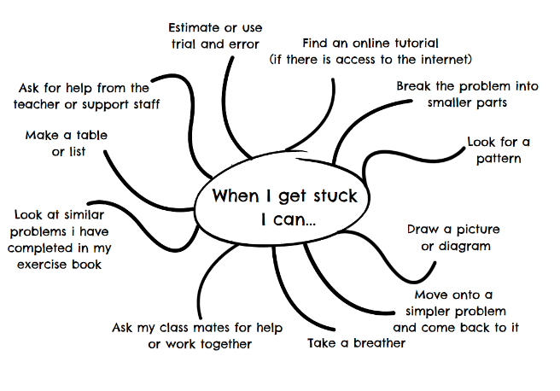
Anxiety and unstuck posters
Anxiety
Share your worries/stresses with someone you trust
Breathing techniques e.g. box breathing
Start with questions you feel comfortable with
Remember, a little bit of stress helps you to concentrate and learn new things!
Understanding over memorisation.
Know what to do when you get stuck.
Notes:
This slide is hidden – this is a prompt for tutors:
It is important learners understand how to move out of the red zone into the amber zone, by implementing strategies to cope with anxiety or being stuck.

Slide 14
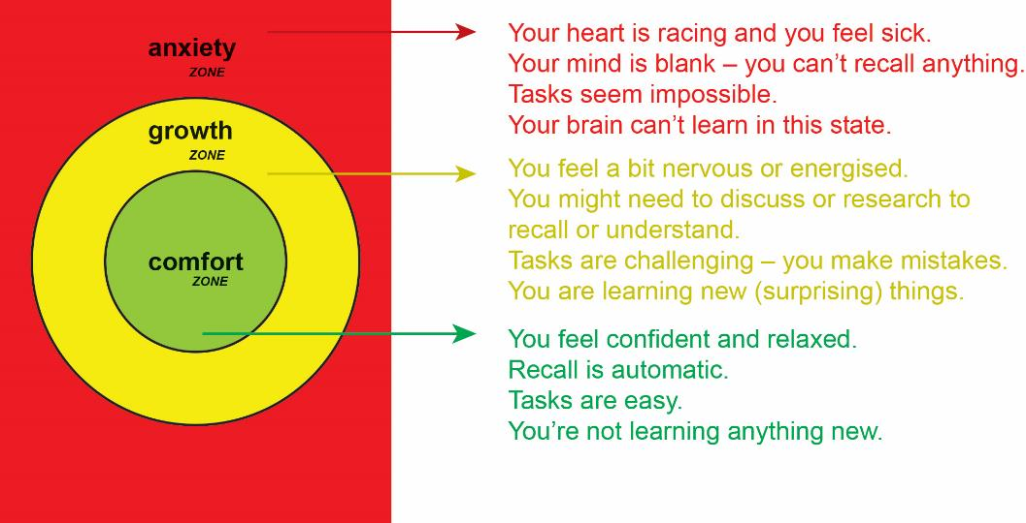
Growth Zone
insert image RP_PRJ1403_W2_aw_L2_ 006
Notes:
This is the definition of each zone on the Growth Zone Model.
This explains how the learners can optimise their learning, through self awareness.
Important – learners need to be able to move into the growth zone to get the maximum benefit from learning to happen.

Slide 15

What happens to your brain when you’re stressed?
REVIEW
Fight
or
Flight
Notes:
The body and brain have a primitive response: fight or flight.

Slide 16
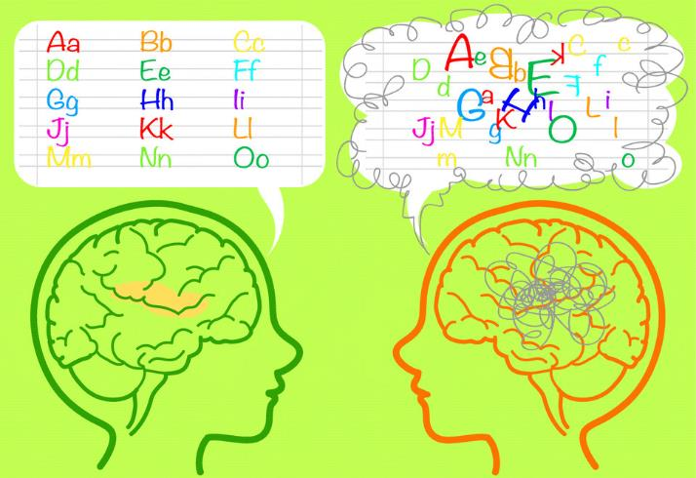
What happens to your brain when you’re stressed?
Your mind goes blank or gets jumbled under stress.
This is because of hormones that flood your body and the brain.
These hormones invade the brain’s pre-frontal cortex and the hippocampus, causing chaos.
This affects your factual retrieval and recall.
< insert image RP_PRJ1403_W2_aw_L2_008>
Notes:
Your mind goes blank under stress, because of hormones. Cortisol and adrenaline flood your body.
These hormones invade the brain’s pre-frontal cortex and the hippocampus, disrupting neuronal activity and your normal brain patterns.
As a result, your factual retrieval and recall methods are disrupted.
Info taken from - https://alumni.lincolncollege.ac.uk/news/mind-goes-blank/#:~:text=The%20feeling%20of%20your%20mind,%E2%80%9D%2C%20explain%20olwcation.com.

Slide 17



Why proportion?
Proportion is present in 30% of the foundation tier.
However it accounts for well above 50% when you look at other GCSE topic areas where it is present.
Notes:
Ratio tables are introduced in the first few weeks of the CfEM SoL. The idea is to introduce ratio tables as a strategy to help learners calculate proportion.
Action research completed in CfEM has demonstrated that learners have successfully applied these tables in the classroom, and this has supporting improvements.
During the ratio table activities, remind the learners of the strategies they have developed when they feel anxious or stuck (as applicable).
Also ask them where they are on the growth zone model, so they can see their starting points.

Slide 18
Number sense – ratio table
Activity
Simplify 480 : 80 into its lowest terms.
480 | 240 | 120 | 60 | 6
80 | 40 | 20 | 10 | 1
Notes:
This slide is tutor led with contributions from the class.
This ratio table will be demonstrated on the board with the tutor asking the learners for input. For example:
How could this be simplified?
Could you divide it in half?
What could you divide this by?

Slide 19
Number sense – ratio table
YOUR
TURN
Simplify 630 : 70 into its lowest terms.
630
70
Notes:
Learners have a go!
How could this be simplified?
Could you divide it in half?
What could you divide this by?

Slide 20
Number sense – ratio table
Activity
13 × 16.
1 | 2 | 4 | 10
16 | 32 | 64 | 160
1 × 16 = 16
2 × 16 = 32
10 × 16 = 160
Add together = 208
Notes:
This slide is tutor led with contributions from the class
This ratio table will be demonstrated on the board with the tutor asking the learners for input. For example:
How could this be simplified?
Could you divide it in half?
What could you divide this by?

Slide 21
Number sense – ratio table
YOUR
TURN
14 × 21
14
21
Notes:
Learners have a go!
How could this be simplified?
Could you divide it in half?
What could you divide this by?

Slide 22
Number sense – ratio table
YOUR
TURN
1 pack of 6 chocolate bars cost £1.20, so how much would 25 cost?
6 bars | 12 bars | 24 bars | 3 bars | 1 bar
£1.20 | £2.40 | £4.80 | 60p | 20p
24 bars = £4.80
1 bar = £0.20
25 bars = £5.00
Notes:
This slide is tutor led with contributions from the class.
Then let the learners try Handout 6
(3 proportion questions)

Slide 23
Time to apply the ratio table.
YOUR
TURN
Handout
available
1. 6 cans of pop cost £3.60. How much would 20 cans cost?
2. Abdul sells 26 chocolate bars at 50p each. How much money does Abdul make?
3. Sally put 10 litres of petrol in her car at a cost of £16.70. The tank size is 43 litres. How much will it cost to buy 43 litres of petrol?
Notes:
This slide is tutor led with contributions from the class.
Then let the learners try Handout 6.
(3 proportion questions)

Slide 24
How did it go?
Review
1. 6 cans of pop cost £3.60. How much would 20 cans cost?
£3.60 | £7.20 | £14.40 | £10.80 | £1.80 | £60p | £11.40 | £12.00
6 | 12 | 24 | 18 | 3 | 1 | 19 | 20
2. Abdul sells 26 chocolate bars at 50p each. How much money does Abdul make?
1 | 2 | 4 | 6 | 20 | 26
50p | £1.00 | £2.00 | £3.00 | £10.00 | £13.00
3. Sally put 10 litres of petrol in her car at a cost of £16.70. The tank size is 43 litres. How much will it cost to buy 43 litres of petrol?
10 | 20 | 40 | 1 | 2 | 3 | 43
£16.70 | £33.40 | £66.80 | £1.67 | £3.34 | £5.01 | £71.81
Notes:
Ask learners to share their answers and methods. Did they do it differently?

Slide 25

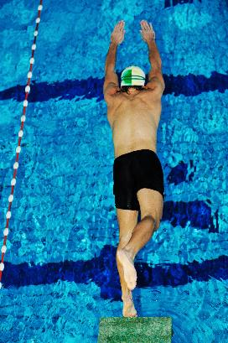
Resilience
Adam Peaty scared of water?
The world breaststroke champion and world record holder, as a small child, would try to climb out of the bath, his fear of the water was so great.
But it all turned round when he went to his first swimming lesson.
"I started my first swimming lesson and absolutely loved it," he says. "My swimming teacher made it into a fun kind of thing and it was through that I learned to love it.”
Notes:
Mathematically resilient learners need to understand the need to STRUGGLE (link to growth mindset), understand that MAKING MISTAKES is part of the learning process

Slide 26
What are the characteristics of a resilient learner?
Activity
Can you identify what it means to be resilient?
Notes:
Do you need a positive/growth mindset?
Being resilient is to be persistent, face challenges, make mistakes, but still keep trying.
Develop problem-solving skills, be self aware – recognise which part of the growth zone you are in and how you move.
Practise and keep trying.

Slide 27





Motivation and resilience
REVIEW
Notes:
Attitude is everything – a positive mindset, belief in success.
Big journeys begin with small steps –achieving your targets is a series of activities.
Do not give up – show persistence, keep going.
Overcome challenges – do not give up, keep trying.
Impossible/possible – the impossible can become possible.

Slide 28

Poster
YOUR
TURN
What strategies will you use to help you succeed?
Share your one takeaway from the first two lessons.
Notes:
Ask learners to produce a poster including all the strategies that have been covered from lesson 1 and lesson 2.
Being stuck, anxiety, mistakes, growth and fixed mindset, growth zone, resilience.
The learners may choose to focus on the key strategies that might help them to move forward.
Ask learners to identify one key ‘takeaway’ from lesson 1 and 2 and share it at their table or with the class.

Slide 29
What have we talked about today?
REVIEW
KEY IDEA
Fixed and growth mindset
The growth zone
Ratio tables
Resilience
Notes:
What has been covered? Link back to lesson 1.
Refer to this as a tool kit that they will need to refer back to throughout the year to support themselves.
It is important that tutors make reference to the content throughout their teaching, as appropriate.

Slide 30
Lesson review:
Mindsets, resilience and number sense
Objectives
Categorise attitudes into fixed or growth mindsets
Recognise that progress is maximised when in the growth zone
Use ratio tables to answer proportion questions
State the characteristics of mathematical resilience

Slide 31

Lesson 2:
Credits
Text acknowledgements
Pearson Edexcel Level 1/Level 2 GCSE (9−1) Mathematics Paper 2 (Non−Calculator) Foundation Tier November 2020, 1MA1/1F, Pearson Edexcel Level 1 GCSE (9-1) In Mathematics Paper 1 (Non-Calculator) Foundation Tier June 2010 1MA1/1F
Photo acknowledgements
123RF.com: alsimonov, ivelinradkov, leungchopan, M R Fakhrurrozi; Shutterstock.com: Aysezgicmeli, Busyok Creative, Carla Francesca Castagno, Constantin Stanciu, dotshock, iQoncept, Julien Tromeur, Maksim M, marekuliasz, Peyker, Sangoiri, Pixel 4 Images, vitstudio; Lee, Clare and Johnston-Wilder, Sue (2018): Getting into and staying in the Growth Zone. NRICH.

