Slide 1


Lesson 29:
Substitution and formulae Level 2
Objectives
Revise order of operations
Use formulae in words and symbols
Substitute positive and negative numbers in formulae
Notes:
You may choose not to share the lesson objectives at the beginning of the lesson so as not to disengage learners who may resist engagement with algebra.

Slide 2
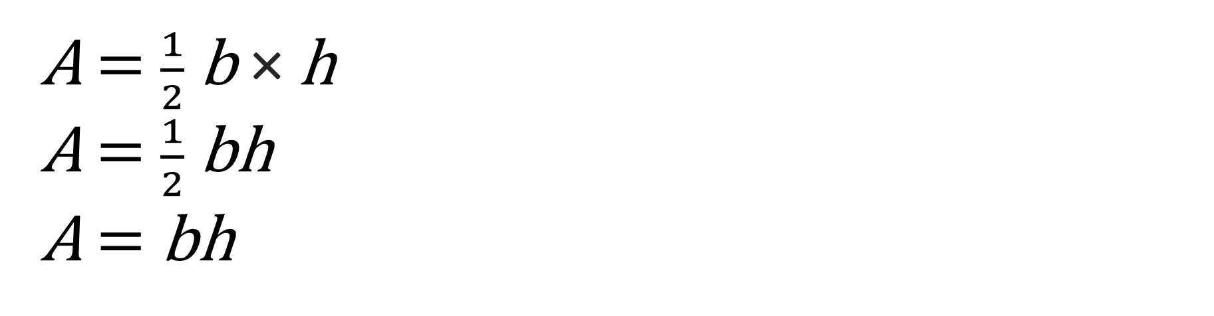
What’s the same? What’s different?
DISCUSS
A = $\frac{1}{2}$b × h
A = $\frac{1}{2}$bh
A = bh
Any letter can be a variable, not just x.
Notes:
Depending on class size, this can be a grouped, paired or individual activity.
Allow time for discussions to take place between learners before capturing feedback.
Ensure captured feedback is recorded to demonstrate existing knowledge.
Ensure key language is introduced if learners are not already using key language.
The purpose of this slide and the following two is to understand the level of prior knowledge that students are bringing to this topic. Slides 2-5 also support the tutor to address misconceptions and address key algebra vocabulary if students are not forthcoming.
The questions can serve as a prompt and help learners to see patterns, relationships/connections and help to build learning. This aids the formation of a strong conceptual network.
Ask learners what’s the same and what’s different and allow time for them to consider.
Highlight that though x is often used as a variable other letters can be used. This addresses the misconception that students can have about x always being the variable.
Remind students that bh is the same as b × h as part of order of operations. This is a key misconception that students often confuse and add bh together instead of multiplying.
Highlight that letters together with no symbol represents multiplication. This also addresses a common misconception that nothing is done with letters with no symbol between them.
What are these formulae? Ask the class. Area of a triangle. Area of a rectangle or parallelogram.

Slide 3
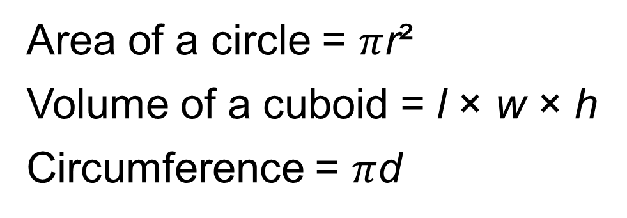
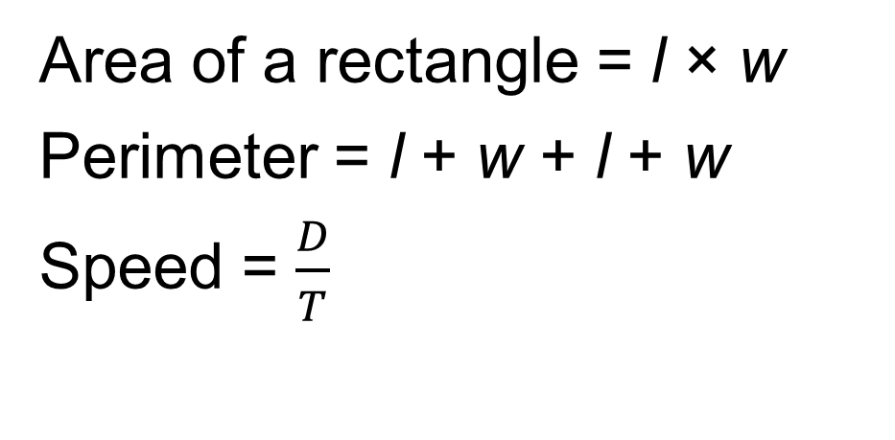
What other formula can you think of?
Area of a rectangle = l × w
Perimeter = l + w + l + w
Speed = $\frac{D}{T}$
Area of a circle = $π$r²
Volume of a cuboid = l × w × h
Circumference = $π$d
Remember that a formula in a question is there
to help you answer it.
Notes:
Allow time for learners to consider.
This slide is to get learners to think about any formulae they know.
Why do we have formulae? Explain that formulae help us to work things out, for example, temperature, dosage of medicine according to weight, BMI, speed, etc.
This information can be recorded onto a board or discussed as a class. This will also demonstrate prior knowledge and could be referred to later when working through the area, speed and temperature-based examples.
Highlight that if there is a formula given in a question there is a reason for it. The formula is there for support. Common formulae such as area and volume will need to be memorised.

Slide 4


What’s the same? What’s different? (1)
(3a)² and 3a²
Dev thinks the expressions are both the same.
Ruby thinks that they are different.
Who do you think is correct?
Notes:
Dev and Ruby are recurring characters throughout this lesson.
Use the scenario to judge learner’s knowledge.
Some learners might recognise the brackets but not know what they mean. Allow time for discussion and consideration if necessary.
The discussion could see learners explain what the brackets mean (use of BIDMAS – developed later).
Confirm that Ruby is correct and that the expressions are different.

Slide 5
What’s the same? What’s different? (2)
2a + 3 and 2(a + 3)
Are these the same or different?
Notes:
Dev and Ruby are recurring characters throughout this lesson.
Use the scenario to judge learner knowledge.
This slide compounds the knowledge from the previous example. Again, the aim is for learners to recognise that there is a difference between the two due to the brackets, following BIDMAS rules.
Some learners might still not know what brackets actually mean though this will be dealt with in the following slides. At this point, the key understanding is that there is a difference and that the brackets play a role in the order of operations.

Slide 6
What if a = 2?
DISCUSS
Discuss
(3a)² and 3a²
(3a)²
= (3 × 2)²
= 6²
= 36
3a²
= 3 × 2²
= 3 × 4
= 12
Substitution replaces the letter with a number.
In this case a is replaced by 2.
Notes:
This slide refers back to Slide 4 and will use substitution to calculate an answer.
Tutor to explain that substitution is just replacing the letters with the given number.
In this case, a is to be substituted by the number 2.
Complete the worked examples. Potential for learner collaboration if used as a mini-whiteboard exercise.
Confirm knowledge of BIDMAS here as part of order of operations and how to complete the given examples. It might be helpful to write BIDMAS on a board for review throughout the lesson.
Address understanding of the term indices as well.
Address the common misconception with indices that learners multiply by 2, rather than square the number when calculating.
B = Brackets
I = Indices
D = Division
M = Multiplication
A = Addition
S = Subtraction

Slide 7
YOUR TURN
What if a = 2?
2a + 3 and 2(a + 3)
2a + 3
= 2 × 2 + 3
= 4 + 3
= 7
2(a + 3)
= 2 × (2 + 3)
= 2 × 5
= 10
Use BIDMAS to complete the calculations.
Notes:
This slide refers back to the scenarios on slide 5.
Allow learners time to complete the calculations and support if necessary.
Depending on groups dynamics, learners could complete these together or volunteer to complete the question using the whiteboard.
In the above example, remind students that 2a (no symbol in between) is equivalent to multiplication – so 2 × a or 2 × 2. Common misconception – students add numbers when there is no symbol present.
Explain that this would be the case in any other scenario where a symbol does not appear.

Slide 8
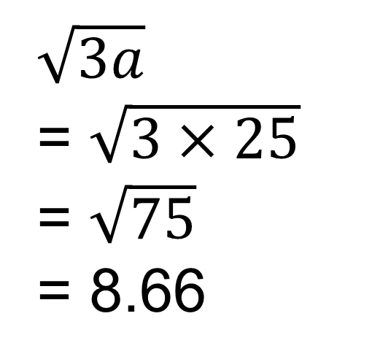
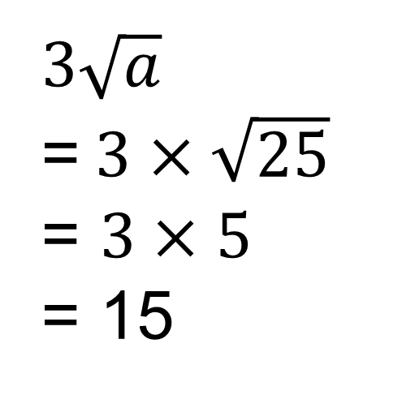
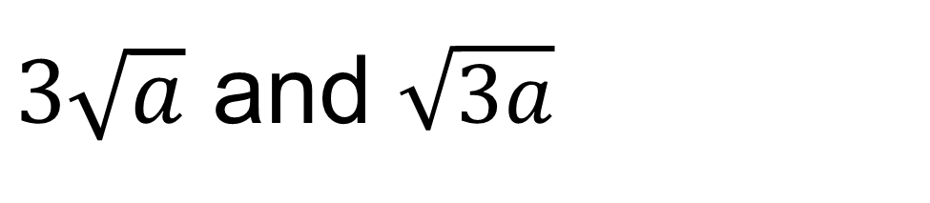
What if a = 25?
YOUR TURN
$3\sqrt{a}$ and $\sqrt{3a}$
$\sqrt{3a}$
= $\sqrt{3×25}$
= $\sqrt{75}$
= 8.66
$3\sqrt{a}$
=$3×\sqrt{25}$
= $3×5$
= 15
Substitute a into both expressions to calculate their values.
8
Notes:
FS L2 exam questions sometimes contain square roots, so this question is getting learners familiar with the operation.
Allow learners time to complete the calculations and support if necessary.
Depending on groups’ dynamics, learners could complete together or volunteer to complete the question using the whiteboard.
In the above example remind learners where the square root button is on their calculator.

Slide 9

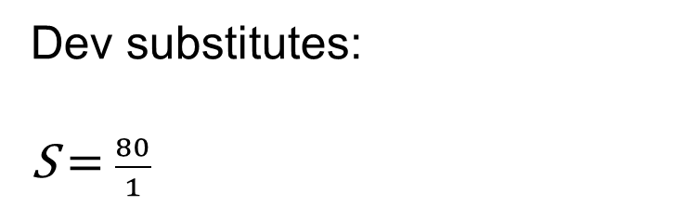
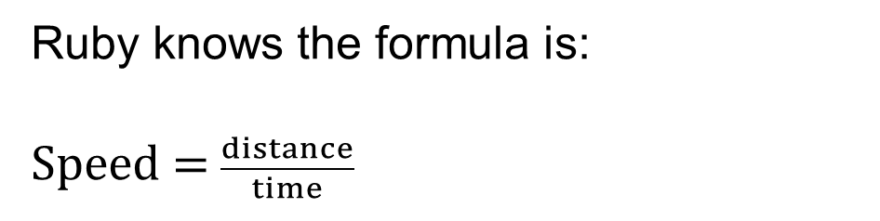
Substitution example: calculating speed
DISCUSS
Dev and Ruby take the train to London for a college trip. They travel 80 kilometres from their town to the city. The train journey takes 1 hour. Dev wonders how fast they travelled.
Ruby knows the formula is:
Speed = $\frac{distance}{time}$
Dev substitutes:
S = $\frac{80}{1}$
Ruby explains that they travelled at 80 km/h.
Dev says when he and his dad drove to London from their town, it took 2 hours, so they were travelling at 160 km/h.
Is Dev correct? Why?
Notes:
The questioning of Dev’s accuracy is an opportunity for learners to demonstrate their problem-solving skills.
The tutor should use ‘why’ questions to allow learners to explore Dev’s answer in more detail and offer their suggestions and opinions. This should give the tutor a much clearer insight into the learners’ learning journey.
The tutor can use this as an opportunity to identify who is consolidating their learning, is ready to learn the next concept, and has made links with previous learning.
Have learners write down the formula on whiteboards and substitute, resulting in an answer of 80 km/h.
The tutor will then have the blue box question appear and allow learners to consider whether Dev is correct or incorrect and offer reasons why, via class discussion.
The misconception addressed here is that Dev is misreading the formula and not substituting correctly. Dev has wrongly assumed that if the journey has doubled in time (1 hour to 2 hours), then the speed has doubled too (from 80 km/h to 160 km/h).
By working through the formula and substituting correctly, the tutor can demonstrate that S = $\frac{80}{2}$ = 40 km/h. Learners should be able to recognise that the journey was at a slower speed and therefore took longer.
The scenario can require significant structure from the tutor if learners are finding this question challenging. The concepts of time, distance and speed may require discussion to unpack and comprehend. Either way, emphasise that substitution is the key and is, in this case, straightforward.

Slide 10

Formula
REVIEW
KEY IDEA
A formula is a sum made with variables.
Substitution is when you replace the variables (letters) with their numerical values and then work out the sum.
Order of operations (BIDMAS) can define the steps required to solve the sum.
Notes:
This slide can be used to recap knowledge from previous slides.
This is also an opportunity to emphasise the importance of formula structure.
This might also be an opportunity to summarise and review the knowledge and language covered so far.

Slide 11

Card match
EXPLORE
Worksheets
available
Step 1: Card match up | Step 2: Number tables
Match up the formula with the expression using the cards provided. | Calculate the missing numbers in the sequence by matching to the paired sentences and expressions. How are you going to work out the missing numbers?
Notes:
The tutor to hand out envelopes of cut up expressions and formulae.
Learners to complete the paired card activity first.
Depending on the dynamics of the class, this would ideally be an activity for 2 or 3 learners and good for collaborative learning.
Once checked by the tutor, the next part of the activity can be distributed to the learners.
If the paired exercise has incorrect answers, encourage learners to review.
If the answers are all correct, distribute the number tables. The tutor will need to explain and can use the prompts on the slide.
Learners can be encouraged to write the correct formula in the same box as the number tables, allowing the tutor to check and mark their work throughout.
Answers will be shown on the next slide, though learners may not match up in the same order. By having learners write the expression, checking will be easier.
This is a significant activity that consolidates the objectives of the lesson. Allow plenty of time for moving around the classroom, engaging all groups, and having guided conversations to ensure learners understand the processes of this activity.
This activity also recaps the effective application of BIDMAS and the importance of order of operations in calculation.

Slide 12

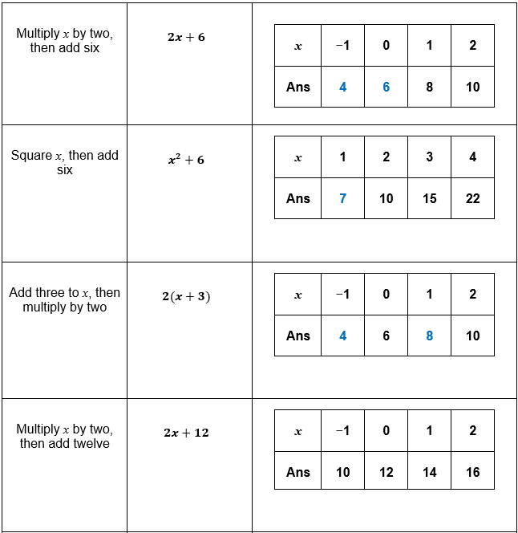
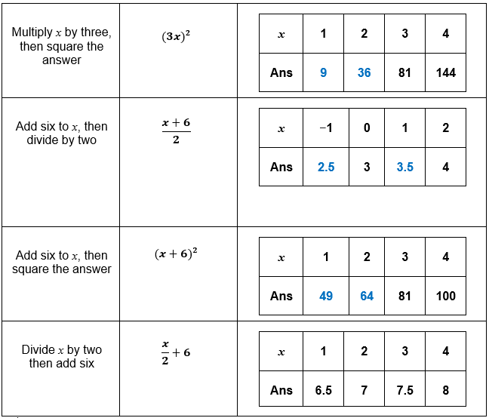
Card match answers
REVIEW
Handout
available
Notes:
The tutor should print out the answers to use as part of the card sort exercise when working with learners.
The answers on this slide can be projected once the activity is completed.

Slide 13
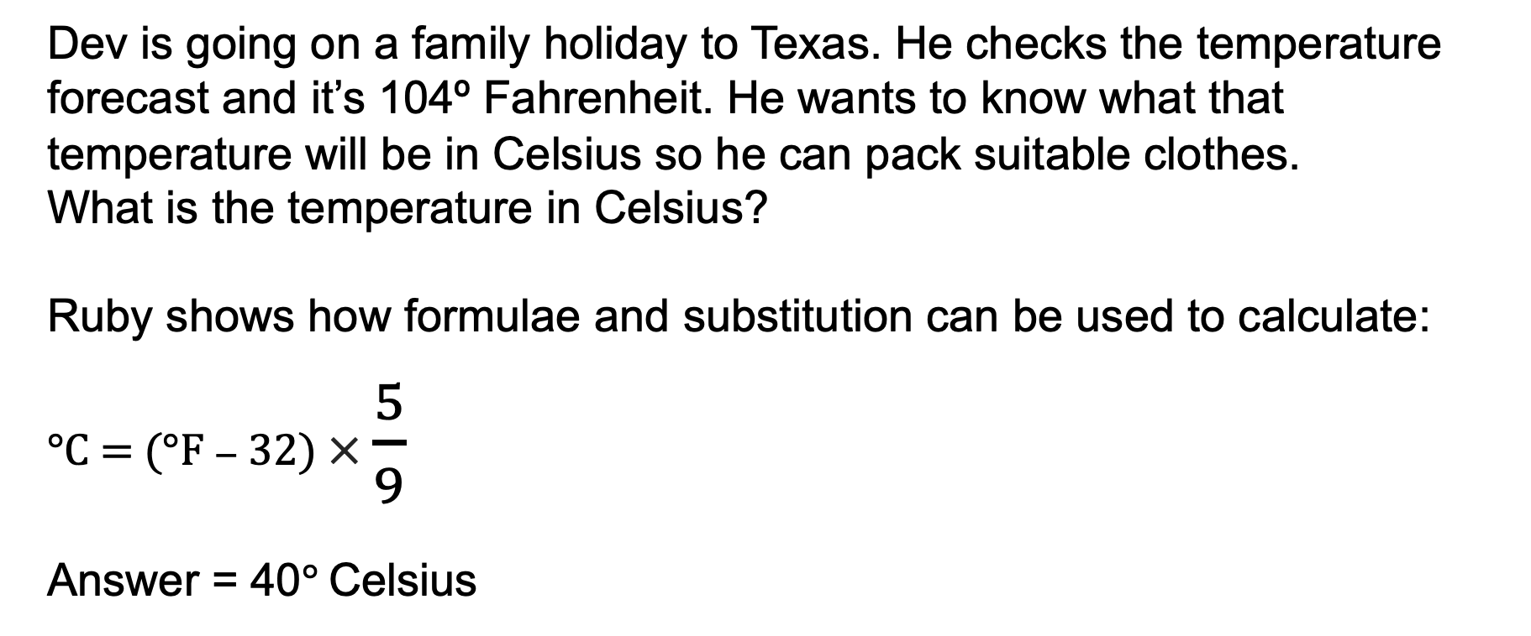
Converting Fahrenheit to Celsius
DISCUSS
Dev is going on a family holiday to Texas. He checks the temperature forecast and it’s 104º Fahrenheit. He wants to know what that temperature will be in Celsius so he can pack suitable clothes.
What is the temperature in Celsius?
Ruby shows how formulae and substitution can be used to calculate:
°C = (°F − 32) × $\frac{5}{9}$
Answer = 40° Celsius
Substitute 104 for °F and complete the calculation. Remember your order of operations.
Notes:
Ideal opportunity to assess consolidation of knowledge and skills of applying order of operations. Are there still any misconceptions that need addressing?
If so, tutor is to intervene at this point and review.
This is a substitution question that uses a real-life scenario. It also reflects some of the questions found in an exam paper that have a context.
This is an individual activity that learners can complete using their own whiteboards and it provides an opportunity to reflect on their own learning that has taken place during this lesson. Equally, the tutor can gather feedback on class knowledge and understanding.
Tutor to provide feedback with the answer and this will feed into the next slide question.

Slide 14
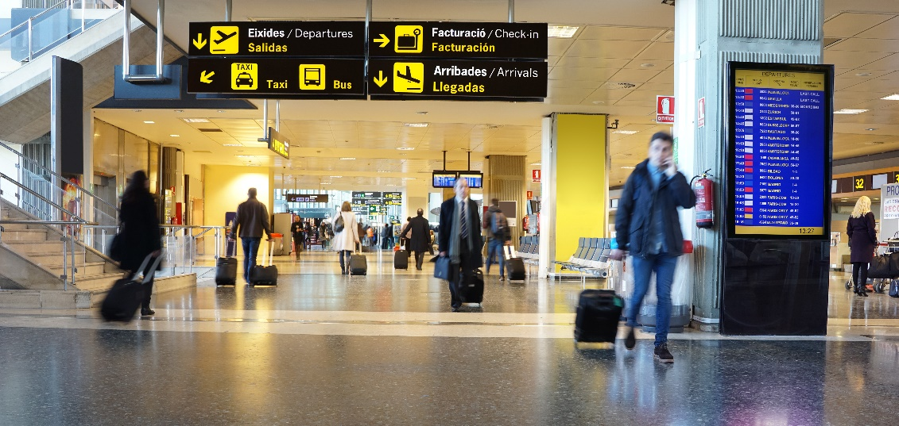
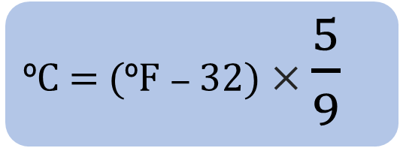
Converting Fahrenheit to Celsius 2
EXPLORE
Ruby is going on holiday with her family to Mexico in December to celebrate the festive season.
The forecast temperature is 79 ºF.
Dev tells Ruby to take a woolly hat and some gloves because December is always cold.
Is he right? Why?
ºC = (ºF − 32) × $\frac{5}{9}$
Notes:
Less scaffolding is given in this scenario so learners can demonstrate knowledge from the previous example.
Learners are required to extract information from the scenario as before and decide whether or not Dev is correct in saying that December is always cold and to justify their reasoning.
Learners to use their whiteboards to calculate the answer. Tutor to provide structure if required but aim for the blue box providing the relevant information.
79 − 32 = 47
47 × 5 = 235
235 ÷ 9 = 26.1 recurring.
This provides a learning opportunity to review suitable rounding.
This question is consistent with the previous Ruby and Dev scenario from earlier in the lesson (travelling to London and speed) as well as the previous slide.
It encourages learners to engage with the narrative and continuity of the two characters and promotes a sense of familiarity that can enhance learners' confidence in solving tasks.

Slide 15
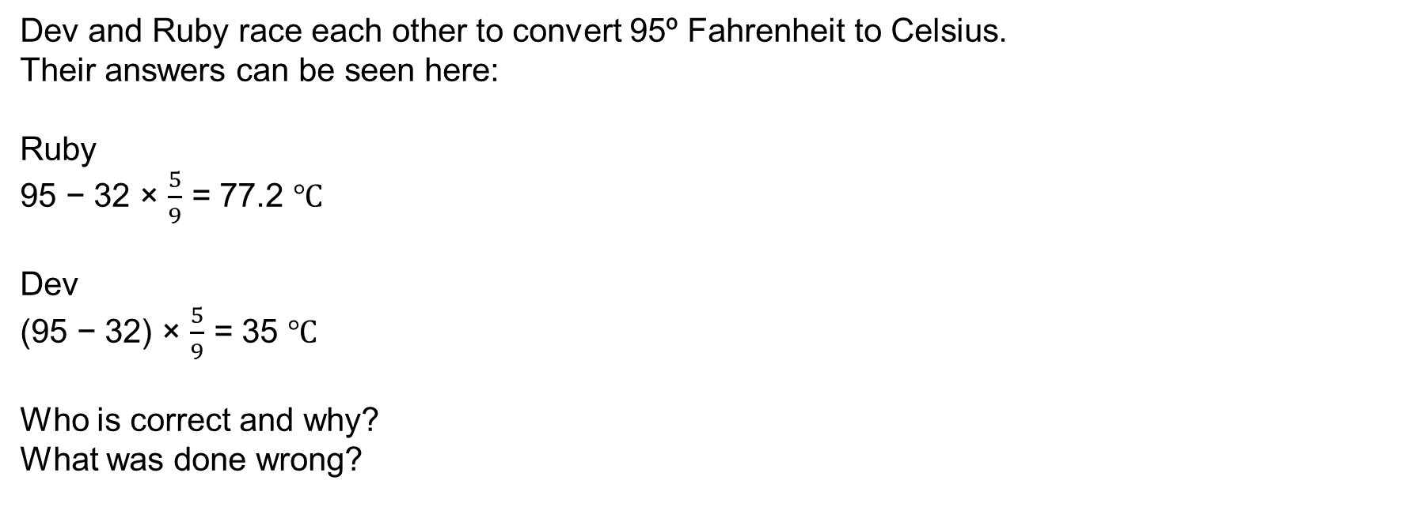
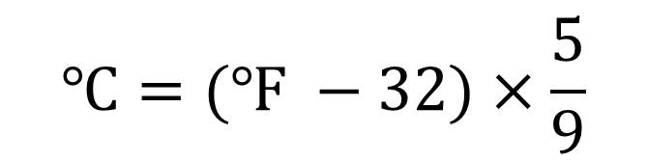
Converting Fahrenheit to Celsius 3
EXPLORE
Dev and Ruby race each other to convert 95º Fahrenheit to Celsius.
Their answers can be seen here:
Ruby
95 − 32 × $\frac{5}{9}$ = 77.2 $℃$
Dev
(95 − 32) × $\frac{5}{9}$ = 35 $℃$
Who is correct and why?
What was done wrong?
$$℃=(℉ −32)×\frac{5}{9}$$
15
Notes:
Learners to use their whiteboards to calculate the answer. Tutor to provide structure if required but aim for the blue box providing the relevant information. This consolidates learning from the previous slides.
Use BIDMAS to ensure 95 – 32 is completed first, before multiplying by 5 and dividing by 9.
95 – 32 = 63
63 × 5 = 315
315 / 9 = 35
Emphasise the use of units.
This question is consistent with the Ruby and Dev scenario from earlier in the lesson (travelling to London and speed) as well as the previous slide.
It encourages learners to engage with the narrative and continuity of the two characters and promotes a sense of familiarity that can enhance learner’s confidence in solving tasks.

Slide 16
Review
REVIEW
KEY IDEA
Substitution changes letters for numbers
A variable is not always the letter x
Variables change in value
Use BIDMAS to work through a formula
Add units if appropriate
Notes:
This is an opportunity to review the lesson and progress made so far.
Allow time for questions where required.
Lead into exam questions as the next activity.

Slide 17
Exam question examples
PRACTICE QUESTION
Worksheet
available
Use your skills to complete the exam questions.
Remember to use units where possible.
Notes:
Exam handout to be distributed and tutor to support throughout the activity.
Highlight that all examples relate to the skills developed throughout the lesson.
The tutor should use this activity to relate knowledge and skills to exam questions. Tutor to support and check answers as appropriate.
Activity can be concluded by the tutor projecting questions and working through them or asking learners to explain their answers.

Slide 18
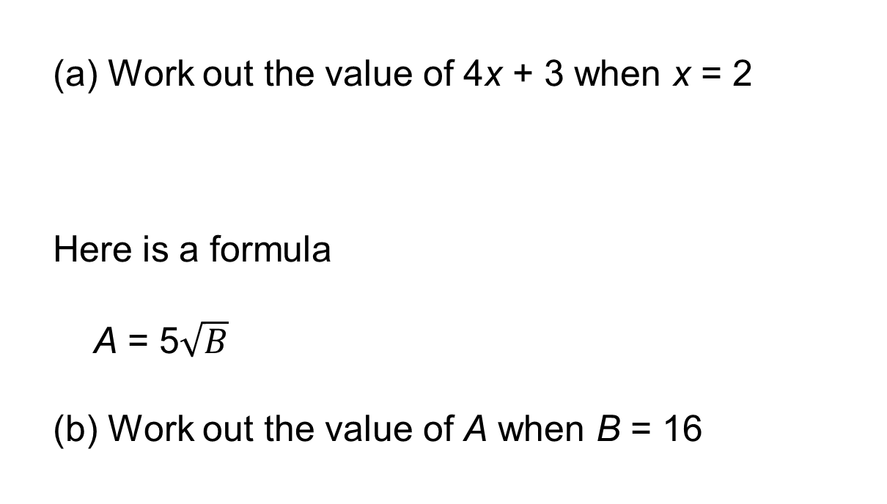
Exam question 1
PRACTICE QUESTION
Worksheet
available
  Work out the value of 4x + 3 when x = 2
  Here is a formula
  A = 5$\sqrt{B}$
  Work out the value of A when B = 16
Answer: 11
Answer: 20
Notes:
Past paper 3 (set 3) non calc

Slide 19
Exam question 2
PRACTICE QUESTION
Worksheet
available
  Here is a formula.
  P = 3T²
  Work out the value of P when T = 10
Answer: 300
Notes:
Practice set 1 L2 non calc

Slide 20

Exam question 3
PRACTICE QUESTION
Worksheet
available
Here is a formula.
Find the value of m when a = 8 and y = 3.5
Give your answer correct to 3 decimal places.
$$m= \frac{2.67a}{4y}$$
Answer: 1.526
Notes:
Practice set 3

Slide 21
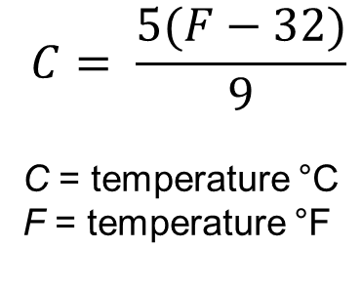
Exam question 4
PRACTICE QUESTION
Worksheet
available
Johan is cooking using an old recipe.
The recipe says to preheat the oven to a temperature of 350 °F.
The oven Johan uses is marked in centigrade (°C).
He finds this formula to change from °F to °C.
$$C= \frac{5(F−32)}{9}$$
C = temperature °C
F = temperature °F
Answer: No, 350 °F is equal to 176.67 °C. So 190 °C is too hot.
Johan sets the oven temperature to 190 °C.
Has Johan set the oven to the correct temperature for this recipe?
Notes:
Paper 4 (set 4)

Slide 22
Lesson review:
Substitution and formulae Level 2
Objectives
Revise order of operations
Use formulae in words and symbols
Substitute positive and negative numbers in formulae
Notes:
See below the objectives facing the tutor, which complement the learner-friendly objectives shown on the slide:
Use order of operations to navigate through expressions and formulae.
Use formulae in words and numbers, recognising links between language and numbers.
Substitute positive and negative numbers in algebraic formulae.
Use variations of concepts to promote mathematical thinking and discussion, building on existing knowledge relevant for substitution and formulae.
As part of concluding the lesson, the tutor should run through objectives and draw out key learning points from learners and the activities completed.

Slide 23
Lesson 16:
Credits
Photo acknowledgements
Shutterstock.com: BOOCYS
Text acknowledgements
Pearson Edexcel Functional Skills, Past Paper 3 - Mathematics Level 2 (Non-Calculator) PMAT2/N03 Question 2, Pearson Edexcel Functional Skills, Practice Paper 1 - Mathematics Level 2 (Non-Calculator) PRACL2/N01 Question 2, Pearson Edexcel Functional Skills, Practice Paper 3 - Mathematics Level 2 (Calculator) PRACL2/C01 Question 2, Pearson Edexcel Functional Skills, Past Paper 4 - Mathematics Level 2 (Calculator) PMAT2/C04 Question 1

