Slide 1

Careers Education in the Curriculum
Alison Sadler
Further Education & Skills Manager

Slide 2
Today’s Webinar
What is modern high quality careers education?
Distributed leadership – careers is everyone’s business
Embedding careers in the curriculum – approaches, examples and case studies
Sharing best practice
FREE! Support and resources available
Question & Answer time

Slide 3
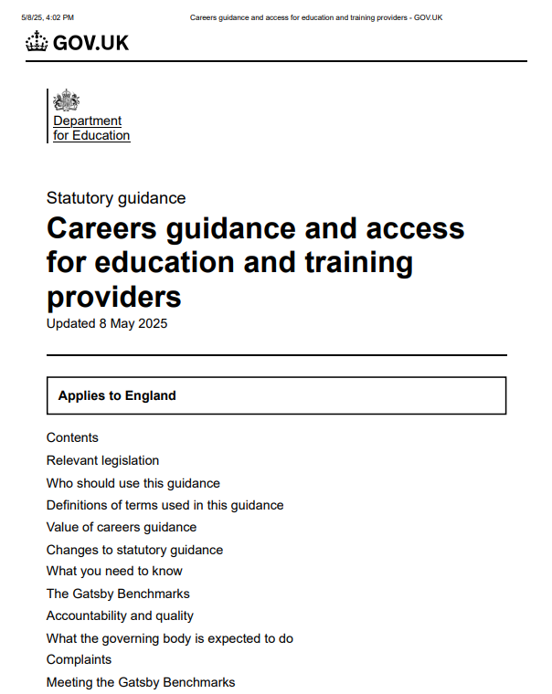

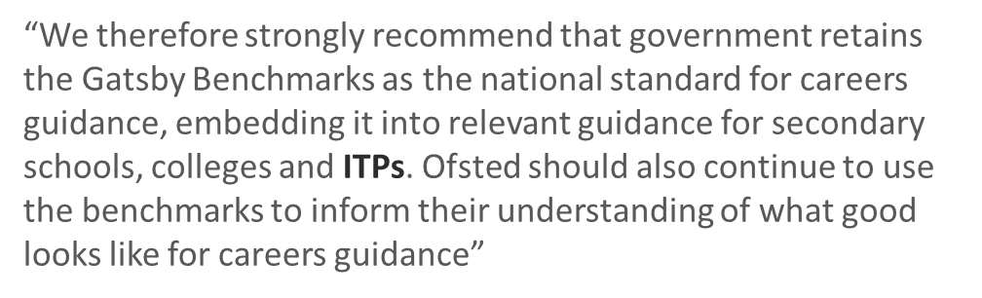
National Policy Drivers
Future Events
The statutory guidance has been updated to reflect the government’s policy priorities.
Changes include:
an overview of the changes to the Gatsby Benchmarks of Good Career Guidance following extensive research led by the Gatsby Charitable Foundation
DfE’s expectations of what schools, colleges and ITPs should do to meet the updated benchmarks – CEC guidance for colleges here
preparing for the future introduction of a guarantee of 2 weeks’ worth of work experience for every young person

Slide 4
Local careers hub & projects
Local skills / Government Priorities / LMI
Organisation Strategic Plan & Improvement plan
Delivery approach – cross organisation & embedded
Strategic Careers Plan
Benchmark Achievement
Whole Organisation Approach
Ofsted measures
National CEC resource & support
Board, SLT, staff, parents & employers

Slide 5
Supports:
Improved retention and engagement
Raised aspirations
Improved achievement (and grades)
Improved student experience and enjoyment
Positive progression / pipeline and career progression planning
Effective contribution to meeting the skills needs of employers and the local, regional and national economy
A fully embedded Strategic Careers Plan
Notes:
Retention and engagement – learners are working towards a positive destination
Raised aspirations – possibilities have been shown to them
Achievement and grades – aiming high to achieve their career goals
Experience and enjoyment – employer experiences, career learning as part of their experience adds value and interest to the programme

Slide 6
Gatsby Benchmarks
1. A Stable Careers Programme
2. Learning from careers and labour market information
3. Addressing needs of each student
4. Linking curriculum learning to careers
5. Encounters with employers and employees
6. Experiences of workplaces
7. Encounters with further and higher education
8. Personal guidance
Notes:
1. Focus of today’s session - includes all others embedded

Slide 7
Distributed leadership
Everyone has a role to play in careers education
The benchmarks highlight that this is more than just a 1-1 guidance meeting
“Careers leadership is supported with specific training and is embedded across the staffing structure and within college development planning. Systems and processes support a shared responsibility for delivery of careers across the college, enabled by clearly defined roles and responsibilities”

Slide 8
Careers Learning Outcomes
“Staff work in partnership with employers in curriculum planning (with a focus on alignment to local skill needs) - All staff consistently and regularly highlight the relevance of their subject to the world of work and careers - All staff make links from their curriculum to careers, pathways and essential skills - Staff embed learning in the context of the world of work or careers”
“A documented, responsive and differentiated careers learning journey, underpinned by relevant progressive careers-related learning outcomes, provides a measurable approach to developing essential skills through the curriculum”
Benchmark 1: Suggested universal career-related learning outcomes | CEC Resource Directory

Slide 9
Embedding careers in the curriculum

Slide 10





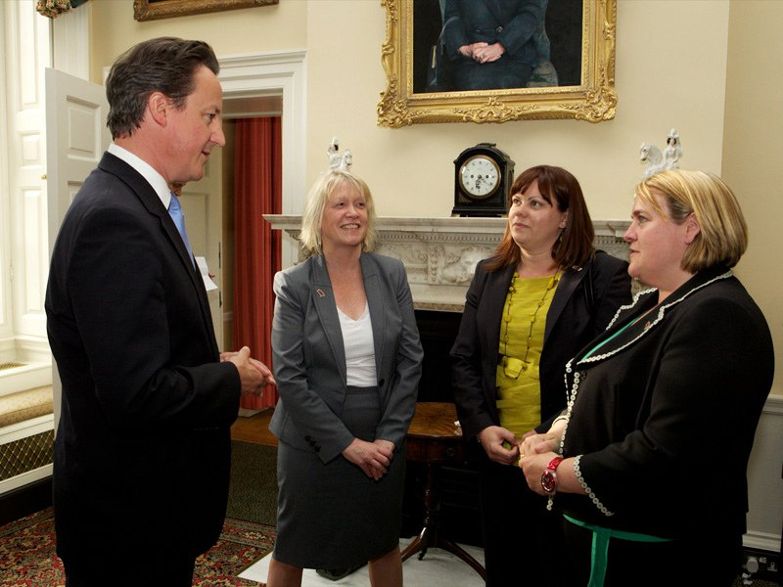
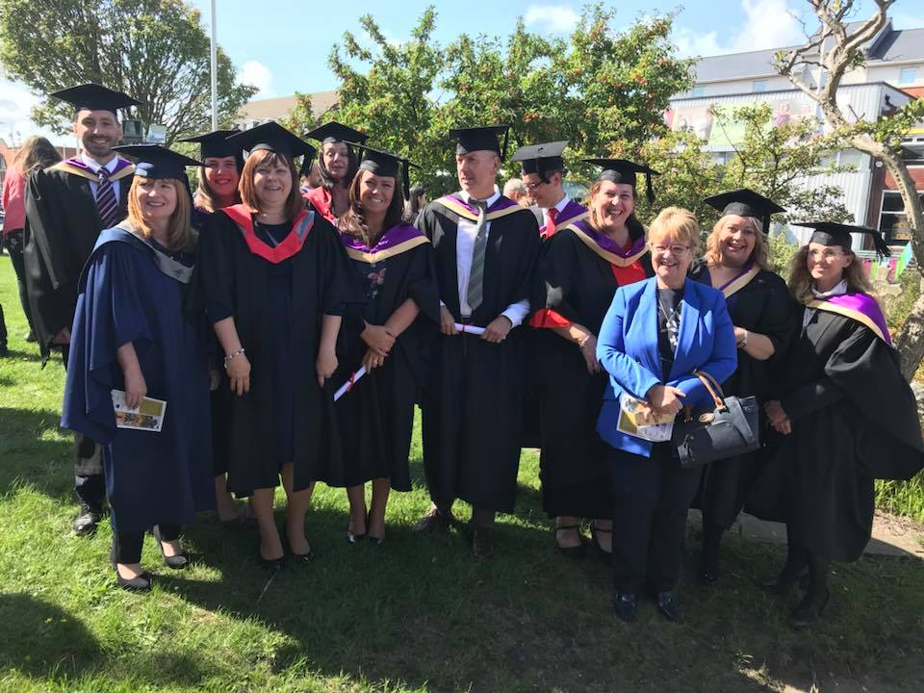


Bringing own career experience
Notes:
Probably do this already but how can it be formalised

Slide 11
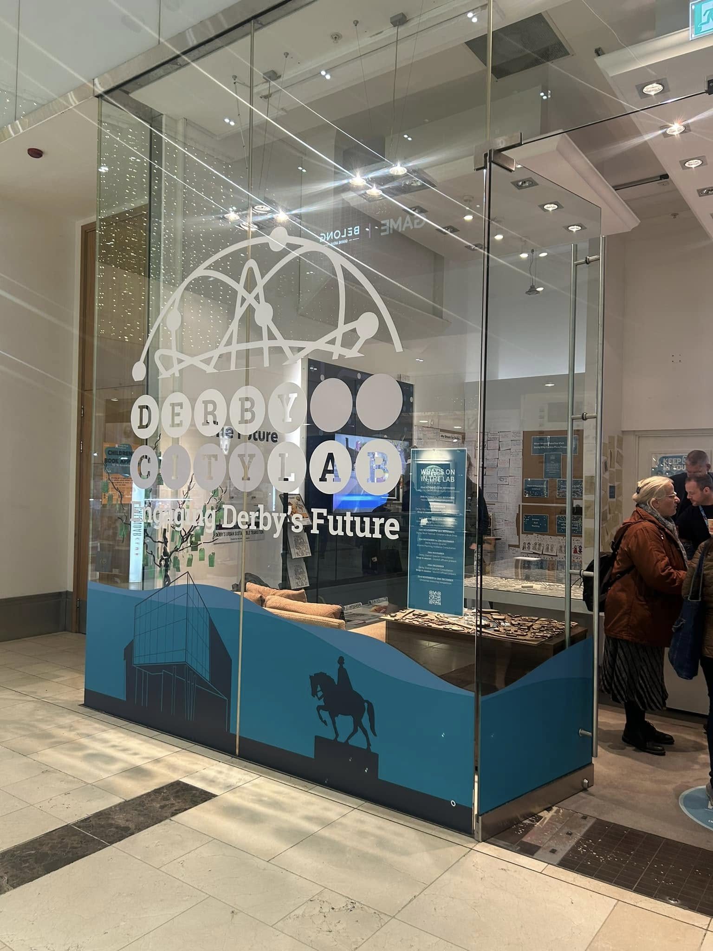
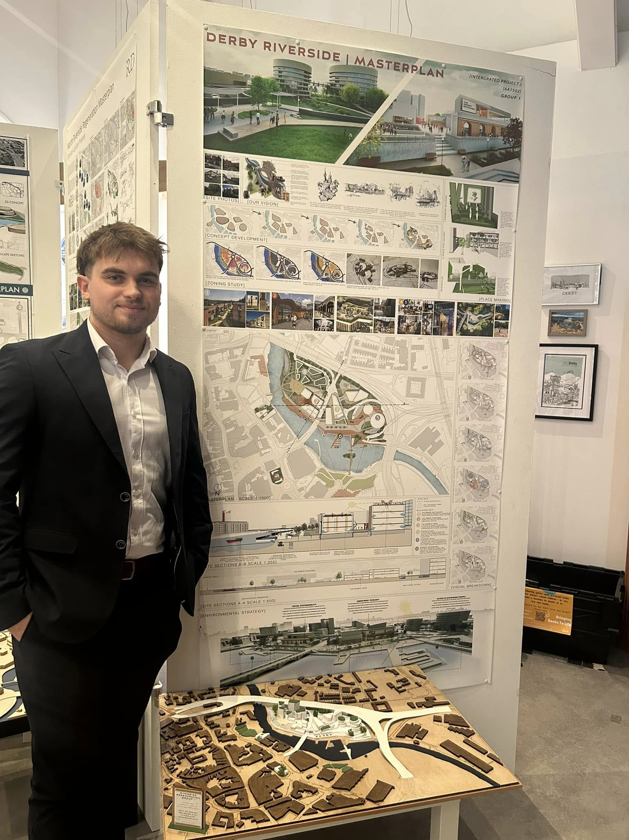
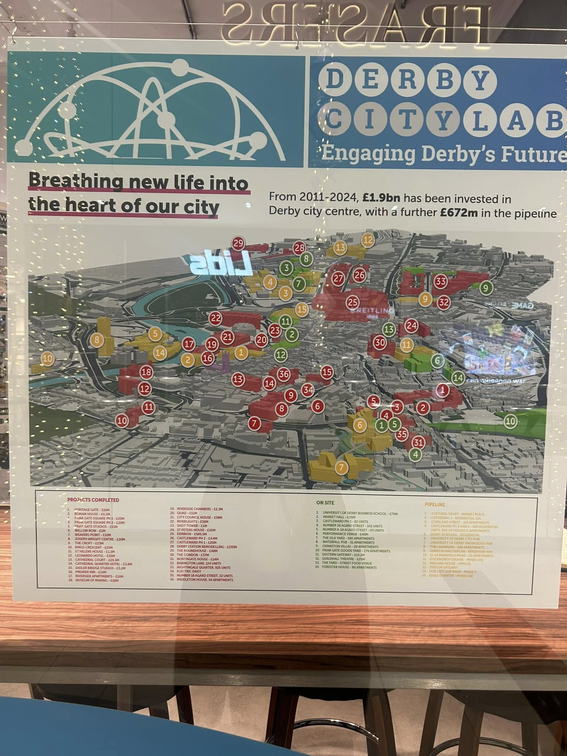
Employer live briefs
  Derby City Council live brief
  Student brief for CSA / Architecture students
  Presentation to city planners
  Showcase in Derbian Citylab
  Experience on CV
  Soft skill development
Notes:
Probably do this already but how can it be formalised

Slide 12

Guest Speakers
Full workshops or part of lesson
Combine fun activity, LMI and career opportunities in addition to vocational learning
Q&A – exploring aspects of how curriculum relates to work
Notes:
Probably do this already but how can it be formalised

Slide 13
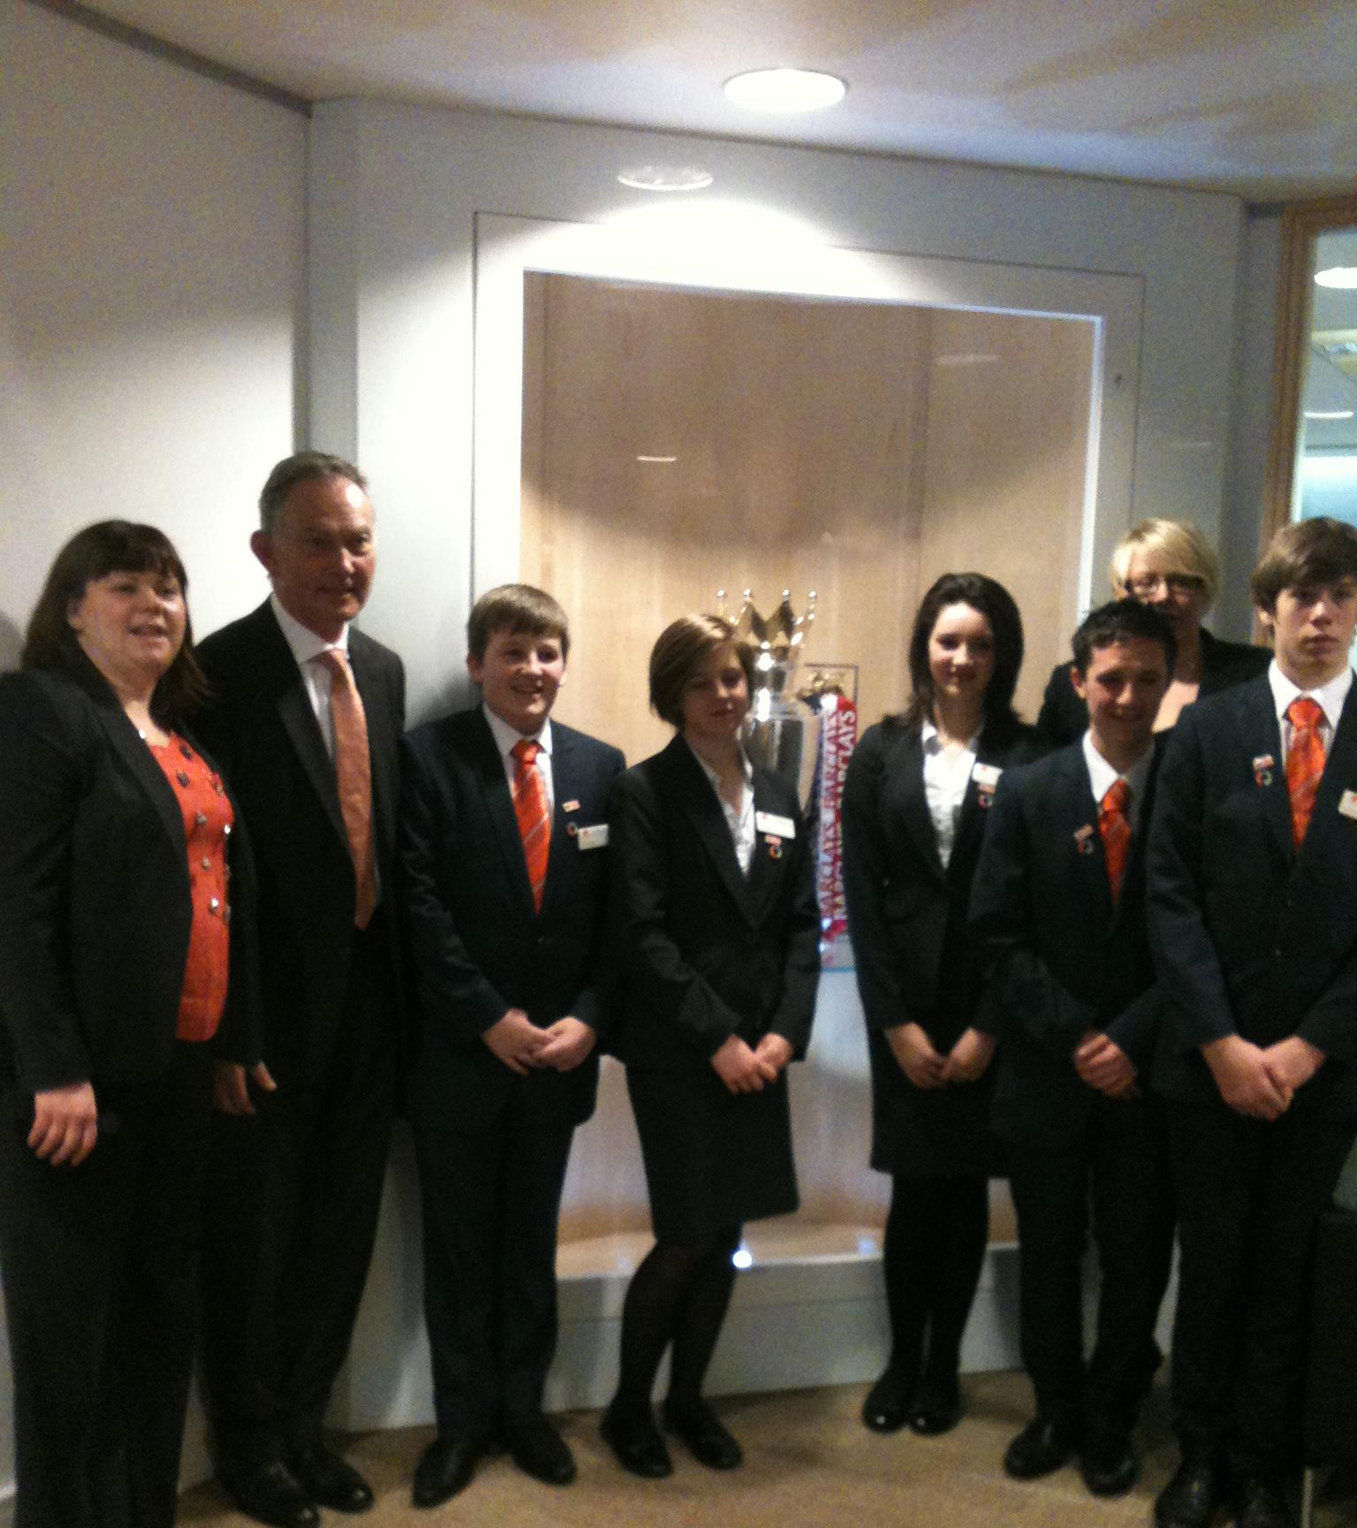

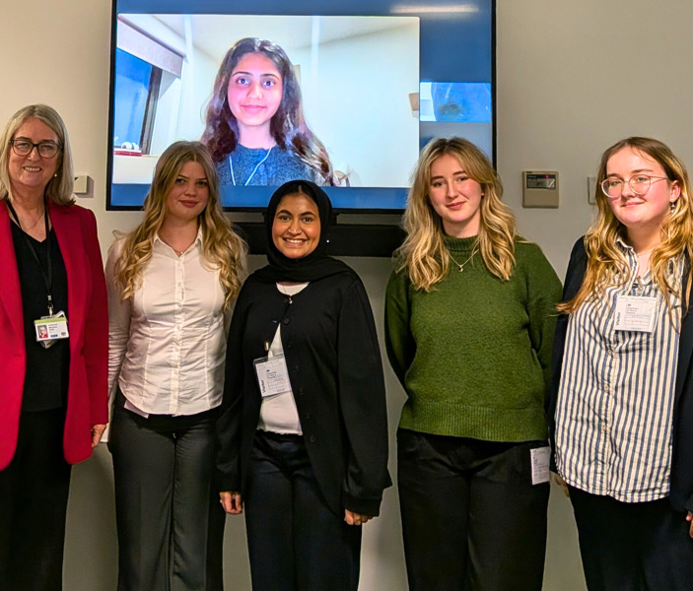
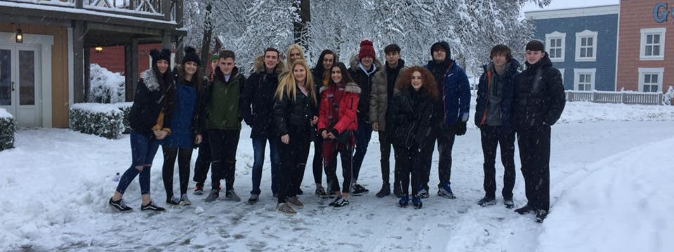
Trips and visits to employers & workplaces…..
Disneyland Paris, The Premier League and government!

Slide 14

Employers informing curriculum planning, skills focus and evaluation as part of quality cycle

Slide 15
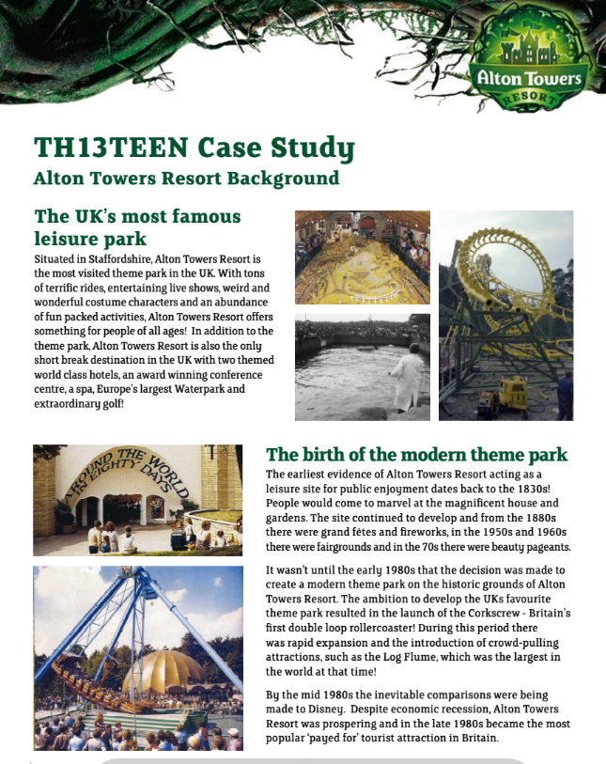
Contextualising assessments
Can be coupled with visits, independent research, LMI information, guest speaker etc etc

Slide 16
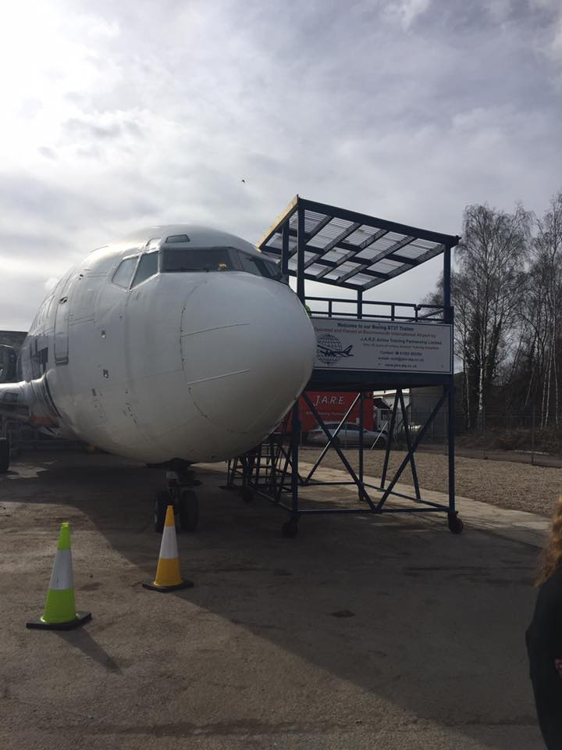
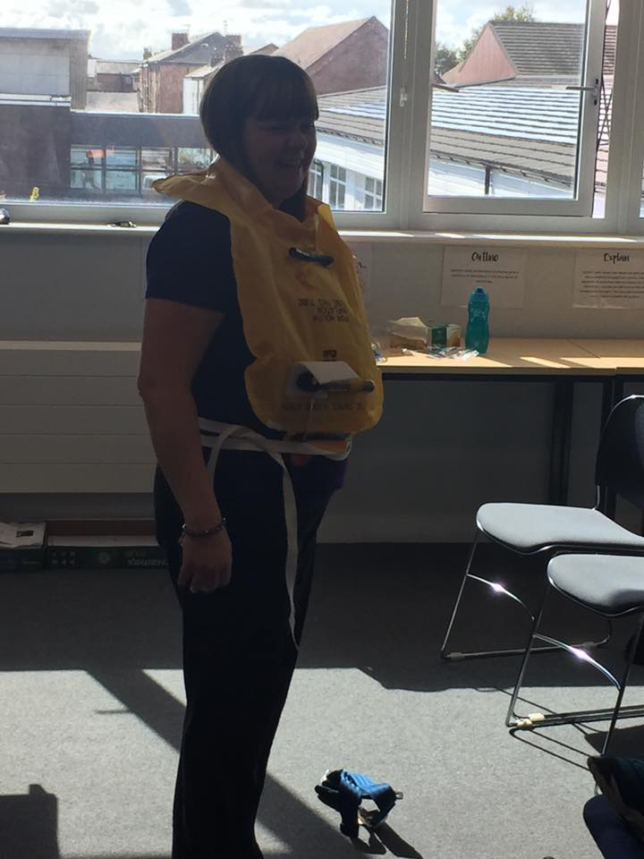
Linked to qualification
Careers learning directly linked to qualification learning outcomes
Bringing learning outcomes to life through delivery of learning outcomes in more creative, fun ways linked to future career pathways

Slide 17
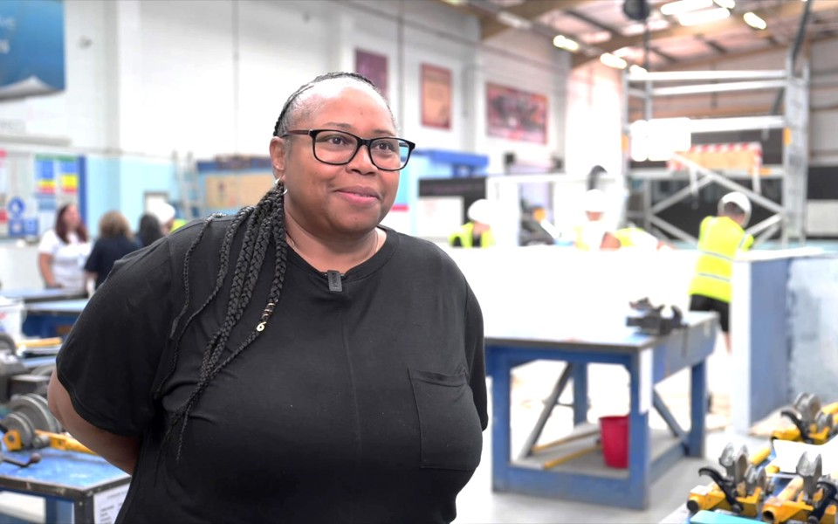
Challenging stereotypes & misconceptions
A blog by Norma Odain-Hines, Senior Social Value Manager at Morgan Sindall Construction
How to make industry taster days more impactful | The Careers and Enterprise Company
Notes:
Probably do this already but how can it be formalised

Slide 18
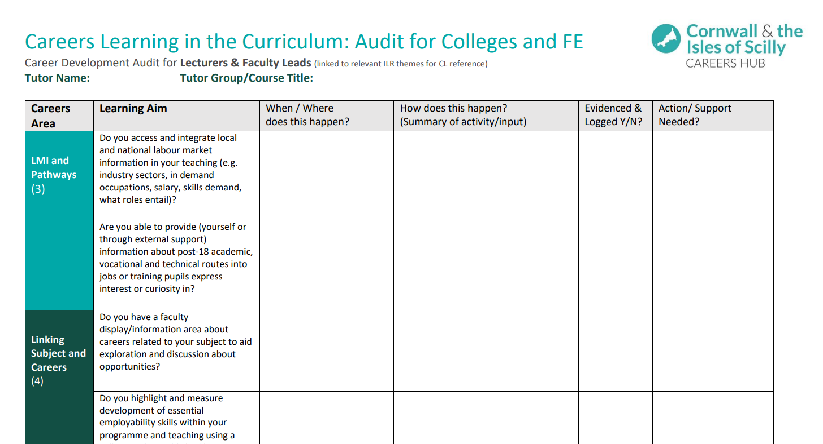
Audit tool
Careers-Learning-in-the-Curriculum-Audit_Colleges.pdf

Slide 19

Case Study 1
Subject Academies e.g. Engineering
Sponsored and supported by 1 or more employers
Solves an employer problem (capacity, pipeline planning, recruitment)
Opportunity for students to expand networks, social mobility and skill development
Project based / work experience / linked to learning outcomes

Slide 20

Case Study 2
Creative subjects
A local theatre works alongside the creative department in a college.
Opportunities for work experience
Live projects for learners – script writing, photography, set design, marketing & social media, performance.
Theatre director is on employer forum and provides materials and access to staff, supporting curriculum, LMI etc

Slide 21

Breakout Session
An opportunity to reflect on existing practice and share ideas
How could you embed careers learning outcomes and related activity into your practice?
Share anything that works well and consider what more you could do in the future…
30 mins

Slide 22


Hot Topic Webinars
DATE | FOCUS
Tuesday 17 March 2026, 10am - 11am | Modern Work Experience, FE Developments and Equalex Careers in the new Ofsted framework *Guest speaker
Tuesday 16 June 2026, 10am - 11am | Showcase of Excellence in Careers AoC Beacon Award Winners 2026 Sharing best practice
Register Here
Open to All! Online via Zoom - Free to attend

Slide 23
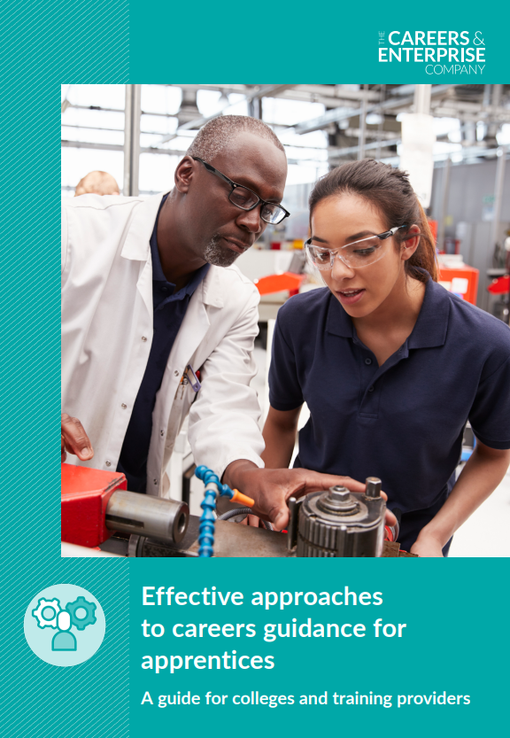
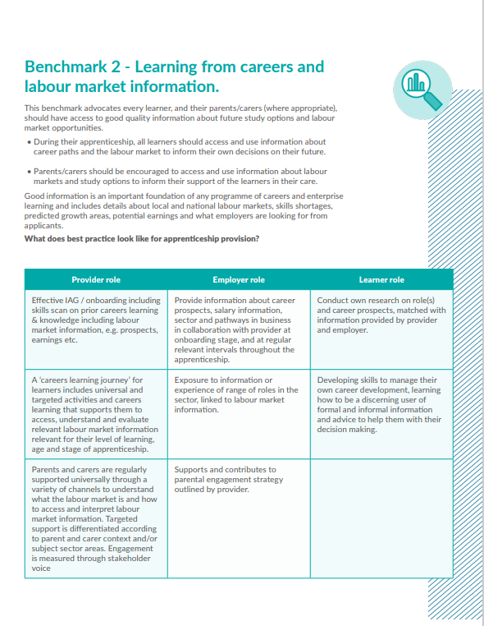
Effective approaches to careers education for apprentices –
A guide focused on application of benchmarks and high-quality careers education for apprentices.
Full of Case Studies and ideas!
Apprenticeship Guide | CEC Resource Directory (careersandenterprise.co.uk)

Slide 24

KEEP IN TOUCH !
If you want to keep updated on the latest activity, events and projects for FE careers leaders please sign up to our termly newsletter
FE and ITPs Connect Newsletter | The Careers and Enterprise Company
Alison Sadler – Education Development – FE & Skills
asadler@careersandenterprise.co.uk

Slide 25


Thank you.
Any questions?
Notes:
Use where appropriate depending on delivery (F2F/online)

