Slide 1


Lesson 14: Compound interest and financial calculations
Objectives
Calculate a percentage change without a calculator
Understand the difference between simple and compound interest
Calculate a repeated percentage change using multipliers
Use a double number line to see the common mathematical structure of percentage questions

Slide 2

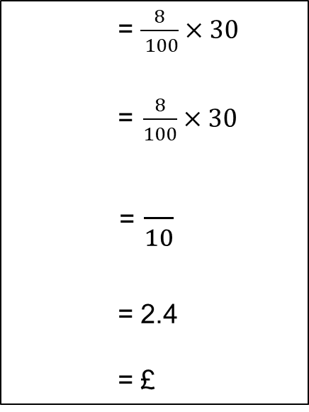
Finding percentages without a calculator
DISCUSS
Worksheet
available
Learners in a class have been asked to calculate 8% of £30
Here are four learners’ methods, but some of their working has been rubbed out. Fill in the gaps to complete their solutions.
= $\frac{8}{ 100}×30$
= $\frac{8}{100}×30$
= $\frac{}{10}$
= 2.4
= £
100% = £30
10% =
1% = £0.30
8% = 8 × 0.3 = 2.4
= £2.40
÷10
Percentage | 100 | 10 | 5 | 1 |  | 8
Cost (£) | 30 | 3 |  | 0.3 | 0.9 | 2.4
Cost = £2.40
8% of £30 = 30% of £8
10% =
% = 3 × 0.8 = 2.4
= £2.40
Which method would you have used?
Why?
Notes:
Learners to work in pairs to explore different ways of calculating percentages without a calculator.
Do they have a different method?
Which do they prefer?

Slide 3
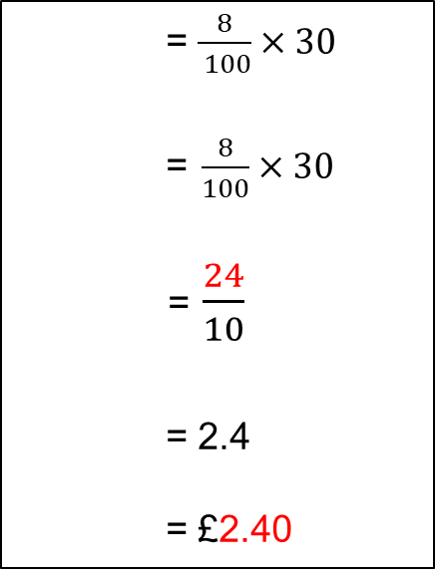
Finding percentages without a calculator – Answers
DISCUSS
Learners in a class have been asked to calculate 8% of £30
Here are four learners’ methods, but some of their working has been rubbed out. Fill in the gaps to complete their solutions.
= $\frac{8}{ 100}×30$
= $\frac{8}{100}×30$
= $\frac{24}{10}$
= 2.4
= £2.40
100% = £30
10% = £3
1% = £0.30
8% = 8 × 0.3 = 2.4
= £2.40
÷10
Percentage | 100 | 10 | 5 | 1 | 3 | 8
Cost (£) | 30 | 3 | 1.5 | 0.3 | 0.9 | 2.4
÷10
Cost = £2.40
8% of £30 = 30% of £8
10% = 0.8
30% = 3 × 0.8 = 2.4
= £2.40
Which method would you have used?
Why?
Notes:
Learners to work in pairs to explore different ways of calculating percentages without a calculator.
Do they have a different method?
Which do they prefer?

Slide 4

Percentage changes without a calculator
Explore
EXPLORE
Worksheet
available
The original cost of the drill is £120.
The hardware shop increases its prices by 11% in April and then again by 10% in September.
How much does the drill cost now?
Aman:
If you add 11% and 10% you get 21% so work out a 21% increase on £120
Eve:
Work out an 11% increase on £120 first.
Then work out a 10% increase on that answer.
Work out each learner’s method.
Are they the same?
Which one is correct?
Notes:
Learners to work in pairs to practise using non-calculator methods.
Ask them, before they start, if they think the two methods will give the same answer.
This activity will lead them into the next section on the difference between simple and compound interest.

Slide 5

Explore
EXPLORE
Percentage changes without a calculator – Answers
The original cost of the drill is £120.
The hardware shop increases its prices by 11% in April and then again by 10% in September.
How much does the drill cost now?
Aman:
If you add 11% and 10% you get 21% so work out a 21% increase on £120
Cost now: £145.20
Eve:
Work out an 11% increase on £120 first.
Then work out a 10% increase on that answer.
Cost now: £146.52
Work out each learner’s method.
Are they the same?
Which one is correct?
Eve
Notes:
Reveal the answers and check if learners got the same.
Discuss the different methods and why they resulted in different answers.

Slide 6
Simple vs compound interest
Discuss
DISCUSS
Simple interest
Interest is calculated on the original amount you saved.
You will not receive interest on interest each year, so the amount of interest you receive is the same every year.
E.g. £200 saved at 3% simple interest
Start : £200
Year 1: £200 + £6 = £206
Year 2: £206 + £6 = £212
Year 3: £212 + £6 = £218
Compound interest
Interest is calculated on the amount in your account at the start of the year.
You receive interest on interest each year, so the amount of interest you receive changes every year.
You will earn more money over time with compound interest compared to simple interest.
E.g. £200 saved at 3% compound interest
Start : £200
Year 1: £200 + £6 = £206
Year 2: £206 + £6.18 = £212.18
Year 3: £212.18 + £6.37 = £218.55
Notes:
Highlight and discuss the difference between simple and compound interest. Nominate a learner to explain why more interest is obtained through compound interest.

Slide 7
Calculating compound interest
Model
MODEL
Ella invests £1000 in a savings account that pays 4% interest per annum for 3 years.
How much money does she have at the end?
Year 1: £1040
0
× 1.04
Year 2: £1081.60
100
104
%
Year 3: £1124.86
£
1040
To calculate the final sum of money we did
1000
How do we simplify this calculation on our calculator?
1000
1081.60
1040
1124.864
0
1081.60
× 1.04
× 1.04
× 1.04
× 1.04
Notes:
Model how to put the information from the question on to the Double Number Line (DNL).
The original amount is 100%.
The most efficient way to get to the amount at the end of each year is to use a multiplier.
If your learners have not become confident at finding multipliers with a calculator, you will perhaps need to spend some time explaining how to find a multiplier between any two numbers by dividing backwards.
Finish by asking learners how the calculation can be simplified, bringing out that 1.04 x 1.04 x 1.04 = 1.04³. Highlight that the index number relates to the number of years at that interest rate.
Although this example leads them right through to the standard equation for compound interest, learners need to develop a strong understanding of the process so make sure this is the main focus.

Slide 8
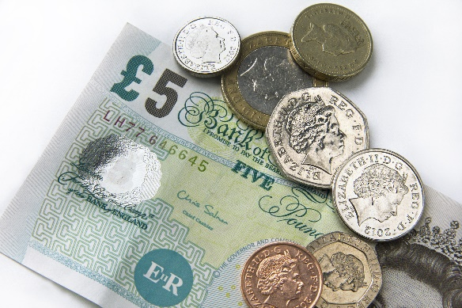
Which savings account?
EXPLORE
Worksheet
available
Danny has £800 that he wants to save in an account so he can gain interest on his money.
Here are 5 savings accounts he can choose from.
Provider | Years | Interest rate | Type | Min deposit
Nimbus Bank | 1 | 4% | Compound | £1
PGG Bank | 2 | 5% | Simple | £1
Neverwinter Savings | 4 | 4.6% | Compound | £50
Elysian Building Society | 4 | 4.8% | Simple | £500
Strive Savings | 5 | 5% | Compound | £1000
He will have to leave his money in the account for the full amount of years to get the interest.
Calculate how much interest he will earn in total for each of the possible accounts.
How can you compare each account?
Which account do you think he should use? Explain why?
Notes:
Learners to work in pairs.
They will need to identify the type of interest each time as this will change their calculations.

Slide 9
Which savings account? – Answers
EXPLORE
Danny has £800 that he wants to save in an account so he can gain interest on his money.
Here are 5 savings accounts he can choose from.
Provider | Years | Interest rate | Type | Min deposit
Nimbus Bank | 1 | 4% | Compound | £1
PGG Bank | 2 | 5% | Simple | £1
Neverwinter Savings | 4 | 4.6% | Compound | £50
Elysian Building Society | 4 | 4.8% | Simple | £500
Strive Savings | 5 | 5% | Compound | £1000
Total money
£832.00
£880.00
£957.67
£953.60
£1021.03
Interest
£32.00
£80.00
£157.67
£153.60
£221.03
He will have to leave his money in the account for the full amount of years to get the interest.
Calculate how much interest he will earn in total for each of the possible accounts.
How can you compare each account?
Which account do you think he should use? Explain why?
Notes:
When discussing the answers, highlight key considerations in addition to the amount of interest earned, e.g.:
Danny cannot invest in Strive Savings because the min. deposit is £1000
Even though Danny gets more interest from Neverwinter or Elysian, this requires him to leave his money in the account for 4 years – so he may prefer Nimbus or PGG.

Slide 10

Mixing your interests
MODEL
Top Bank
3% interest for the first year
and
5.5% each year from then on
Ruby has £400 to save with Top Bank.
How much will she have in total:
(a) After 2 years?
(b) After 3 years?
×1.03
0
×1.055
100
105.5
103
%
Year 1: £412.00
Year 2: £434.66
£
400
434.66
412
412
458.5663
Year 3: £458.57
434.66
× 1.03
× 1.055
Can you write this as one calculation in your calculator?
400 × 1.03 × 1.055²
Notes:
This slide models situations where there is more than one compound interest rate.
Similar to the previous question, it would be more important to get learners comfortable with the process than trying to use the final formula.

Slide 11
Match the calculations
EXPLORE
Worksheet
available
Invest £300 at 7% in the first year and 5% every year after that
Invest for 5 years
= 500 × 1.07 × 1.05⁶
Invest at % in the first year and % every year after that
Invest for years
= 500 × 1.03 × 1.07⁴
Invest £500 at 7% in the first year and 5% every year after that
Invest for 3 years
= × ×
Invest £300 at 7% in the first year and 3% every year after that
Invest for 3 years
= 300 × 1.07 × 1.05²
Notes:
Learners to work in pairs to match the statements.
The emphasis should remain on ‘What is the multiplier each year?’.
There are blanks for the learners to fill in.

Slide 12
Match the Calculations – Answers
EXPLORE
Invest £300 at 7% in the first year and 5% every year after that
Invest for 5 years
= 500 × 1.07 × 1.05⁶
Invest £500 at 3% in the first year and 7% every year after that
Invest for 7 years
= 500 × 1.03 × 1.07⁴
Invest £500 at 7% in the first year and 5% every year after that
Invest for 3 years
= 300 × 1.07 × 1.03²
Invest £300 at 7% in the first year and 3% every year after that
Invest for 3 years
= 300 × 1.07 × 1.05²

Slide 13
Exam question (1) (Non-calculator)
REVIEW
Worksheet
available
No calculator allowed!
Paul sees this advert for a payment plan for a laptop.
Laptop payment plan
normal price £240
pay a deposit of £36 and £15 a month for 12 months
use our payment plan and save 8% of the normal price
Does using the payment plan save 8% of the normal price?
You must show your working.
Notes:
Learners to work on their own initially and then share their thinking with a partner.
Encourage learners to show their non-calculator methods clearly.
How can they make the final statement clear using their working?

Slide 14
REVIEW
Exam question (1) – Answer
Paul sees this advert for a payment plan for a laptop.
Laptop payment plan
normal price £240
pay a deposit of £36 and £15 a month for 12 months
use our payment plan and save 8% of the normal price
Does using the payment plan save 8% of the normal price?
You must show your working.
Possible method:
Payment plan = 36 + 15 × 12 = £216 Saving = 240 – 216 = £24
8% of £240 = £19.20 The payment plan saves you more than 8%.

Slide 15
REVIEW
Exam question (2) – Calculator
Worksheet
available
Karen invests £2500 for 3 years.
The investment earns 1.7% compound interest per year.
Work out the value of the investment at the end of 3 years.
Notes:
Learners to work on their own initially and then share their thinking with a partner.
Encourage learners to use multipliers and a DNL if required to support them to feel confident about what they are doing.

Slide 16
REVIEW
Exam question (2) – Answer
Karen invests £2500 for 3 years.
The investment earns 1.7% compound interest per year.
Work out the value of the investment at the end of 3 years.
Answer: 2500 × 1.017 × 1.017 × 1.017 = £2629.68
Notes:
Learners to work on their own initially and then share their thinking with a partner.
Encourage learners to use multipliers and a DNL if required to support them to feel confident about what they are doing

Slide 17
Lesson review: Compound interest and financial calculations
Objectives:
Calculate a percentage change without a calculator
Understand the difference between simple and compound interest
Calculate a repeated percentage change using multipliers
Use a double number line to see the common mathematical structure of percentage questions
Suggested further steps/areas to work on
Budgeting and money management

Slide 18
Lesson 14:
Credits
Photo acknowledgements
123RF.com: Lance Bellers, Anton Samsonov
Text acknowledgements
Pearson Edexcel Functional Skills, Past Paper 5 - Mathematics Level 2 (Calculator) PMAT2/C05, Question 4, Pearson Edexcel Functional Skills, Past Paper 3 - Mathematics Level 2 (Non-Calculator) PMAT2/N03 Question 4

